Slide 1
HUMAN ACTIVITY RECOGNITION
Deep Learning-Based Video Classification Using 3D ResNet-18
ML Project Presentation
UCF101 Dataset • PyTorch • OpenCV • Flask

Slide 2
1. Problem Statement
Why is this project needed?
The Problem
Our Solution
Project Goal
Understanding human actions from video manually can be time-consuming and difficult when large numbers of videos need to be analyzed.
We developed a deep learning system that analyzes a video and automatically predicts the human activity taking place in it.
To classify video-based human activities using spatial information from frames and temporal information from movement over time.
Human Activity Recognition | 2

Slide 3
2. Project Objective
• Build a deep learning model for Human Activity Recognition.
• Process video data instead of traditional tabular data.
• Learn both visual appearance and movement patterns.
• Classify videos into 5 selected activity classes.
• Deploy the trained model through a Flask backend and web interface.
Human Activity Recognition | 3

Slide 4
3. Dataset
UCF101 Human Action Recognition Dataset
Dataset
Selected Data
Dataset Split
UCF101 is a standard video dataset containing videos of different human activities.
5 activity classes were selected. 100 videos per class Total: approximately 500 videos
80% Training 10% Validation 10% Testing Stratified splitting was used to preserve class distribution.
Human Activity Recognition | 4

Slide 5
4. What Are the Features?
The model learns features automatically from video data
Unlike traditional tabular ML, we do not manually define features such as age or salary.
Spatial Features
Temporal Features
Learned Automatically
Information inside a frame: • Objects • Body posture • Shape • Color • Visual appearance
Information across frames: • Movement • Direction • Speed pattern • Change in body position
The 3D ResNet-18 model automatically learns useful visual and movement patterns during training.
Human Activity Recognition | 5

Slide 6
5. Video Preprocessing
Converting a raw video into model-ready input
1
2
3
4
5
6
Video
16 Frames
RGB
Resize
Normalize
Tensor
Raw video file
Representative frames sampled
BGR converted to RGB
112 × 112 pixels
Standardized pixel values
Ready for deep learning
Final input shape: [3, 16, 112, 112] → RGB Channels × Frames × Height × Width
Human Activity Recognition | 6

Slide 7
6. Deep Learning Model: 3D ResNet-18
The core of the Human Activity Recognition system
Why 3D CNN?
Why ResNet?
Final Output
A video contains both: Spatial information → what is visible Temporal information → how it changes over time 3D convolution learns both together.
ResNet uses residual/skip connections. These help deep networks learn effectively and reduce vanishing gradient problems.
The final fully connected layer was changed to produce 5 output classes for the selected human activities.
Human Activity Recognition | 7

Slide 8
7. Model Training Configuration
Model
3D ResNet-18
Loss Function
Cross Entropy Loss
Optimizer
AdamW
Learning Rate
0.0001
Batch Size
2
Epochs
10
Scheduler
ReduceLROnPlateau
Human Activity Recognition | 8

Slide 9
8. Training Workflow
How does the model learn?
Input Video
Preprocessing
3D ResNet-18
Loss
Backpropagation
AdamW
→
→
→
→
→
16 frames
Resize + Normalize
Prediction
Compare with true label
Calculate gradients
Update weights
This process is repeated across the training dataset for 10 epochs.
Human Activity Recognition | 9

Slide 10
9. Evaluation of the Model
How do we measure performance?
Accuracy
Precision
Recall
F1-Score
Percentage of correctly classified videos.
How many predicted samples of a class were actually correct?
How many actual samples of a class were correctly found?
Balance between precision and recall.
Human Activity Recognition | 10

Slide 11
10. Confusion Matrix & Training Graphs
Confusion Matrix
Training Curves
Shows the relationship between actual and predicted classes. It helps identify which activities are classified correctly and which activities are confused with each other.
Training and validation loss show learning behaviour. Training and validation accuracy show how performance changes across epochs. These graphs can help identify overfitting.
Human Activity Recognition | 11

Slide 12
11. Prediction & Confidence
Model Output
Final Prediction
Raw logits → Softmax → Probabilities
The class with the highest probability is selected as the predicted activity.
Example
Activity A: 92% Activity B: 4% Activity C: 2% Other: 2%
Result
Predicted Activity: Activity A Confidence: 92%
Human Activity Recognition | 12

Slide 13
12. Application Architecture
From user upload to final result
Frontend
HTML + CSS + JavaScript
↓
Backend API
Flask
↓
Preprocessing
OpenCV + PyTorch
↓
ML Model
3D ResNet-18
↓
Result
Activity + Confidence
Human Activity Recognition | 13

Slide 14
13. Complete Project Workflow
1
Upload Video
2
Extract 16 Frames
3
Preprocess Frames
4
3D ResNet Prediction
5
Softmax Probabilities
6
Activity + Confidence
Human Activity Recognition | 14

Slide 15
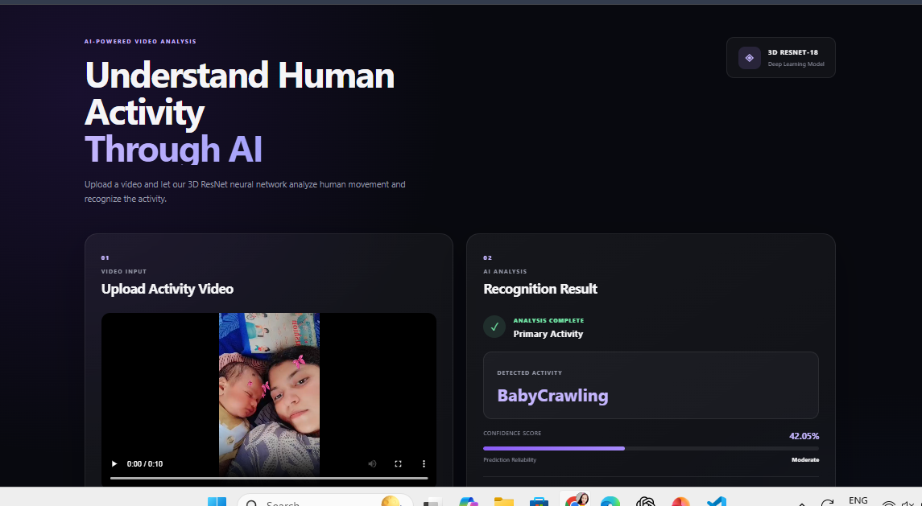
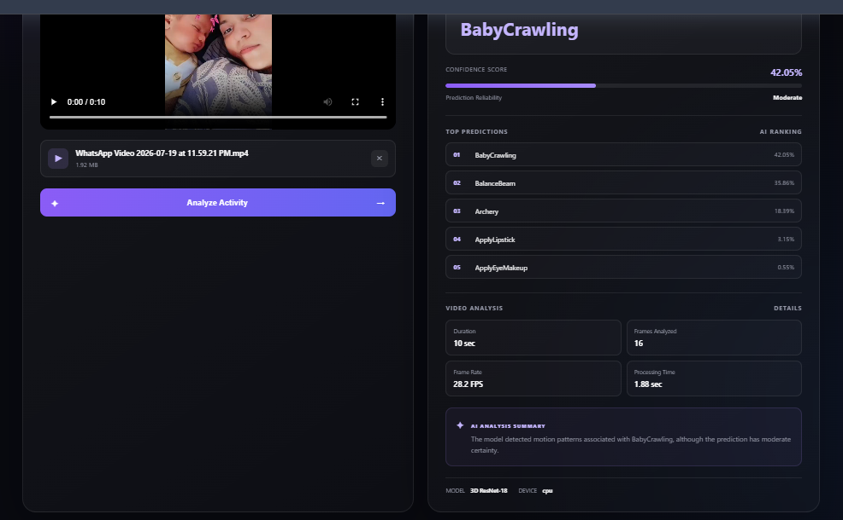
14. Frontend

Slide 16
15. Limitations & Future Scope
Current Limitations
Future Improvements
• Model is trained on only 5 selected activity classes. • Dataset size is limited compared with the full UCF101 dataset. • Activities outside the trained classes cannot be reliably recognized. • Video deep learning requires significant computational resources.
• Add more activity classes and videos. • Use transfer learning with pretrained weights. • Use stronger data augmentation. • Explore transformer-based video models. • Deploy on GPU or cloud infrastructure.
Human Activity Recognition | 15

Slide 17
THANK YOU
Questions & Discussion
Human Activity Recognition Using Deep Learning
3D ResNet-18 • UCF101 • PyTorch • Flask

