Slide 1
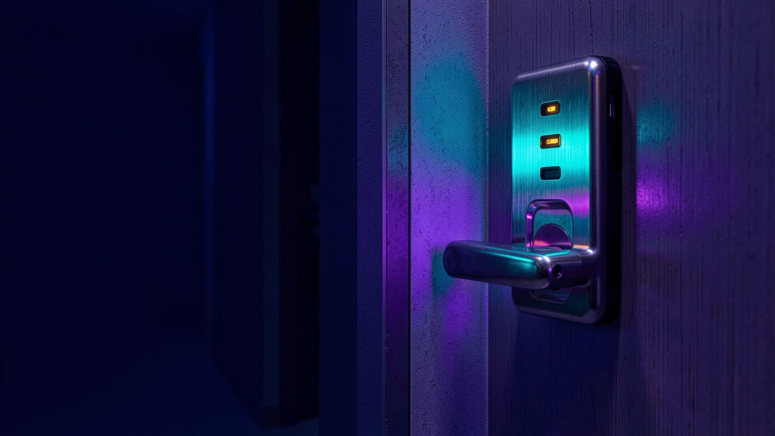
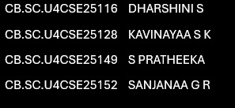
BIOMETRIC ACCESS CONTROL SYSTEM
Keypad, fingerprint and SD logging door access with a neural-network risk engine, duress PIN and resident alert panel. Arduino MEGA 2560 | Wokwi simulation.
Notes:
1

Slide 2

Problem and scope
Scope
Problem
  PINs kept in plain text
  A stolen PIN always works
  No safe way to call for help under force
  Neighbours unaware of break-ins
  PIN, fingerprint and guest PIN entry
  Admin menu for residents
  SD card logs and typing profiles
  Alert to all flats; one entrance door
02
Notes:
2

Slide 3





Existing vs proposed solution
FEATURE | EXISTING | PROPOSED
PIN storage | Plain text or fixed code | Salted hash on SD card
Authentication | PIN only, always trusted | PIN, fingerprint, guest PIN + AI risk check
Under force | No option | Duress PIN, silent alarm to all flats
Brute force | Fixed or no lockout | Lockout 30 to 240 s
Break-in warning | Local buzzer | Siren, SMS to every flat, notice board
Visitors | Share resident PIN | One-time PIN, 5 minutes
Existing: Storage
Proposed: Response
Existing: Authentication
Proposed: Security
03
Notes:
3

Slide 4
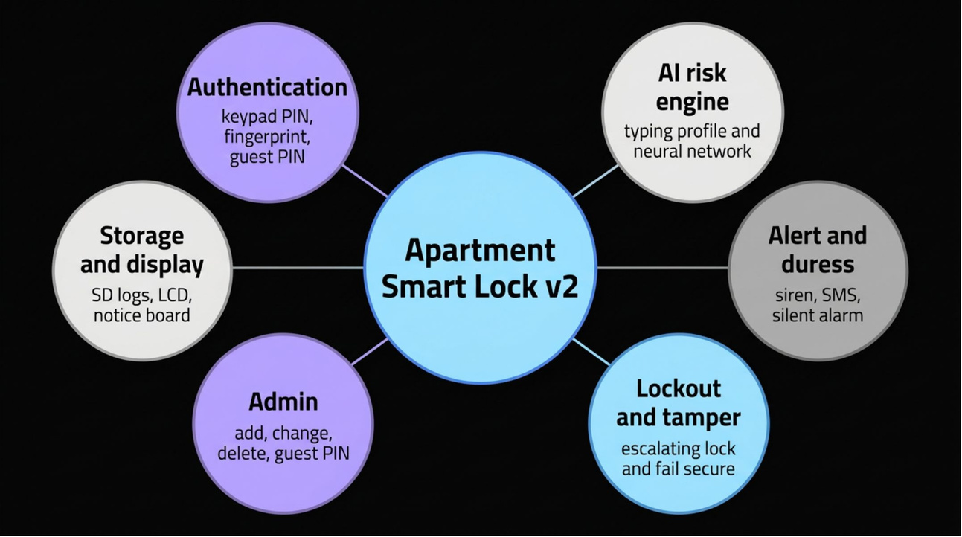
Proposed modules
  Authentication: keypad PIN, fingerprint, guest PIN
  AI risk engine: typing profile + neural network
  Alert and duress: siren, SMS, silent alarm
  Lockout and tamper: escalating lock, fail secure
  Admin: add, change, delete, guest PIN
  Storage and display: SD logs, LCD, notice board
04
Notes:
4

Slide 5
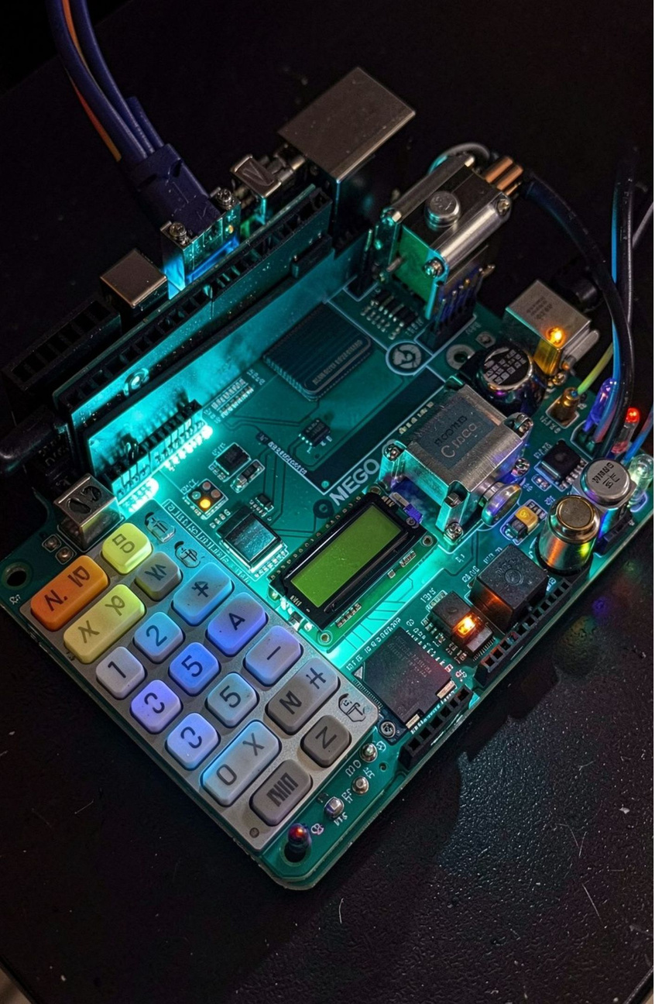

Simulation circuit (Wokwi)
  Wokwi circuit of the lock
  Arduino MEGA 2560: controller
  16×2 + 20×4 I2C LCD: 0x27 / 0x26
  4×4 keypad: pins 9–2
  Servo: pin 10
  SD module: CS 53
  Buzzer, 2 LEDs: 11, 12, 24
  3 push buttons: 13, A0, 22
05
Notes:
5

Slide 6
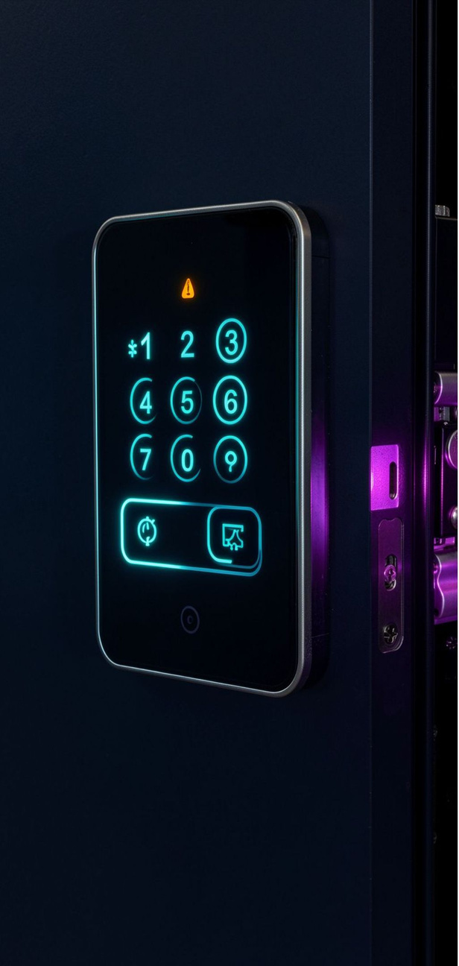

Algorithm flow
Read Credential
Hash & Identify
AI Risk Score
Decision
  Duress: real PIN with last digit +1 opens the door and sends a silent alarm
  Guest PIN: one use, expires in 5 minutes
  Lockout: 3 failures trigger siren, alert to all flats, and lockout 30 × 2^level s
  Tamper input: door forced shut, alert, 30 s lockout
06
Notes:
6

Slide 7

AI risk engine
Sigmoid output
Rhythm deviation
Produces risk score 0–1
Timing pattern variability
  Inputs: rhythm deviation, failed attempts / 3, tamper in last 60 s
  3–4–1 network, ReLU hidden layer, sigmoid output
  Rhythm learned per user at rate 0.2 and saved to PROFILES.TXT
  Active after 3 learned entries; reject at risk 0.70 or more
ReLU hidden layer
Neural-network Risk Engine
Failed attempts / 3
Nonlinear activation
Normalized failure count
3–4–1 network
Tamper in last 60 s
Three inputs, one hidden layer
Recent physical interference
07
Notes:
7

Slide 8
Performance analysis
1 in 10,000:
~45/hour:
0.12 vs 0.97:
chance of guessing a PIN per try
worst-case guesses after lockouts
normal vs abnormal risk score
Non-blocking timers keep keypad and tamper input live during alerts
Hashed PINs: SD card theft does not reveal codes
Limits: simulated SMS and fingerprint, hand-set NN weights, 32-bit hash, 8 residents
09
Notes:
9

Slide 9
Conclusion and future work
NEXT
NEXT
real fingerprint module
RTC
  Hashed PINs, duress code, guest PIN and building-wide alerts on a low-cost board
  AI risk check stops correct-but-suspicious entries
  Next: real fingerprint module, GSM or Wi-Fi alerts, RTC, model trained on real typing data
NEXT
NEXT
GSM or Wi-Fi alerts
model trained on real typing data
Thank you | Questions?
10
Notes:
10

