Slide 1

CASE PROJECT: FACEBOOK MARKETPLACE
- SANJANA KULKARNI

Slide 2
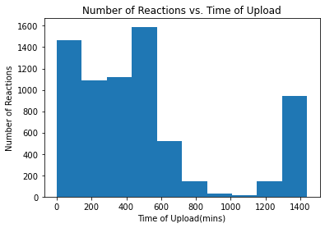
Time of upload
When uploaded between 7 to 10 in the morning no of reactions are maximum
Approx after 10 rate of reactions start to decrease
In contrast if uploaded between 4.30 to 7 in evening reactions are minimum
After 8 pm rate of reactions again starts to increase
Thus sellers should upload post between 7 to 10 am
Should not upload in afternoon

Slide 3
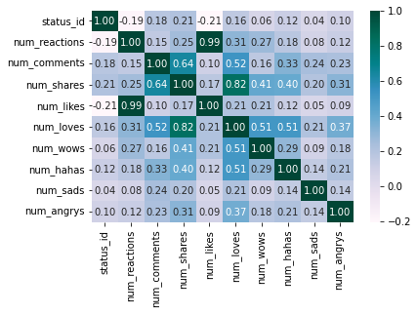
CORRELATIONS
Number of reactions and comments : + 0.15
this is a weak and not significant correlation
Number of reactions & shares : 0.25
As +ve reactions increases with increase in shares . But weak.
Number of shares & comments : 0.64
Moderate correlation . Comments increases with greater sharing
Likes & reactions : 0.99
Very Strong correlation . It is a perfect relationship

Slide 4
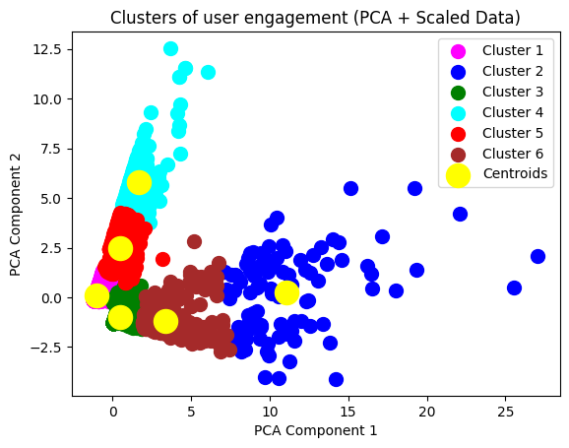
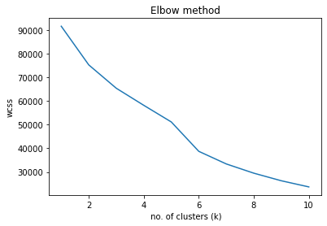
K-MEANS CLUSTERRING
From these we get K as 6 as the optimal no of clusters
Thus here ,6 clusters are formed

Slide 5
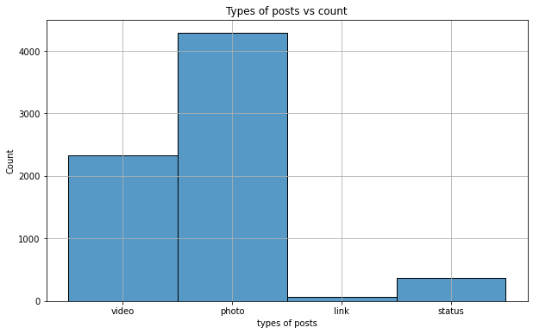
Average | Reactions | Comments | Shares
Link | 50.0 | 1.0 | 4.39
Photo | 34.0 | 2.0 | 2.55
Status | 120.0 | 10.0 | 2.55
Video | 160.0 | 39.0 | 12.0
The average number of reactions , comments and shares on the post type : video is much higher than the other type of posts
So the sellers should upload more videos

Slide 6
THANK YOU !!

