Slide 1
CASE PROJECT sales prediction
- Sanjana kulkarni

Slide 2
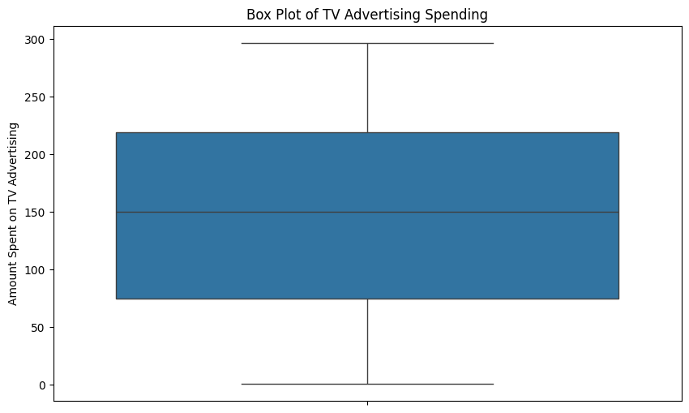
Average expenditure
FEATURES | AVERAGE
TV | 147.0425
RADIO | 23.2606060
NEWSPAPER | 25.75
The highest amount is spent on TV advertisement while the lowest is spent on radio

Slide 3
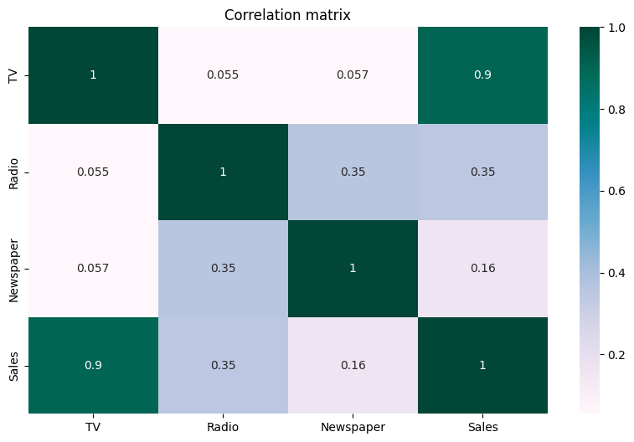
correlation
The relation between newspaper expenditure and sales is the weakest 0.055
Thus it doesn’t affect the sales at all
While the Radio amount and the sales have moderate positive correlation .
Hence practically with increase in cost spent on radio increases the sales but it is not the main factor which affects the sales
TV and sales have strong positive correlation.
This indicates that an increase in sales is highly dependent on the amount spent on TV advertising.
In other words, as the expenditure on TV advertising increases, sales tend to increase as well.

Slide 4
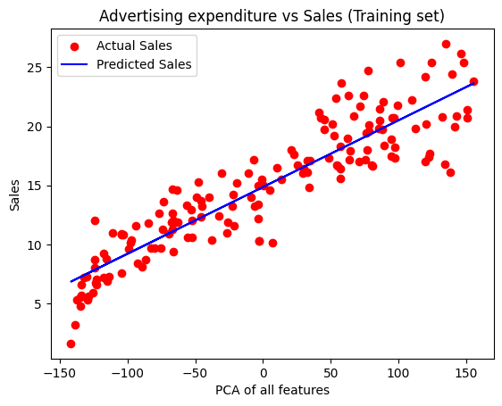
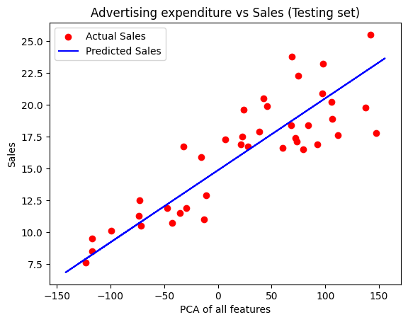
Linear regression model
Thus the model is predicting the results approximately same as the actual values

Slide 5
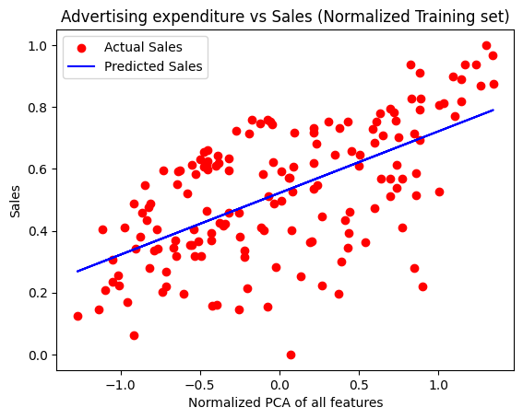
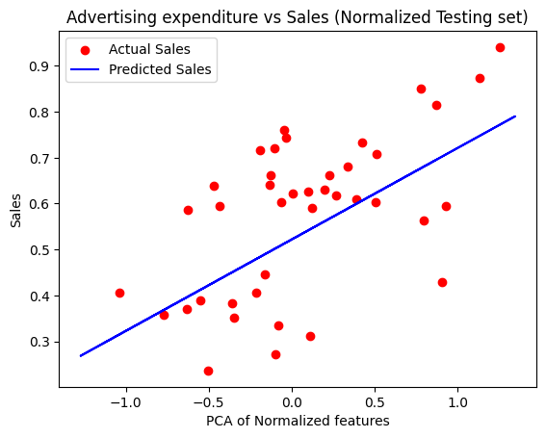
Model on normalized dataset
Normalization helps prevent the prediction from being dominated by features with high values. Although the data may be somewhat scattered, normalization ensures that the range of values is consistent and manageable.

Slide 6
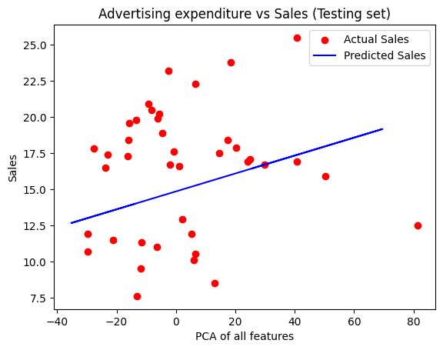
Excluding Tv dataset
As observed from the regression line, the actual sales data points are from the line significantly dispersed
This discrepancy arises because the TV expenditure dataset has a much larger impact on the sales values, and we have not considered this factor
Consequently, the graph appears more scattered, and the model's predictions are not accurate.

Slide 7
Thank you !!
In conclusion,
Company should spent more amount on the advertising expenditure on TV to increase the sale and should spend less on the NEWSPAPER

