Slide 1

HACAKIFINITY
Project Title : Project Revival AI – Bring Back Dead Student Projects
Team Name : HACAKIFINITY
Team Members (Names + Roles Briefly) : Pravalika Muthoju – AI/ML Engineer
Sanjana Bayya – Full Stack Developer
Sindhu Mididoddi – UI/UX Designer
Hari Priya Katherla – Product Strategist
Theme Chosen (Web3 / AIML / Fintech / Healthcare / Open Innovation / EdTech) : AIML

Slide 2
HACAKIFINITY
PROBLEM STATEMENT &
TARGET AUDIENCE
Problem We're Solving
Target Users
75%+ CS students abandon at least one project
Lack of mentorship, clarity, or direction halts progress
Wasted potential — great ideas never completed
No tool exists to revive, fix, or guide such projects
Students lose confidence, efforts go unseen
Tech students (B.Tech / M.Tech / BCA / MCA)
Educators & mentors in academic settings
B2C model – supports individual students directly
Ideal for final-year projects, hackathon ideas,personal builds

Slide 3
HACAKIFINITY
OUR UNIQUE SOLUTION
Key Features
Why It's Different
Upload ZIP file, GitHub repo, or documentation
AI scans and detects what's missing or incomplete
Step-by-step revival roadmap generated
“Find Collaborators” based on project domain
Goes beyond version control—diagnoses root causes of failure
Merges AI-powered gap analysis with practical next steps
Community-driven: links students with potential collaborators
Project failure prediction
Revival strategy based on code + docs + trends

Slide 4
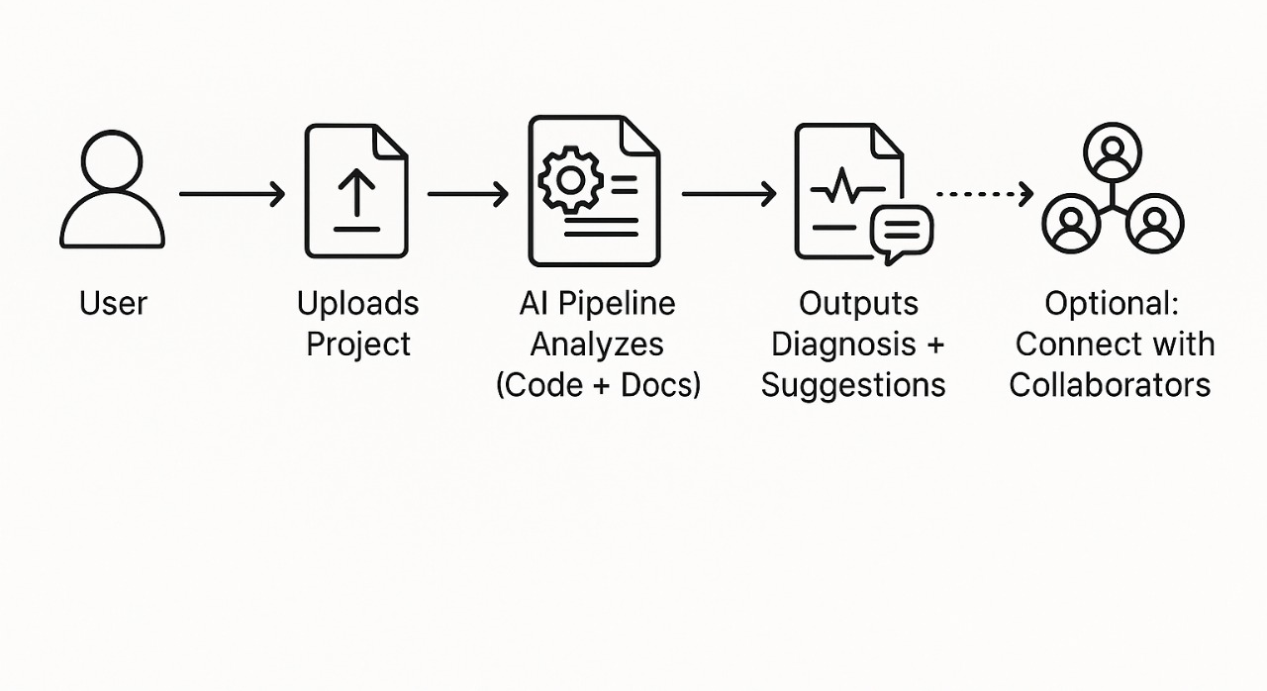
HACAKIFINITY
TECH STACK + ARCHITECTURE
Tech Stack
Architecture
Frontend: React.js
Backend: Flask + FastAPI
AI Models: GPT-4 + Custom Code Analyzers
Database: PostgreSQL + Firebase Auth
Collaboration: WebSockets, REST APIs

Slide 5
HACAKIFINITY
FEASIBILITY AND SHOWSTOPPERS
Feasibility
Skilled team with ML, full-stack, and UX experience
Use of existing AI models and APIs speeds up development
MVP can be built in 36–48 hrs
Showstoppers
Blocker: Poorly structured uploads
→ Fix: Step-wise guided upload + parsing
Blocker: Generic AI not suited to student projects
→ Fix: Fine-tuned models + academic templates

Slide 6
HACAKIFINITY
Important Pointers
You may change the current layout (boxes/sections), but ensure all required content is included.
Keep your submission to a maximum of 5 slides, including the Title Slide.
It’s recommended to put your ideas in bullet points.
Focus on the core idea – keep it crisp and avoid over-explaining.
Do not change the title bar (project name, team, etc.).
Ideas must be original and not copied from existing solutions.
Save and submit your file as a PDF only. Other formats will not be accepted.

