Slide 1


SMART INDIA HACKATHON 2026
TITLE PAGE
Problem Statement ID – SIH26188
Problem Statement Title- AI Based Fake Identity & Document Screening System
Theme- Blockchain and Cybersecurity
PS Category- Software
Team ID-
Team Name- VISIONARY6

Slide 2
IDEA TITLE
VISIONARY6
Proposed Solution
VeriScan turns a single uploaded ID into one clear, explainable risk score:
1
2
3
Ingest & Verify
Forensic Analysis
Explainable Score
Reads the uploaded Aadhaar / PAN / DL / Passport, runs OCR, checks format + checksum, and decodes the QR code.
A visual forensics layer most tools skip — Error Level Analysis plus copy-move detection to catch tampering.
One risk score (0–100) with the exact reasons flagged, so the verifier sees why — not just a “fake” label.
i
Explainable, Not Black-Box
✓
A Forensics Layer Most Tools Skip
Every score ships with the reasons behind it — verifiers get an explanation, never a mystery flag.
Error Level Analysis + copy-move detection surface tampering that plain OCR-based checkers miss entirely.

Slide 3
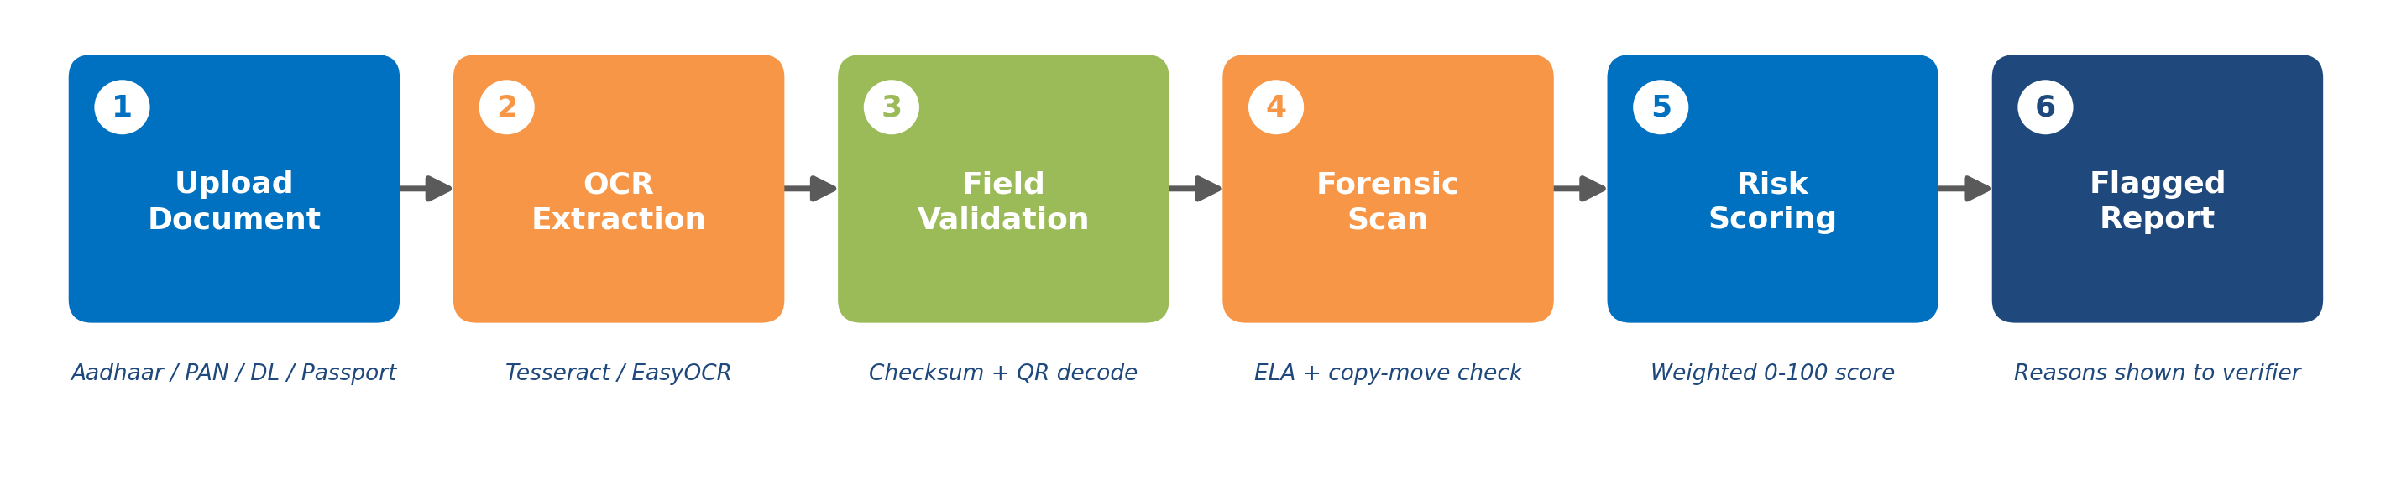
TECHNICAL APPROACH
VISIONARY6
Built end-to-end on mature, open-source Python libraries — realistic within a hackathon timeline.
OCR
FORENSICS
QR CODE
RISK MODEL
BACKEND
FRONTEND
Tesseract / EasyOCR
OpenCV + PIL
pyzbar
scikit-learn
FastAPI
React Dashboard
Methodology — the six-step verification pipeline:
Why this stack: ▸ Offline-capable, no paid APIs ▸ Sub-2-second scoring per document ▸ Runs on a single commodity server

Slide 4
FEASIBILITY AND VIABILITY
VISIONARY6
✓
What Works In Our Favor
!
Challenges We're Solving For
▸ Every core piece — OCR, checksum rules, QR decoding, basic forensics — runs on mature open-source libraries
▸ Realistic to build within a hackathon timeline
▸ No special hardware required
▸ No public dataset of real fake IDs exists (for good reason)
▸ OCR accuracy drops on poor-quality phone-camera scans
1
2
3
4
Rule-Based Checks First
Synthetic Tampered Samples
Image-Quality Guidance
License as a KYC API
Zero training data needed to launch
Generated for realistic testing
Nudges users to a clean upload
Standalone revenue for banks & telecoms
Bottom line: ▸ Buildable by a small team within the hackathon window ▸ Every dependency is free, open-source and well-documented

Slide 5
IMPACT AND BENEFITS
VISIONARY6
Who Uses VeriScan
GOV
BANK
TEL
HR
Government Verification Desks
Bank / NBFC KYC Teams
Telecom SIM Counters
HR Onboarding Teams
Impact & Benefits
SOCIAL
ECONOMIC
BUSINESS MODEL
Fewer citizens hurt by identity fraud, with faster, fairer verification for everyone.
Cuts manual review time and the fraud-driven loan and SIM losses institutions absorb today.
A pay-per-scan API for fintechs and telecoms — not just a one-time government deployment.
Market opportunity: ▸ 1B+ Aadhaar-linked verifications happen in India every year ▸ KYC fraud costs banks and telecoms crores annually

Slide 6
RESEARCH AND REFERENCES
VISIONARY6
ELA
ID
Tamper Detection — ELA
ID Checksum Validation
Krawetz, “A Picture's Worth” (Hacker Factor) — Error Level Analysis exposes recompressed, edited regions.
Verhoeff checksum algorithm — the same method UIDAI uses to validate Aadhaar numbers.
CM
LAW
Copy-Move Detection
Data Compliance
SIFT / ORB feature matching (OpenCV docs) — flags duplicated regions pasted within a document.
DPDP Act, 2023 — referenced for lawful, consent-based handling of applicant data.
Why it matters: ▸ Every technique is peer-reviewed or industry-standard ▸ Grounded in real regulatory requirements, not assumptions

