Slide 1
EXECUTIVE SUMMARY
Telecom Customer Churn Analysis
Analyzed 6,418 customers to identify attrition drivers, build an 84% accurate predictive model, and deliver actionable retention strategies.
6,418
1,732
Total Customers
Churned Customers
27%
84%
Overall Churn Rate
Model Accuracy
Technologies: SQL · Python · Scikit-Learn · Power BI

Slide 2
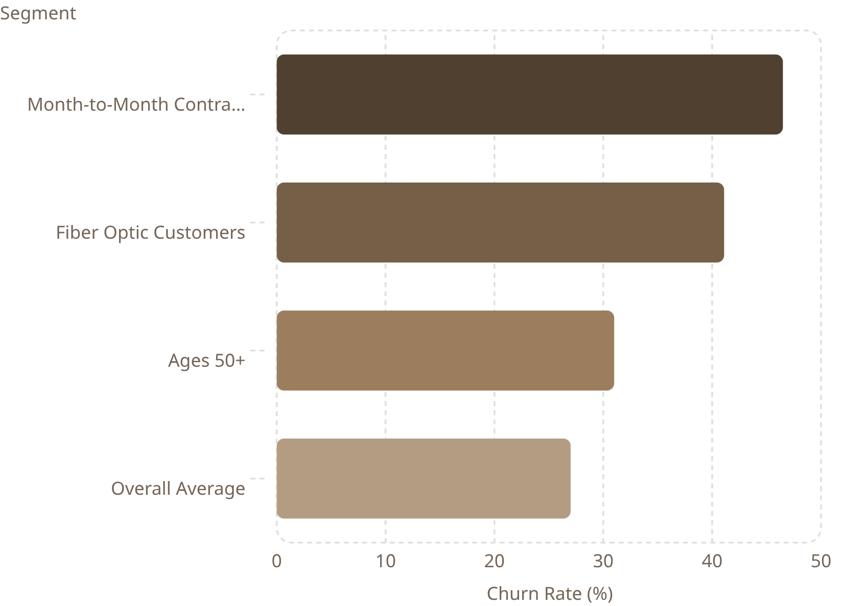

KEY FINDINGS
Who Is Leaving — and Why
Top 5 Churn Drivers
1
Contract Type
2
Total Revenue
3
Total Charges
4
Monthly Charges
5
Long Distance Charges
Key insight: Over 35% of predicted future churners are aged 50+, and competition is the leading reason customers leave.

Slide 3

RETENTION STRATEGY
Five Priorities to Reduce Churn
1
Reduce Contract-Based Churn
Incentivize annual plan upgrades with discounts and early renewal offers.
2
Improve Fiber Optic Experience
Address service complaints and outages; launch targeted satisfaction surveys.
3
Retain High-Risk Age Groups
Deploy personalized loyalty campaigns for customers aged 50+.
4
Protect High-Value Customers
Prioritize model-identified at-risk customers with revenue-based retention offers.
5
Strengthen Long-Term Retention
Reward customers with 24+ months tenure through loyalty programs and exclusive benefits.
Expected Impact: Lower churn, higher CLV, improved satisfaction, and stronger revenue stability.

