Slide 1


Atlassian Bamboo
Author: Sanjana Chaturvedi
This document and all its contents contain information from Cybage Software Private Limited which may be privileged, confidential,
or otherwise protected from disclosure. The information is intended to be for the addressee(s) only. Any unauthorized disclosure,
copy, distribution, or use of the contents of this message is strictly prohibited.
Notes:
1

Slide 2
Level 1

Slide 3
Agenda
Agile it is
Why CI??
CI
CI-server
Why Bamboo?
Getting started with Bamboo
Agents and capabilities
Let’s dive-in Bamboo[Demo]
Bamboo’s Working Directory
Permissions
Artifact sharing

Slide 4
Agile it is
Working software is the primary measure of progress.
At regular intervals, the team reflects on how to become more effective, then tunes and adjusts its behavior accordingly.
Continuous attention to technical excellence and good design enhances agility.
Welcome changing requirements, even late in development.
Deliver working software frequently, from a couple of weeks to a couple of months, with a preference to the shorter timescale.
Our highest priority is to satisfy the customer through early and continuous delivery of valuable software.

Slide 5
Why CI?
Use of shared version control (e.g. Git, Subversion).
Automated testing after every code change.
Automated notifications of test failures.
An automated product release process.

Slide 6
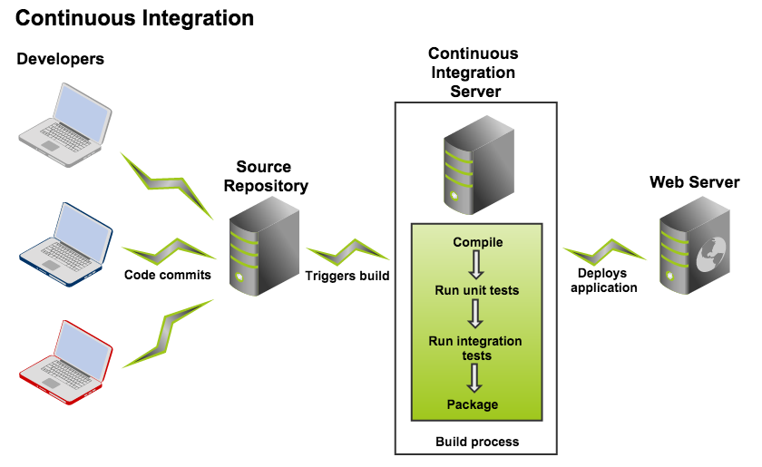
CI-Continuous Integration

Slide 7
Now we need something to trigger it
CI-server

Slide 8
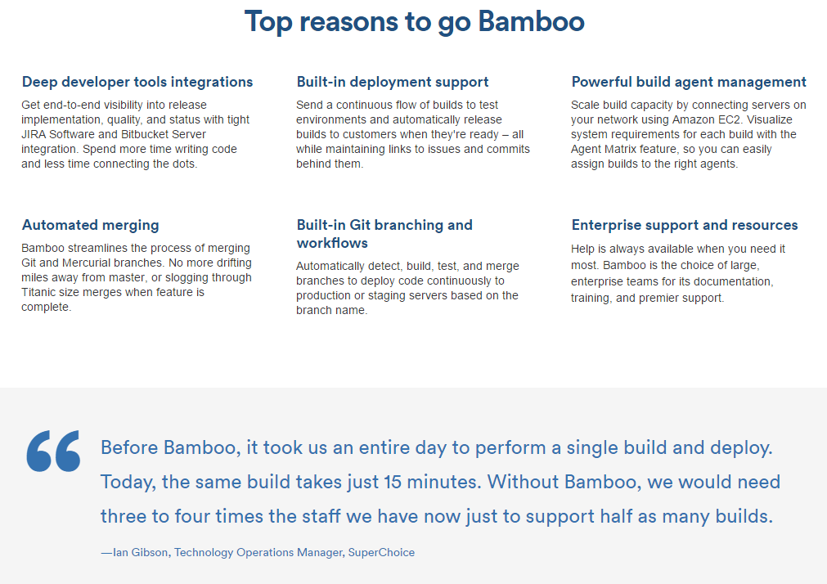
Why Bamboo?
Plan branches
Aggregated test results
Build stages
Build variables
Automated merges
Multiple build triggers
Test frameworks
Killer Add-ons.
Jira issue creation
Build-to-issue-links

Slide 9
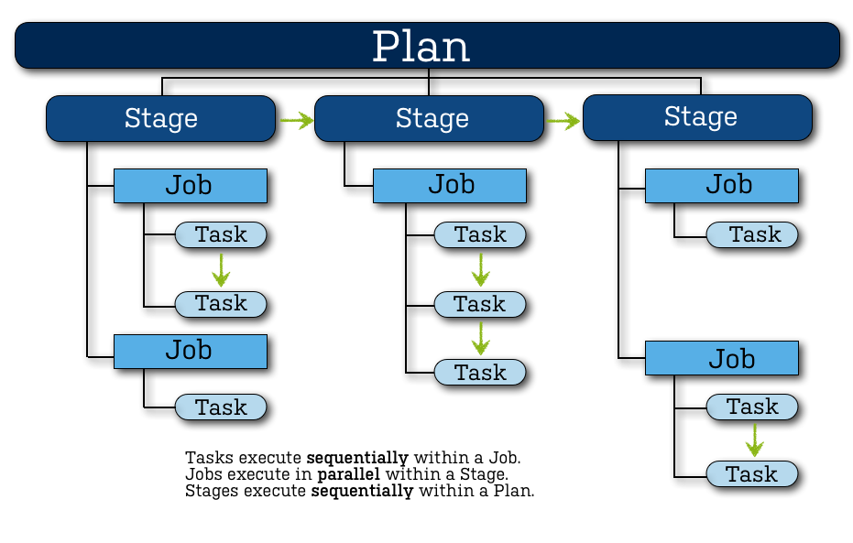
Getting started with Bamboo.
Bamboo needs:
a code repository that contains the complete source code for the project
build scripts
test suites
Workflow ->

Slide 10
Agents and capabilities
A Bamboo Agent is a service that can run job builds.
There are the following types of Bamboo agents:
Local agents run as part of the Bamboo server
Remote agents run on computers, other than the Bamboo server, that run the remote agent tool
Elastic agents run in the Amazon EC2
Local agents run in the Bamboo server's process, i.e. in the same JVM as the server.
Each remote agent runs in its own process, i.e. has its own JVM.
Each agent has a defined set of capabilities and can only run builds for jobs
whose requirements match the agent's capabilities.

Slide 11
Agents and capabilities contd.
A Capability is a feature of an Agent.
Capabilities typically define the path to an executable that has already been installed, and must be defined in Bamboo before Bamboo or its agents can make use of those
Capabilities can be defined specifically for an agent, or they can be shared between either all local agents or all remote agents.
Note : the value of an agent-specific capability overrides the value of a shared capability of the same name (if one exists).
A capability can be defined on an agent for:
an executable (e.g. Maven)
a JDK
a Version Control System client application (e.g. Git)
a custom capability. This is a key-value property which defines a particular characteristic of an agent (e.g. 'operating.system=WindowsXP' or 'fast.builds=true').

Slide 12
Let’s dive-in Bamboo[Demo]
Simple start
Dashboard walk-through
Working build plan - CI with PHP
Branching and merging

Slide 13
Bamboo’s Working Directory
The Working Directory is where Bamboo temporarily puts the checked-out files it is building
By default, this directory is located under the xml-data directory in the Bamboo home directory
Each build's jobs have their own working directory relative to this configured working directory:
xml-data/build-dir/JOB_KEY
To change the location of Bamboo's working directory:
Shut down Bamboo
Open the <Bamboo-Home>/bamboo.cfg.xml file in a text editor. Find the following line -
<property name="buildWorkingDir">/home/Bamboo-home/xml-data/build-dir</property>
Edit the Bamboo working directory to point to a new folder on disk
3. Save the changes and restart Bamboo.
Note: Bamboo will do a fresh checkout and perform a clean build of all your plans, once the directory is changed.

Slide 14
Permissions
Users
Groups
3 types of Permissions ->
Granting global permissions to users or groups.
Granting plan permissions in bulk.
Allowing anonymous access to Bamboo.

Slide 15
Thank you!

Slide 16
Level 2

Slide 17
Agenda
Artifact Promotion
Introduction to Continuous Delivery
Problems in a traditional CI server for Continuous Delivery
Bamboo’s Solution
Artifacts and Deployment releases
Deployment Project Workflow
Creating and Configuring a Deployment Project
Branch Deployments and their Strategies
Elastic Bamboo
Elastic Bamboo[Walkthrough]
Bamboo Best practices

Slide 18
Artifact Promotion
Created for a job.
Shared between jobs.
Shared between plans.
Promoted to a deployment environment.

Slide 19
Continuous Delivery
It is the process of building software that can be released to production at any time. It helps to reduce the cost, time, and risk of delivering incremental changes to users, following set of practices.
DEV ENV
QA ENV
STAGING ENV
PROD ENV
Deploy
Deploy
Integration
Staging
Code check-ins
Functional test (Automated)
Continuous Monitoring
Code analysis
Unit test
Code coverage
Acceptance test
Performance test
SCM
Test
Production
Deploy
Continuous Delivery
19

Slide 20
Problems in a traditional CI server for Continuous Delivery
Deployed builds are difficult to find
Difficult to find what changes were made between deployments
Difficult to know what was deployed, and when and where it was deployed
Lack of insight into the QA process
Poor control over who can deploy
Notes:
Using a traditional Continuous Integration server for Continuous Delivery is less than ideal because:
Deployed builds are difficult to find – Builds that were deployed only a few days ago are de-emphasized by the system. While this is good for a Continuous Integration workflow, the behavior makes it difficult for team members to identify which builds have been deployed and when, versus which have not.Teams can work around this with a system that uses labeling but it's not immediately obvious how it should work unless team members are trained to use it correctly.
Difficult to find what changes were made between deployments – Build results report commit and issue data between a specific build result and the one immediately before it. There can be many build results between two different deployments. Often the entire history has to be navigated between the two deployments to build a complete view of the changes between them. Sometimes, even other tools have to be used, such as version control systems.
Difficult to know what was deployed, and when and where it was deployed – Builds do not have visibility of where code is deployed or what was previously deployed to an environment.
Lack of insight into the QA process – Given a list of deployment candidates, builds offer no clear way (other than commenting or labeling) for QA to 'sign off' on a tested release or mark a release as broken or un-releasable.
Poor control over who can deploy – While it can be controlled by permissions who can run, view or edit a build, they do not give enough fine grained control over which people in the team can deploy to production or other sensitive environments. In essence, if someone has permission to run the build they can deploy the software any time they wish

Slide 21
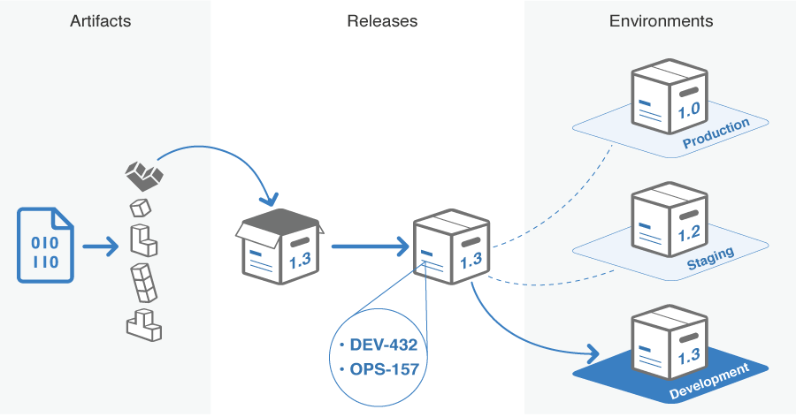
Bamboo’s Solution
Deployment Project
Environment
Release
How do deployment projects work?
Notes:
Deployment project – Represents the software you are deploying (such as a web application), the releases of the software deployed and the environments that they will be deployed to throughout the lifecycle.
Environment – Represents the servers or groups of servers where the software release has been deployed to, and the tasks that are needed for the deployment to work smoothly. Example environments could be named Development, QA, Staging or Production. Environments have permissions that allow fine grained control of who can deploy, edit or view an environment and record the full history of releases deployed to it.
Artifacts
Create and test deployable artifacts with build plans. Ensure any artifacts you wish to deploy with Bamboo are flagged as "shared" to make them available to the deployment instructions of the environment.
Releases
Any artifact that has been successfully tested can be used to create a release; you can create as many releases as you like. Bamboo will add other metadata such as related commits and JIRA issues to each release which enable reporting and tracking as it moves through your environments.
Environments
Environments in Bamboo reflect the development, testing and production environments in your IT infrastructure – hostnames and authentication credentials for each environment reside at the task level inside your deployment jobs. At any point in time, you will be able to see which release is running in each environment, which release it replaced, when it was deployed and who deployed it. You will also be able to see any associated JIRA issues.

Slide 22
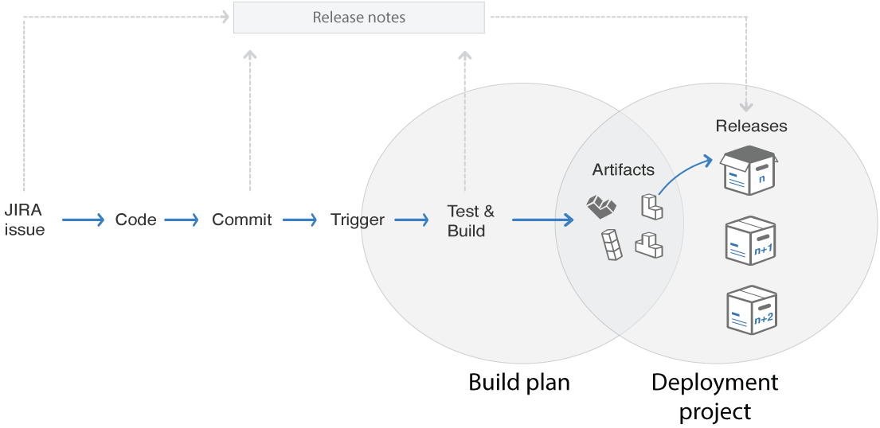
How artifacts and deployment releases work together?
The relationship between artifacts and releases shows the 'hand-over point' between Bamboo builds and Bamboo deployments
Notes:
As the diagram shows, a developer who is responding to JIRA issues, commits a code change and triggers a build. This build produces a number of artifacts. In a deployment, these artifacts are assembled into a release, and the JIRA issue, commits and test/build metadata are added. This release then gets a unique identification name which serves as an identifier throughout the system. You can define the unique identifier according to your needs using the release naming system.
Once a release has been created, it is now ready to be deployed to an environment.

Slide 23
Deployment Project Workflow
Prerequisites
A build plan
Artifacts to deploy (these are produced by the build plan and shared)
Workflow
Step 1: Create a new deployment project
Step 2: Decide on a release naming scheme
Step 3: Decide who can view and edit the project
Step 4: Create a deployment environment
Step 5: Customize your deployment environment
(Tasks, Triggers, Permissions, Agents, Notifications, Variables)
Step 6: Start deploying!
Notes:
Step 1: Create a new deployment project
Creating the deployment project is the first step. Here we will give the project a name and a description, but most importantly we associate the deployment project with an existing Bamboo build plan. This is why we must have a build plan available to associate with our new deployment project.
Learn more about creating a deployment project here.
Step 2: Decide on a release naming scheme
The next step is to configure the release naming scheme for the deployment project. The release naming scheme will define how Bamboo names the releases that you create from your build artifacts for deployment. You can use either a simple release naming scheme, or a scheme that uses global or plan variables already defined in Bamboo.
Learn more about release naming schemes here.
Step 3: Decide who can view and edit the project
You need to decide who can view and edit the deployment project: This is done using the permission scheme. You can add or remove individuals or groups from the scheme, and give them access to either view and/or edit the project.
Learn more about the permissions scheme here.
Step 4: Create a deployment environment
The next step is to create a deployment environment. A deployment environment represents the servers or groups of servers where the software has been deployed, and any tasks needed for the deployment to go smoothly. You can call the deployment environment anything you like, though typical names are QA, Staging and Production.
Learn more about creating a deployment environment here.
Step 5: Customize your deployment environment
Once you have created your deployment environment, you need to set it up to reflect the needs of your project. You can control most aspects of the deployment environment, including:
Tasks - Run executable tasks during the deployment process, for example downloading a needed artifact from a different plan
Triggers - Decide which events or schedule points will trigger off deployment of your project to an environment
Permissions - Decide who can view and edit your deployment environment
Agents - Control which agents you will use to support your deployment process
Notifications - Create a notification scheme to keep you informed about your deployment progress
Variables - Assign variables for your deployment projects
Step 6: Start deploying!
Once you have set up your deployment project, you're ready to start the deployment process.

Slide 24
Creating and configuring a Deployment Project [Walkthrough]

Slide 25
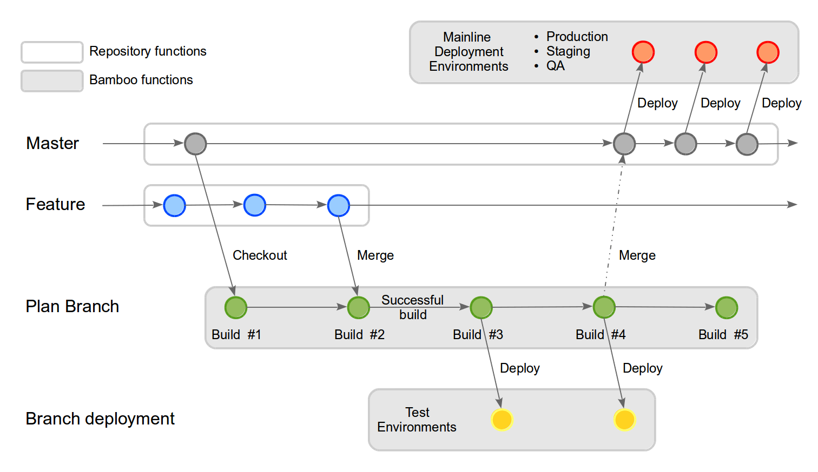
Branch Deployments
Bamboo deployments allow a plan branch to be deployed to a non-critical test environment before the feature code is merged back to master
This means that the feature code can be thoroughly tested and evaluated in a real server environment before the developer merges back the changes to master
Developers should consider using branch deployments whenever they want to keep their in-progress development code separate from the master code, but want to test it within a deployable environment
Notes:
The following diagram shows a typical deployment branch example.
The developer creates a new branch off of the master and a plan branch is automatically created for the new branch in Bamboo
The developer commits code against the branch and the plan branch automatically builds the changes
Following a successful build, they then deploy the results of builds #3 and #4 into a test environment for thorough testing
When satisfied that all of the tests have been passed, the developer manually merges their feature branch back into master
Now that the changes are in master – sporting the new feature – a new release can be created and deployed to the mainline environments (e.g. QA, Staging and Production).

Slide 26
Strategies of Branch Deployment
Manual Deployment
Automated Deployment

Slide 27
Elastic Bamboo
When Bamboo is set-up to use the Amazon Elastic Compute Cloud
Elastic Bamboo uses AMI to create instances of agents in the EC2
Key Concepts
Elastic Image - an Amazon Machine Image (AMI) that is stored in one of Amazon data centers for use with the Elastic Bamboo feature, unique identification : AMI ID
Elastic Instance - An elastic instance is a running instance of an elastic image
Elastic Agent –
An agent that runs in the Amazon EC2
An elastic agent process runs in an elastic instance of an elastic image
Inherits its capabilities from the elastic image that it was created from.

Slide 28
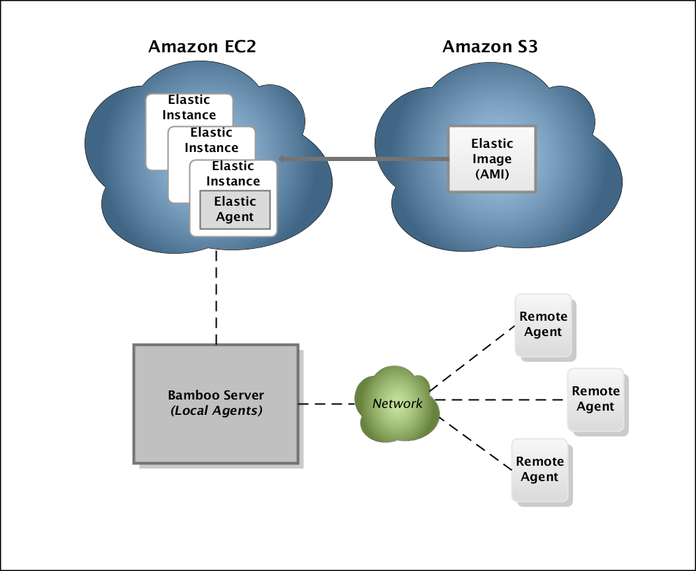
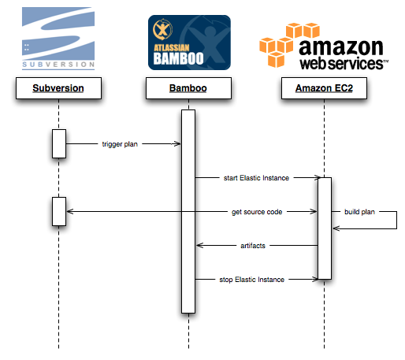
Elastic Bamboo

Slide 29
Elastic Bamboo [Walkthrough]

Slide 30
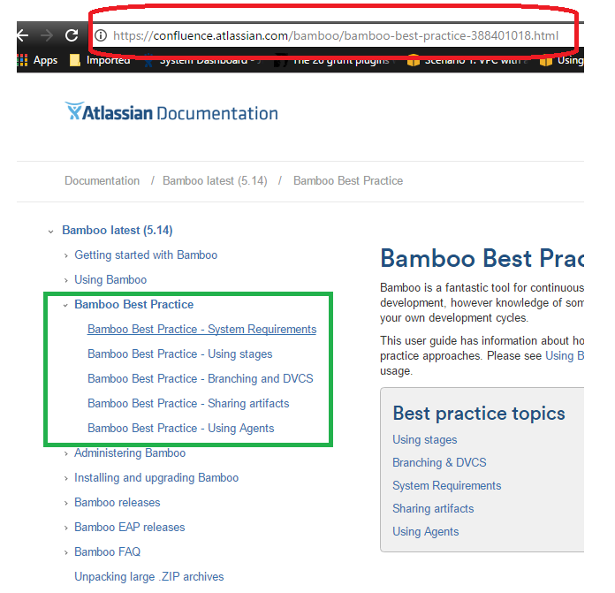
Bamboo Best practices reference

Slide 31
Thank you!

