Slide 1



Author: Sanjana Chaturvedi
This document and all its contents contain information from Cybage Software Private Limited which may be privileged, confidential,
or otherwise protected from disclosure. The information is intended to be for the addressee(s) only. Any unauthorized disclosure,
copy, distribution, or use of the contents of this message is strictly prohibited.
Notes:
1

Slide 2
Agenda
Version Control Systems
CVCS and DVCS
Core disadvantages of CVCS
Core Advantages of DVCS over CVCS
STORAGE mechanism of VCS
GIT follows DAG
Why GIT?
What is GIT?
Getting Started and Git internals
Basic Workflow
GIT Branching GIT Workflows

Slide 3
Version Control System
Version control is a system that records changes to a file or set of files over time so that you can recall specific versions later.
Every modification to the code is tracked in a special kind of database.
If you screw things up or lose files, developers can turn back the clock and compare earlier versions of the code to help fix the mistake while minimizing disruption to all team members.

Slide 4
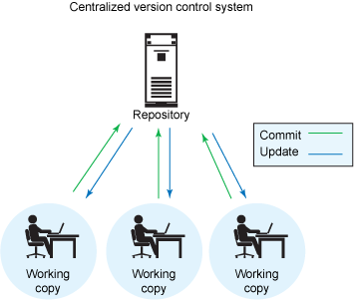
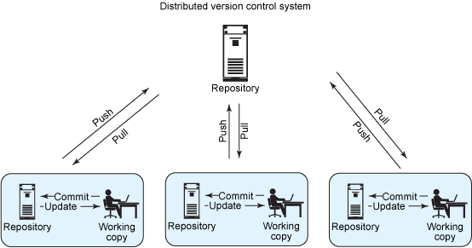
CVCS and DVCS

Slide 5
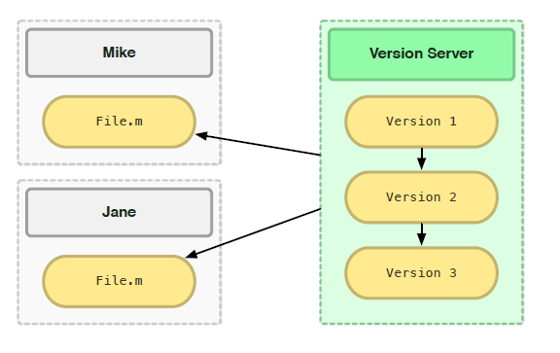
Core disadvantages of CVCS
Single point of failure
Dependent on access to the server
Hard to manage a server and backups
It can be slower because every command connects to the server.
Branching and merging tools are difficult to use.
Multi-developer conflicts ruin the development.

Slide 6
Core Advantages of DVCS over CVCS
Speed : Performing actions other than pushing and pulling change-sets is extremely fast
Local Work : Committing new change-sets can be done locally. Once you have a group of change-sets ready, you can push all of them at once
Reduced Dependency on network connectivity : Everything but pushing and pulling can be done without an internet connection
Clone copy : Each programmer has a full copy of the project repository, thereby contributing to work in active collaboration
Notes:
Performing actions other than pushing and pulling changesets is extremely fast because the tool only needs to access the hard drive, not a remote server.
Committing new changesets can be done locally without anyone else seeing them. Once you have a group of changesets ready, you can push all of them at once.
Everything but pushing and pulling can be done without an internet connection. So you can work on a plane, and you won’t be forced to commit several bugfixes as one big changeset.
Since each programmer has a full copy of the project repository, they can share changes with one or two other people at a time if they want to get some feedback before showing the changes to everyone.

Slide 7
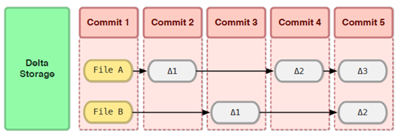
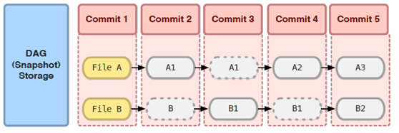
STORAGE mechanism of VCS
Delta Storage: Stores data as changes to a base version of each file.
Snapshot Storage : Each commit takes a full snapshot of your entire working directory.

Slide 8
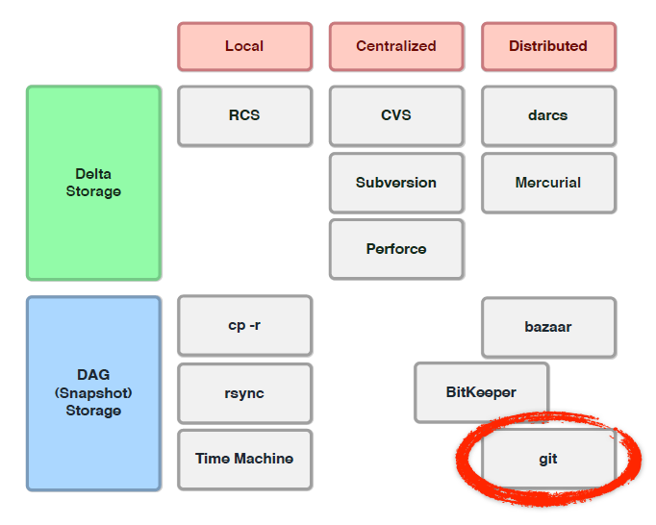
GIT follows DAG
Git is a distributed VCS that uses the snapshot storage model.

Slide 9
Why GIT?
Free and Open Source
Strong support for non-linear development
Simple design
GIT
High Speed
Excellent Branching and Merging
Handles large projects efficiently
Fully distributed

Slide 10
What is GIT?
By far, the most widely used modern version control system in the world today is Git.
It is a mature, actively maintained open source project originally developed in 2005 by Linus Torvalds.
Having a distributed architecture, every developer's working copy of the code is also a repository that can contain the full history of all changes.
In addition to being distributed, Git has been designed with performance, security and flexibility in mind.

Slide 11
Local Operations
Git Directory
Staging Area
Working Directory
This leads us to the three main sections of a Git project
Git Directory: is where Git stores the metadata and object database for your project.
Checkout the Project
Staging Area: stores information about what will go into your next commit. Also called ‘Index’.
Stage Files
Working directory: is a single checkout of one version of the project
Commit

Slide 12
Basic Workflow
Basic Workflow
Git Repository
Fetch
Push
Init or Clone
a repo
Local Repository
Checkout Head
Commit
Staging Area
Stage the
changes
Working Folder

Slide 13
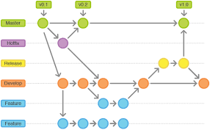
GIT Branching
$ git branch
* Master
$ git branch <feature_branch>
$ git checkout <feature_branch>
$ git add .
$ git commit -m "adding a change from the feature branch“
$ git checkout master
$ git merge <feature_branch>
$ git push origin <feature_branch>
13

Slide 14
Git Workflows
Git workflows are designed to be guidelines rather than concrete rules.
You can mix and match aspects from different workflows to suit your individual needs.
Major workflows are
Centralized Workflow
Feature Branch Workflow
Gitflow Workflow
Forking Workflow

Slide 15
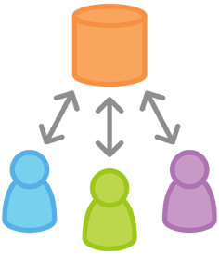
Centralized Workflow
Centralized Workflow
Your team can develop projects in the exact same way as they do with Subversion.
Gives every developer their own local copy of the entire project.
Gives you access to Git’s robust branching and merging model.
Comfort of Subversion, advantages of Git!!!

Slide 16
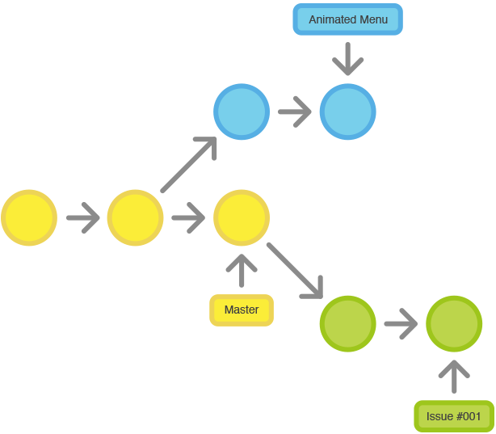
Feature Branch Workflow
Feature Branch Workflow
To encourage collaboration and streamline communication between developers.
All feature development should take place in a dedicated branch instead of the master branch.
Easy for multiple developers to work on a particular feature without disturbing the main codebase
The master branch will never contain broken code, which is a huge advantage for continuous integration environments.
16

Slide 17
Gitflow Workflow
Gitflow Workflow
Defines a strict branching model designed around the project release.
Provides a robust framework for managing larger projects.
Assigns very specific roles to different branches and defines how and when they should interact.
Uses individual branches for preparing, maintaining, and recording releases.

Slide 18
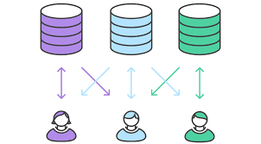
Forking Workflow
Forking Workflow
Each contributor has not one, but two Git repositories: a private local one and a public server-side one
The main advantage of the Forking Workflow is that contributions can be integrated without the need for everybody to push to a single central repository
This also makes it an ideal workflow for open source projects
Notes:
Every developer a server-side repository. Each contributor has not one, but two Git repositories: a private local one and a public server-side one.
The main advantage of the Forking Workflow is that contributions can be integrated without the need for everybody to push to a single central repository.
Every developer a server-side repository. Each contributor has not one, but two Git repositories: a private local one and a public server-side one.
The main advantage of the Forking Workflow is that contributions can be integrated without the need for everybody to push to a single central repository. Developers push to their own server-side repositories, and only the project maintainer can push to the official repository. This allows the maintainer to accept commits from any developer without giving them write access to the official codebase.
This also makes it an ideal workflow for open source projects.

Slide 19

Any Questions?
19

Slide 20
Thank you!

