Slide 1
Superstore Sales Analysis
Data Analysis & Business Intelligence Project
Tools: Python • Pandas • Matplotlib • Power BI

Slide 2
1. Project Overview
Objective: analyze Superstore sales data to understand sales, profit, quantity, discounts, categories and regional performance.
Identify trends, high- and low-performing areas, relationships between variables, and potential business improvement opportunities.
Build an interactive Power BI dashboard to communicate the most important business metrics.
2

Slide 3
2. Dataset & Tools
Dataset: Superstore retail transaction dataset.
Original dataset: 10,800 rows and 21 columns.
After preparation: 9,994 valid transaction rows and 25 columns.
Key fields: Order Date, Ship Mode, Segment, Region, Category, Sub-Category, Sales, Quantity, Discount and Profit.
Tools: Python/Pandas for preparation and EDA; Matplotlib for visualizations; Power BI for dashboarding.
3

Slide 4
3. Data Preparation & Cleaning
Inspected column names, data types and missing values.
Removed 806 rows without Order Date because they did not represent valid transaction records.
Converted Order Date and Ship Date into proper datetime format.
Created Year, Month, Month Name and Quarter fields for time-based analysis.
11 Postal Code values remained missing; they were retained because Postal Code is a geographic identifier rather than a core analytical measure.
Saved the prepared dataset as superstore_cleaned.csv.
4

Slide 5
4. Exploratory Data Analysis
Total Sales
$2.30M
Total Profit
$286.40K
Total Quantity
37.9K
Valid Rows
9,994
Sales and Profit show substantial variation across transactions.
Sales and Profit have a moderate positive correlation (0.48).
Discount and Profit show a negative correlation (-0.22), indicating that high-discount transactions deserve attention.
Sales is strongly right-skewed; high-value transactions create legitimate outliers.
5

Slide 6
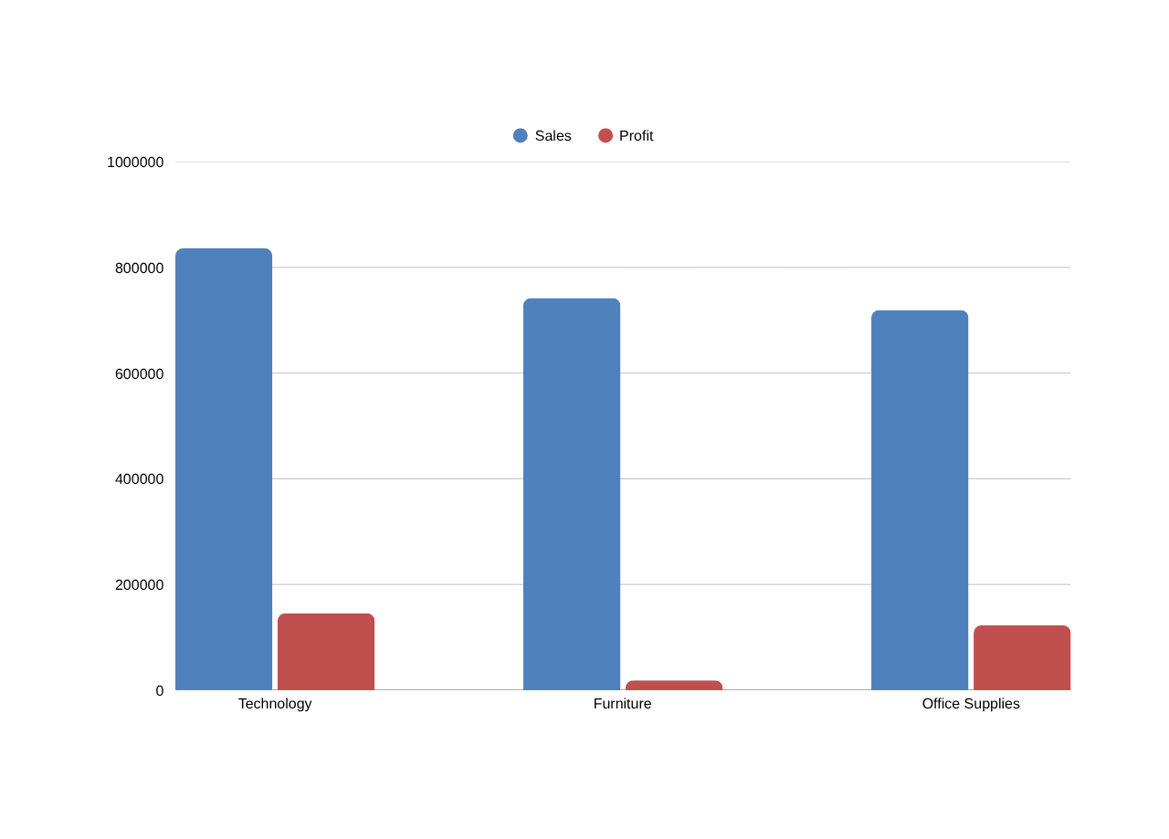
5. Category Performance
Technology is the strongest category by both sales and profit.
Office Supplies has the highest sales volume by quantity.
Furniture generates substantial sales but much lower profit, making it a priority for margin review.
6

Slide 7
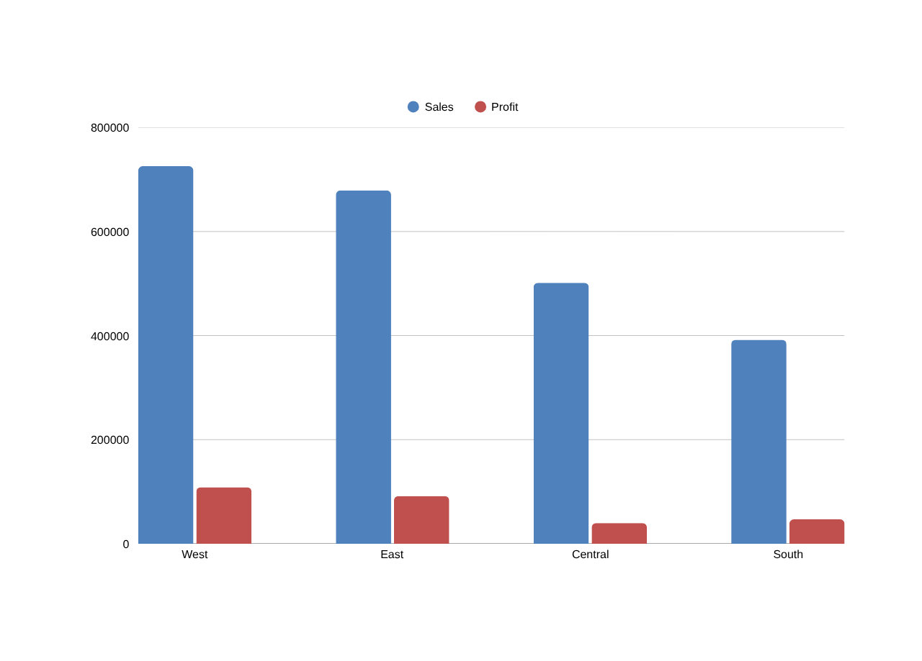
6. Regional Performance
West is the strongest region for both sales and profit.
Central has lower profitability and the highest average discount (24%).
South records the lowest sales and quantity among the four regions.
Regional performance should be evaluated using profit as well as sales.
7

Slide 8
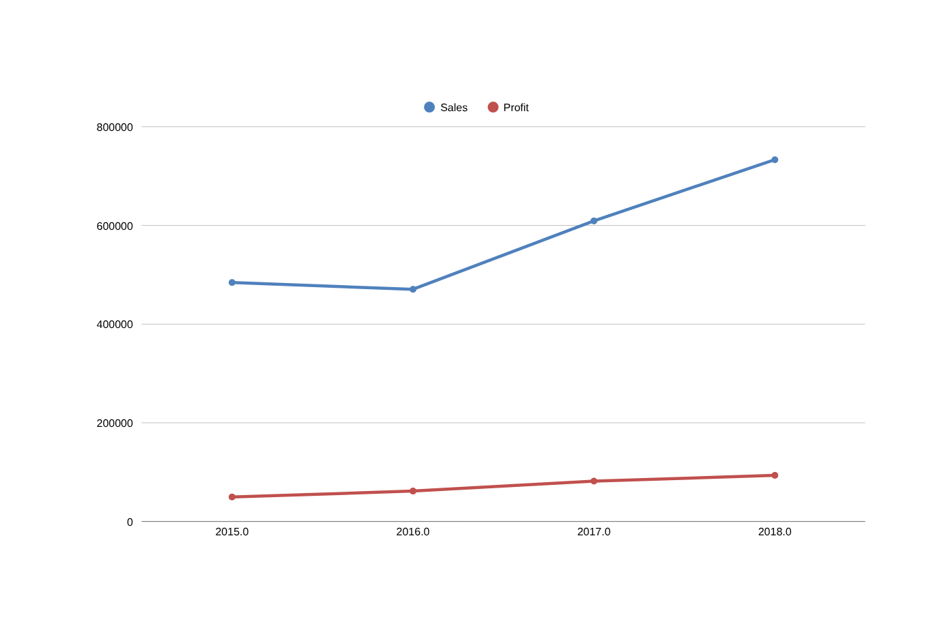
7. Sales & Profit Trend
2016 sales were slightly below 2015, while profit increased.
Sales and profit rose strongly from 2016 onward.
2018 achieved the highest sales and profit in the analyzed period.
The overall long-term trend is positive.
8

Slide 9
8. Power BI Dashboard
Interactive dashboard created in Power BI using the cleaned Superstore dataset.
KPI Cards: Total Sales, Total Profit and Total Quantity.
Visuals: Sales by Category, Profit by Region, Sales Trend by Year and Profit by Category.
Slicers: Year and Region.
The dashboard allows users to filter the business view and compare performance interactively.
Sales
Profit
Quantity
Sales by
Category
Profit by
Region
Sales Trend
by Year
Profit by
Category
9

Slide 10
9. Key Business Insights
Technology is the strongest overall category and should remain a key growth focus.
Furniture has high sales but comparatively low profit, suggesting margin pressure.
West is the strongest region; Central requires closer profitability monitoring.
Business performance improved substantially after 2016, with 2018 the strongest year.
Discount has a negative relationship with Profit; discount-heavy transactions should be monitored.
Outliers are present in Sales, Quantity, Discount and Profit and may represent legitimate high-value or loss-making transactions.
10

Slide 11
10. Recommendations
Review Furniture pricing, product mix and discount levels to improve margins.
Investigate Central-region transactions to understand why profitability is lower.
Expand and promote successful Technology products while monitoring profitability.
Use profit-based KPIs alongside sales KPIs when evaluating categories and regions.
Set clearer discount controls and monitor the profitability of high-discount orders.
Study the practices behind West-region performance and identify strategies that can be replicated elsewhere.
11

Slide 12
Conclusion
The analysis converts raw Superstore transaction data into actionable business information.
Python supported cleaning and EDA, while Power BI provided an interactive dashboard for decision-making.
Thank You
12

