Slide 1

Internship Project Presentation on Analyzing Performance of Different Pre-Trained Models on Pneumonia Detection using X-Ray Images
Presented By:
SANJANA:11201172022

Slide 2
Work Description
Our model presents a comprehensive analysis of the performance of pre-trained Convolutional Neural Networks (CNNs) – ResNet, VGG16, and DenseNet – in detecting pneumonia from X-ray images. The study addresses the critical need for early pneumonia detection, given its significant impact on childhood mortality. The integration of AI-driven models, particularly CNNs, is explored as a revolutionary approach to enhance sensitivity and specificity in pneumonia diagnosis.
The experimental setup involves a dataset of 5,216 X-ray images, meticulously prepared with data augmentation and normalization techniques. Each model is fine-tuned with varying hyperparameters, leading to accuracy ranges between 65.38% and 93.91%. The paper emphasizes the importance of hyperparameter choices in influencing model accuracy.
The presentation will delve into the architecture complexities of ResNet, VGG16, and DenseNet, providing insights into their design and functionality. ResNet's efficient training of deep networks, VGG16's simplicity and versatility, and DenseNet's dense connectivity pattern are highlighted. Additionally, the paper discusses related studies, including transfer learning applications and novel architectures like REF-Net and MFR-DenseNet.
The future scope envisions the integration of pneumonia detection models into telemedicine platforms, AI-assisted radiology processes, cross-disease detection capabilities, and long-term patient health monitoring. The findings contribute to ongoing discussions on leveraging AI in healthcare diagnostics, emphasizing the potential for significant advances in child respiratory health.

Slide 3
Work Outcome
Our model investigates the performance of pre-trained Convolutional Neural Networks (CNNs) – ResNet, VGG16, and DenseNet – in detecting pneumonia from X-ray images, a critical factor in reducing childhood mortality. The study, conducted on a dataset of 5,216 images, carefully explores hyperparameters such as learning rates, momentum, and epochs, while employing data augmentation and normalization techniques.
Results indicate varying accuracies for each model under different conditions, with ResNet achieving 93.91%, VGG16 reaching 90.06%, and DenseNet attaining 93.11%. The research emphasizes the importance of these models in early pneumonia detection, leveraging the power of AI to enhance diagnostic accuracy and speed.
The paper also reviews related studies, highlighting the broader landscape of AI in medical image analysis. The architecture diagrams provide insights into the design strengths of each model, showcasing ResNet's deep training capacity, VGG16's simplicity, and DenseNet's efficient dense connectivity pattern.
In conclusion, the study underscores the potential of AI-driven models to revolutionize pneumonia diagnosis, contributing to the ongoing discourse on integrating AI into healthcare. The research sets the stage for future applications, including telemedicine integration, AI-assisted radiology, cross-disease detection, and long-term patient monitoring, showcasing the promising future of AI in respiratory health diagnostics

Slide 4
Research Paper
Research paper underscores the critical role of early pneumonia detection in reducing childhood mortality, particularly through the utilization of artificial intelligence-driven models such as ResNet, VGG16, and DenseNet. The study's experimental setup involved a meticulous approach, employing a dataset of 5,216 X-ray images with careful data augmentation and normalization techniques. Performance evaluations revealed varying accuracies for each model under different hyperparameter settings.
ResNet exhibited accuracies ranging from 68.91% to 93.91%, with the optimal configuration involving a learning rate of 0.0001, a momentum of 0.9, and 10 training epochs. VGG16 achieved accuracies between 65.38% and 90.06%, with the highest accuracy obtained at a learning rate of 0.0001, a momentum of 0.75, and 10 training epochs. DenseNet demonstrated accuracies from 68.91% to 93.11%, with the most favourable results attained with a learning rate of 0.0001, a momentum of 0.9, and 10 training epochs.
The findings emphasize the importance of thoughtful hyperparameter selection in training these pre-trained CNN models for optimal accuracy. Overall, this study contributes to the advancement of pneumonia detection methodologies and encourages further exploration of AI applications in healthcare diagnostics
https://docs.google.com/document/d/1dI3ViWcZcziHWO6ifT1vixE7stjuMo3G/edit?usp=sharing&ouid=111534381207103211267&rtpof=true&sd=true

Slide 5
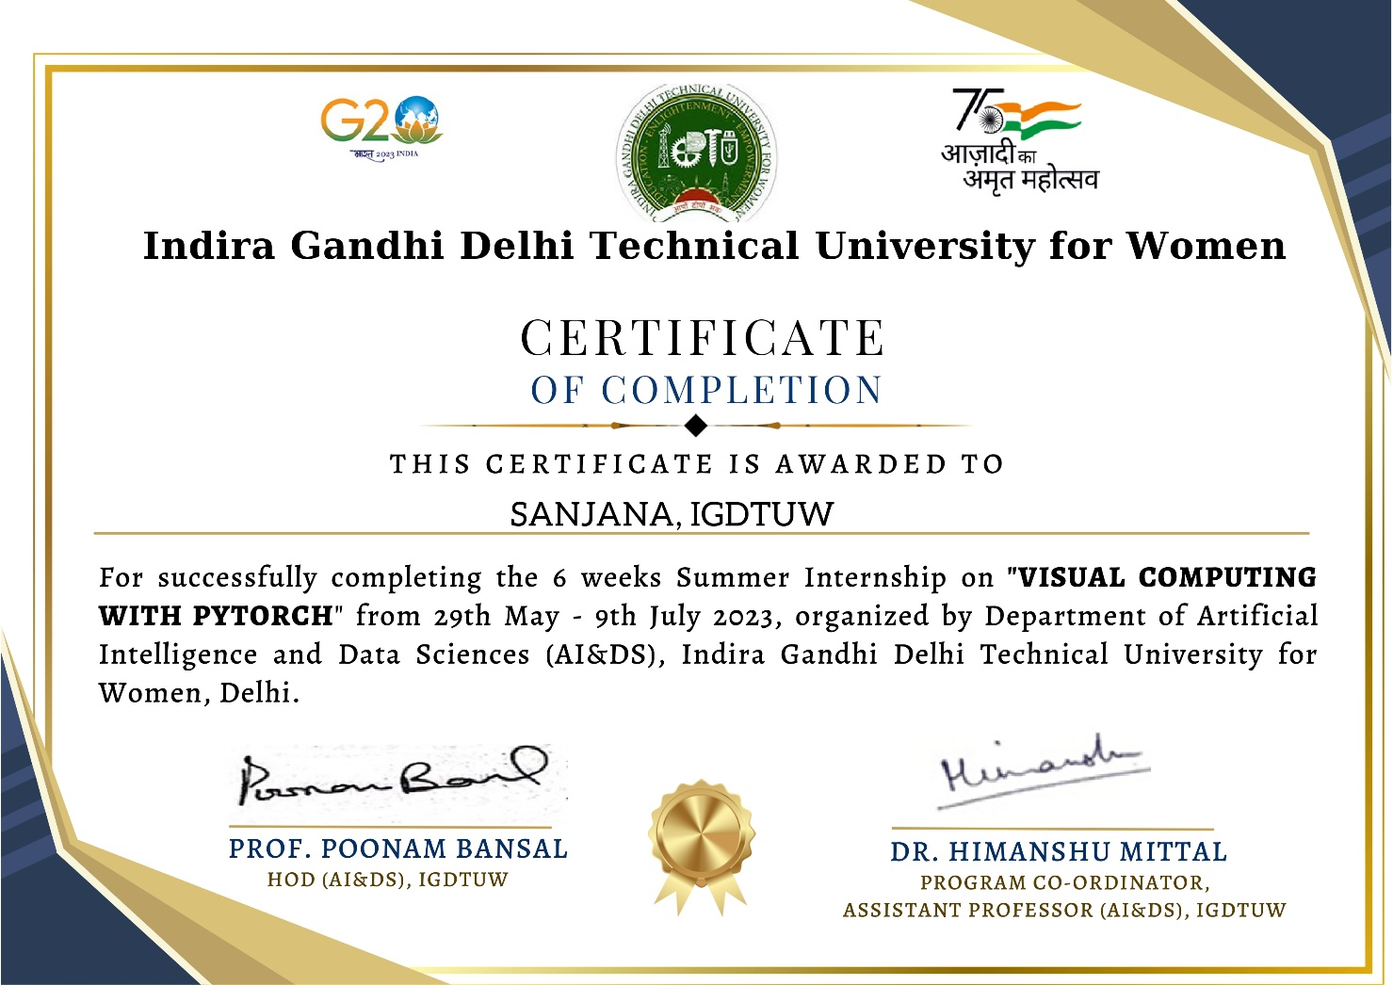
Internship Certificate

