Slide 1
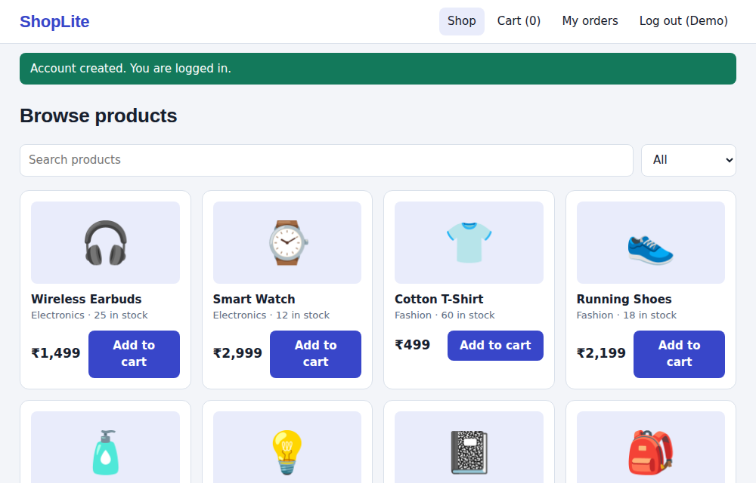
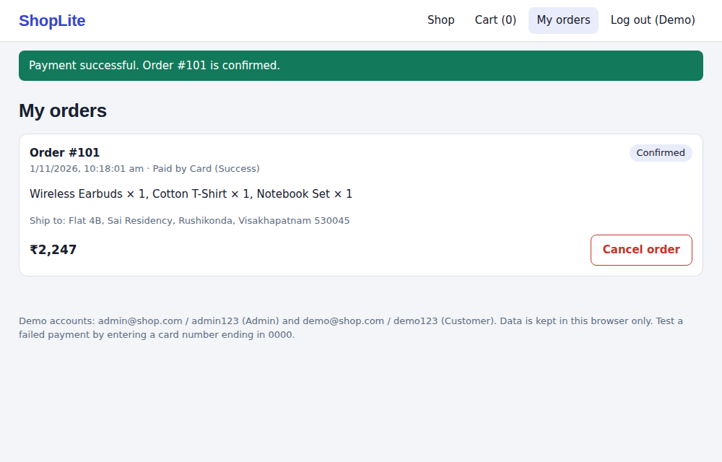
Online Shopping System
UML MINI PROJECT
SANJANA (5241412020)
B.Tech CSE (AI&ML)
Gayatri Vidya Parishad College for Degree and PG Courses (A)
Guide: Ch. Bhanu Kumar, Assistant Professor
Notes:
Good morning. My project is an Online Shopping System, modelled with UML and implemented as a working prototype called ShopLite.

Slide 2
Presentation outline
OUTLINE
1
Abstract
2
Introduction
What the project is about
Problem, objectives and scope
3
Requirements
4
UML Diagrams
Actors, functions, tools
Design of the system
5
Results
6
Conclusion
Implementation, screens, testing
Summary and future scope
Notes:
This is the outline of my presentation.

Slide 3




Abstract
ABSTRACT
Problem
Solution
Buying in shops costs time and relies on manual bills and registers
A web system for browsing, cart, payment and orders, designed with UML
Users
Outcome
Customers shop and pay; admins manage products, orders and users
Working prototype ShopLite, six UML diagrams, 31 of 31 tests passed
Notes:
In short: shopping in person is slow and manual. We built a web shopping system, designed it with UML and implemented a working prototype.

Slide 4



Why this project
INTRODUCTION
Manual billing
Totals and bills written by hand lead to mistakes
No live stock
Customers cannot tell what is available before they visit
One system for products, carts, orders and payments
Fixed hours, limited choice
Shops close and shelves hold only so much
Notes:
Shopping in person costs time and shops depend on manual billing and registers. Our system puts products, carts, orders and payments in one place.

Slide 5
Objectives and scope
INTRODUCTION
Central platform for products, carts, orders and payments
Search products and order without visiting a shop
Automatic totals and stock checks
Card or UPI payment recorded with the order
Admin control of products, orders and users
Design first with UML, then implement
In scope
Login, browse, cart, checkout, payment, orders, admin screens
Future scope
Real gateway, server database, reviews, coupons, notifications
Notes:
These are the objectives. The prototype stores data in the browser and the payment gateway is simulated; those are listed as future scope.

Slide 6


Who uses the system
REQUIREMENTS
Customer
Admin
Register and log in
Browse and search products
Manage the cart
Check out and pay
Track or cancel orders
Log in
Add, edit, remove products
Update stock and prices
Change order status
Block or unblock users
External actor: Payment Gateway
Notes:
There are two actors, customer and admin, and the payment gateway is an external system.

Slide 7





Functional requirements
REQUIREMENTS
Accounts
Catalogue
Cart
Register, log in, role-based screens
Browse, search, filter by category
Add, change quantity within stock
Checkout
Orders
Admin
Address, card or UPI payment
Confirm, cancel, restore stock
Products, orders, users
Notes:
These are the main functional requirements; the full list of twelve is in the report.

Slide 8
Non-functional and tools
REQUIREMENTS
Non-functional
Software and hardware
Security: role-based access, input checks
Usability: clear messages, simple screens
Portability: any modern browser
Maintainability: modular code
Reliability: stock never oversold
HTML5, CSS3, JavaScript
Browser localStorage (JSON)
VS Code with Live Server
IBM Rational Software Architect Designer
Windows 10 / 11, 4 GB RAM
Notes:
Besides the functions, the system must be secure, easy to use, portable and maintainable. The tools are listed on the right.

Slide 9
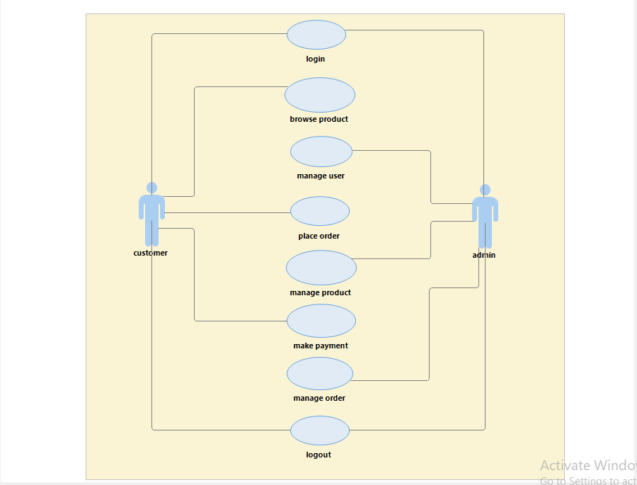
Use case diagram
UML DIAGRAMS
Two actors: Customer and Admin
Customer: browse, place order, make payment
Admin: manage product, order, user
Login and logout shared by both
Notes:
The use case diagram shows login, browse, place order and make payment for the customer, and manage product, order and user for the admin.

Slide 10
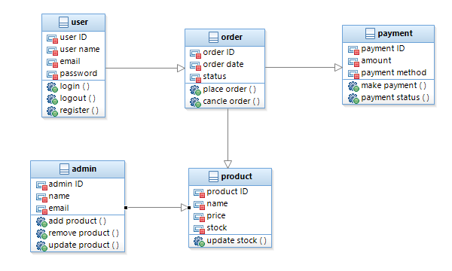
Class diagram
UML DIAGRAMS
Five classes: user, order, payment, product, admin
Attributes and operations in each class
User places orders, order has a payment
Admin manages products
Notes:
The class diagram has five classes: user, order, payment, product and admin, each with attributes and operations.

Slide 11
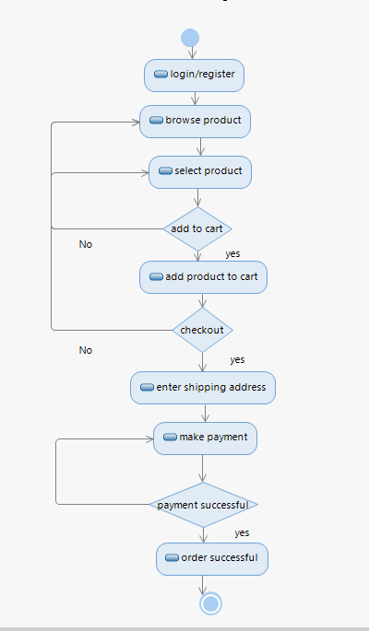
Activity diagram
UML DIAGRAMS
1
Login or register
2
Browse and select a product
3
Add to cart? Checkout?
4
Enter shipping address
5
Make payment, order successful
Notes:
The activity diagram shows login or register, browse and select a product, the add to cart and checkout decisions, shipping address, payment, and the payment successful decision before the order is successful.

Slide 12
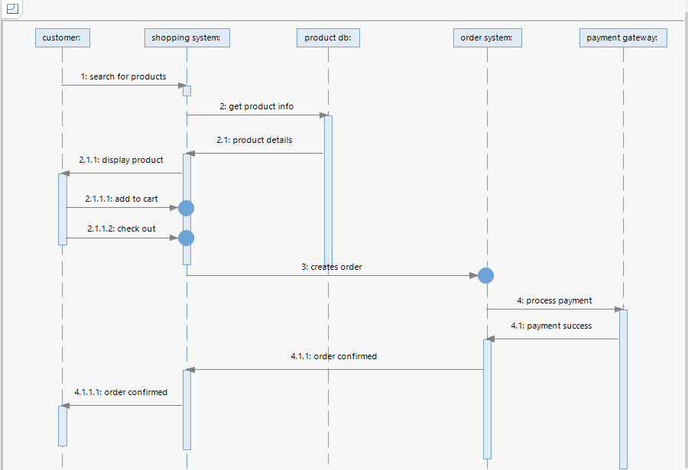
Sequence diagram
UML DIAGRAMS
Five lifelines: customer, shopping system, product DB, order system, payment gateway
Search, add to cart, check out
Create order, process payment, order confirmed
Notes:
The customer searches products, the shopping system gets product info from the product database, the customer adds to cart and checks out, the order is created, and the payment gateway processes the payment and confirms the order.

Slide 13
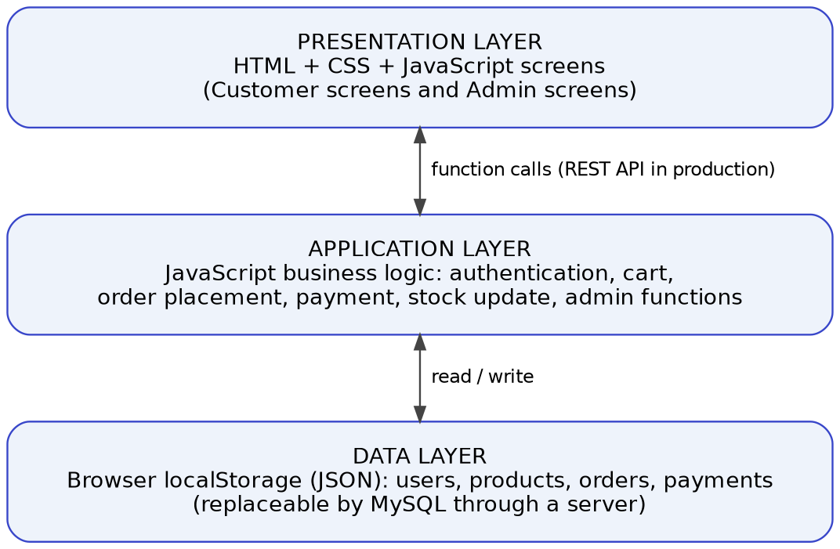
Three-tier architecture
UML DIAGRAMS
Presentation: HTML, CSS, JavaScript screens
Application: login, cart, order, payment, stock rules
Data: browser storage now, MySQL later
Notes:
The presentation, application and data layers. In the prototype the application layer is JavaScript and the data layer is browser storage; production would use a server and MySQL.

Slide 14
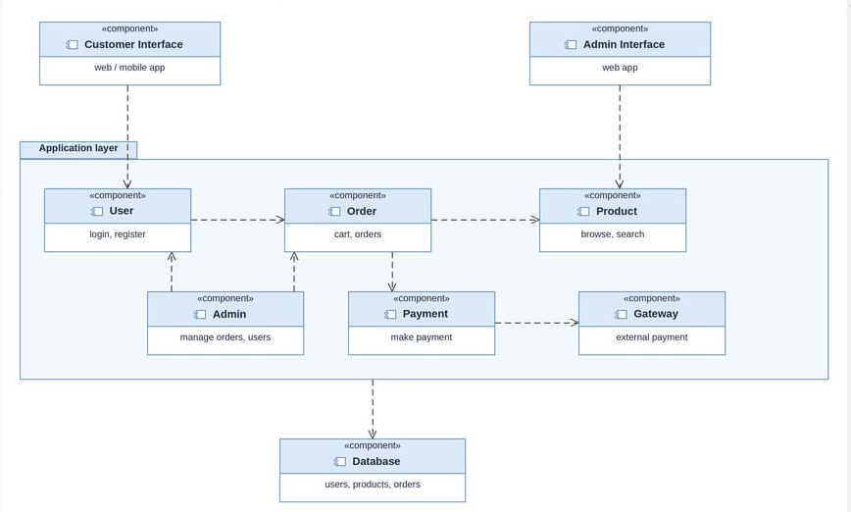
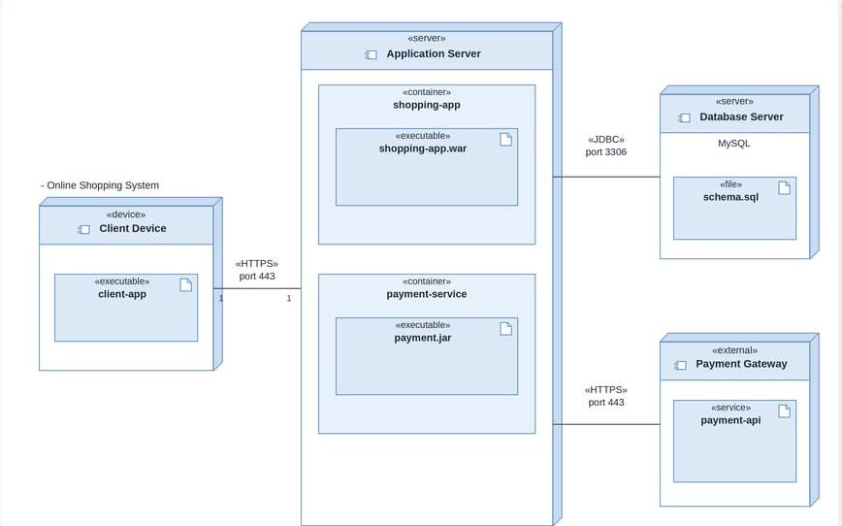
Component and deployment
UML DIAGRAMS
Component diagram
Deployment diagram
Notes:
The component diagram shows the software parts. The deployment diagram shows the client device, application server, database server and the external payment gateway.

Slide 15



Implementation: ShopLite
RESULTS
HTML, CSS, JavaScript
total = sum(price * qty)
if card ends with 0000:
declined, no order
else:
create order
stock = stock - qty
Single-page app, light and dark mode
Browser storage
JSON in localStorage, seeded demo data
Three files
index.html, style.css, app.js
Notes:
ShopLite is a front end prototype in three files. The design was mapped to functions and screens.

Slide 16




How an order is placed
RESULTS
Address
Stock check
Gateway
Create order
Reduce stock
If payment is declined
No order, stock unchanged, cart and address kept
If an order is cancelled
Stock is restored automatically
Notes:
Five steps protect the shop. A declined payment never creates an order, and the cart and address are kept so the customer can retry.

Slide 17
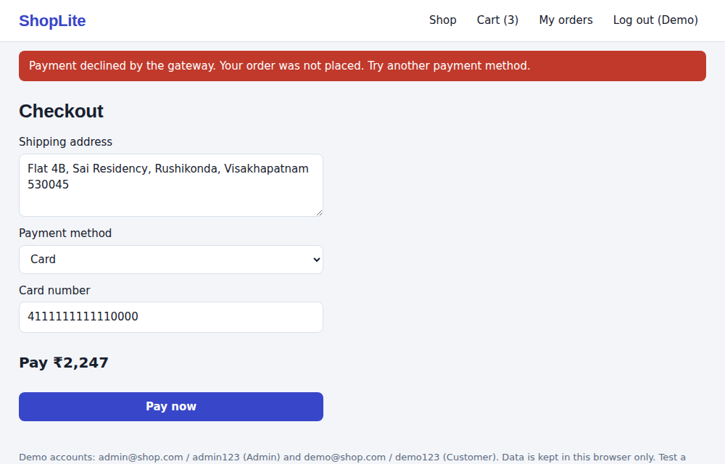
Results: customer screens
RESULTS
Declined payment: no order, address kept
Successful payment: order confirmed
Notes:
A declined payment keeps the cart and address, and a successful payment confirms the order.

Slide 18
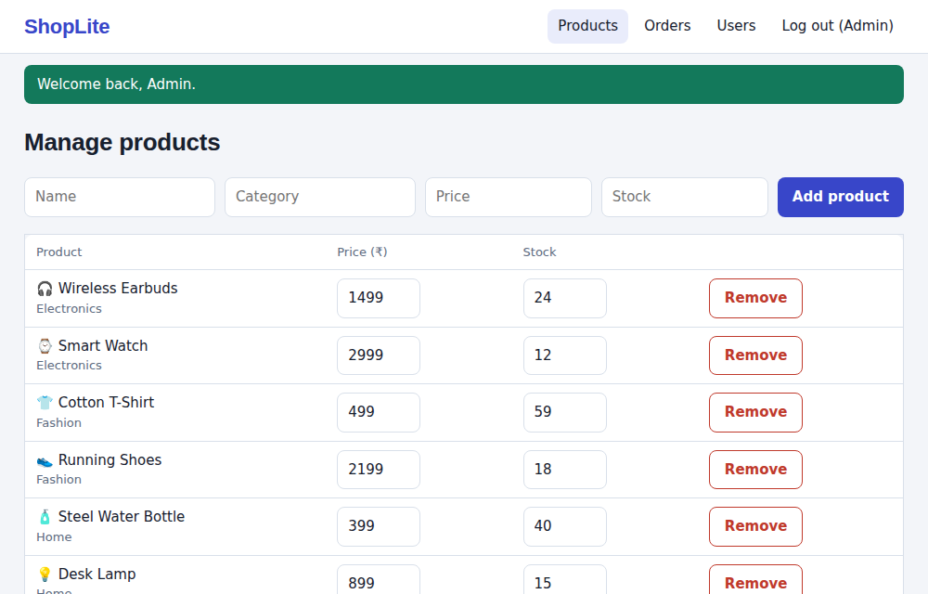
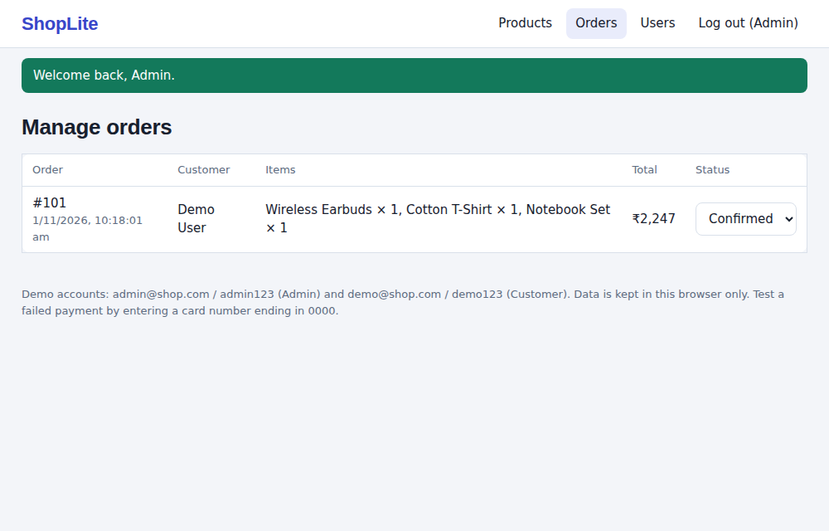
Results: admin screens
RESULTS
Admin: manage products and stock
Admin: update order status
Notes:
The admin manages products and orders.

Slide 19
Testing results
RESULTS
31/31
automated tests passed
Login, cart, payment, orders, admin
Notes:
Thirty one automated tests were run against the application logic and all passed.

Slide 20

Conclusion and future scope
CONCLUSION
What we achieved
Future scope
Six UML diagrams
Working shopping prototype
Stock never oversold
31 of 31 tests passed
Server and MySQL database
Hashed passwords
Real payment gateway
Reviews, coupons, tracking
Notes:
The design was carried into a working system. Next steps are a real server, hashed passwords and a real payment gateway.

Slide 21
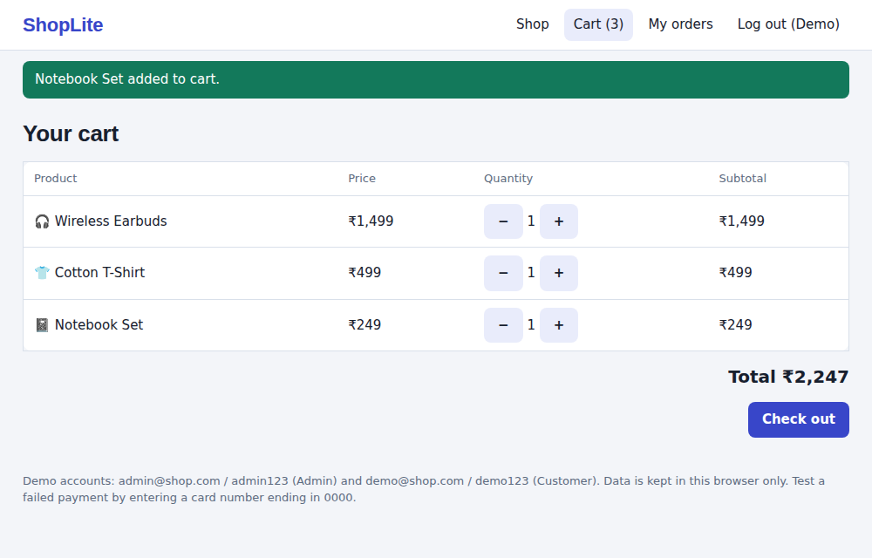
Thank you
Questions?
SANJANA (5241412020)
Notes:
Thank you. I am happy to take questions.

