Slide 1



Team Name : Team Sudarshan
Overnight Hackathon
Saish Ambar
Inika Ranganath Prasad
Sanjana H V
Rohan Mathad

Slide 2



Problem Statement
Title: The ₹70,000 Crore Challenge
The Crisis:
Indian government spends ₹70,000 crores annually on agricultural subsidies
Significant portion never reaches farmers due to systemic fraud
Key Fraud Patterns:
Ghost Farmers: Fake beneficiaries in dealer lists
Over-Claiming: Fertilizer claims exceeding land capacity
Market Diversion: Subsidized goods sold at market prices
Invoice Manipulation: Fake transactions for undelivered goods

Slide 3
Problem Statement
Current Limitations:
Annual manual audits cover only 1-2% of transactions
Multiple intermediaries create opacity
No real-time monitoring or verification
Impact:
Farmers pay market prices despite subsidies
Taxpayer money funds phantom beneficiaries
Undermines agricultural productivity

Slide 4
Proposed Solution
Title: Intelligent Subsidy Integrity Platform
Core Concept:
A real-time fraud detection system that analyses subsidy distribution patterns to identify anomalies and verify beneficiary authenticity.
How It Works:
Data Aggregation: Consolidate farmers, dealers, and transactions data
Real-time Verification: Instant trust scoring during subsidy distribution
Actionable Insights: Flag suspicious entities for investigation
Value Proposition:
For Government: 15-30% reduction in subsidy leakage
For Farmers: Guaranteed access to entitled subsidies
For Dealers: Clean ecosystem, reduced audit burden

Slide 5
Key Features
1. Real-time Fraud Detection
Over-Claiming Analysis: Land size vs. claim quantity correlation
Dealer Anomaly Detection: Statistical outlier identification
2. Interactive Dashboard
Live Monitoring: Real-time transaction tracking
Geographic Heatmaps: District-wise fraud pattern visualization
Risk Scoring: 0-100 trust score for every farmer

Slide 6
Key Features
3. Verification Engine
Multi-factor Authentication: Aadhar, land records, bank account cross-verification
Historical Pattern Analysis: Seasonal claim consistency checks
Alert System: Automated flags for suspicious patterns
4. Reporting & Analytics
Automated Audit Reports: CSV generation of suspicious cases
Trend Analysis: Year-on-year comparison
Predictive Modelling: Forecast potential fraud hotspots
Demo Highlights:
Working prototype with sample data
Real-time trust verification
Interactive visualizations

Slide 7
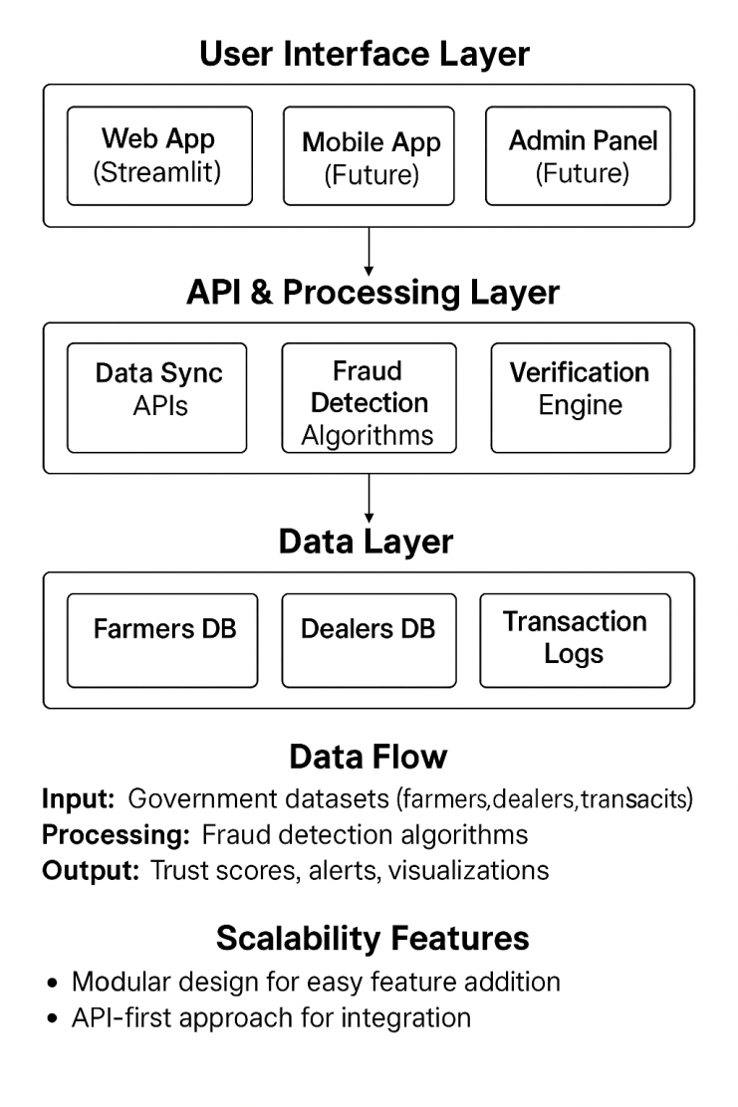
System Architecture
Data Flow:
Input: Government datasets (farmers, dealers, transactions)
Processing: Fraud detection algorithms
Output: Trust scores, alerts, visualizations
Scalability Features:
Modular design for easy feature addition
API-first approach for integration
Cloud-ready architecture

Slide 8
Tech Stack
Frontend:
Streamlit: Rapid web app development
Plotly: Interactive data visualizations
Backend & Data Processing:
Python 3.9+: Core programming language
Pandas: Data manipulation and analysis
Numpy:Data calculation purposes

Slide 9
Tech Stack
Fraud Detection Algorithms
Statistical Analysis: Z-score, standard deviation
Pattern Recognition: Temporal and geographic clustering
Anomaly Detection: Isolation Forest, Local Outlier Factor
Development & Deployment
Git/GitHub: Version control
Why This Stack?
Rapid Prototyping: Streamlit enables quick iterations
Scalability: Python ecosystem supports growth
Cost-effective: Open-source technologies
Maintainable: Clean, modular codebase

Slide 10
Challenges Faced
Challenge 1: Data Integration
Problem: Multiple data formats, missing fields, inconsistent schemas
Solution: Built flexible data loaders with intelligent column matching
Outcome: Single interface for CSV, Excel, and future database sources
Challenge 2: Realistic Sample Data
Problem: No access to real government datasets
Solution: Created synthetic data with embedded fraud patterns
Outcome: Realistic demonstration of detection capabilities
Challenge 3: User Experience
Problem: Making complex analytics accessible to non-technical users
Solution: Intuitive dashboard with visual explanations
Outcome: Clear insights through charts, scores, and simple language

Slide 11
Future Scope
Phase 1
Pilot Program: Implement in one district with real data
Enhanced Algorithms: Add ML models for pattern recognition
Mobile Integration: Field officer app for on-site verification
Phase 2
State-wide Rollout: Scale to multiple districts
Blockchain Integration: Immutable transaction records
API Ecosystem: Integration with banking and land records

Slide 12
Future Scope
Phase 3
National Platform: Pan-India subsidy monitoring
Predictive Analytics: Forecast fraud before it happens
Multi-scheme Support: Expand beyond fertilizers to seeds, equipment
Long-term Vision
Global Applicability: Adapt for other countries' subsidy programs
Farmer Empowerment Portal: Direct benefit transfer interface
Policy Analytics: Data-driven subsidy policy recommendations
Impact Metrics:
Target: 25% reduction in subsidy leakage within 2 years
Goal: 100% beneficiary verification in pilot district
Vision: Transparent, efficient agricultural subsidy ecosystem

Slide 13
Thank You

