Slide 1
Laptop Price Predictor
-Sanjana Nilesh Kakad
BE ELECTRONICS

Slide 2
Content :-
Overview of AI & ML
Problem Statement
Exploratory data analysis
Tools involved in data gathering
Algorithm
Conclusion

Slide 3
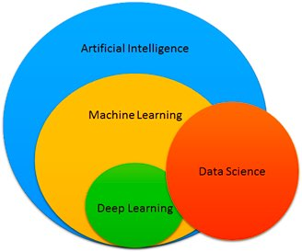
Overview of AI & ML

Slide 4

Problem statement
If any user wish to purchase a laptop then the application designed by us should provide a tentative price of laptop according to the user configuration.

Slide 5
Exploratory data analysis
EDA involves Univariate, Bivariate, or Multivariate analysis.Exploratory analysis is a process to explore and understand the data and data relationship.
We will start from the first column and explore each column and understand what impact it creates on the target column.
At the required step, we will also perform preprocessing and feature engineering tasks. our aim in performing in-depth EDA is to prepare and clean data.

Slide 6
Distribution of target column
The distribution of the target variable is skewed and it is obvious that commodities with
low prices are sold and purchased more than the branded ones.

Slide 7
Company column
Now if we plot the company relationship with price then you can observe that how price varies with different brands. Razer, Apple, LG, Microsoft, Google, MSI laptops are expensive, and others are in the budget range.

Slide 8
3. Type of laptop
Which type of laptop you are looking for like a gaming laptop, workstation, or notebook. As major people prefer notebook because it is under budget range and the same can be concluded from our data.

Slide 9
4. Price variation with laptop size in inches
A Scatter plot is used when both the columns are numerical and it answers our question in a better way. From the below plot we can conclude that there is a relationship but not a strong relationship between the price and size column.

Slide 10
Tools involved in data gathering
requirements
Create a file named requirements.txt. It is a text file that contains the name and version of a library that you have used to create your project. we need to define the libraries used to cloud so that when we deploy it creates a complete setup by installing required files. If you do not specify the version then it will install the current updated version of the library. we have used only four libraries for creating streamlit apps. :- streamlit, sklearn, numpy, pandas .
2. Procfile
Create a file name Procfile which is an initiator file for Heroku. It only contains one line of code that says which file to run or it simply runs your python file.
web: sh setup.sh && streamlit run app.py

Slide 11
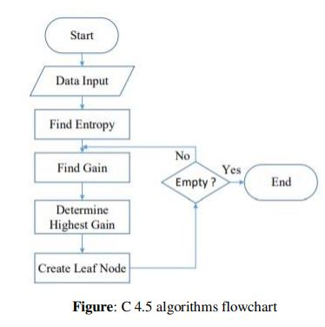
Algorithm

Slide 12
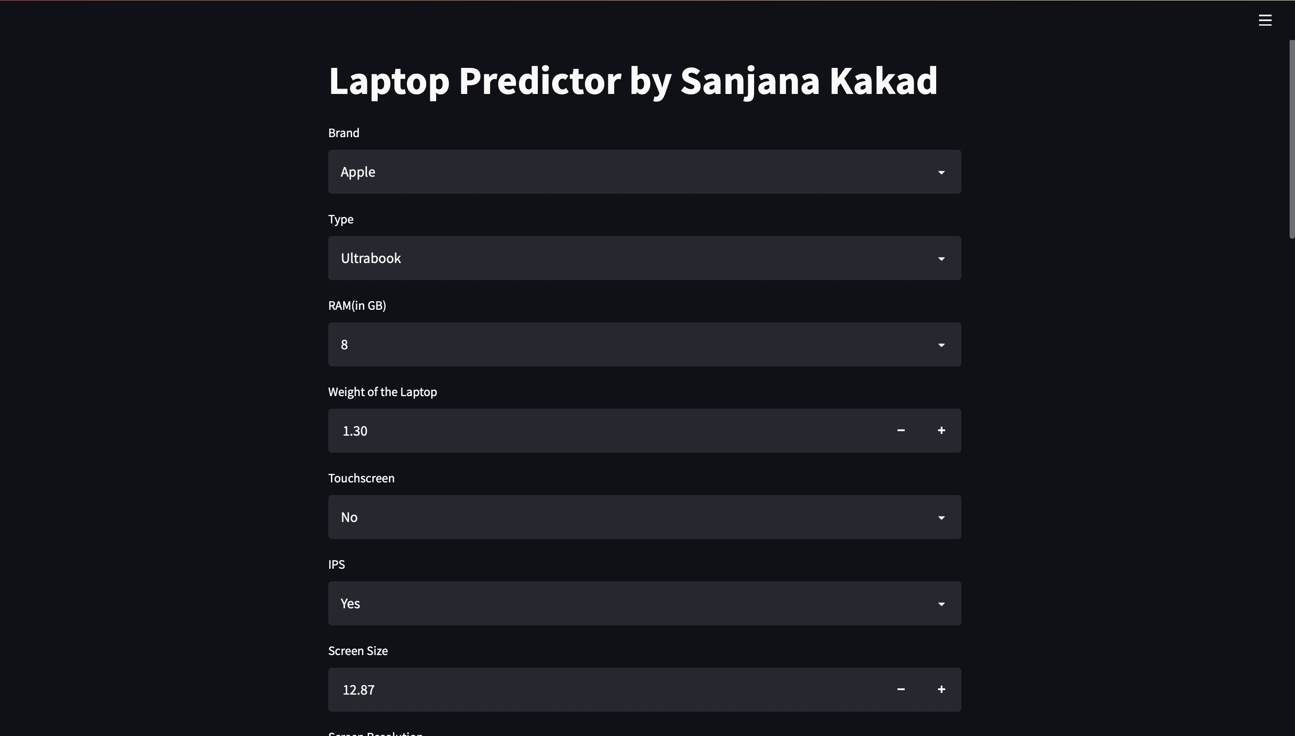
Result

Slide 13
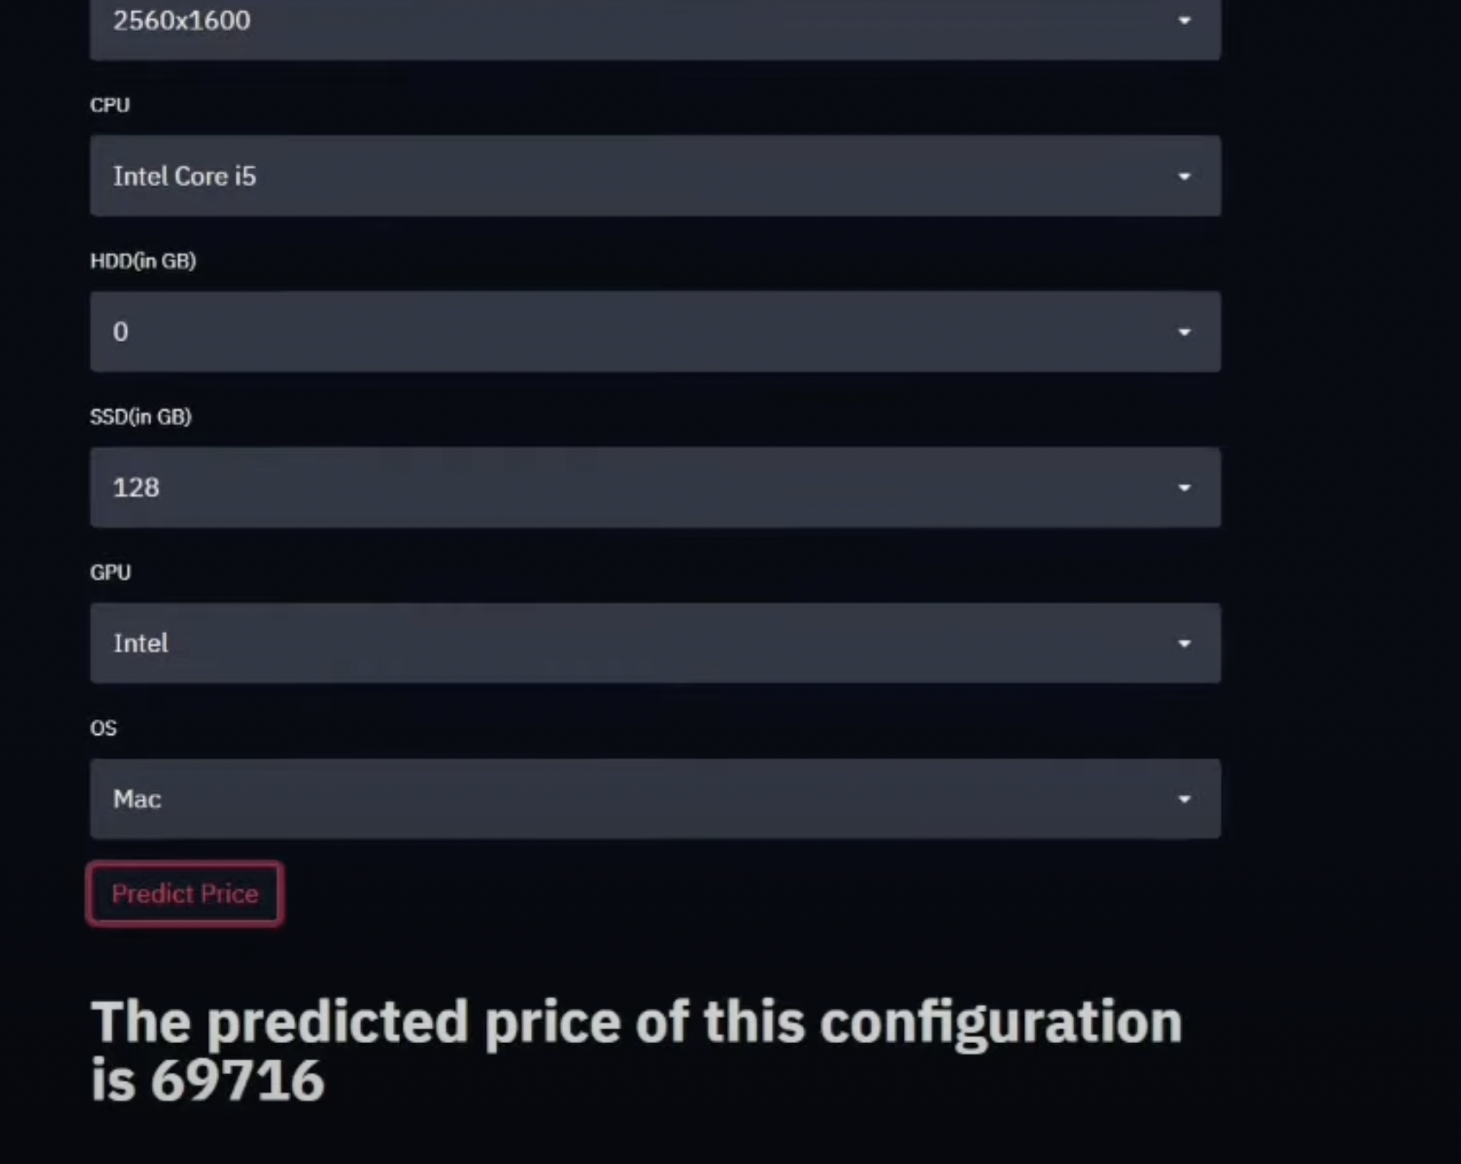

Slide 14
Conclusion
Predicting something through the application of machine learning using the Decision Tree algorithm makes it easy for students, especially in determining the choice of laptop specifications that are most desirable for students to meet student needs and in accordance with the purchasing power of students. Students no longer need to look for various sources to find laptop specifications that are needed by students in meeting the needs of students, because the laptop specifications from the results of the machine learning application have provided the most desirable specifications with their prices of laptops.

