Slide 1
TITLE
NAME:SANJANA SUBHASH KAMBLE
COLLEGE NAME:ABASAHEB GARWARE COLLEGE
PROJECT:Secure File Transfer Monitoring System
SUBJECT-CYBERSECURITY
TYBSC-COMPUTER SCIENCE
ROLLNO:13389
ACADEMIC YEAR:2025-2026

Slide 2
INDEX
Sr. No. | Title
1 | Introduction
2 | Project Overview
3 | Objectives of the Project
4 | Practical Motivation
5 | Scope of the Project
6 | System Requirements
7 | Technology Used
8 | Module Description
9 | Working of the System
10 | Program Code Overview
11 | Sample Output
12 | Advantages
13 | Limitations
14 | Applications
15 | Future Enhancements
16 | Conclusion
17 | References

Slide 3
1.Introduction
In today’s digital environment, files are constantly created, modified, transferred, and deleted. Unauthorized file access or movement can lead to data leakage, malware spread, and security breaches.
This project implements a Secure File Transfer Monitoring System using Python that continuously monitors a specified directory and records all file-related activities. It also detects sensitive file access and generates alerts for security auditing.
An important feature of this system is the monitoring of sensitive directories. Files located in these directories usually contain confidential or critical information. Any activity related to such files triggers an alert, allowing administrators to take immediate action. Additionally, the system maintains a log file that records all detected events, creating a reliable audit trail that can be used for security analysis and compliance purposes.
The Secure File Transfer Monitoring System is useful in various environments such as corporate offices, educational institutions, malware analysis labs, and secure data handling systems. Although the project is console-based, it demonstrates core concepts of file system monitoring, security auditing, and integrity verification. This project provides a strong foundation for understanding how automated monitoring tools can enhance data security and can be further extended with advanced features in future.
A Secure File Transfer Monitoring System is designed to observe and record all file-related operations occurring within a specific directory. Instead of relying on manual supervision, this system provides automated, real-time monitoring of file system activities. It ensures that every important action such as file creation, modification, deletion, or movement is detected and logged for future reference.
In the modern digital world, data is one of the most valuable assets for individuals and organizations. Files containing important information are constantly created, modified, shared, transferred, and deleted on computer systems. However, this continuous movement of files also increases the risk of data theft, unauthorized access, accidental deletion, malware infection, and insider misuse. Therefore, monitoring file activities has become a critical requirement in maintaining system security.

Slide 4
2. Project Overview
The Secure File Transfer Monitoring System is a Python-based application that monitors a directory in real time and logs file system events such as:
File creation
File modification
File deletion
File movement
Additionally, the system:
Generates SHA-256 hash values to ensure file integrity
Detects activities inside sensitive directories
Maintains a detailed log file for auditing purposes

Slide 5
3. Objectives of the Project
To monitor file activities in real time
To detect unauthorized file transfers
To maintain file integrity using hashing
To generate alerts for sensitive file operations
To provide a security audit trail through logging

Slide 6
4.Objective of Project
To monitor file activities in real time
To detect unauthorized file transfers
To maintain file integrity using hashing
To generate alerts for sensitive file operations
To provide a security audit trail through logging

Slide 7
5.Pratical Motivation
Organizations need to track file movement to prevent data loss
Sensitive files must be monitored for unauthorized access
Manual monitoring is inefficient and error-prone
Automated monitoring improves security, accountability, and compliance

Slide 8
6.Scope of Project
6.1 In-Scope
Monitor directories and subdirectories
Detect file creation, modification, deletion, and movement
Generate SHA-256 hash of files
Log all events into a log file
Identify sensitive file operations

Slide 9
6.2Out of Scope
Network-based file transfer monitoring
User authentication system
Encryption of files
Graphical User Interface (GUI)

Slide 10
7.System Requirements
7.1 Hardware Requirement.
Processor: Intel i3 or above
RAM: Minimum 4 GB
Storage: Minimum 10 GB free space.
7.2Software Requirements.
Operating System: Windows 10 / 11
Python Version: Python 3.13.2.
Python Libraries:
watchdog
hashlib
logging
time

Slide 11
8.Technology Used
Technology | Purpose
Python | Core programming language
Watchdog | File system monitoring
Hashlib | File integrity hashing
Logging | Event logging
Windows OS | Execution platform

Slide 12
9.Module Description
9.1 Directory Monitoring Module
Uses the watchdog Observer to monitor file system events in real time.
9.2 Event Handling Module
Handles events such as:
on_created
on_modified
on_deleted
on_moved

Slide 13
9.3 Hashing Module
Generates SHA-256 hash values for files to detect content changes.
9.4 Logging Module
Stores all activities in a log file for future auditing.
9.5 Sensitive File Detection Module
Identifies file activities occurring inside sensitive directories and raises alerts.

Slide 14
10. Working of the System
User defines a directory to monitor
The Observer starts monitoring the directory
When a file event occurs:
Event handler captures the event
Hash is generated (if applicable)
Event is logged
Alert is generated for sensitive files
The system runs continuously until stopped by the user

Slide 15
11.Program Code (Main Logic Overview)
Observer() watches the directory
FileSystemEventHandler handles file events
SHA-256 hash ensures file integrity
Logging records all actions

Slide 16
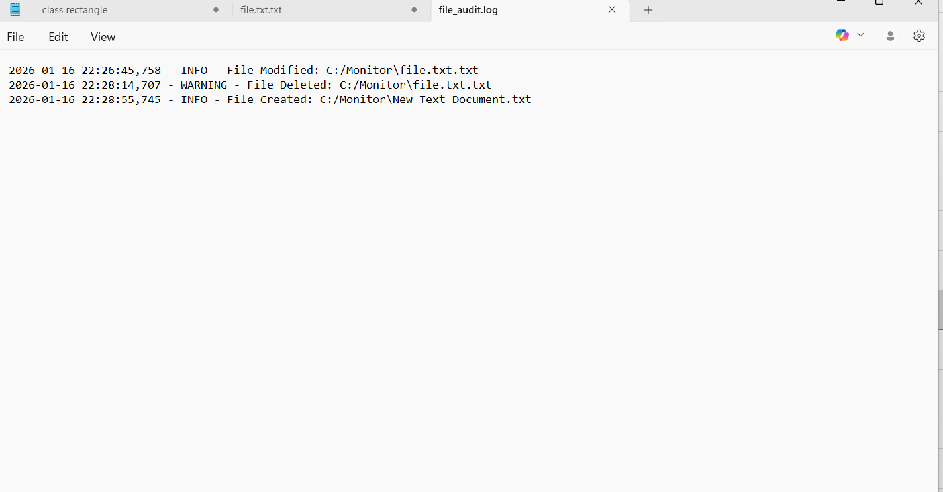
12.Sample Output

Slide 17
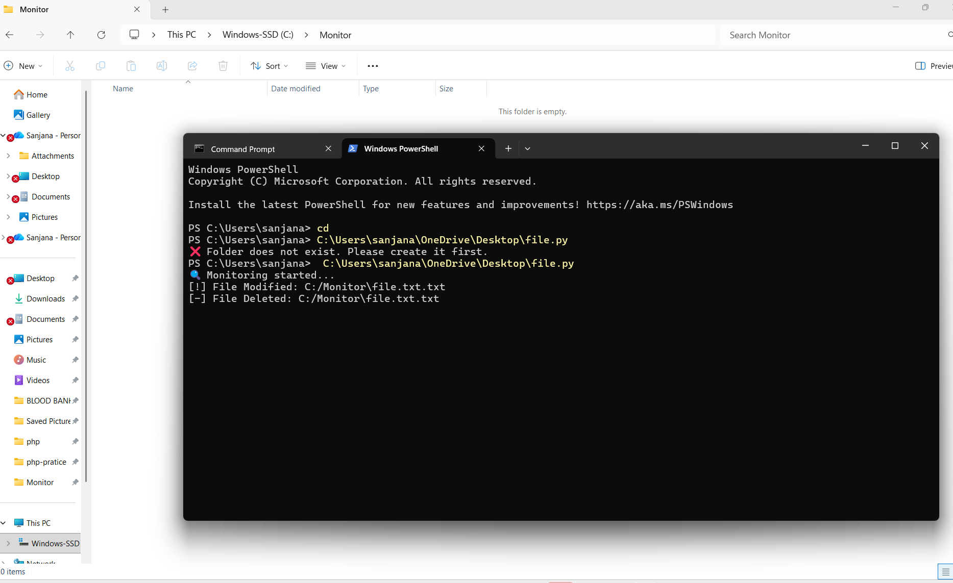
12.1 Result/Sample Output.

Slide 18
13. Advantages of the System
Real-time monitoring
Improves data security
Detects unauthorized file movement
Maintains audit logs
Easy to implement and use

Slide 19
14.Limitations
No graphical interface
Monitors only local directories
Does not block file operations, only detects them

Slide 20
15. Applications
Corporate data security
Academic institutions
Malware analysis environments
Secure document handling systems
File auditing and compliance monitoring

Slide 21
16.Future Enhancements
Add email or SMS alerts
Implement GUI interface
Integrate database for log storage
Add encryption verification
Support network file monitoring

Slide 22
17.Conclusion
The Secure File Transfer Monitoring System successfully demonstrates how Python can be used to monitor file system activities in real time. By using watchdog, hashing, and logging mechanisms, the system ensures file integrity, detects sensitive file operations, and maintains a reliable audit trail. This project is effective for improving data security and monitoring file transfers in a controlled environment.
The Secure File Transfer Monitoring System developed using Python 3.13.2 successfully achieves its objective of monitoring file system activities in real time. The system continuously observes a specified directory and records all important file events such as file creation, modification, deletion, and movement, ensuring complete visibility of file operations.
By integrating the Watchdog library, the project efficiently captures file system changes without manual intervention. The use of SHA-256 hashing ensures file integrity by detecting even minor modifications in file content. This helps in identifying unauthorized changes and potential security threats. Additionally, the system identifies operations performed on sensitive directories and generates alerts, making it useful for protecting confidential data.
The logging mechanism plays a vital role by maintaining a permanent audit trail of all file activities. These logs can be used for security analysis, compliance verification, forensic investigation, and troubleshooting. The project demonstrates how simple yet powerful Python modules can be combined to build a practical and effective security monitoring tool

