Slide 1
TITLE
NAME:SANJANA SUBHASH KAMBLE
COLLEGE NAME:ABASAHEB GARWARE COLLEGE
PROJECT:Payload_Encoding_Framework
SUBJECT-CYBERSECURITY
TYBSC-COMPUTER SCIENCE
ROLLNO:13389
ACADEMIC YEAR:2025-2026

Slide 2
index
Sr. No. | Title
1 | Introduction
2 | Project Overview
3 | Objectives of the Project
4 | Practical Motivation
5 | Scope of the Project
6 | System Requirements
7 | Technology Used
8 | Module Description
9 | Working of the System
10 | Program Code Overview
11 | Sample Output
12 | Advantages
13 | Limitations
14 | Applications
15 | Future Enhancements
16 | Conclusion
17 | References

Slide 3
1.Introduction
In today’s cybersecurity landscape, security systems such as Antivirus, Firewalls, Intrusion Detection Systems (IDS), and Endpoint Detection & Response (EDR) solutions detect malicious payloads using signature-based and behavior-based detection techniques. However, attackers often use encoding and obfuscation techniques to bypass these detection mechanisms.
The Payload Encoding Framework is designed to study how offensive payloads are transformed into encoded or obfuscated formats to evade detection. This project demonstrates how different encoding techniques alter payload structure while maintaining functionality. The purpose is educational and defensive — to understand attacker techniques and improve security solutions
The main goal is not to create malware, but to understand:
How encoding techniques work
How attackers evade detection
How defenders can improve security mechanisms
This project focuses on defensive research and cybersecurity awareness.

Slide 4
2. Project Overview
The Payload Encoding Framework is a practical cybersecurity project that:
Takes a sample payload as input.
Applies different encoding techniques.
Generates encoded output.
Demonstrates how encoding changes payload signatures.
Helps analyze detection evasion methods.
The framework allows experimentation with multiple encoding schemes such as Base64, XOR encoding, Hex encoding, URL encoding, and custom obfuscation methods.
The framework is modular in structure, allowing different encoding methods to be implemented and tested independently. It provides:
A user input system for entering sample payloads.
Multiple encoding techniques applied to the same payload.
Comparison between original and transformed payload.
Output display for analysis.
Reversibility testing to ensure encoded payload integrity

Slide 5
3. Objectives of the Project
To improve understanding of red team techniques for defensive research.
1. Educational Objective
To provide hands-on understanding of encoding and obfuscation.
To bridge theoretical cybersecurity concepts with practical implementation.
2. Technical Objective
To implement various encoding techniques such as:
Base64 Encoding
Hex Encoding
XOR Encoding
URL Encoding
Custom string obfuscation
To design a modular and scalable framework structure.

Slide 6
4. Practical Motivation
Modern security tools rely heavily on signature-based detection. If a payload is slightly modified, encoded, or obfuscated, traditional detection methods may fail.
This project helps:
Students understand real-world attack techniques.
Security researchers analyze detection bypass strategies.
Developers improve malware detection systems.
Ethical hackers simulate evasion techniques in lab environments.
This project helps:
Cybersecurity students understand real-world evasion
Security researchers test detection mechanisms
Developers design stronger defense systems

Slide 7
5. Scope of the Project
Implement encoding algorithms.
Provide command-line interface.
Compare encoded outputs.
Analyze detection evasion conceptually.
Work in controlled lab environment (Kali Linux / Windows).
Limitations:
Not a real exploitation tool.
For educational and research purposes only.
The framework includes:
Basic encoding techniques
Multiple layered encoding
Payload transformation
Obfuscation methods
Logging and output comparison
Out of Scope:
Real malware creation
Exploit development
Illegal usage

Slide 8
6. System Requirements
Hardware Requirements
Minimum 4GB RAM
20GB Free Disk Space
Intel i3 or above processor
Software Requirements
Windows 10+
Python 3.x
Terminal
Basic command-line knowledge
Optional Tools:
Wireshark (for analysis)
VirusTotal (for detection comparison)
VirtualBox for lab setup

Slide 9
7. Technology Used
Programming Language: Python
Platform: Kali Linux / Windows CMD
Libraries Used:
base64
hashlib
os
argparse
Virtual Machine for safe testing

Slide 10
8. Module Description
1. Input Module
Accepts payload from user.
2. Encoding Module
Applies encoding algorithms:
Base64 Encoding
Hex Encoding
XOR Encoding
URL Encoding
3. Obfuscation Module
Applies:
String manipulation
Character replacement
Randomization
4. Output Module
Displays encoded payload.
5. Comparison Module
Compares original and encoded payload length & structure.

Slide 11
9. Working of the System
User provides payload.
System selects encoding method.
Encoding algorithm transforms payload.
Encoded output is generated.
User can decode to verify integrity.
Flow:
Input → Encoding Algorithm → Encoded Payload → Output

Slide 12
10. Program Code Overview
import base64
payload = input("Enter payload: ")
encoded = base64.b64encode(payload.encode())
print("Encoded Payload:", encoded.decode())
def xor_encode(data, key):
return ''.join(chr(ord(c) ^ key) for c in data)
payload = input("Enter payload: ")
key = 5
encoded = xor_encode(payload, key)
print("XOR Encoded:", encoded)

Slide 13
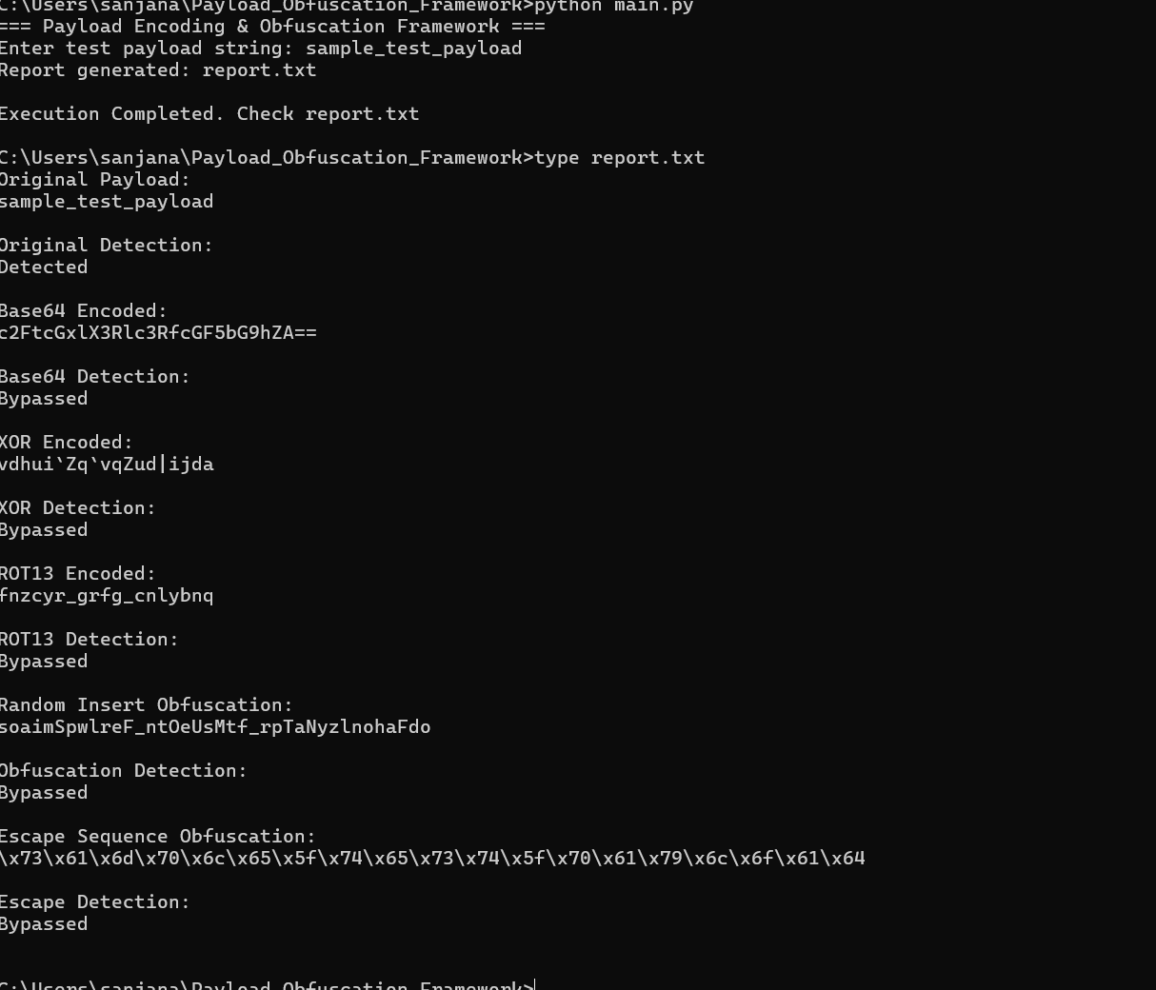
11. Sample Output

Slide 14
12. Advantages
Easy to understand encoding techniques.
Practical hands-on learning.
Improves cybersecurity knowledge.
Modular and extendable.
Helps understand detection evasion.
Educational cybersecurity tool
Modular design
Easy to extend
Safe research-based implementation

Slide 15
13. Limitations
1. Limited to Basic Encoding
The framework includes only basic encoding techniques and does not implement advanced cryptographic or polymorphic methods.
2. Does Not Guarantee Real-World Bypass
Modern security systems use machine learning and behavioral analysis. Simple encoding alone may not bypass advanced detection systems.
3. No Real Exploit Integration
The framework does not generate real exploit payloads. It works with sample text-based payloads only.
4. Controlled Environment Requirement
The system must be used in a lab or virtual machine environment. It should not be used irresponsibly.
5. No Automated Detection Analysis
The project does not automatically test payloads against live antivirus engines.
6. Performance Constraints
Large payloads may require additional optimization.
7. Legal and Ethical Boundaries
The project must be used strictly for educational and defensive research purposes.

Slide 16
14.Applications
1. Limited to Basic Encoding
The framework includes only basic encoding techniques and does not implement advanced cryptographic or polymorphic methods.
2. Does Not Guarantee Real-World Bypass
Modern security systems use machine learning and behavioral analysis. Simple encoding alone may not bypass advanced detection systems.
3. No Real Exploit Integration
The framework does not generate real exploit payloads. It works with sample text-based payloads only.
4. Controlled Environment Requirement
The system must be used in a lab or virtual machine environment. It should not be used irresponsibly.
5. No Automated Detection Analysis
The project does not automatically test payloads against live antivirus engines.
6. Performance Constraints
Large payloads may require additional optimization.
7. Legal and Ethical Boundaries
The project must be used strictly for educational and defensive research purposes

Slide 17
15. Future Enhancements
Add GUI interface
Add AES encryption module
Add detection comparison module
Integrate with sandbox
Add polymorphic engine
Add payload mutation engine
Add automatic encoding randomizer

Slide 18
16. Conclusion
The Payload Encoding and Obfuscation Framework successfully demonstrates how encoding techniques can transform the structure of a payload while preserving its functionality. Through implementation of multiple encoding methods, the project highlights how signature-based detection systems can be challenged by simple transformations.
This project emphasizes the importance of moving beyond traditional signature-based detection toward behavioral and heuristic-based security solutions. By understanding attacker methodologies, cybersecurity professionals can better design stronger defensive systems.
Overall, the project:
Strengthens practical cybersecurity knowledge.
Demonstrates real-world evasion concepts in a safe lab setup.
Encourages research into advanced detection technologies.
Bridges the gap between offensive techniques and defensive improvements.
The framework serves as a foundation for further research into encryption, polymorphism, automated detection comparison, and AI-based security analysis.
.

Slide 19
17.REFERENCES
Python Official Documentation
OWASP Security Documentation
MITRE ATT&CK Framework
Cybersecurity research papers
Ethical hacking study materials

