Slide 1
Index
Sr. No. | Title
1 | Introduction
2 | Project Overview
3 | Objectives of the Project
4 | Practical Motivation
5 | Scope of the Project
6 | System Requirements
7 | Technology Used
8 | Module Description
9 | Working of the System
10 | Program Code Overview
11 | Sample Output

Slide 2
1.Introduction
In the modern digital era, computer networks and information systems play a vital role in daily operations of organizations, educational institutions, businesses, and individuals. With the rapid growth of internet usage and network-connected devices, the risk of cyber threats such as unauthorized access, malware attacks, data breaches, and file tampering has significantly increased.
Cybersecurity is the practice of protecting systems, networks, and data from digital attacks. Organizations use various security mechanisms such as firewalls, intrusion detection systems (IDS), antivirus software, and monitoring tools to safeguard their infrastructure. However, many advanced security tools are expensive and require specialized operating systems like Kali Linux.
SentinelShield is a basic cybersecurity monitoring system developed using Python to demonstrate fundamental security concepts such as:
Network scanning
Intrusion detection
File integrity monitoring
Log generation and analysis
The main objective of this project is to design and implement a simple, lightweight, and cost-effective monitoring system that can run on a Windows operating system using Command Prompt (CMD). Unlike many cybersecurity tools that require Linux-based environments, this project proves that basic security monitoring can also be implemented effectively in a Windows environment.
The system continuously monitors the local network to detect active devices and identifies unauthorized systems connected to the network. I

Slide 3
2.Project Overview
SentinelShield is a security monitoring system that:
Scans devices connected to a network
Monitors system activities
Detects suspicious IP addresses
Logs detected activities
Alerts users about possible threats
The project is implemented using Python and executed through Windows CMD

Slide 4
3.Objectives of the Project
Primary Objectives:
To develop a simple intrusion detection system
To implement network scanning using Python
To monitor file changes in real time
To generate logs for tracking suspicious activities
To understand cybersecurity fundamentals
Secondary Objectives:
To work with Windows CMD environment
To use Python libraries for security applications
To gain hands-on experience in cybersecurity tools development

Slide 5
4.Pratical Motivation
The motivation behind developing SentinelShield includes:
Increasing cybercrime cases worldwide
Need for basic security tools in small organizations
High cost of commercial security software
Educational need for practical cybersecurity implementation
Understanding how intrusion detection systems work
This project helps students understand the practical working of monitoring systems without needing advanced penetration testing tools.

Slide 6
5.Scope of the Project
Current Scope:
Detect active devices in local network
Monitor file creation, deletion, modification
Log suspicious events
Provide command-line alerts
Educational Scope:
Useful for academic projects
Helps understand ARP scanning
Demonstrates file system event handling
Introduces logging and hashing techniques
Future Scope:
Can be converted into full IDS (Intrusion Detection System)
Can be integrated with database
Can support cloud monitoring
Can include automatic blocking mechanism

Slide 7
6. System Requirements
Hardware Requirements:
Processor: Intel i3 or higher
RAM: Minimum 4GB
Hard Disk: 20GB free space
Software Requirements:
Windows 10/11
Python 3.x
CMD (Command Prompt)
Python libraries:
scapy
watchdog
hashlib
logging
argparse
os
time

Slide 8
7. Technology Used
Technology | Purpose
Python | Main programming language
Scapy | Network scanning
Watchdog | File monitoring
Hashlib | File integrity checking
Logging | Event recording
CMD | Execution environment

Slide 9
8.Module Description
1.Network Scanning Module
This module:
Sends ARP requests to IP range
Identifies active devices
Displays IP and MAC addresses
Detects unknown devices
Working:
Uses Scapy library
Broadcasts ARP packets
Receives response packets
Extracts device information
2. File Monitoring Module
This module:
Monitors specific directory
Detects file creation
Detects file deletion
Detects file modification
Working:
Uses Watchdog Observer
Tracks file system events
Triggers event handler

Slide 10
3.Hashing Module
This module:
Generates hash value of file
Detects file tampering
Compares old and new hash values
Working:
Uses hashlib (SHA-256)
Calculates file fingerprint
Detects integrity change
4.Logging Module
This module:
Stores suspicious activities
Records date and time
Maintains security history
Working:
Uses Python logging library
Saves data into log file (.log)

Slide 11
9. Working of the System
User opens Command Prompt
Navigates to project folder
Runs Python file using command:
python sentinelshield.py
System starts scanning network
Active devices are displayed
File monitoring begins
If file is modified or deleted → Alert shown
Event recorded in log file

Slide 12
10.Program Code Overview
Main Sections of Code:
Import libraries
Define scan() function
Define FileSystemEventHandler class
Implement hashing logic
Setup logging
Start observer
Run main function
Important Functions:
scan(ip_range) → Scans network
on_modified() → Detects file changes
on_deleted() → Detects file deletion
calculate_hash(file) → Generates file hash

Slide 13
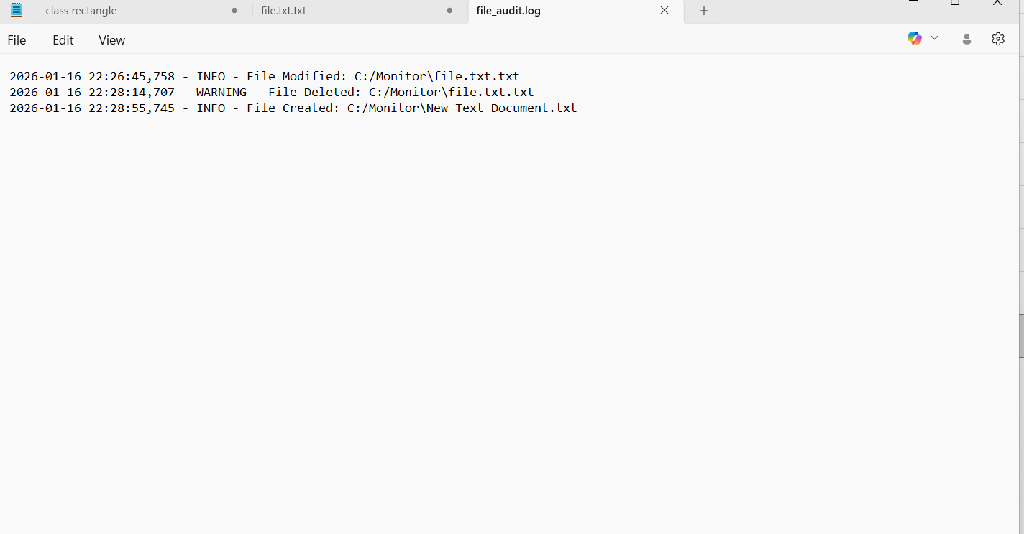
11. Sample Output

Slide 14
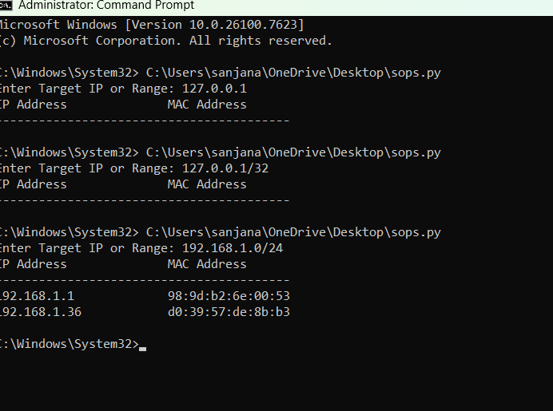

Slide 15
12.Advantages
Easy to understand
Runs on Windows CMD
No need for Kali Linux
Lightweight and simple
Useful for students
Real-time monitoring

Slide 16
13.Limitations
Basic Level Security Tool
Not as powerful as commercial IDS/IPS systems.
Cannot detect advanced persistent threats.
2️⃣ Limited to Local Network
Only scans devices in local LAN.
Cannot monitor external networks.
3️⃣ No Automatic Blocking
Only detects suspicious activity.
Does not automatically block malicious IPs.
4️⃣ No Graphical User Interface (GUI)
Works only in Command Prompt.
May not be user-friendly for non-technical users.

Slide 17
14.Future Enchancement
GUI interface using Tkinter
Email alert system
SMS notification system
Real-time dashboard
AI-based anomaly detection
Cloud integration
Database logging system

Slide 18
15.Conclusion
SentinelShield is a basic cybersecurity monitoring tool developed using Python and executed through Windows CMD. The system successfully performs network scanning and file monitoring operations.
The project demonstrates practical implementation of cybersecurity concepts such as:
Intrusion detection
File integrity monitoring
Network scanning
Log analysis
Although it is a beginner-level tool, it provides strong foundational knowledge for developing advanced security systems in the future.

