Slide 1



MALLAREDDY INSTITUTE OF ENGINEERING AND TECHNOLOGY
Major Project Stage-2
On
SMART CAR PARKING AND NUMBER PLATE RECOGNITION USING AI
GUIDED BY:
Mrs. M. SHENBAGAM ,
Assistant Professor,
Department of Computer Science & Engineering
PRESENTED BY:
K.SANJANA (23W95A0515)
D.ANUSHA (23W95A0509)
G.HANVITHA (23W95A0513)
K.RUPA SRI (23W95A0514)

Slide 2
ABSTRACT
This system automates parking lot management using Artificial Intelligence (AI) and Computer Vision technologies. It employs number plate recognition to identify vehicles automatically at the entry and exit points of the parking area. The system captures the vehicle’s image, detects the license plate, and extracts the registration number using Optical Character Recognition (OCR). The recognized plate number is then verified against a database to confirm vehicle authorization and parking availability .Once verified, the system enables seamless entry or exit by automatically controlling the gate and updating parking records in real time. By minimizing human involvement, the proposed system reduces congestion, prevents unauthorized access, and enhances overall parking management efficiency. This AI-based solution provides a scalable, reliable, and cost-effective approach for smart cities, commercial complexes, and residential parking facilities, ensuring faster vehicle processing and improved user experience.

Slide 3
EXISTING SYSTEM
In the existing parking management systems, most operations are manual or semi-automated. Parking attendants are responsible for checking vehicles, issuing tickets, collecting fees, and recording entry or exit times. Vehicle number plates are noted manually, and verification of vehicle details is done by human staff. Parking space allocation and monitoring are also handled manually, leading to inefficiencies and delays. Some semi-automated systems may use sensors to detect car presence, but they still rely on human input for registration, verification, and record keeping.
Disadvantages
Manual operation Needed
Time consuming
Prone to human errors
Low Security

Slide 4
PROPOSED SYSTEM
The proposed system introduces an AI-based Smart Car Parking and Number Plate Recognition System that automates parking management using computer vision and machine learning. In this system, cameras placed at the entry and exit gates capture the image of each vehicle. Using AI-based number plate detection and Optical Character Recognition (OCR), the system automatically extracts the vehicle’s registration number. The recognized number is then verified with a database to check for authorization and parking availability. If the vehicle is verified, the automatic gate opens, and the system assigns an available parking slot. It also records the entry and exit times, updates the parking database, and continuously monitors slot availability. This automation removes the need for manual verification and enables faster, more secure, and more efficient parking management.
Advantages
No Manual Operation
Less Time Consuming
High Security

Slide 5
SYSTEM REQUIREMENTS
Operating System | Windows 10 or above
Programming Language | Python 3.8 minimum
Frontend Technologies | HTML, CSS, JavaScript (for user interface)
Frameworks / Libraries | OpenCV (image processing), TensorFlow / PyTorch (ML model training), Tesseract OCR (character recognition), Flask/Django
Database | MySQL / SQLite (for storing vehicle number, time, and image records)
SOFTWARE REQUIREMENTS:
HARDWARE REQUIREMENTS:
Processing Unit | Computer system / Raspberry Pi 4 Model B
Automatic Gate Barrier /Servo Motor | Electric gate barrier /motor power : 12V – 24V DC
Sensors | Ultrasonic Sensor(HC-SR04)
Storage | Minimum 250 GB HDD / SSD (for datasets, models, and logs)
Camera | IP Camera / USB Camera /Raspberry Pi Camera Module V3

Slide 6
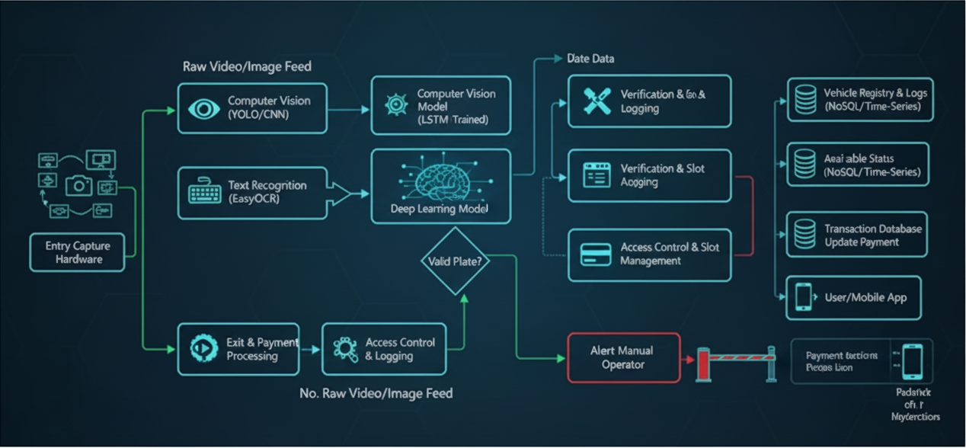
SYSTEM ARCHITECTURE

Slide 7
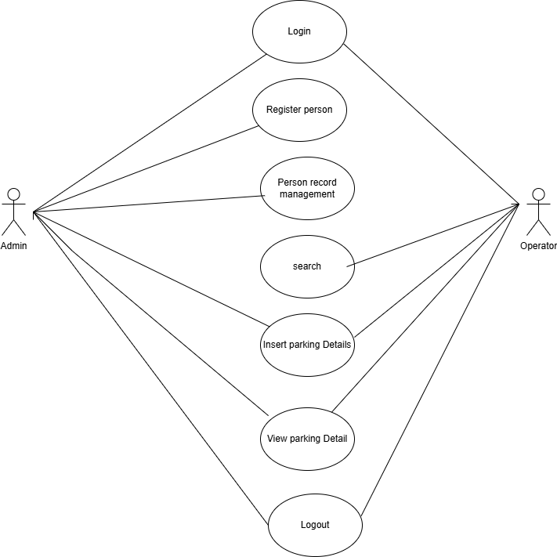
USE CASE DAIGRAM:

Slide 8
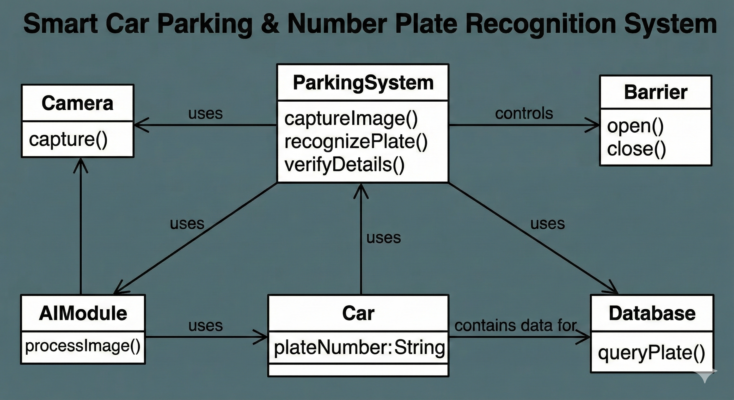
CLASS DIAGRAM:

Slide 9
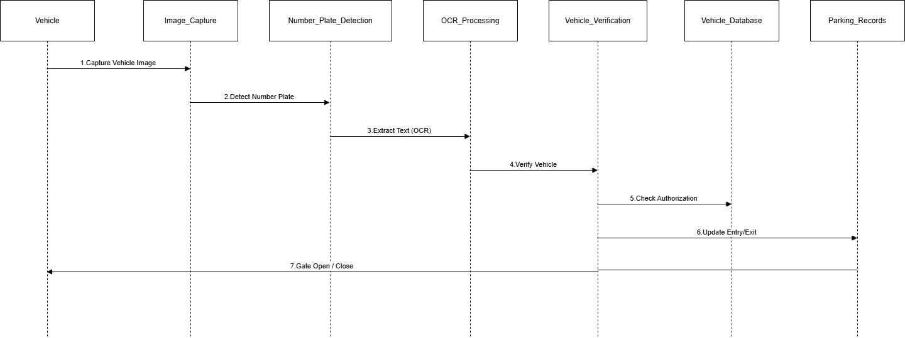
SEQUENCE DIAGRAM:
'

Slide 10
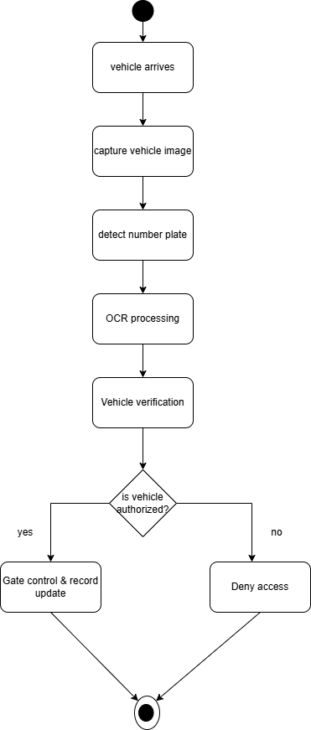
ACTIVITY DIAGRAM:

Slide 11
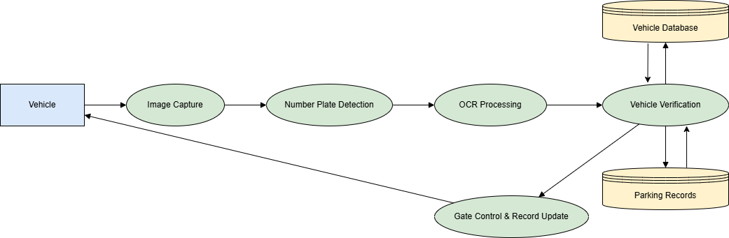
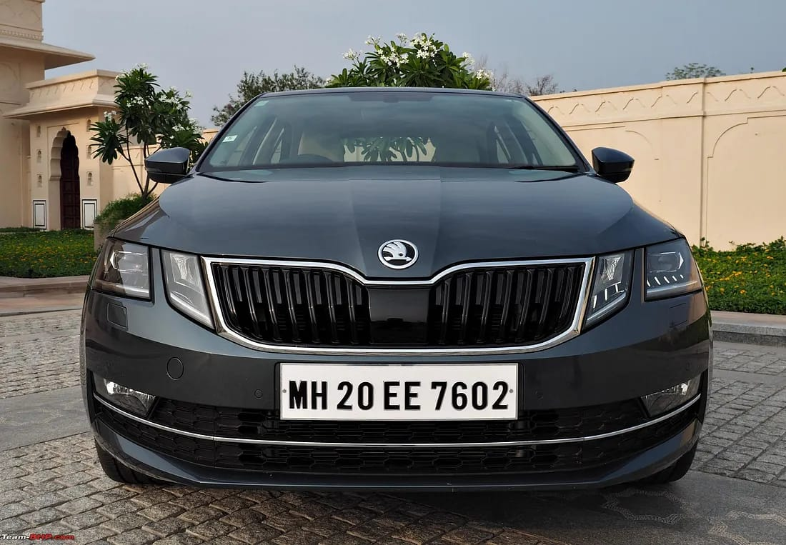
DATAFLOW DIAGRAM:

Slide 12
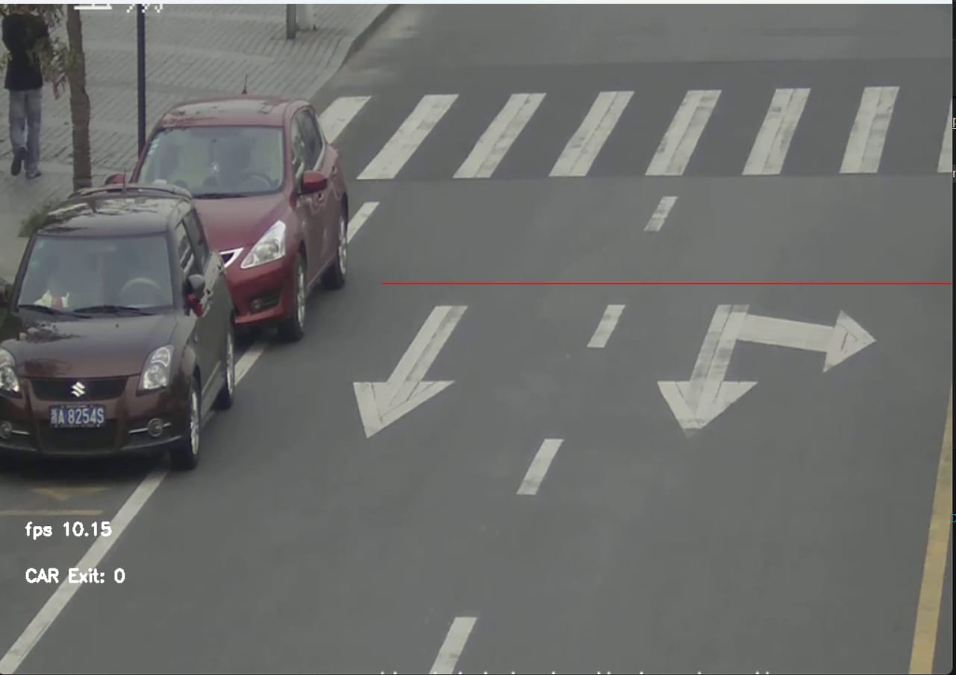
OUTPUT SCREEN-1

Slide 13
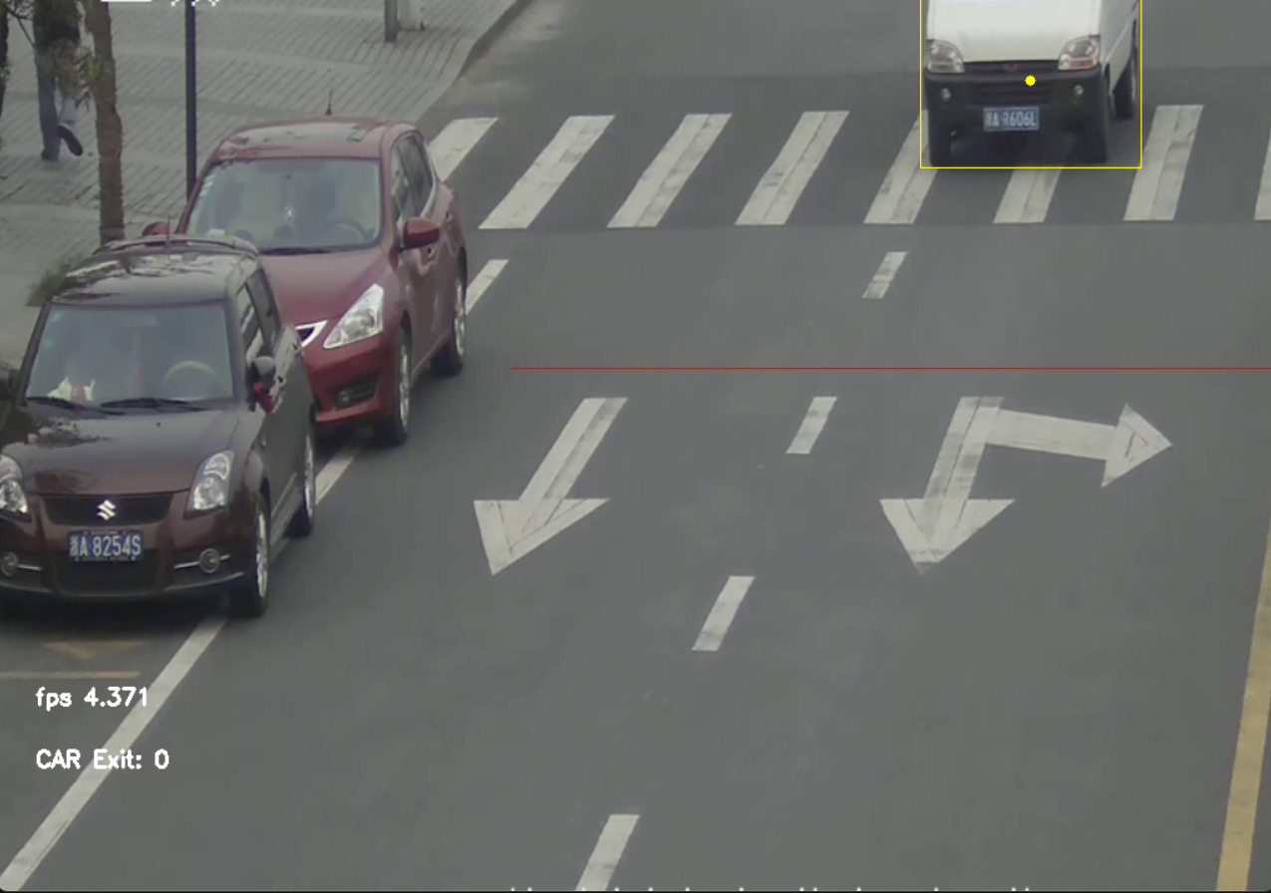
OUTPUT SCREEN-2

Slide 14
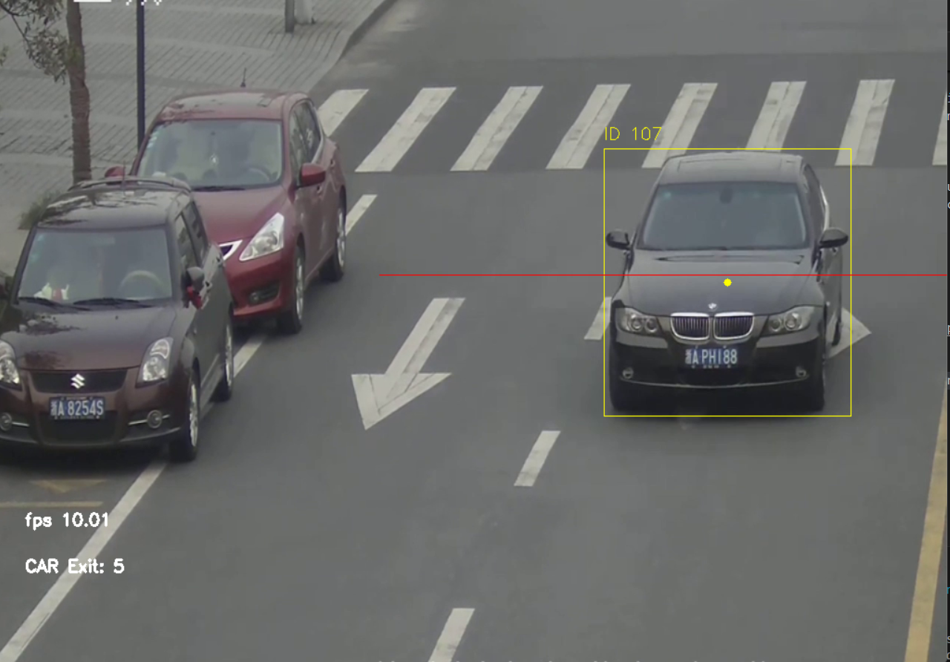
OUTPUT SCREEN-3

Slide 15
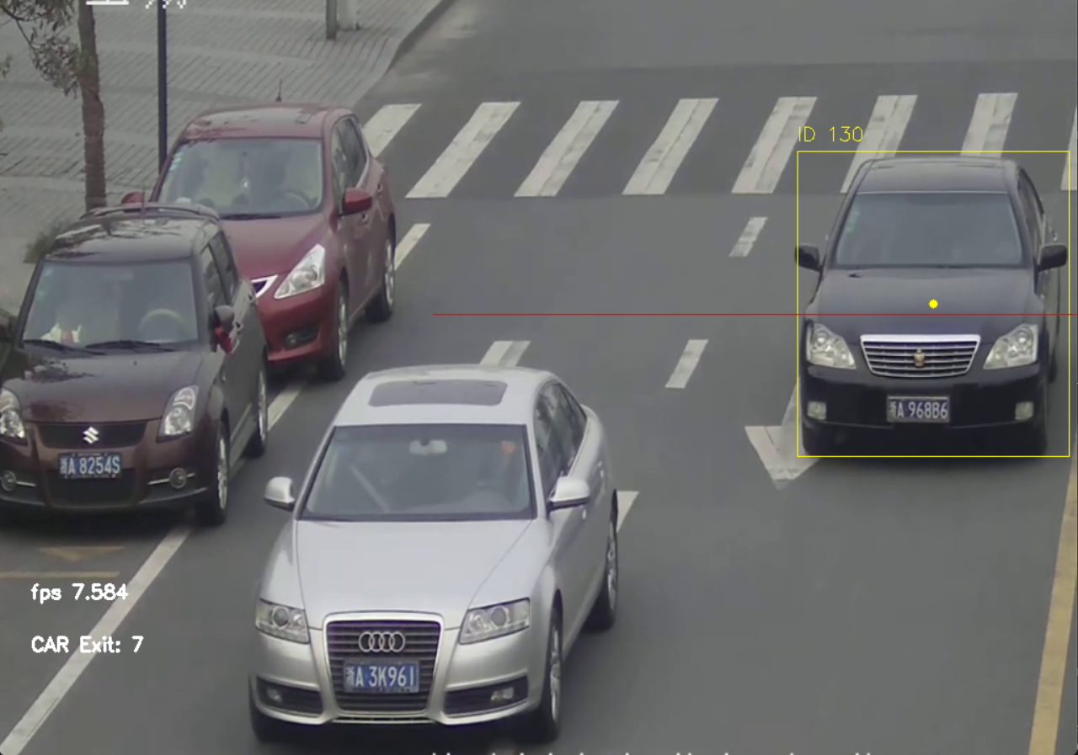
OUTPUT SCREEN-4

Slide 16
CONCLUSION
The Major Project detailing the Smart Car Parking and Number Plate Recognition system successfully established a technologically robust, AI-driven solution to automate access control and management. By addressing the significant limitations of traditional sensor-based and manual parking systems, the project validates the necessity of leveraging deep learning for high-reliability infrastructure applications. Ultimately, this project contributes a high-reliability, transparent, and scalable solution to urban logistics, providing a platform that can be extended with advanced predictive and analytical capabilities to further optimize space utilization and traffic flow. The core success is attributed to the distributed, modular architecture and the stringent application of Computer Vision techniques.

Slide 17
FUTURE ENHANCEMENT
The smart car parking and number plate recognition system using AI and computer vision can make the solution more intelligent, secure, and scalable. The system can be improved by integrating real-time parking availability prediction and mobile applications for slot reservation and cashless payments. Advanced deep learning models can be used to increase number plate detection accuracy under low light, bad weather, and high-speed conditions. Cloud-based storage and analytics can enable large-scale deployment and provide useful insights into parking usage and traffic patterns. Integration with IoT sensors and government vehicle databases can further enhance slot detection accuracy and automatic vehicle verification. These improvements will support smart city development by reducing traffic congestion, improving user convenience, and ensuring efficient parking management.

Slide 18
THANK YOU

Slide 19


