Slide 1

GYM MANAGEMENT SYSTEM
SANJANA KARRA [NUID: 002784432]
KODAND RAM MOVVA [NUID: 002701533]
SAI SREE POTHIREDDY GARI [NUID: 000000000]

Slide 2
INTRODUCTION
Gym visits have become a habit as people become more conscious of their health and well-being, so having applications that cater to the needs of gyms is critical.
Making sure that the application is scalable is the most important aspect of the design process. When the systems are not interconnected, this makes it harder and sometimes impossible for the business to have multiple services under a single system.
Gym management systems are web-based projects that are used by gym managers and customers.
This software is used to save records of customers related to their fitness, schedule, diet, fees, and personal details.
Because of this, the work of the gym manager becomes easy and time-saving.
The gym management system provides an easy-to-use interface for the users and a database for the admin to maintain the records.

Slide 3
PRIMRY GOALS
The main aim of the project is to provide the administrator and the user with a platform to interact online about every piece of information and detail required and to make sure the gym is well maintained. It makes it easy for both the admin and the users to stay updated about membership, courses being offered, schedules, etc.

Slide 4
Proposed System
This project is a system where all the details of the users, including their details, payment status, online order status, courses registered, and membership, will be updated.
The admin can check whose membership is about to expire, and the users can check when their membership is about to expire so they can renew accordingly.
The manager can accept clients into courses, and clients can also request an appointment with a trainer.
The proposed system is secure.
It provides a username and password for every user and even the administrator.
It is updated with every detail and transaction.
The admin can make changes to every detail, like inventory or course status.

Slide 5
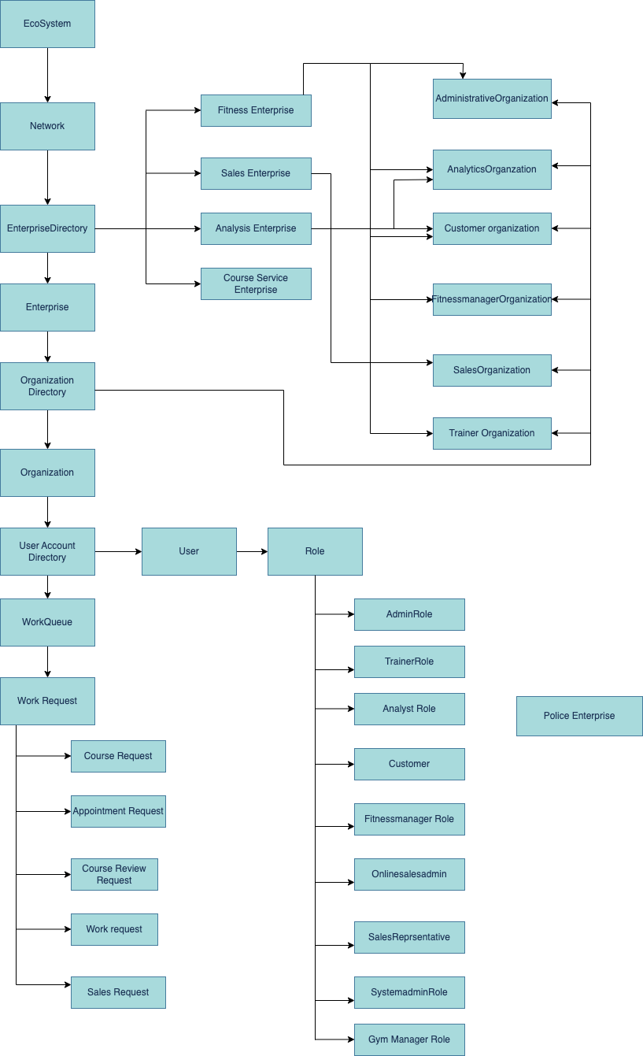
Object model Diagram

Slide 6
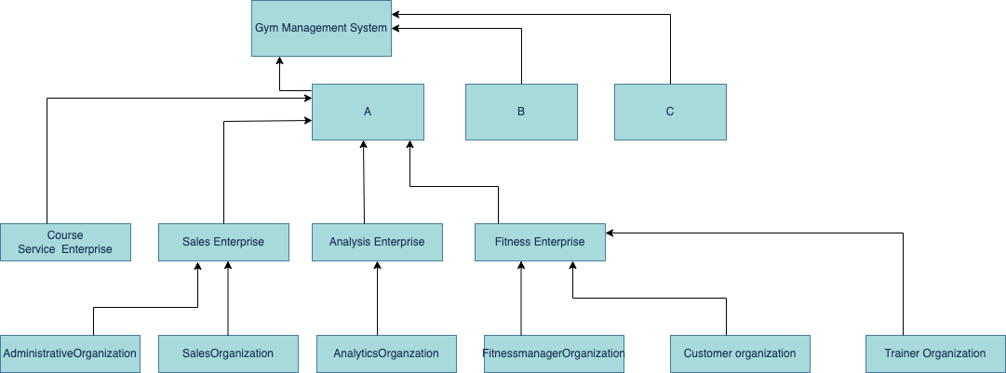
Hierarchy Diagram

Slide 7
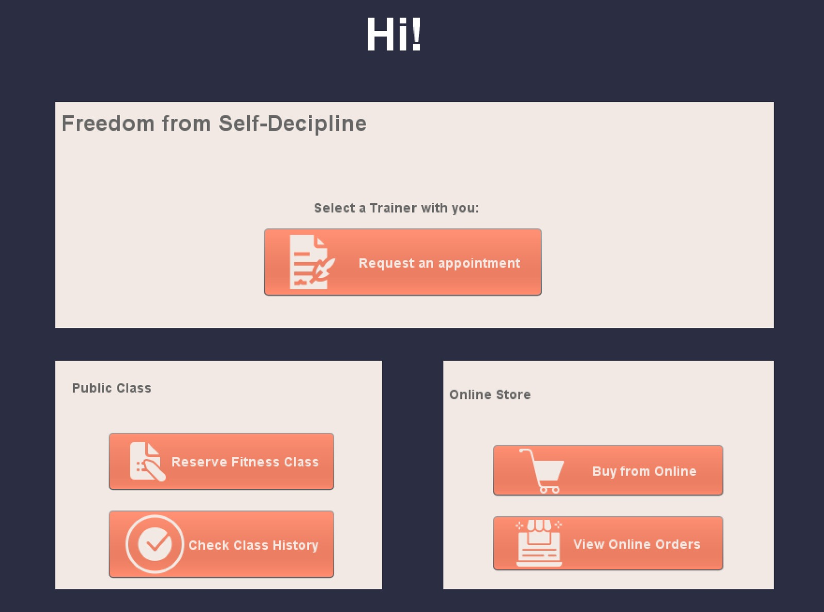
Customer page

Slide 8
Future Scope
In the future, many more improvements can be done to the system. Like, Adding time slots for the members to be booked for their workout by the members, Attendance for the users, Banners for different offers and discounts available in the Gym, etc.

Slide 9
SUMMARY
We addressed issue of maintaining records physically and developed a system which is of convenience to both customer and gyms. Going to gym is much more organized because of our system and customers could concentrate on actual part of going to gym rather than struggling to find particular time slot.

Slide 10
THANK YOU

