Slide 1
AI-Driven Crop Disease Prediction and Management System
CSE7101- Capstone Project
Review-1
Batch Number:CSE145
Roll Number | Student Name
20221CSE0571 20221CSE0567 20221CSE0558 | KC SANJANA SRUSHTI BH SUSHMA M HULAKUND
Under the Supervision of,
Mr.jerrin Joe Francis
Professor
School of Computer Science and Engineering
Presidency University
Name of the Program: B-tech CSE
Name of the HoD: Dr. Blessed prince
Name of the Program Project Coordinator: Dr. Muthuraju v
Name of the School Project Coordinators: Dr. Sampath A K , Dr. Geetha A

Slide 2
Problem Statement Number: PSCS_282
Organization: Presidency University
Category (Hardware / Software / Both) :Both
Problem Description:Rice is one of the most important staple crops in the world, feeding billions of people, especially in Asia. However, its production is severely affected by various leaf diseases such as Leaf Blast, Bacterial Leaf Blight, and Brown Spot.
Early detection of these diseases is crucial for preventing yield loss, but current methods have major limitations:
Manual visual inspection by farmers or agricultural experts is time-consuming, requires expertise, and is prone to human error.
Limited access to experts in rural areas leads to delays in diagnosis and treatment.

Slide 3
Content
Problem Statement
Objectives
Background and Related work for title Selection
Analysis of Problem Statement
Innovation or Novel Contributions
Git-hub Link
Timeline of the Project
References

Slide 4
Objectives :
Develop an automated rice leaf disease detection system using Convolutional Neural Networks (CNN).
Apply Transfer Learning (VGG16, ResNet50, MobileNet) to handle small datasets effectively.
Classify leaves into Healthy, Leaf Blast, Leaf Blight, and Brown Spot.
Enable deployment on mobile and web platforms for farmer accessibility.

Slide 5
Analysis of Problem Statement:
Current Situation:
Rice, being a staple food crop, is highly vulnerable to diseases such as Leaf Blast, Bacterial Leaf Blight, and Brown Spot.
Farmers in rural areas rely on manual visual inspection, which:
  Requires expert knowledge.
  Is time-consuming and error-prone.
  Can cause delays in treatment, leading to reduced yield and quality.
Even existing automated methods often require large datasets, high computational power, or lab-based analysis, which is not practical for most farmers.

Slide 6
Analysis of Problem Statement:
Pain Points
Lack of Accessibility – Advanced disease detection technologies are not widely available to farmers.
Small Dataset Challenge – Limited availability of labeled images for rice leaf diseases makes training from scratch inefficient.
Low Generalization – Models trained on specific datasets may fail when tested in real field conditions with different lighting, angles, and backgrounds.
Slow Response – Manual reporting and expert consultation can take days, allowing the disease to spread.
Limited Scalability – Traditional systems are difficult to deploy on low-resource devices like mobile phones.

Slide 7
Analysis of Problem Statement:
Need for AI Solution
An AI-powered, real-time, image-based detection system that:
  Works with small but well-augmented datasets.
  Is lightweight enough for mobile deployment (e.g., MobileNet).
  Can generalize well to different field conditions.
  Provides instant results to farmers without requiring expert presence.
Automated Image-Based Diagnosis
Farmers can capture and upload a photo of a suspected diseased leaf via a mobile app or web interface.
The system uses CNN with Transfer Learning to classify the disease instantly.
Lightweight & Real-Time Processing

Slide 8
Github Link
Github Link
https://github.com/sushma566/AI-Driven-Crop-Disease-Prediction-and-Management-System

Slide 9
Analysis of Problem Statement (contd...)
Frontend – Mobile & Web UI (React / Flutter / Angular).
Backend – REST API (Node.js, Django, or Java Spring Boot).
Database – RDBMS (PostgreSQL/MySQL) or hybrid with NoSQL (MongoDB).
GPS & Map APIs – Google Maps API / OpenStreetMap.
Notification Service – Firebase Cloud Messaging (FCM) or similar.
Security Layer – JWT authentication, role-based access, HTTPS.

Slide 10
Analysis of Problem Statement (contd...)
.
Methodology
Requirements Analysis – Collect stakeholder needs from agencies.
Database Design – Centralized, scalable, secure.
UI/UX Development – Map integration, filters, forms.
Location Tracking Integration – Automated GPS updates.
Collaboration Tools – Alerts, requests, messaging.
Security Implementation – Authentication, authorization, encryption.
Testing – Unit, integration, and user acceptance testing.
Deployment & Maintenance – Cloud hosting, updates, support.
Feedback & Iteration – Continuous improvements.

Slide 11
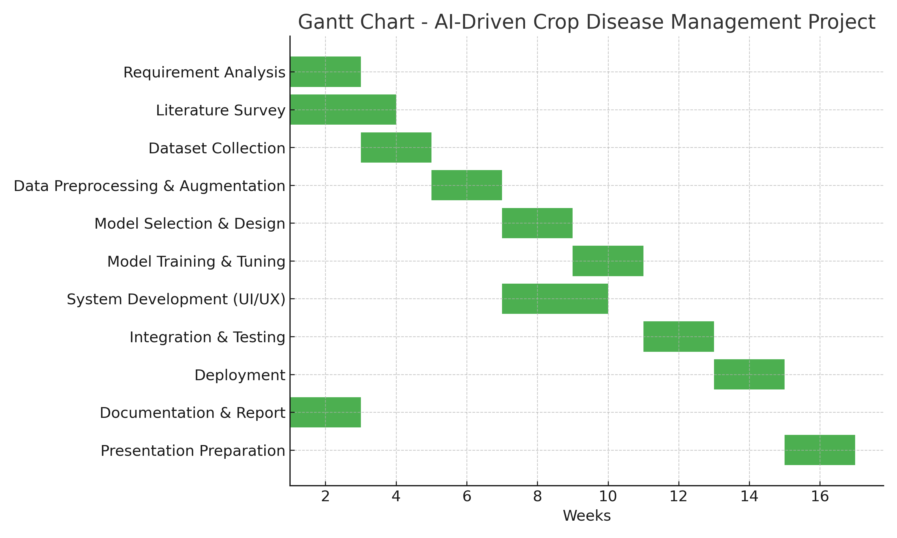
Timeline of the Project (Gantt Chart)

Slide 12
References (IEEE Paper format)
[1] Xiaolong Xu, Lei Zhang, Marcello Trovati, Francesco Palmieri, Eleana Asimakopoulou, and Olayinka Johnny, Nik Bessis, “PERMS: An efficient rescue route planning system in disasters,” Published on November 2021.
[2] Omar Cheikhrouhou, Anis Koubaa, and Anis Zarrad, “A Cloud Based Disaster Management System,” Published on January 13, 2020.
[3] Punith Kumar M. B., Sumanth S., and Manikant Amaresh Savadatti, “Internet Rescue Robots for Disaster Management,” Published on 08 April 2021.
[4] Preetinder Singh Brar, Babar Shah, Jaiteg Singh, Farman Ali, and Daehan Kwak, “Using Modified Technology Acceptance Model to Evaluate the Adoption of a Proposed IoT-Based Indoor Disaster Management Software Tool by Rescue Workers,” Published on 26 February 2022.

Slide 13


