Slide 1
AI-Driven Crop Disease Prediction and Management System
CSE7101- Capstone Project
Review-2
Batch Number:CSE145
Roll Number | Student Name
20221CSE0571 20221CSE0567 20221CSE0558 | KC SANJANA SRUSHTI BH SUSHMA M HULAKUND
Under the Supervision of,
Mr.jerrin Joe Francis
Professor
School of Computer Science and Engineering
Presidency University
Name of the Program: B-tech CSE
Name of the HoD: Dr.Blessed prince
Name of the Program Project Coordinator: Dr. Muthuraju v
Name of the School Project Coordinators: Dr. Sampath A K , Dr. Geetha A

Slide 2
Content
Problem Statement
Objectives
Background and Related work for title Selection
Analysis of Problem Statement
Innovation or Novel Contributions
Git-hub Link
Timeline of the Project
References

Slide 3
Abstract
This project presents an AI-Driven Crop Disease Prediction and Management System aimed at addressing the challenges faced by farmers in identifying and managing rice crop diseases.
By leveraging Convolutional Neural Networks (CNNs) with Transfer Learning approaches such as MobileNetV2, VGG16, and ResNet50, the system accurately classifies rice leaf conditions into Healthy, Leaf Blast, Bacterial Leaf Blight, and Brown Spot categories.
The system integrates image-based disease detection with real-time web and mobile applications, ensuring farmers can capture, upload, and instantly receive diagnosis results.
The solution promotes sustainable farming through early disease detection, reduced dependency on expert consultation, and improved crop yield outcomes.

Slide 4
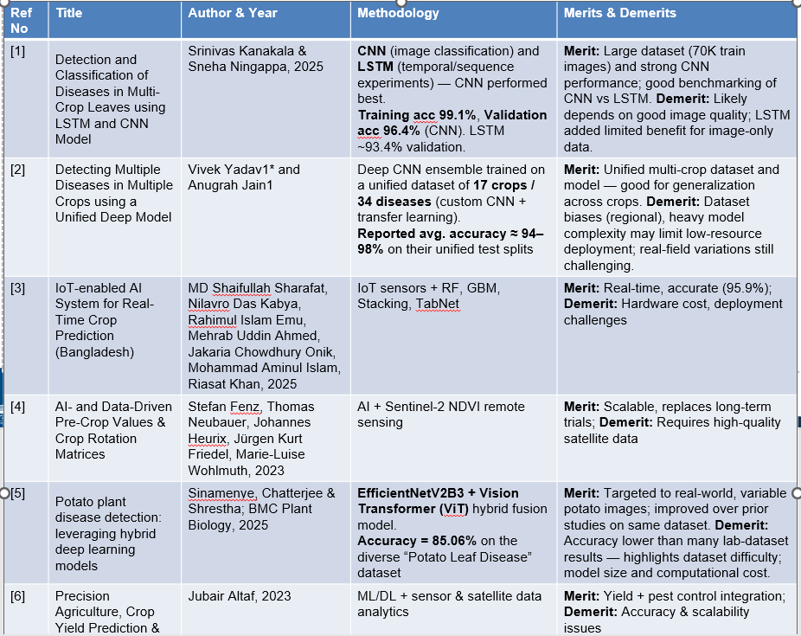
Literature Survey

Slide 5
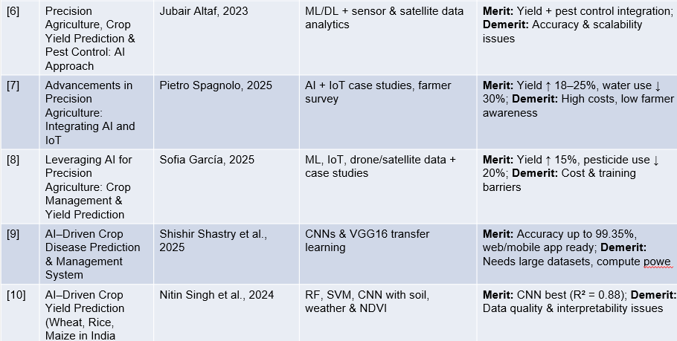
.

Slide 6
Objectives
1. Develop an automated rice leaf disease detection system using CNNs with ≥95% accuracy.
2. Apply Transfer Learning (VGG16, ResNet50, MobileNetV2) to ensure efficiency on small datasets.
3. Build mobile and web applications for real-time farmer access, ensuring <2s response time.
4. Enable predictive recommendations for disease management based on detected conditions.
5. Ensure scalability and deployability on cloud & edge devices, targeting rural farmers’ accessibility.

Slide 7
1. Existing Methods and Drawbacks
Traditional Methods: Manual inspection and expert consultations are time-consuming, subjective, and prone to human error.
ML Approaches: Require hand-crafted features, often limited generalization.
Deep Learning: High accuracy but needs large, annotated datasets and high computational resources.
Drawbacks Identified: Lack of scalability, limited real-time usability, high cost for small farmers, dataset dependency.

Slide 8
2. Proposed Method & Feasibility Study
Proposed Solution: AI-driven crop disease prediction system using CNN with Transfer Learning (MobileNetV2, VGG16, ResNet50).
Features: Real-time image-based disease classification, predictive recommendations, and web/mobile integration.
Feasibility:
  Technology: Uses lightweight deep learning models optimized for mobile/web.
  Cost: Affordable for small-scale farmers through open-source frameworks & cloud deployment.
  Resources: Scalable via Firebase & cloud platforms; usable even in rural areas with low bandwidth.

Slide 9
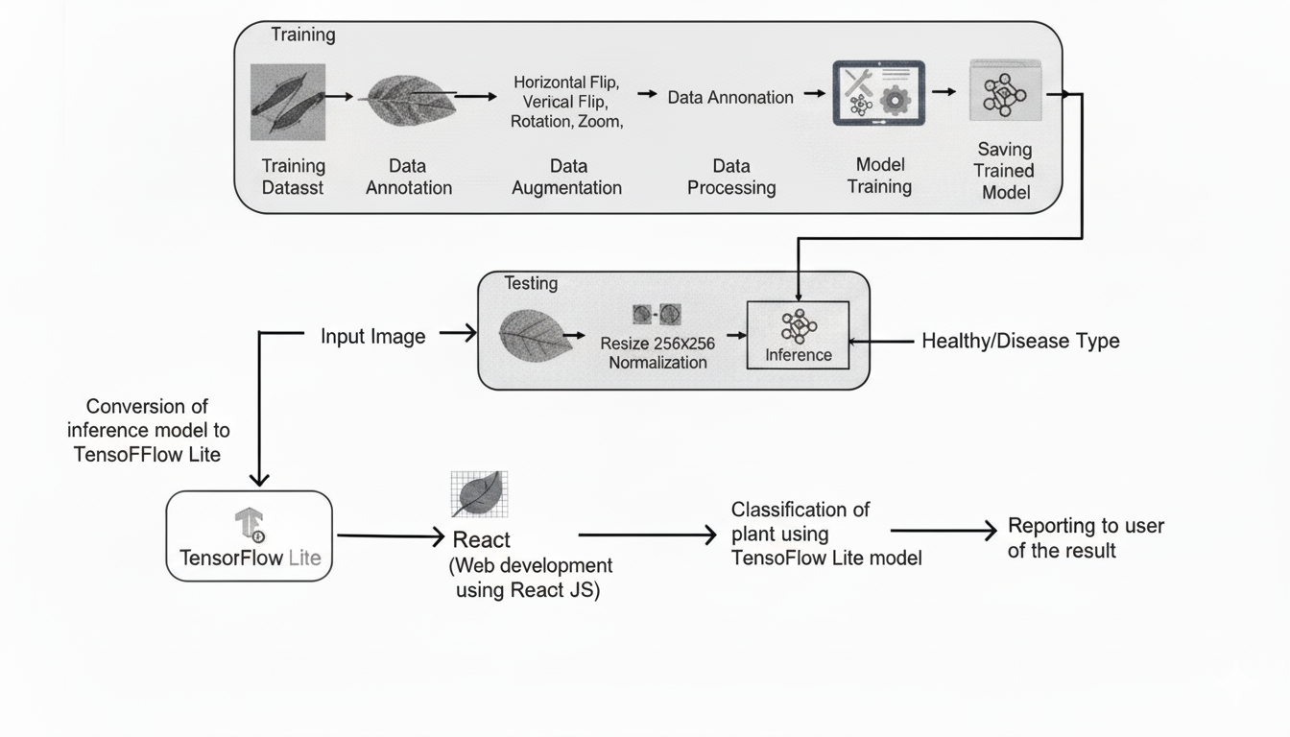
Analysis of Problem Statement:
3. Architecture Diagram

Slide 10
Analysis of Problem Statement:
4. Modules
Data Collection Module – Captures image/environmental data.
Preprocessing Module – Normalizes and augments datasets.
Prediction Module – CNN-based classification.
Recommendation Module – Provides disease-specific remedies.
User Interface Module – Farmer-friendly mobile/web apps.
Cloud Integration Module – Data storage, scalability, updates.

Slide 11
Analysis of Problem Statement (contd...)
Hardware and Software Details:
Hardware: Smartphones (for image capture), IoT sensors (humidity, temperature, soil), drones (optional).
Software:
  AI frameworks: TensorFlow, Keras, PyTorch
  Cloud: AWS, Firebase, Google Cloud
  Web & Mobile: React.js, Flutter/Django REST API
  Database: Firebase/SQL

Slide 12
Github Link
Github Link
https://github.com/sushma566/AI-Driven-Crop-Disease-Prediction-and-Management-System

Slide 13
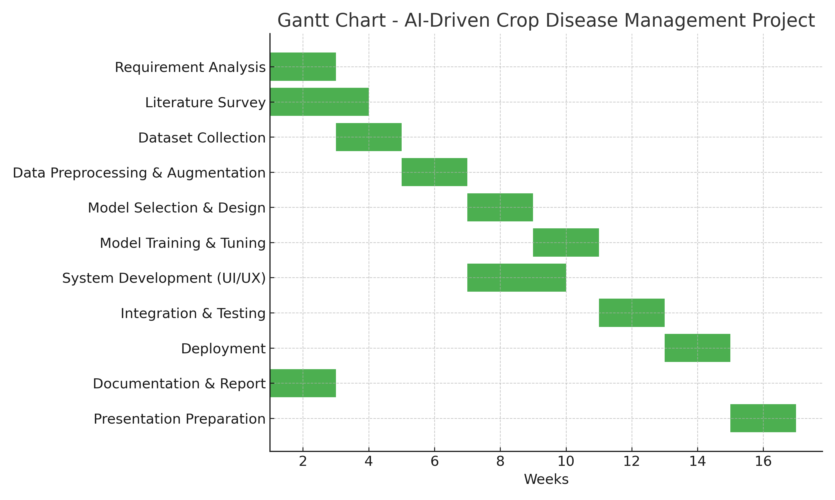
Timeline of the Project (Gantt Chart)

Slide 14
References (IEEE Paper format)
[1] Xiaolong Xu, Lei Zhang, Marcello Trovati, Francesco Palmieri, Eleana Asimakopoulou, and Olayinka Johnny, Nik Bessis, “PERMS: An efficient rescue route planning system in disasters,” Published on November 2021.
[2] Omar Cheikhrouhou, Anis Koubaa, and Anis Zarrad, “A Cloud Based Disaster Management System,” Published on January 13, 2020.
[3] Punith Kumar M. B., Sumanth S., and Manikant Amaresh Savadatti, “Internet Rescue Robots for Disaster Management,” Published on 08 April 2021.
[4] Preetinder Singh Brar, Babar Shah, Jaiteg Singh, Farman Ali, and Daehan Kwak, “Using Modified Technology Acceptance Model to Evaluate the Adoption of a Proposed IoT-Based Indoor Disaster Management Software Tool by Rescue Workers,” Published on 26 February 2022.

Slide 15


