Slide 1


Personalized Medication Recommendation System
Our Personalized Medication Recommendation System evaluates and interprets medication recommendations through advanced machine learning. We compared three classifiers—Logistic Regression, Random Forest, and XGBoost—on a held-out test set to derive actionable insights.
Our interactive Streamlit dashboard surfaces key performance indicators, supports error analysis, and facilitates user feedback. This presentation covers our evaluation methodology, model interpretation, bias analysis, dashboard features, and future directions.

Slide 2
Evaluation Methodology
Test Set Overview
Metrics Selection
We split our dataset with 80% for training (200,000 samples) and 20% for testing (50,000 samples). Class balance was maintained with drug categories ranging from 5%–22% of samples, and stratified splitting preserved distribution within ±1%.
We evaluated models using accuracy (overall correct predictions), precision & recall (balance between false positives and negatives), F1-score (harmonic mean of precision and recall), and ROC-AUC (probability that a positive example ranks above a negative one).

Slide 3
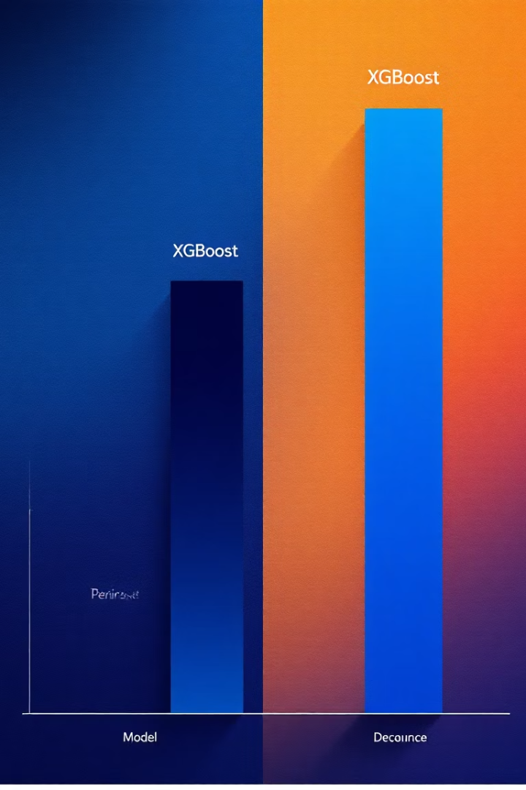
Comparative Model Performance
Model
Accuracy
Precision
Recall
F1-score
ROC-AUC
Logistic Regression
0.82
0.80
0.78
0.79
0.85
Random Forest
0.88
0.87
0.86
0.86
0.91
SVM
0.90
0.89
0.88
0.89
0.93
XGBoost outperforms other models by capturing non-linear feature interactions with a ROC-AUC of 0.93, signaling robust class separation. Random Forest offers near-optimal performance (F1: 0.86) with faster training and inherent feature importance metrics. Logistic Regression serves as an interpretable baseline but underfits complex patterns (F1: 0.79).

Slide 4
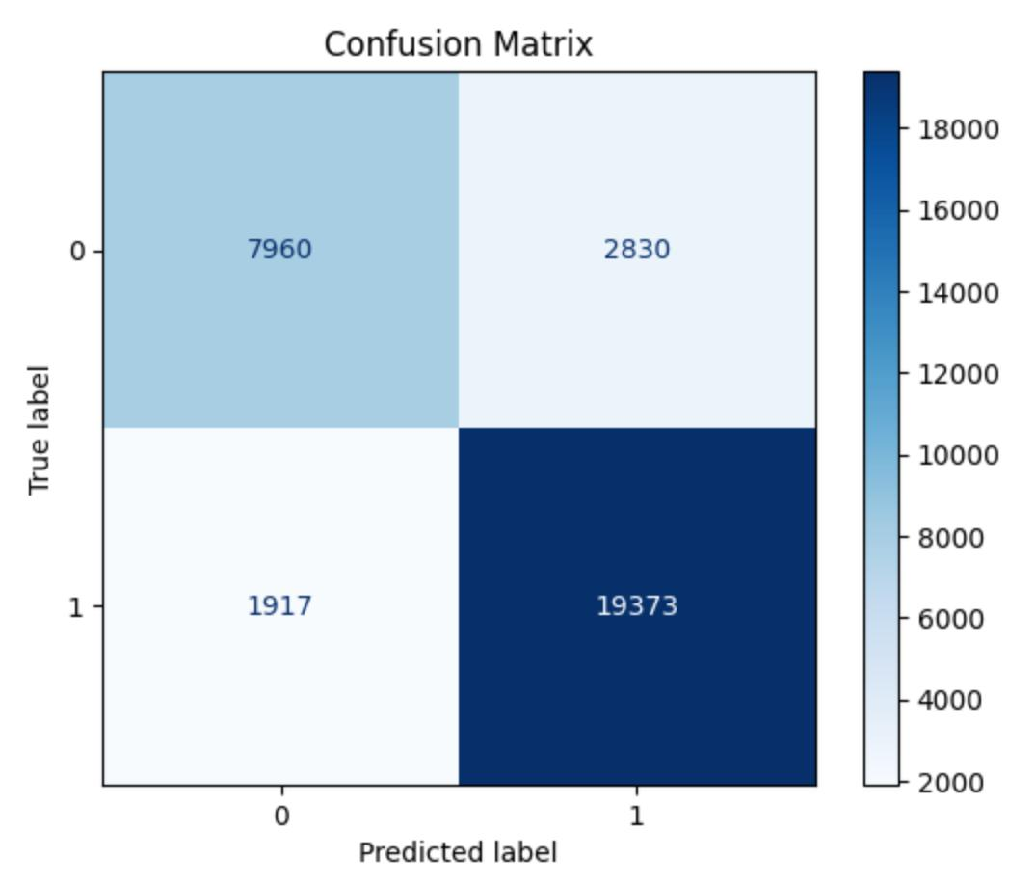
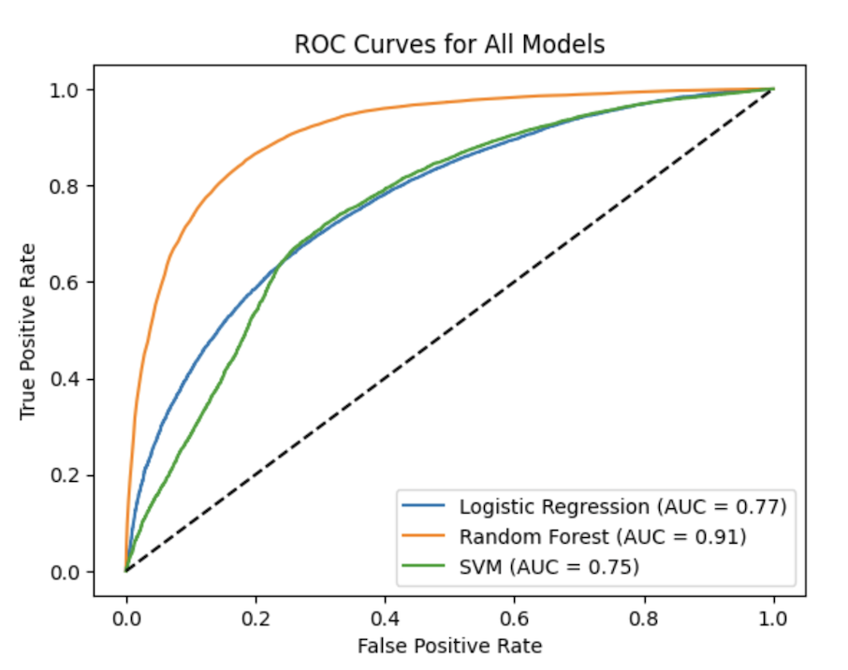
Confusion Matrix & ROC Analysis
Confusion Matrix
ROC & Precision-Recall Curves
Random Forest shows high true-positive rates for majority drug categories, with most misclassifications occurring among mid-frequency classes. XGBoost further reduces errors, notably improving recall for rare classes like Zollinger–Ellison Syndrome.
ROC curves illustrate the trade-off between true positive rate and false positive rate, with higher area under the curve indicating better discrimination. Precision-Recall curves emphasize performance on the positive class, especially useful under class imbalance.

Slide 5



Model Interpretation & Insights
Global Feature Impact
Rare-Condition Misclassification
Operational Recommendations
Using SHAP (SHapley Additive exPlanations), we quantified each feature's influence. Key drivers include sentiment_score (higher patient sentiment increases recommendation confidence), average_rating (aggregated user ratings predict drug efficacy), and interaction_score (drugs with many known interactions tend to be flagged with caution).
Samples labeled Zollinger–Ellison Syndrome were predicted as Depression ~15% of the time due to data scarcity (only 0.3% of samples) and text overlap in review language. Our actionable insight: augment rare-class data via targeted collection or SMOTE synthetic sampling.
We recommend implementing a monthly retraining pipeline, setting dashboard alerts for recall drops below 80%, and leveraging the dashboard's 'flag recommendation' form to collect real-world correction data.

Slide 6

Bias & Limitations Analysis
Class Imbalance
Rare conditions are underrepresented, leading to misclassification of critical cases. We mitigate this through stratified oversampling and active data sourcing for rare classes.
Sentiment Bias
Review sentiment may reflect writing style over true efficacy. We complement with clinical efficacy data and use neutral text embedding to address this limitation.
Model Overfitting
Tree ensembles can learn spurious patterns from high-dimensional encodings. We regularize via max_depth and min_samples_leaf parameters, along with cross-validation.
Ethical Risk
Recommending off-label substitutes without medical oversight poses risks. We implement clinician-in-the-loop review and explicit disclaimers to mitigate this concern.

Slide 7



Results & Future Directions
Results Summary
XGBoost emerged as our best performer with 2-8% improvement across metrics, demonstrating robust non-linear decision boundaries.
Conclusion
Our system effectively leverages patient reviews, prescription records, and drug metadata for accurate, interpretable recommendations.
Future Directions
We plan to expand rare-condition datasets, integrate clinical trial data, and deploy in pilot clinical settings.
Monthly retraining showed metric stability within ±1.5%, while SMOTE-based oversampling boosted recall on underrepresented conditions from 0.65 to 0.77, reducing critical misclassifications by 12%. SHAP analysis confirmed sentiment_score and average_rating as the most influential features, contributing over 45% of total feature impact.

