Slide 1
Summary SOG1 array 2
For Jordan Stefani. By Margot Galle.

Slide 2
3 documents to consult on the topc of library 2
Summary_SOG1_array2.ppt This PowerPoint presentation is your first-aid kit when trying to orient yourself in the second tile library. It summarizes the content of all tile categories, as well as formulates the relevant research questions and remarks per category. The used colours and titles match those in the two Excel files below.
Visit2_V8_summary.exe Each tab in this Excel file represents a tile category (labelled A. → P. ). The tab names match the orange titles in abovementioned PowerPoint presentation (this one). (Sub)titles are highlighted in grey boxes. Under the blue banner, the upper rows of each worksheet clarify keywords that might help you understand the difference between (sub)categories. Each tile can be – but is not always - characterized by 7 columns: TileID, AA interval, length, SOG1 partim, Description, AA sequence and Remarks. Columns that are not applicable to a tile are empty or filled out with “NA”. For example SOG1 partim is not relevant for tiles from other NAC transcription factors in the FAM category.
SeqLib_Visit2_2023.exe The first tab is a schematic overview of the library organization. This table is shown in full on slide 10 of this PowerPoint presentation. The second and third tab enlist all tiles from the second and first library respectively. The columns are labelled with the same abbreviations as those in bold in the schematic overview. This list will be easiest to build the sequencing library from by adding a column with the activity score.
Note that all documents encompassing the second library actually have more tiles than those that were ordered (23350 versus 11470). See the second slide of this PowerPoint presentation for more details on this.

Slide 3
Genesis of the library design in files
Jordan removed duplicates from both the old library and within the new library: 12056 tiles. → Too many, thus remove 1543 tiles of secondary importance: “SOG1_Lib2_TilesToExcludeIfNecessary” Result in t_list2 = 10757 tiles
→ Add series of 650 tiles: “SOG1_Lib2_AdditionAfterExclusion” Result in t_list3 = 11408 → Remove duplicates for a final time. Result in fin_twist = 11388 → Saved as “2023_twist_tiles.txt” (See script Jordan in text)
Max added the wild type SOG1 tiles (42), more controls (32) and the Gcn4Lib (20) tiles. → Final array 2 encompasses a total of 11482 (11388+ 94) unique tiles. “Sog1_array2_v1_Max.csv” = 11482 = List with ADseq (protein seq in AA) and charge, hydrophobicity and AA count per tile. Remark: 12 duplicates! “Sog1_array2_v1_Max.txt” = 11470 = DNAseq tiles
Max used the Python2.8 script for reverse translation, addition overhangs etc. → Twist order as oligo pool.
Margot designed second library: 23350 tiles: “SeqLib_Visit2_2023” → Cut down to 15905 tiles: “SOG1_Lib2_InclDuplicates”

Slide 4
Four regions of interest in the SOG1 protein sequence
Regions abbreviated as R1-R4. Basic tiles encompassed in these regions written between brackets.
Remark: In reality, regions R1 and R2 were oftentimes excluded from tile categories in this library due to the limited number of tiles
Green = Confirmed phosphosites
Red or red underlined = Predicted phosphosites using PhosPhAt and the Eukaryotic Linear Motif (ELM) Resource
Underlined = Leftover Ser (S), Thr (T) and Tyr (Y) residues, non-putative phosphosites
NTD
NAC
CTD
MAGRSWLIDS NRIATKIMSA SASSDPRQVV WKSNPSRHCP KCQHVIDNSD VVDDWPG
LPRGVKFDPS DPEIIWHLLA KSGLSGLSSH PFIDEFIPTV NQDDGICYTH PKNLPGVKSD GTVSHFFHKA IKAYSTGTRK RRKIHDDDFG DVRWHKTGRT KPVVLDGVQR GCKKIMVLYG GKAVKTNWVM HQYHLGIEED EKEGDYVVSK IFYQ
QPQQLVVKRG DKAEQEVSED IFAAVTPTAD PVTPKLATPE PRNAVRICSD
SHIASDYVTP SDYVSAHEVS LAETSEVMCM EDEVQSIQPN HERPSSGPEL
EHGLENGAKE MLDDKEEQEK DRDNENQGEE DPTWFDSGSQ FILNSQQLVE
ALSLCDDLLG SQDREENTNS GSLKDKQPCI ADYAHLGPED FKRDLEECQK
IVLDPSNIEL DTPPEFRLSQ LEFGSQDSFL AWGTGKTD
res 1-57 [57 aa]; pI 8,91
TAD1 + New PS (3-10)
R1
NTD
NAC
CTD
res 58-211 [154 aa]; pI 9,28
New PS (21-25)
R2
NTD
NAC
CTD
TAD2 (32-38)
res 212-449 [238 aa]; pI 4,47
R3
TAD3 (40-42)
R4

Slide 5
Tile ID | AA interval | Length | SOG1 partim | AA sequence | Tile region
3 | 21-60 | 40 | NTD + NAC | SASSDPRQVVWKSNPSRHCPKCQHVIDNSDVVDDWPGLPR | R1
4 | 31-70 | 40 | NTD + NAC | WKSNPSRHCPKCQHVIDNSDVVDDWPGLPRGVKFDPSDPE | R1
5 | 41-80 | 40 | NTD + NAC | KCQHVIDNSDVVDDWPGLPRGVKFDPSDPEIIWHLLAKSG | R1
6 | 51-90 | 40 | NTD + NAC | VVDDWPGLPRGVKFDPSDPEIIWHLLAKSGLSGLSSHPFI | R1
7 | 61-100 | 40 | NAC | GVKFDPSDPEIIWHLLAKSGLSGLSSHPFIDEFIPTVNQD | R1
8 | 71-110 | 40 | NAC | IIWHLLAKSGLSGLSSHPFIDEFIPTVNQDDGICYTHPKN | R1
9 | 81-120 | 40 | NAC | LSGLSSHPFIDEFIPTVNQDDGICYTHPKNLPGVKSDGTV | R1
10 | 91-130 | 40 | NAC | DEFIPTVNQDDGICYTHPKNLPGVKSDGTVSHFFHKAIKA | R1
21 | 201-240 | 40 | NAC + CTD | GDYVVSKIFYQQPQQLVVKRGDKAEQEVSEDIFAAVTPTA | R2
22 | 211-250 | 40 | NAC + CTD | QQPQQLVVKRGDKAEQEVSEDIFAAVTPTADPVTPKLATP | R2
23 | 221-260 | 40 | CTD | GDKAEQEVSEDIFAAVTPTADPVTPKLATPEPRNAVRICS | R2
24 | 231-270 | 40 | CTD | DIFAAVTPTADPVTPKLATPEPRNAVRICSDSHIASDYVT | R2
25 | 241-280 | 40 | CTD | DPVTPKLATPEPRNAVRICSDSHIASDYVTPSDYVSAHEV | R2
32 | 311-350 | 40 | CTD | LEHGLENGAKEMLDDKEEQEKDRDNENQGEEDPTWFDSGS | R3
33 | 321-360 | 40 | CTD | EMLDDKEEQEKDRDNENQGEEDPTWFDSGSQFILNSQQLV | R3
34 | 331-370 | 40 | CTD | KDRDNENQGEEDPTWFDSGSQFILNSQQLVEALSLCDDLL | R3
35 | 341-380 | 40 | CTD | EDPTWFDSGSQFILNSQQLVEALSLCDDLLGSQDREENTN | R3
36 | 351-390 | 40 | CTD | QFILNSQQLVEALSLCDDLLGSQDREENTNSGSLKDKQPC | R3
37 | 361-400 | 40 | CTD | EALSLCDDLLGSQDREENTNSGSLKDKQPCIADYAHLGPE | R3
38 | 371-410 | 40 | CTD | GSQDREENTNSGSLKDKQPCIADYAHLGPEDFKRDLEECQ | R3
40 | 391-430 | 40 | CTD | IADYAHLGPEDFKRDLEECQKIVLDPSNIELDTPPEFRLS | R4
41 | 401-440 | 40 | CTD | DFKRDLEECQKIVLDPSNIELDTPPEFRLSQLEFGSQDSF | R4
42 | 410-449 | 40 | CTD | QKIVLDPSNIELDTPPEFRLSQLEFGSQDSFLAWGTGKTD | R4

Slide 6
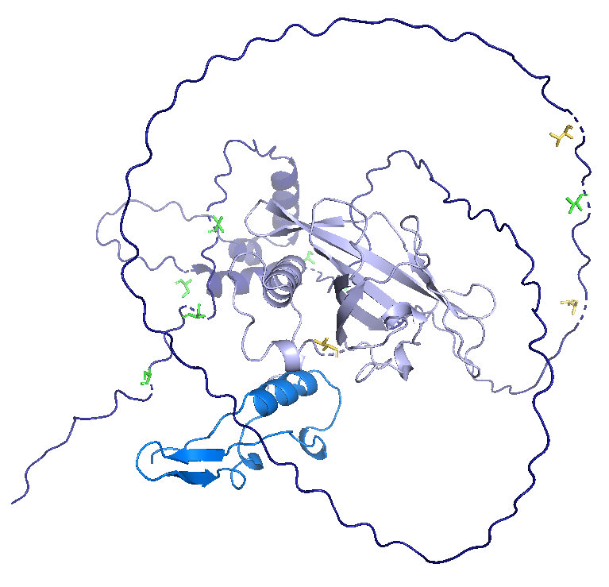
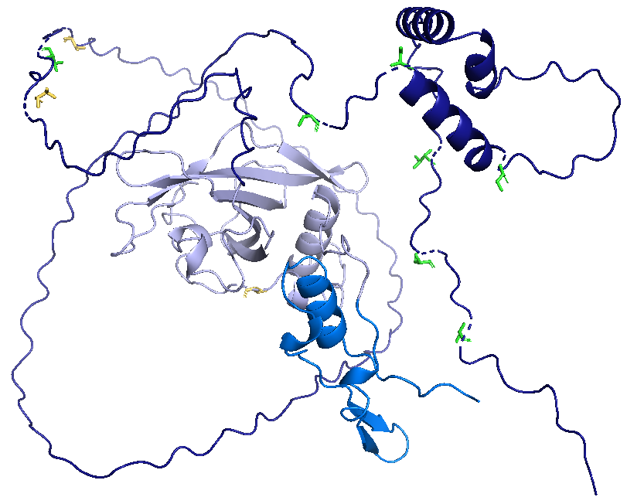
Green: PS used in 1st library
Yellow: PS added to the 2nd library
T249
T249
T244
S356
T237
T244
S350
T423
S356
T423
S372
S350
S372
T237
S430
S430
T96
S436
T96
S436
M1
M1
D449
D449
180°

Slide 7
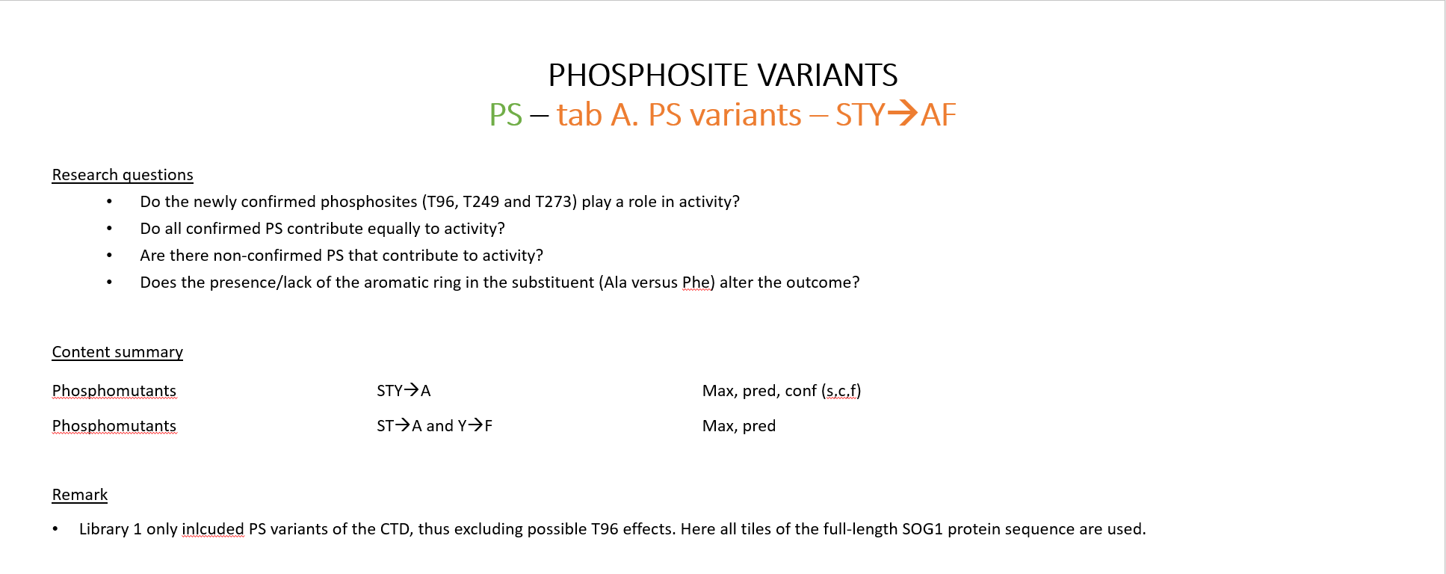
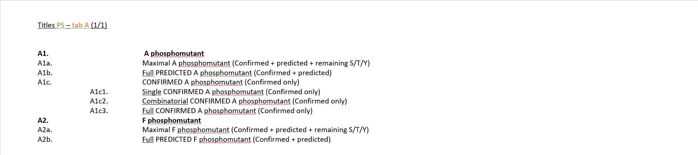
Document 1: Summary_SOG1_array2.ppt

Slide 8
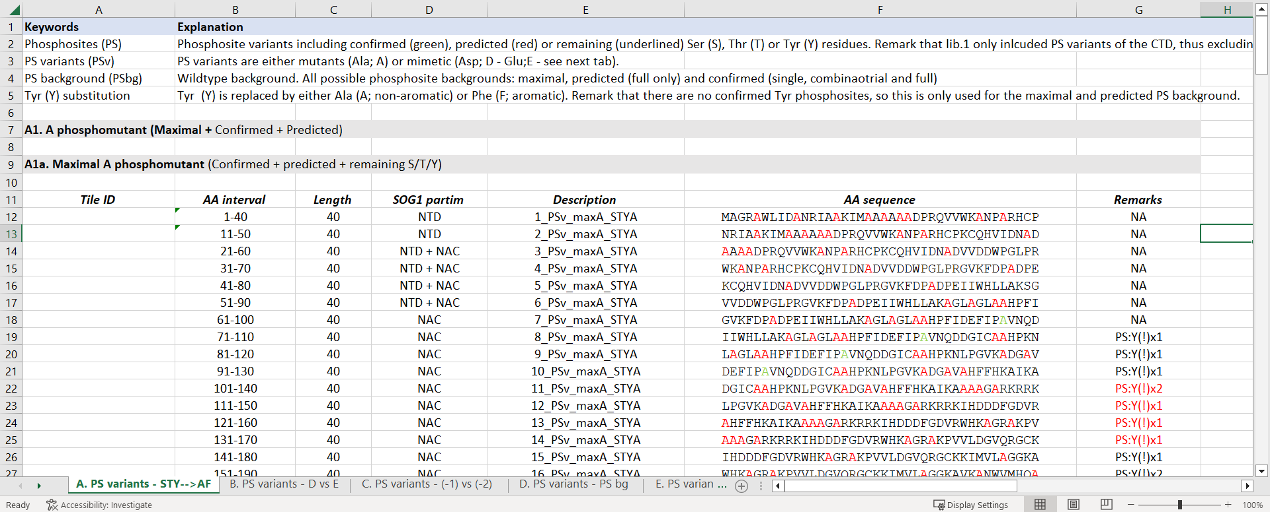
Document 2: Visit2_V8_summary.exe

Slide 9


Document 3: SeqLib_Visit2_2023.exe

Slide 10
Schematic overview of the library organisation See also first tab in < SeqLib_Visit2_2023.exe >

Slide 11
PHOSPHOSITE VARIANTS PS – tab A. PS variants – STY→AF
Research questions
Do the newly confirmed phosphosites (T96, T249 and T273) play a role in activity?
Do all confirmed PS contribute equally to activity?
Are there non-confirmed PS that contribute to activity?
Does the presence/lack of the aromatic ring in the substituent (Ala versus Phe) alter the outcome?
Content summary Phosphomutants STY→A Max, pred, conf (s,c,f)
Phosphomutants ST→A and Y→F Max, pred
Remark
Library 1 only included PS variants of the CTD, thus excluding possible T96 effects. Here all tiles of the full-length SOG1 protein sequence are used.

Slide 12
Titles PS – tab A (1/1)
A1. A phosphomutant
A1a. Maximal A phosphomutant (Confirmed + predicted + remaining S/T/Y)
A1b. Full PREDICTED A phosphomutant (Confirmed + predicted)
A1c. CONFIRMED A phosphomutant (Confirmed only)
A1c1. Single CONFIRMED A phosphomutant (Confirmed only) A1c2. Combinatorial CONFIRMED A phosphomutant (Confirmed only) A1c3. Full CONFIRMED A phosphomutant (Confirmed only)
A2. F phosphomutant
A2a. Maximal F phosphomutant (Confirmed + predicted + remaining S/T/Y) A2b. Full PREDICTED F phosphomutant (Confirmed + predicted)

Slide 13
PHOSPHOSITE VARIANTS PS – tab B. PS variants - D vs E
Research questions
Do the newly confirmed phosphosites (T96, T249 and T273) play a role in activity?
Do all confirmed PS contribute equally to activity?
Are there non-confirmed PS that contribute to activity?
Do Asp and Glu substitutions effect the tile activity the differently? Are they equivalent?
Content summary
Phosphomimetic STY→D/E Max, pred, conf (s,c,f)
Remark
Library 1 only included PS variants of the CTD, thus excluding possible T96 effects. Here all tiles of the full-length SOG1 protein sequence are used.

Slide 14
Titles PS – tab B (1/1)
B1. D phosphomimetic
B1a. Maximal D phosphomimetic (Confirmed + predicted + remaining S/T/Y) B1b. Full PREDICTED D phosphomimetic (Confirmed + predicted)
B1c. CONFIRMED D phosphomimetic (Confirmed only) B1c1. Single CONFIRMED D phosphomimetic (Confirmed only) B1c2. Combinatorial CONFIRMED D phosphomimetic (Confirmed only) B1c3. Full CONFIRMED D phosphomimetic (Confirmed only)
B2. E phosphomimetic
B2a. Maximal E phosphomimetic (Confirmed + predicted + remaining S/T/Y) B2b. Full PREDICTED E phosphomimetic (Confirmed + predicted) B2c. CONFIRMED E phosphomimetic (Confirmed only)
B2c1. Single CONFIRMED E phosphomimetic (Confirmed only) B2d2. Combinatorial CONFIRMED E phosphomimetic (Confirmed only) B2c3. Full CONFIRMED E phosphomimetic (Confirmed only)

Slide 15
PHOSPHOSITE VARIANTS PS – tab C. PS variants - (-1) vs (-2)
Research questions
Does increasing the charge per PS from one to two negative charges alter the tile activity?
If so, is this a consequence of the additional charge or the substitution of a second AA in the tile?
Content summary
Phosphomimetic STY→DD/EE Pred, conf (s,c,f)
Remark
Library 1 only included PS variants of the CTD, thus excluding possible T96 effects. Here all tiles of the full-length SOG1 protein sequence are used.
Using double charged substituents unavoidably includes mutating AA located next to the PS. However, replacing aromatics (F, W, Y), prolines (P) and charged residues (D, E, R, H, K) was avoided as much as possible.

Slide 16
Titles PS – tab C (1/1)
C1. DD phosphomimetic
C1a. Full PREDICTED DD phosphomimetic (Confirmed + predicted) C1b. CONFIRMED DD phosphomimetic (Confirmed only)
C1b1. Single CONFIRMED DD phosphomimetic (Confirmed only) C1b2. Combinatorial CONFIRMED DD phosphomimetic (Confirmed only) C1b3. Full CONFIRMED DD phosphomimetic (Confirmed only) C2. EE phosphomimetic
C2a. Full PREDICTED EE phosphomimetic (Confirmed + predicted) C2b. CONFIRMED EE phosphomimetic (Confirmed only)
C2b1. Single CONFIRMED EE phosphomimetic (Confirmed only) C2b2. Combinatorial CONFIRMED EE phosphomimetic (Confirmed only) C2b3. Full CONFIRMED EE phosphomimetic (Confirmed only)

Slide 17
PHOSPHOSITE VARIANTS PS – tab D. PS variants - PS bg
Research questions
How much does each PS in a tile contribute to the difference in activity between the wildtype, Pmut and Pmim variants of that same tile?
Is there a specific PS that can complement the activity of a phosphodead tile to that of a wildtype tile?
Is there a specific PS that is particularly detrimental to the activity of a phosphohyper tile?
Do multiple phosphosites within a single tile affect activity additively, cumulatively or cooperatively? (Note: doubt about correct terminology!)
Do the phosphodead and –hyper tiles represent the activity minimum- and maximum of a tile? If not, what phosphorylation state does represent these extrema?
Content summary
Phosphodead bg (STY→A, full pred/conff) Mimetic (STY→D/E) Pred (f), conf (s,c,f)
Phosphodead bg (STY→A, full pred/conff) Mimetic (STY→DD/EE) Pred (f), conf (s,c,f)
Phosphohyper bg (STY→D/E, full pred/conff) Mutant (STY→A) Pred (f), conf (s,c,f)
Phosphohyper bg (STY→DD/EE, full pred/conff) Mutant (STY→A) Pred (f), conf (s,c,f)
Remark
Library 1 only inlcuded PS variants of the CTD, thus excluding possible T96 effects. Here all tiles of the full-length SOG1 protein sequence are used.
Using double charged substituents unavoidably includes mutating AA located next to the PSbb. However, replacing aromtics (F, W, Y), prolines (P) and charged residues (D, E, R, H, K) was avoided as much as possible.

Slide 18
Titles PS – tab D (1/2)
D1. AtSOG1 single charged (-1) PS mimetics in mutant bg ("phosphpodead") D1a. CONFIRMED PS D mimetic in a full CONFIRMED A phosphomutant bg D1a1. Single CONFIRMED PS D mimetic in a full CONFIRMED phosphomutant bg (Confirmed only) D1a2. Combinatorial CONFIRMED PS D mimetic in a full CONFIRMED phosphomutant bg (Confirmed only) D1a3. Full CONFIRMED PS D mimetic in a full CONFIRMED phosphomutant bg (Confirmed only) D1b. CONFIRMED PS D mimetic in a full PREDICTED A phosphomutant bg (Confirmed only) D1b1. Single CONFIRMED PS D mimetic in a full PREDICTED A phosphomutant bg (Confirmed only) D1b2. Combinatorial CONFIRMED PS D mimetic in a full PREDICTED A phosphomutant bg (Confirmed only) D1b3. Full CONFIRMED PS D mimetic in a full PREDICTED A phosphomutant bg (Confirmed only) D1c. CONFIRMED PS E mimetic in a full CONFIRMED A phosphomutant bg (Confirmed only) D1c1. Single CONFIRMED PS E mimetic in a full CONFIRMED phosphomutant bg (Confirmed only) D1c2. Combinatorial CONFIRMED PS E mimetic in a full CONFIRMED phosphomutant bg (Confirmed only) D1c3. Full CONFIRMED PS E mimetic in a full CONFIRMED phosphomutant bg (Confirmed only) D1d. CONFIRMED PS E mimetic in a full PREDICTED A phosphomutant bg (Confirmed only) D1d1. Single CONFIRMED PS E mimetic in a full PREDICTED A phosphomutant bg (Confirmed only) D1d2. Combinatorial CONFIRMED PS E mimetic in a full PREDICTED A phosphomutant bg (Confirmed only) D1d3. Full CONFIRMED PS E mimetic in a full PREDICTED A phosphomutant bg (Confirmed only)
D2. AtSOG1 double charged (-2) PS mimetics in mutant bg ("phosphodead")
D2a. CONFIRMED PS DD mimetic in a full CONFIRMED A phosphomutant bg (Confirmed only)
D2a1. Single CONFIRMED PS DD mimetic in a full CONFIRMED phosphomutant bg (Confirmed only)
D2a2. Combinatorial CONFIRMED PS DD mimetic in a full CONFIRMED phosphomutant bg (Confirmed only)
D2a3. Full CONFIRMED PS DD mimetic in a full CONFIRMED phosphomutant bg (Confirmed only)
D2b. CONFIRMED PS DD mimetic in a full PREDICTED A phosphomutant bg (Confirmed only)
D2b1. Single CONFIRMED PS DD mimetic in a full PREDICTED A phosphomutant bg (Confirmed only)
D2b2. Combinatorial CONFIRMED PS DD mimetic in a full PREDICTED A phosphomutant bg (Confirmed only)
D2b3. Full CONFIRMED PS DD mimetic in a full PREDICTED A phosphomutant bg (Confirmed only)
D2c. CONFIRMED PS EE mimetic in a full PREDICTED A phosphomutant bg (Confirmed only)
D2c1. Single CONFIRMED PS EE mimetic in a full CONFIRMED phosphomutant bg (Confirmed only)
D2c2. Combinatorial CONFIRMED PS EE mimetic in a full CONFIRMED phosphomutant bg (Confirmed only)
D2c3. Full CONFIRMED PS EE mimetic in a full CONFIRMED phosphomutant bg (Confirmed only)
D2d. CONFIRMED PS EE mimetic in a full PREDICTED A phosphomutant bg (Confirmed only)
D2d1. Single CONFIRMED PS EE mimetic in a full PREDICTED A phosphomutant bg (Confirmed only)
D2d2. Combinatorial CONFIRMED PS EE mimetic in a full PREDICTED A phosphomutant bg (Confirmed only)
D2d3. Full CONFIRMED PS EE mimetic in a full PREDICTED A phosphomutant bg (Confirmed only)

Slide 19
Titles PS – tab D (2/2)
D3. AtSOG1 PS mutants in mimetic bg ("single phosphohyper")
D3a. CONFIRMED PS A mutant in a full CONFIRMED D phosphomimetic bg (Confirmed only)
D3a1. Single CONFIRMED PS A mutant in a full CONFIRMED D phosphomimetic bg (Confirmed only)
D3a2. Combinatorial CONFIRMED PS A mutant in a full CONFIRMED D phosphomimetic bg (Confirmed only)
D3a3. Full CONFIRMED PS A mutant in a full CONFIRMED D phosphomimetic bg (Confirmed only)
D3b. CONFIRMED PS A mutant in a full PREDICTED D phosphomimetic bg (Confirmed only)
D3b1. Single CONFIRMED PS A mutant in a full PREDICTED D phosphomimetic bg (Confirmed only)
D3b2. Combinatorial CONFIRMED PS A mutant in a full PREDICTED D phosphomimetic bg (Confirmed only)
D3b3. Full CONFIRMED PS A mutant in a full PREDICTED D phosphomimetic bg (Confirmed only)
D3c. CONFIRMED PS A mutant in a full CONFIRMED E phosphomimetic bg (Confirmed only)
D3c1. Single CONFIRMED PS A mutant in a full CONFIRMED E phosphomimetic bg (Confirmed only)
D3c2. Combinatorial CONFIRMED PS A mutant in a full CONFIRMED E phosphomimetic bg (Confirmed only)
D3c3. Full CONFIRMED PS A mutant in a full CONFIRMED E phosphomimetic bg (Confirmed only)
D3d. CONFIRMED PS A mutant in a full PREDICTED E phosphomimetic bg (Confirmed only)
D3d1. Single CONFIRMED PS A mutant in a full PREDICTED E phosphomimetic bg (Confirmed only)
D3d2. Combinatorial CONFIRMED PS A mutant in a full PREDICTED E phosphomimetic bg (Confirmed only)
D3d3. Full CONFIRMED PS A mutant in a full PREDICTED E phosphomimetic bg (Confirmed only)
D4. AtSOG1 double charged (-2) PS mutants in mimetic bg ("double phosphohyper")
D4a. CONFIRMED PS A mutant in a full CONFIRMED DD phosphomimetic bg (Confirmed only)
D4a1. Single CONFIRMED PS A mutant in a full CONFIRMED DD phosphomimetic bg (Confirmed only)
D4a2. Combinatorial CONFIRMED PS A mutant in a full CONFIRMED DD phosphomimetic bg (Confirmed only)
D4a3. Full CONFIRMED PS A mutant in a full CONFIRMED DD phosphomimetic bg (Confirmed only)
D4b. CONFIRMED PS A mutant in a full PREDICTED DD phosphomimetic bg (Confirmed only)
D4b1. Single CONFIRMED PS A mutant in a full PREDICTED DD phosphomimetic bg (Confirmed only)
D4b2. Combinatorial CONFIRMED PS A mutant in a full PREDICTED DD phosphomimetic bg (Confirmed only)
D4b3. Full CONFIRMED PS A mutant in a full PREDICTED DD phosphomimetic bg (Confirmed only)
D4c. CONFIRMED PS A mutant in a full CONFIRMED EE phosphomimetic bg (Confirmed only)
D4c1. Single CONFIRMED PS A mutant in a full CONFIRMED EE phosphomimetic bg (Confirmed only)
D4c2. Combinatorial CONFIRMED PS A mutant in a CONFIRMED EE phosphomimetic bg (Confirmed only)
D4c3. Full CONFIRMED PS A mutant in a CONFIRMED EE phosphomimetic bg (Confirmed only)
D4d. CONFIRMED PS A mutant in a full PREDICTED EE phosphomimetic bg (Confirmed only)
D4d1. Single CONFIRMED PS A mutant in a full PREDICTED EE phosphomimetic bg (Confirmed only)
D4d2. Combinatorial CONFIRMED PS A mutant in a full PREDICTED EE phosphomimetic bg (Confirmed only)
D4d3. Full CONFIRMED PS A mutant in a full PREDICTED EE phosphomimetic bg (Confirmed only)

Slide 20
PHOSPHOSITE VARIANTS PS – tab E. PS variants - Alternative PS
Research questions
The identity and exact sequence of AA composing the PS usually determines kinase binding. Does it also effect activity outcomes in this experimental set-up?
Does the PS backbone (Ser, Thr or Tyr) effect the tile activity? In other words, are tiles with TQ and YQ PS equivalent in activity to those with SQ PS? Is the also valid for the other known (non-SQ) PS in the SOG1 sequence?
Does the orientation of the PS matter? For example, does a tile with SQ PS have the same activity score as that same tile with QS PS?
Is the PS motif key to the tile activity? For example, does a tile with TP PS motifs have the same activity as one with SS PS motifs?
Content summary
Wildtype bg PSbb solely S/T/Y Conf (s, f)
Wildtype bg PSreversal Single PS, per 10 AA or entire tile
Wildtype bg Psmotifs: SS, SE, SG, KT, PT, TD, TP and SP Conf (f)
Remark
Library 1 only included PS variants of the CTD, thus excluding possible T96 effects. Here all tiles of the full-length SOG1 protein sequence are used.

Slide 21
Titles PS – tab E (1/1)
E1. Alternative PS backbone
E1a. Confirmed PS backbone Ser-Thr-Tyr switches in wild type bg
E1a1. Single confirmed PS backbone to Ser (S) switches in a wild type bg
E1a2. Single confirmed PS backbone to Thr (T) switches in a wild type bg
E1a3. Single confirmed PS backbone to Tyr (Y) switches in a wild type bg
E1b. Full confirmed PS backbone Ser-Thr-Tyr switches in wild type bg
E1b1. Full confirmed PS backbone to Ser (S) switches in a wild type bg
E1b2. Full confirmed PS backbone to Thr (T) switches in a wild type bg
E1b3. Full confirmed PS backbone to Tyr (Y) switches in a wild type bg
E2. Alternative PS motifs
E2a. Reversed confirmed PS motifs in a wild type bg
E2a1. Entire wild type tile reversal
E2a2. Reversal per 10 residues in the wild type tile
E2a3. Full confirmed PS reversal in a wild type bg
E2a4. Single confirmed PS reversal in a wild type bg
E2b. Confirmed PS motif substitutions in a wild type bg
E2b1. Full confirmed PS substituted by SS in a wild type bg
E2a2. Full confirmed PS substituted by SE in a wild type bg
E2a3. Full confirmed PS substituted by SG in a wild type bg
E2a4. Full confirmed PS substituted by KT in a wild type bg
E2a5. Full confirmed PS substituted by PT in a wild type bg
E2a6. Full confirmed PS substituted by TD in a wild type bg
E2a7. Full confirmed PS substituted by TP in a wild type bg
E2a8. Full confirmed PS substituted by SP in a wild type bg

Slide 22
PHOSPHOSITE VARIANTS PSvsCHA_DD35 and PSvsCHA – tab F. PS variants - PS vs charge
Research questions
Is the activity jump in Pmim tiles caused by the addition of charge at that specific location? Or can this effect be recreated by addition of that same charge at different locations in that same tile?
Content summary
PSvsCHA
PSbg WT, Pmut, PmimD or PmimE (conff) Charged AA: D or E Charge added per PS: single or double No. of PS: one or all
PSvsCHA_DD35
PSbg WT, Pmut, PmimD or PmimE (conff) Charged AA: D or E Charge added per PS: single or double PS: S350, S356 or S372
Remark
Series PSvsCHA was designed by Margot. Series PSvsCHA_DD35 was designed by Jordan. Only Series PSvsCHA_DD35 was include in the Twist order.

Slide 23
Titles PS – tab F (1/3)
F1. Charge addition nearby confirmed PS in a wild type bg
F1a. Single charge addition (E or D) nearby a single confirmed PS in a wild type bg
F1a-1. Single charge addition ( E ) nearby a single confirmed PS in a wild type bg
F1a-2. Single charge addition (D ) nearby single confirmed PS in a wild type bg
F1b. Double charge addition (E or D) nearby confirmed PS in a wild type bg
F1b-1. Single charge addition ( EE ) nearby single confirmed PS in a wild type bg
F1b-2. Single charge addition (DD ) nearby single confirmed PS in a wild type bg
F1c. Single charge addition (E or D) nearby all confirmed PS in a wild type bg
F1c-1. Single charge addition ( E ) nearby all confirmed PS in a wild type bg
F1c-2. Single charge addition ( D ) nearby all confirmed PS in a wild type bg
F1d. Double charge addition (E or D) nearbyall confirmed PS in a wild type bg
F1d-1. Double charge addition ( EE ) nearby all confirmed PS in a wild type bg
F1d-2. Double charge addition ( DD ) nearby all confirmed PS in a wild type bg
F2. Charge addition nearby confirmed PS in a full confirmed Pmut (A) bg
F2a. Single charge addition (E or D) nearby a single confirmed PS in a full confirmed Pmut (A) bg
F2a-1. Single charge addition ( E ) nearby a single confirmed PS in a full confirmed Pmut (A) bg
F2a-2. Single charge addition (D ) nearby single confirmed PS in a full confirmed Pmut (A) bg
F2b. Double charge addition (E or D) nearby confirmed PS in a full confirmed Pmut (A) bg
F2b-1. Single charge addition ( EE ) nearby single confirmed PS in a full confirmed Pmut (A) bg
F2b-2. Single charge addition (DD ) nearby single confirmed PS in a full confirmed Pmut (A) bg
F2c. Single charge addition (E or D) nearby all confirmed PS in a full confirmed Pmut (A) bg
F2c-1. Single charge addition ( E ) nearby all confirmed PS in a full confirmed Pmut (A) bg
F2c-2. Single charge addition ( D ) nearby all confirmed PS in a full confirmed Pmut (A) bg
F2d. Double charge addition (E or D) nearbyall confirmed PS in a full confirmed Pmut (A) bg
F2d-1. Double charge addition ( EE ) nearby all confirmed PS in a full confirmed Pmut (A) bg
F2d-2. Double charge addition ( DD ) nearby all confirmed PS in a full confirmed Pmut (A) bg

Slide 24
Titles PS – tab F (2/3)
F3. Charge addition nearby confirmed PS in a full confirmed Pmim (D) bg
F3a. Single charge addition (E or D) nearby a single confirmed PS in a full confirmed Pmim (D) bg
F3a-1. Single charge addition ( E ) nearby a single confirmed PS in a full confirmed Pmim (D) bg
F3a-2. Single charge addition (D ) nearby single confirmed PS in a full confirmed Pmim (D) bg
F3b. Double charge addition (E or D) nearby confirmed PS in a full confirmed Pmim (D) bg
F3b-1. Single charge addition ( EE ) nearby single confirmed PS in a full confirmed Pmim (D) bg
F3b-2. Single charge addition (DD ) nearby single confirmed PS in a full confirmed Pmim (D) bg
F3c. Single charge addition (E or D) nearby all confirmed PS in a full confirmed Pmim (D) bg
F3c-1. Single charge addition ( E ) nearby all confirmed PS in a full confirmed Pmim (D) bg
F3c-2. Single charge addition ( D ) nearby all confirmed PS in a full confirmed Pmim (D) bg
F3d. Double charge addition (E or D) nearbyall confirmed PS in a full confirmed Pmim (D) bg
F3d-1. Double charge addition ( EE ) nearby all confirmed PS in a full confirmed Pmim (D) bg
F3d-2. Double charge addition ( DD ) nearby all confirmed PS in a full confirmed Pmim (D) bg
F4. Charge addition nearby confirmed PS in a full confirmed Pmim (E) bg
F4a. Single charge addition (E or D) nearby a single confirmed PS in a full confirmed Pmim (E) bg
F4a-1. Single charge addition ( E ) nearby a single confirmed PS in a full confirmed Pmim (E) bg
F4a-2. Single charge addition (D ) nearby single confirmed PS in a full confirmed Pmim (E) bg
F4b. Double charge addition (E or D) nearby confirmed PS in a full confirmed Pmim (E) bg
F4b-1. Single charge addition ( EE ) nearby single confirmed PS in a full confirmed Pmim (E) bg
F4b-2. Single charge addition (DD ) nearby single confirmed PS in a full confirmed Pmim (E) bg
F4c. Single charge addition (E or D) nearby all confirmed PS in a full confirmed Pmim (E) bg
F4c-1. Single charge addition ( E ) nearby all confirmed PS in a full confirmed Pmim (E) bg
F4c-2. Single charge addition ( D ) nearby all confirmed PS in a full confirmed Pmim (E) bg
F4d. Double charge addition (E or D) nearbyall confirmed PS in a full confirmed Pmim (E) bg
F4d-1. Double charge addition ( EE ) nearby all confirmed PS in a full confirmed Pmim (E) bg
F4d-2. Double charge addition ( DD ) nearby all confirmed PS in a full confirmed Pmim (E) bg

Slide 25
Titles PS – tab F (3/3)
F5. DeepDive into tile 35 (aa 341-380; PS 350-356-372; R3)
F5a. DD_35 S350
F5a-1. DD_35 S350 WT bg
F5a-2. DD_35 S350 Pmut bg
F5a-3. DD_35 S350 Pmim (D) bg
F5a-4. DD_35 S350 Pmim (E) bg
F5b. DD_35 S356
F5b-1. DD_35 S356 WT bg
F5b-2. DD_35 S350 Pmut bg
F5b-3. DD_35 S356 Pmim (D) bg
F5b-4. DD_35 S356 Pmim (E) bg
F5c. DD_35 S372
F5c-1. DD_35 S372 WT bg
F5c-2. DD_35 S372 Pmut (A) bg
F5c-3. DD_35 S372 Pmim (D) bg
F5c-4. DD_35 S372 Pmim (E) bg

Slide 26
HYDROPHOBICITY VARIANTS HFB – tab G. Hydrofobics
Research questions
Do all hydrophobic AA contribute equally to tile activity? Do all aromatic AA contribute equally to tile activity?
Is there an optimal hydrophobicity range for active tiles? What is the low- and high-hydrophobicity threshold?
Do all hydrophobic AA (regardless of the AA identity) contribute equally affect active tiles or are some positions more important than others?
Can activity be rescued in hydrophobicity-dead active tiles by any hydrophobic addition or does the location in the tile play a role?
Content
Substitution by other hydrophobics F, W, Y, L → F / W / Y / L / M / V / I full equivalence
Substitution by non-hydrophobics L/ F / Y / W / M / V / I → A full neutralization per hydrophobic AA
L / F/ Y / W → A single, double, triple, quadruple, duos combinatorial, full neutralization
Substitution for hydrophobic restoration A → L / F/ Y / W single, double, triple, quadruple, duos combinatorial, full restoration (hydrophobic-dead bg)
Remark
Remark that hydrophobicity scales are not unanimous on the hydrophobicity scores of amino acids.
Regardless of the presence of phosphosites.
Aim of these tiles was to create as large a hydrofobicity gradient as possible.
Some substitutions might also affect other parameters. Avoid other charged residues, Pro and aromatics. Also avoid breaking the PS (maintain SQ and TPP motif).

Slide 27
Titles PS – tab G (1/1)
G1. R1-R4 differential contributions of hydrofobic residues (F, W, Y, L --> F / W / Y / L / M / V / I)
G1a. R1-R4 all L variants in a wild type bg (F,W,Y, L --> L)
G1b. R1-R4 all F variants in a wild type bg (F,W,Y, L --> F)
G1c. R1-R4 all W variants in a wild type bg (F,W,Y, L --> W)
G1d. R1-R4 all Y variants in a wild type bg (F,W,Y, L --> Y)
G1e. R1-R4 all M variants in a wild type bg (F,W,Y, L --> M)
G1f. R1-R4 all V variants in a wild type bg (F,W,Y, L --> V)
G1g. R1-R4 all I variants in a wild type bg (F,W,Y, L --> I)
G2. R1-R4 per type of hydrofobic residue (L, F, Y, W, M, V, I) to Ala substitutions
G2a. R1-R4 full L to Ala substitutions in a wild type bg
G2b. R1-R4 full Y to Ala substitutions in a wild type bg
G2c. R1-R4 full W to Ala substitutions in a wild type bg
G2d. R1-R4 full F to Ala substitutions in a wild type bg
G2e. R1-R4 full M to Ala substitutions in a wild type bg
G2f. R1-R4 full V to Ala substitutions in a wild type bg
G2g. R1-R4 full I to Ala substitutions in a wild type bg
G3. R1-R4 hydrofobic to Ala substitution in a wild type bg
G3a. R1-R4 single L and aromatic (F, W, Y) to Ala substitutions in a wild type bg
G3b. R1-R4 double L and aromatic (F, W, Y) to Ala (A) substitutions in a wild type bg
G3c. R1-R4 triple L and aromatic (F, W, Y) to Ala (A) ssubstitution in a wild type bg
G3d. R1-R4 quadruple L and aromatic (F, W, Y) to Ala (A) substitutions in a wild type bg
G3e. R1-R4 single duo combinatorial L and aromatic (F, W, Y) to Ala (A) substitution in a wild type bg
G3f. R1-R4 full L and aromatic (F, W, Y) to Ala (A) substitution in a wild type bg
G4. R1-R4 full hydrofobic-dead restoration in a wild type bg
G4a. R1-R4 single L and aromatic (F, W, Y) restoration in a full hydrofobic-dead wild type bg
G4b. R1-R4 double L and aromatic (F, W, Y) restoration in a full hydrofobic-dead wild type bg
G4c. R1-R4 triple L and aromatic (F, W, Y) restoration in a full hydrofobic-dead wild type bg
G4d. R1-R4 L and aromatic (F, W, Y) restoration in a full hydrofobic-dead wild type bg
G4e. R1-R4 duo combinatorial L and aromatic (F, W, Y) restoration in a full hydrofobic-dead wild type bg
G4f. R1-R4 full L and aromatic (F, W, Y) restoration in a full hydrofobic-dead wild type bg

Slide 28
CHARGE VARIANTS CHA – tab H. Charged
Research questions
Is there an optimal charge range for active tiles? What is the low- and high-charge threshold?
Do same-charge amino acids contribute equally or is the specific amino acid identity also important? For example, do D and E contribute equally in active tiles?
Do all negatively charged residues contribute equally in active tiles or are some positions more important than others?
Can activity be rescued in charge-dead active tiles by any charge addition (“charge restoration”) or does the location in the tile play a role?
Does the addition of a positively-charged residue (pos_neutr) have the same effect as the removal of a negatively-charged residue (neg_neutr)?
Content
Substitution of neutral AA (N,Q) full charge equivalence (A) full charge addition (K, R or D, E)
Substitution of positively charged AA (K,R) full charge neutralization (A, Q, N) full charge reversal (D, E)
Substitution of negatively charged AA (D,E) full charge equivalence (D, E) single, double, triple, quadruple, duos combinatorial, (semi-)full charge neutralization (A) full charge neutralization (N, Q) single, double, triple, quadruple, duos combinatorial, (semi-)full charge restoration in charge-dead bg (D, E) (semi-)full charge reversal
Remark
Histidine (His, H, positive) can be protonated at physiological pH and can therefore also be classified as a polar (positive) charged amino acid. However, His (H) was not mutated in this category.
Category F. (PS variants - PS vs charge) used Asp (D) and Glu (E ) substitutions at phosphosites to mimic varying phosphorylation states. Charged residues (positive and negative) other than those introduced at phosphosites remained unaltered. In this category H. (Charged), positive and negative residues from the native SOG1 sequence are changed. Charge variations at phosphosites are not included in this categegory.
The aim of this category is to create as large a charge gradient as possible. Some substitutions might also effect other parameters than charge (e.g. hydrophobicity K, R, D and E differ). Be aware of this when making conclusions.

Slide 29
Titles CHA – tab H. Charged (1/2)
H1. R1-R4 full neutral residue ( N, Q ) substitutions in a wild type bg
H1a. R1-R4 full neutral residue ( N, Q ) to neutral substitutions in a wild type bg
H1a-1. R1-R4 full neutral residue ( N, Q ) to Ala (A) substitutions in a wild type bg
H1b. R1-R4 full neutral residue (N, Q) to positive charge substitutions in a wild type bg
H1b-1. R1-R4 full neutral residue ( N, Q ) to positive charged Lys (K) substitutions in a wild type bg
H1b-2. R1-R4 full neutral residue ( N, Q ) to positive charge Arg (R) substitutions in a wild type bg
H1c. R1-R4 full neutral residue (N, Q) to negative charge substitutions in a wild type bg
H1c-1. R1-R4 full neutral residue (N, Q) to negative charged Asp (D) in a wild type bg
H1c-2. R1-R4 full neutral residue (N, Q) to negative charged Glu (E) in a wild type bg
H2. R1-R4 full positive charge ( K, R ) subsitutions in a wild type bg
H2a. R1-R4 full positive charge ( K, R ) neutralization in a wild type bg
H2a-1. R1-R4 full positive charge ( K, R ) neutralization to Ala (A) in a wild type bg
H2a-2. R1-R4 full positive charge ( K, R ) neutralization to Gln (Q) in a wild type bg
H2a-3. R1-R4 full positive charge ( K, R ) neutralization to Asn (N) in a wild type bg
H2b. R1-R4 full positive charge reversal in a wild type bg
H2b-1. R1-R4 full positive charge ( K, R ) reversal to Asp (D) in a wild type bg
H2b-2. R1-R4 full positive charge ( K, R ) reversal to Glu (E) in a wild type bg
H3. R1-R4 full negative charge ( D, E ) subsitutions in a wild type bg
H3a. R1-R4 negative charge equivalence in a wild type bg (D, E-->D/E)
H3a-1. R1-R4 all D variants in a wild type bg (D, E-->D)
H3a-2. R1-R4 all E variants in a wild type bg (D, E --> E)
H3b. R1-R4 negative charge ( D, E ) neutralization to Ala (A) in a wild type bg
H3b-1. R1-R4 single negative charge ( D, E ) neutralization to Ala (A) in a wild type bg
H3b-2. R1-R4 double negative charge ( D, E ) neutralization to Ala (A) in a wild type bg
H3b-3. R1-R4 triple negative charge ( D, E ) neutralization to Ala (A) in a wild type bg
H3b-4. R1-R4 quadruple negative charge ( D, E ) neutralization to Ala (A) in a wild type bg
H3b-5. R1-R4 Duo single combinatorial negative charge ( D, E ) neutralization to Ala (A) in a wild type bg
H3b-6. Full R1-R4 negative charge ( D, E ) neutralization to Ala (A) in a wild type bg
H3b-6a. R1-R4 semi-full negative charge ( D only ) neutralization to Ala (A) in a wild type bg
H3b-6b. R1-R4 semi-full negative charge ( E only ) neutralization to Ala (A) in a wild type bg
H3b-6c. R1-R4 full negative charge ( D, E ) neutralization to Ala (A) in a wild type bg
H3c. R1-R4 full negative charge ( D, E ) neutralization to Gln (Q) in a wild type bg
H3d. R1-R4 full negative charge ( D, E ) neutralization to Asn (N) in a wild type bg

Slide 30
Titles CHA – tab H. Charged (2/2)
H4. R1-R4 negative charge-dead (Ala) restoration in a wild type bg
H4a. R1-R4 single negative charge (D, E) negative charge-dead (Ala) restoration in a wild type bg
H4b. R1-R4 double negative charge (D, E) negative charge-dead (Ala) restoration in a wild type bg
H4c. R1-R4 triple negative charge (D, E) negative charge-dead (Ala) restoration in a wild type bg
H4d. R1-R4 quadruple negative charge (D, E) negative charge-dead (Ala) restoration in a wild type bg
H4e. R1-R4 Duo single combinatorial negative charge (D, E) negative charge-dead (Ala) restoration in a wild type bg
H4f. Full R1-R4 negative charge (D, E) negative charge-dead (Ala) restoration in a wild type bg
H4fa. R1-R4 semi-full negative charge ( D only ) negative charge-dead (Ala) restoration in a wild type bg
H4fb. R1-R4 semi-full negative charge ( E only ) negative charge-dead (Ala) restoration in a wild type bg
H4fc. R1-R4 full negative charge (D, E) negative charge-dead (Ala) restoration in a wild type bg
H5. R1-R4 negative charge (D, E) reversal in a wild type bg.
H5a. R1-R4 semi negative charge ( D only ) reversal to Lys (K) in a wild type bg
H5b. R1-R4 semi negative charge ( E only) reversal to Lys (K) in a wild type bg
H5c. R1-R4 semi negative charge ( D only ) reversal to Arg (R) in a wild type bg
H5d. R1-R4 semi negative charge ( E only) reversal to Arg (R) in a wild type bg
H5e. R1-R4 full negative charge ( D, E ) reversal to Lys (K) in a wild type bg
H5f. R1-R4 full negative charge ( D, E ) reversal to Arg (R) in a wild type bg

Slide 31
SCANNING SCAN – tab I. A, G, P, D, K scanning
Research questions
Do overall tile parameters (charge, hydrophobicity) or the exact AA sequence determine activity?
Can particular key residues or even motifs be identified in the 4AA intervals for tiles in which the activity was significantly altered? For example a reoccurring di- or tripeptide.
Content
4AA blocks XXXX → AAAA /GGGG / PPPP / DDDD / KKKK Single block or combination of 2 blocks
Remark
Tiles designed regardless of the presence of phosphosites.
Category redundant?

Slide 32
Titles SCAN – tab I. A, G, P, D, K scanning (1/1)
I1. R1-R4 per four residues Ala (A) scan of the entire tile
I1a. R1-R4 per four residues Ala (A) scan of the entire tile: single
I1b. R1-R4 per four residues Ala (A) scan of the entire tile: combinatorial
I2. R1-R4 per four residues Gly (G) scan of the entire tile
I2a. R1-R4 per four residues Gly (G) scan of the entire tile: single
I2b. R1-R4 per four residues Gly (G) scan of the entire tile: combinatorial
I3. R1-R4 per four residues Pro (P) scan of the entire tile
I3a. R1-R4 per four residues Pro (P) scan of the entire tile: single
I3b. R1-R4 per four residues Pro (P) scan of the entire tile: combinatorial
I4. R1-R4 per four residues Asp (D) scan of the entire tile
I4a. R1-R4 per four residues Asp (D) scan of the entire tile: single
I4b. R1-R4 per four residues Asp (D) scan of the entire tile: combinatorial
I5. R1-R4 per four residues Lys (K) scan of the entire tile
I5a. R1-R4 per four residues Lys (K) scan of the entire tile: single
I5b. R1-R4 per four residues Lys (K) scan of the entire tile: combinatorial

Slide 33
SHUFFLE SHU – tab J. Shuffle scanning
Research questions
Do overall tile parameters (charge, hydrophobicity) or the exact AA sequence determine activity?
Can particular key residues or even motifs be identified? For example a reoccurring di- or tripeptide.
Content
Remark
Only category ‘Jordan’ used in second library. Category ‘Margot’ was not included in the Twist order.
Shuffle variants do not alter the overall parameters of tiles. The total tile composition is unaltered (same AAs), but the residue's relative positions are changed.
Series that was designed by Margot does not take phosphosites into account. They are shuffled like the rest of the tile sequences. Did Jordan take phosphosites into account?
Category ‘Margot’ | Category ‘Jordan’
5AA block | 2-4-6-8-10AA
Single block, combination of 2 blocks or an entire tile | Sliding windows with 2AA jumps
Tiles in R1-R3-R4 | Tiles 33-35
3 repeats | 10 repeats

Slide 34
Titles SHU – tab J. Shuffle scanning (1/1)
J1. R1 shuffle tiles
J1a. R1 shuffle tiles: single
J1b. R1 shuffle tiles: combinatorial
J1c. R1 shuffle tiles: full
J2. R3 shuffle tiles
J2a. R3 shuffle tiles: single J2b. R3 shuffle tiles: combinatorial
J2c. R3 shuffle tiles: full
J3. R4 shuffle tiles
J3a. R4 shuffle tiles: single
J3b. R4 shuffle tiles: combinatorial
J3c. R4 shuffle tiles: full
J4. Shuffle tiles Jordan (3573)

Slide 35
HELICITY HEL – tab K. Helicity variants
Research questions
Is helicity key to the AD’s functioning?
Does any helicity comply with these prerequisites or does the exact helix’ protein sequence play a role?
Do all (putative) helical secondary structures (H1, H2 and H3) play a role or is merely H1 important?
Does the phosphorylation state effect helicity?
Content
H1 replaced by other SOG1 helices: H1, H2, H3, H2+3 ± GP, H4, H5 WT, mut (conff), mim (conff; -1 and -2) Helix intact
H1 replaced by prokaryotic non-SOG1 helices WT, mut (conff), mim (conff; -1 and -2) Helix intact
H1-Zaragoza variants WT Helix and/or motif intact
Remark
In category K2d. , three out of six tiles might be redundant because they were not included in prior categories (K2a.-b.-c.). See also the red remark in the Excel file “Visit2_V8_summary”. Remove these if wanted.

Slide 36
Titles HEL – tab K. Helicity variants (1/1)
K1. Replace Arabidopsis thaliana SOG1 C-terminal helix H1 in region 3 (R3) with SOG1 helices
K1a. H1 --> H1
K1b. H1 --> H2
K1c. H1 --> H3
K1d. H1 --> H2 + H3 including GP
K1e. H1 --> H2 + H3 excluding GP
K1f. H1 --> H4
K1g. H1 --> H5
K2. Replace Arabidopsis thaliana SOG1 C-terminal helix H1 in region 3 (R3) with non-SOG1 helices ( prokaryotic confirmed helices (15AA between PS)).
K2a. Prokaryotic helices - WT bg
K2b. Prokaryotic helices - Confirmed PS mut bg
K2c. Prokaryotic helices - Confirmed PS mim bg (single charge)
K2d. Prokaryotic helices - Confirmed PS mim bg (single and double charge)
K3. In planta Zaragoza helix mutant

Slide 37
EXTENDED ACIDIC EXPOSURE THEOREM EAEM – L. Ext.Exp.Theor.
Research questions
Can we confirm the EAEM using sequences from transcription factors with a known AD and a confirmed role in its activity for phosphosites nearby?
Is this technique applicable to protein sequences from all kingdoms?
Can this technique be used as an initial screen to identify putative key phosphorylation sites without having any prior knowledge about the TFs functioning?
Content
Remark
Yeast category: GCN4 section encompasses the GCN4 library that Max added (GCN4 orthologs and phosphovariants).
Plant category: HSFA2 section might be redundant because no phosphovariants were added.
VIRAL | YEAST | HUMAN | PLANT
VP16 from HSV1 WT +PsV | MSN2 from S.c. WT +PsV | P53 from H.s. WT +PsV | PIF3 from A.t. WT +PsV
EBNA2 from HHV4 WT +PsV | HCM1 from S.c. WT +PsV | AR from H.s. WT +PsV | E2FA from A.t. WT +PsV
 | GCN4 from S.c. WT + lGCN4 library Max |  | HSFA2 from A.t. WT only

Slide 38
Titles EAEM – tab L. Ext.Exp.Theor. (1/1)
L1. Viral origin
L1a. VP16 from HSV1
L1a-1. VP16 (HSV1): full length WT
L1a-2. VP16 (HSV1): AD and PS variants
L1b. EBNA2 from HHV4
L1b-1. EBNA2 (HHV4): full length WT
L1b-2. EBNA2 (HHV4): AD and PS variants
L2. Yeast origin
L2a. MSN2 from S.c.
L2a-1. MSN2 (S.c.): full length WT
L2a-2. MSN2 (S.c.): AD and PS variants
L2b. HCM1 from S.c.
L2b-1. HCM1 (S.c): full length WT
L2b-2. HCM1 (S.c): AD and PS variants
L2c. GCN4 from S.c.
L2c-1. GCN4 (S.c): full length WT
L2c-2. GCN4 (S.c): GCN4 library Max
L3. Human origin
L3a. P53 from H.s.
L3a-1. P53 (H.s.): full length WT
L3a-2. P53 (H.s.): AD and PS variants
L3b. Androgen Recptor (AR) from H.s.
L3b-1. AR (H.s.): full length WT
L3b-2. AR (H.s.): AD and PS variants
L4. Arabidopsis origin
L4a. PIF3 from A.t.
L4a-1. PIF3 (A.t.): full length WT
L4a-2. PIF3 (A.t.): AD and PS variants
L4b. E2FA from A.t.
L4b-1. E2FA (A.t.): full length WT
L4b-2. E2FA (A.t.): AD and PS variants
L4c. HSFA2 from A.t.
L4c-1. HSFA2 (A.t.): full length WT

Slide 39
SOG1 ORTHOLOG ORT – M. SOG1 orthologs + PS variants
Research questions
Is the location and/or sequence and/or secondary structure of the SOG1 ADs conserved within the plant kingdom?
Is the putative phosphorylation dependence of AD activity also detected in these species? ~ EAEM category
Content
16 species in total: (* = present in library 1 also)
B. rapa M. polymorpha* A. thaliana S. bicolor A. trichopoda V. vinifera O. sativa* P. trichocarpa* Z. mays* G. Max N. bonucifera S. moellendorffii P. patens* B. distachyon E. grandis N. tabacum
Basic tiles full length WT
Phosphosite variants tiles SQ, TP(P) → AQ, AP(P) and DQ, DP(P) single (s) and full (f)
Remark
No functional phosphosites have been reported in literature for SOG1 orthologs. Therefore, we extrapolate the knowledge of Arabidopsis thaliana SOG1 to the other species and assume that SQ, TP(P) di- and tripeptides are putative phosphosites in ortholog sequences.
Phylogenetics were very complicated: alignment-based (NAC domain versus IDR), presence phosphosites, database version etc. Therefore, the origin of each sequence is added to its name in the Excel file “Visit2_V8_summary”.
Selanginella sequence is questionable: no startcodon for Met (M) and very short. Be critical when taking conclusions.

Slide 40
Embryophytes (land plants)
Bryophytes (non-vascular plants) | Tracheophytes (vascular plants)
MOSSES Marchantia polymorpha (umbrella liverwort) Physcomitrium patens (spreading earthmoss) | FERNS Selanginella moellendorffii (fern-like spike moss) | Spermatophytes (seed plants)
 |  | Magnoliophytes (flowering plants)
 |  | Gymnosperms / | Angiosperms
 |  |  | Amborellales Amborella trichopoda (caledonia tree) | Monocots Brachypodium distachyon (stiff brome) Zea mays (maize) Sorghum bicolor (sorghum, great millet) Oryza sativa (rice) | Eudicots Glycine max (soy bean) Nelumbo nucifera (indian lotus) Vitis vinifera (grape vine) Nicotiana tabacum (tobacco) Brassica rapa (rapeseed and cabbage cultivars) Arabidopsis thaliana (thale cress) Populus trichocarpa (black cottonwood, California poplar) Eucalyptus grandis (flooded gum, rose gum)

Slide 41
Titles ORT – tab M. SOG1 orthologs + PS variants. (1/2)
M1. B.rapa_Brara.G00896.1.p_Macovei
M1a. Wild type B. rapa
M1b. PS variant B.rapa
M2. S.bicolor_Sobic.010G111800.2.p_Macovei
M2a. Wild type S.bicolor
M2b. PS variant S.bicolor
M3. E.grandis_Eucgr.G02349.1.p_Macovei
M3a. Wild type E. grandis
M3b. PS variant E.grandis
M4. V.vinifera peptide_GSVIVT01011954001_Macovei
M4a. Wild type V.vinifera
M4b. PS variant V.vinifera
M5. PopulusTrichocarpaSOG1_LiM5
M5a. Wild type P.trichocarpa
M5b. PS variant P.trichocarpa
M6. Nicotianatabacum(tobacco)_A0A1S3X2K2_TAIR
M6a. Wild type N.tabacum
M6b. PS variant N.tabacum
M7. G.max_Glyma.10G204700.1.p_Macovei
M7a. Wild type G.max
M7b. PS variant G.max
M8. Selaginellamoellendorffii(spikemoss)_D8RBR5_TAIR
M8a. Wild type S.moellendorfii
M8b. PS variant S.moeillendorfii
M9. MarchantiaPolymorphaSOG1_LiM9
M9a. Wild type M.polymorpha
M9b. PS variant M.polymorpha
M10. Physcomitrium patens: Basic tiles covering the entire wild type PpSOG1a sequence
M10a. Wild type P.patens
M10b. PS variant P.patens

Slide 42
Titles ORT – tab M. SOG1 orthologs + PS variants. (2/2)
M11. Amborellatrichopoda_W1NK30_TAIR
M11a. Wild type A.trichopoda
M11b. PS variant A.trichopoda
M12. Oryza sativa: Basic tiles covering the entire wild type XP_015640881.1 sequence
M12a. Wild type O.sativa
M12b. PS variant O.sativa
M13. B.distachyon_Bradi1g43840.1.p_Macovei
M13a. Wild type B.distachyon
M13b. PS variant B.distachyon
M14. Zea mays: Basic tiles covering the entire wild type ACL54469.1 sequence
M14a. Wild type Z.mays
M14b. PS variant Z.mays
M15. Nelumbonucifera_Sacredlotus_A0A1U8ABV8_TAIR
M15a. Wild type N.nucifera
M15b. PS variant N.nifucera
M16. Arabidopsisthaliana_TAIR
M16a. Wild type N.nucifera

Slide 43
OTHER NAC FAMILY MEMBERS FAM – N. NAC family
Research questions
Is the location and/or sequence of the SOG1 ADs conserved in the Arabidopsis NAC family ?
Is the ANAC044 AD activity varying with the phosphorylation state as was seen previously for SOG1? ~ EAEM type
Content
15 NAC family members excluding SOG1: (* = present in library 1 also)
ANAC006 ANAC042 ANAC071 ANAC100
ANAC012 ANAC044* ANAC076 ANAC103
ANAC016 ANAC062 ANAC085* ANAC104
ANAC019 ANAC067 ANAC095
Basic tiles full length WT
ANAC044 (only!) phosphosite variants tiles SQ, TP(P) → AQ, AP(P) and DQ, DP(P) single (s) and full (f)
Remark
No functional phosphosites have been reported in literature for SOG1 orthologs. Therefore, we extrapolate the knowledge of Arabidopsis thaliana SOG1 to the other species and assume that SQ, TP(P) di- and tripeptides are putative phosphosites in ortholog sequences.
PS variant tiles have only been added for ANAC044!

Slide 44
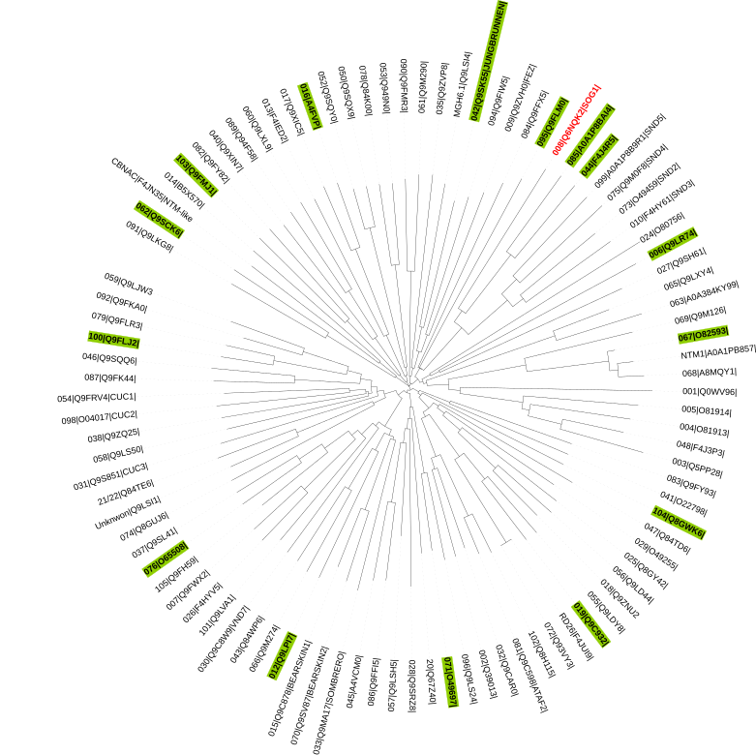
Titles FAM – tab N. NAC family (1/2)
N1. ANAC006^{FL} sequence
N1a. Wild type ANAC006FL
N2. ANAC012FL sequence
N2a. Wild type ANAC012FL
N3. ANAC016FL sequence
N3a. Wild type ANAC016FL
N4. ANAC019FL sequence
N4a. Wild type ANAC019FL
N5. ANAC042FL sequence
N5a. Wild type ANAC016FL
N6. ANAC044FL sequence
N6a. Wild type ANAC044FL
N6b. PS variant ANAC044FL
N7. ANAC062FL sequence
N7a. Wild type ANAC062FL
N8. ANAC067FL sequence
N8a. Wild type ANAC067FL
N9. ANAC071FL sequence
N9a. Wild type ANAC071FL
N10. ANAC076FL sequence
N10a. Wild type ANAC076FL
N11. ANAC085^{FL} sequence
N11a. Wild type ANAC085FL
N12. ANAC095FL sequence
N12a. Wild type ANAC095FL
N13. ANAC100FL sequence
N13a. Wild type ANAC100FL
N14. ANAC103FL sequence
N14a. Wild type ANAC103FL
N15. ANAC104FL sequence
N15a. Wild type ANAC104FL

Slide 45
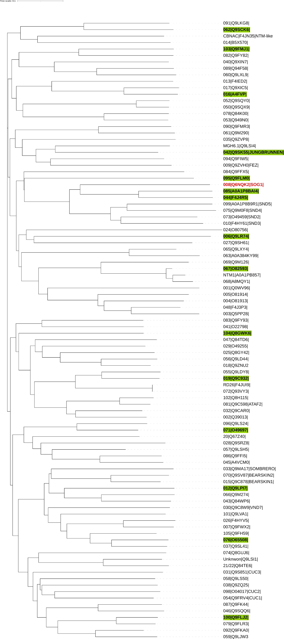

Slide 49
ERKINE TILES ERK – O. Erkine tiles
Research questions
Do Erkine’s tiles comply with the Staller reporter system (20AA tiles completed with 20 Gly to reach 40AA in length total)?
How does the Erkine control (entire Gly tile) compare to our usual controls?
Which dipeptide (WD, LD, YD) and how many repeats are necessary to match the activity of well studied control tiles? Are homo-stretches (W, D, L, Y) of varying length functional?
Does helicity play a role?
Can non-active SOG1 tiles (“ADdead” in Description) be made functional by adding a dipeptide that is activating according to Erkine?
Can an active SOG1 tiles (“ADact” in Description) be simplified to encompassing a single activating dipeptide and remain functional? Does further simplification cause a loss of activity?
Content
Extended Erkine tiles: 20AA tiles copied from Erkine publications and extended into 40AA tiles (Gly added)
Controls (known + full Gly) - Dipeptides (GS, WD, LD, YD) - Homostretches (G, W, D, L, Y) - Helicity
SOG1 Erkine-like tiles: SOG1 active (32, 42) and inactive (2, 22, 29, 31, 38) basic tiles that are being altered to test Erkine’s statements
Remark
There are a lot of repeats and small sequence differences between tiles, possibly complicating their correct recognition during the analysis of sequencing data. Be aware of this.
Some tiles – for example entire hydrophobic repeats - are expected to have only limited solubility, thus influencing fluorescent sorting and sequence-based scoring! Consider including a solubility calculator/ predictor when drawing conclusions. Remark that A. Erkine did not question/ test this in his work.
Titles ERK – tab O. Erkine tiles
O1. Extended Erkine tiles
O2. SOG1 Erkine-like tiles

Slide 50
CONTROL TILES CRL – P. Controls
Research questions
Do the activity scores of identical control tiles differ between libraries and sorts?
Do we use the controls to identify an activity threshold? If so, what is the cut-off value?
How do these control tiles compare to the Erkine control (entire Gly tile) and the AD-lacking TF (absolute control)? How does the choice of control effect our conclusions?
Content
Standard controls
GCN4 library controls
Remark
The tiles in CRL were used as controls in the first library also. Can these be used to scale scores between libraries and sorts?
Titles CRL– tab P. Controls
P1. Standard controls
P2. GCN4 library controls

