Slide 1

IILM UNIVERSITY, GREATER NOIDA
INTERNSHIP REPORT PRESENTATION
Data Science Master
Virtual Internship
AICTE – EduSkills Virtual Internship Program | Supported by Siemens
Sanjana Kumari
IILM University, Greater Noida
April – June 2026

Slide 2
ABOUT THE STUDENT
👩‍🎓
Candidate Profile
🪪
Roll Number
Sanjana
Kumari
2410031590
🏛️
Institute
IILM University, Greater Noida, U.P.
Data Science Master Program
🎓
Programme
Data Science Master, AICTE–EduSkills Virtual Internship
🎯
Internship Domain
Data Science (Supported by Siemens)
📅
Duration
8 Weeks | April – June 2026
Data Science Master Virtual Internship • Sanjana Kumari
02

Slide 3
ABOUT THE PROGRAM
EduSkills, AICTE & Siemens
EduSkills Foundation is a non-profit organisation building an Industry 4.0-ready digital workforce in India. It partners with the All India Council for Technical Education (AICTE) to run the AICTE–EduSkills Virtual Internship Program under the AICTE National Internship Portal. For the Data Science Master track, EduSkills collaborates with Siemens, whose Altair/RapidMiner Academy delivers an industry-aligned, no-code-to-code data science curriculum through structured learning modules and a capstone project.
🤝
🏳️
🏭
Nation Building
AICTE Patronage
Siemens Support
EduSkills works under the theme “Nation Building Through Skills” for India's students.
Run under the AICTE National Internship Portal, jointly certified with the Ministry of Education.
Industry curriculum delivered via Siemens' Altair/RapidMiner Academy learning pathways.
Data Science Master Virtual Internship • Sanjana Kumari
03

Slide 4
PROBLEM STATEMENT
Bridging Theory and Applied Data Science
Although many students learn statistics and machine learning theory in coursework, very few get structured, hands-on exposure to the full data science lifecycle — from cleaning messy real-world data to building, evaluating and communicating predictive models. Concepts such as regression, classification and model tuning are often understood only theoretically, with little practice applying them to real datasets using industry tools.
This internship addressed that gap — practically learning the full data science workflow:
Explore Data
→
Build Models
→
Evaluate & Tune
→
Deliver Insights
Data Science Master Virtual Internship • Sanjana Kumari
04

Slide 5
PROJECT OBJECTIVES
What the Internship Set Out to Achieve
🧹
📊
📈
Data Wrangling
Exploratory Analysis
Predictive Modeling
Clean, transform and prepare messy real-world datasets for analysis.
Uncover patterns and relationships through statistics and visualization.
Build regression & classification models using Python and RapidMiner.
🧪
🗂️
🚀
Model Evaluation
Insight Storytelling
Capstone Project
Validate, tune and compare models using standard performance metrics.
Communicate findings clearly through charts, dashboards and reports.
Deliver an end-to-end data science case study from raw data to insight.
Data Science Master Virtual Internship • Sanjana Kumari
05

Slide 6
TECHNOLOGIES & TOOLS
The Toolkit Behind the Internship
🐍
🧮
📉
🧠
Python
Pandas & NumPy
Matplotlib / Seaborn
RapidMiner Studio
Core programming language
Data wrangling & analysis
Data visualization
No-code ML workflows
📐
🤖
🛠️
📁
Statistics
Scikit-learn
Model Tuning
Capstone Project
Hypothesis testing & inference
Regression & classification
Evaluation & optimization
End-to-end case study
Data Science Master Virtual Internship • Sanjana Kumari
06

Slide 7
DATA SCIENCE PIPELINE
From Raw Data to Actionable Insight
🗄️
Data Collection Layer
Raw structured & unstructured datasets gathered
↓
Cleaning & Preprocessing
Missing values, outliers and formatting handled
🧹
↓
Exploratory Analysis Layer
Statistical summaries & visual pattern discovery
🔍
↓
Model Building Layer
Regression & classification models trained
🧠
↓
Evaluation & Tuning Layer
Metrics compared; hyperparameters optimized
🧪
↓
Insight & Reporting Layer
Findings visualized and delivered as a capstone
📢
Data Science Master Virtual Internship • Sanjana Kumari
07

Slide 8
METHODOLOGY
The 8-Week Learning Journey
1
WEEK
2
WEEK
3
WEEK
4
WEEK
Foundations & Statistics
Data Wrangling
Exploratory Data Analysis
No-Code ML with RapidMiner
Core statistics and data science principles
Cleaning & transforming data with Python
Visual & statistical pattern discovery
Building workflows on RapidMiner Studio
5
WEEK
6
WEEK
7
WEEK
8
WEEK
Regression Models
Classification Models
Evaluation & Tuning
Capstone Project
Predicting continuous outcomes
Predicting categorical outcomes
Metrics, cross-validation & optimization
End-to-end data science case study
Data Science Master Virtual Internship • Sanjana Kumari
08

Slide 9
EXPECTED OUTCOMES
Skills & Capabilities Gained
✓
Ability to clean, wrangle and explore real-world datasets using Python (Pandas & NumPy)
✓
Practical understanding of building machine learning models with RapidMiner and Python
✓
Hands-on exposure to regression, classification and model evaluation techniques
✓
Capability to visualize data and communicate insights clearly through charts and reports
✓
Skill to build an end-to-end data science pipeline, from raw data to actionable insight
✓
Completed all learning-pathway modules & the capstone project; cleared the Final Credential Validation with an “Outstanding” grade
Data Science Master Virtual Internship • Sanjana Kumari
09

Slide 10
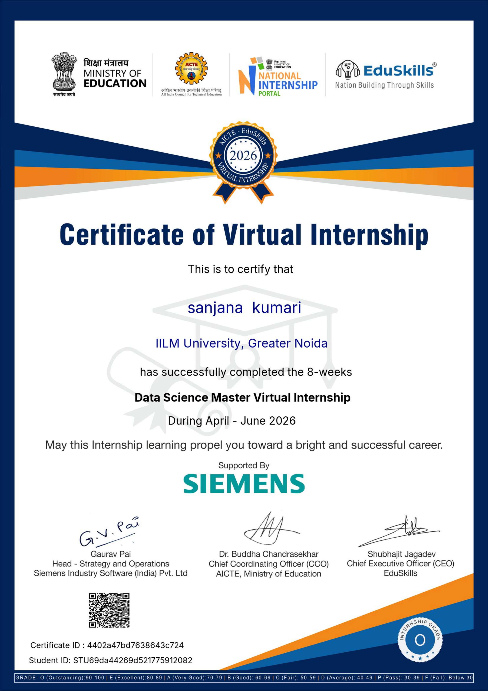
CERTIFICATION
Successfully Completed
🏅
Grade
O – Outstanding
🎫
Certificate ID
4402a47bd7638643c724
🪪
Roll Number
2410031590
📅
Duration
8 Weeks | April – June 2026
Data Science Master Virtual Internship • Sanjana Kumari
10

Slide 11
Thank You
Data Science Master Virtual Internship | AICTE – EduSkills Program
Sanjana Kumari
IILM University, Greater Noida

