Slide 1


Human Resource Distribution
View in Power BI

Slide 2
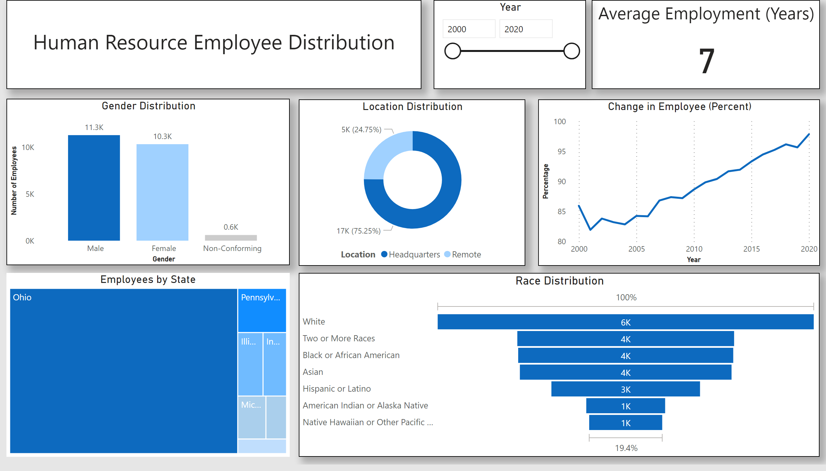
Report 1
Notes:
textbox
No alt text provided
Average Employment (Years)
No alt text provided
Gender Distribution
No alt text provided
Location Distribution
No alt text provided
Change in Employee (Percent)
No alt text provided
Employees by State
No alt text provided
Race Distribution
No alt text provided
Year
No alt text provided

Slide 3
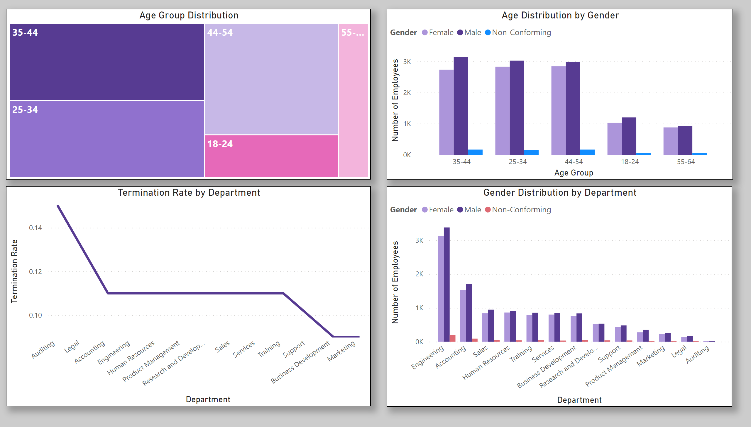
Report 2
Notes:
Age Group Distribution
No alt text provided
Age Distribution by Gender
No alt text provided
lineChart
No alt text provided
Gender Distribution by Department
No alt text provided

