Slide 1
Optimization Techniques in Machine Learning for Edge Deployment
EDGE-AI
28-JULY-2026
Sanjana , Anjana, Sayyam

Slide 2
Why Optimize? (The “Why”)
Many ML models are too large/slow for edge devices (like phones, IoT, embedded systems).
Challenges:
Limited memory and computing power.
Power/battery constraints.
Real-time response needs.
Goal: Achieve the best trade-off between speed, size, and accuracy.
What is Optimization? (The “What”)
Definition:The process of making a model smaller, faster, or more efficient—without significant loss in accuracy.
Example:
Original: Using a large deep neural network for object detection on a smart camera.
Problem: Camera lags, overheats, short battery life.
After Optimization:
Model size reduced, now smooth performance and longer battery life.
A well-optimized model = practical, reliable on edge devices.

Slide 3
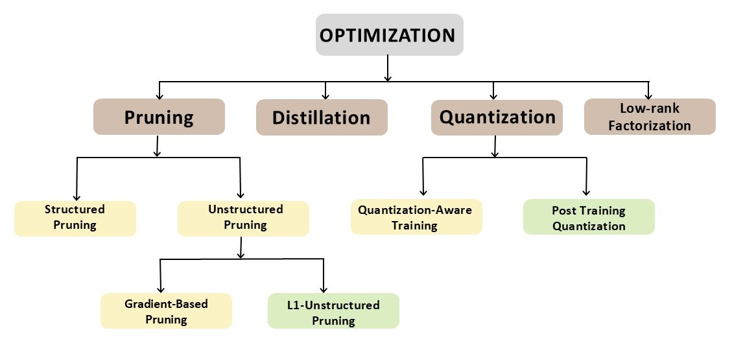
Types of Optimization Techniques
Post-training Quantization

Slide 4
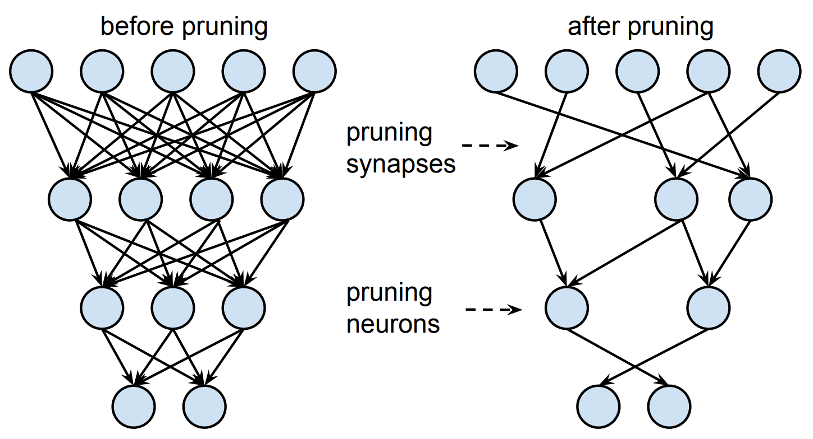
Model Compression and Pruning
Remove unneeded neurons/connections from neural networks.
Methods:
Weight Pruning: Remove small/insignificant weights.
Structured Pruning: Remove layers or channels.
Lowers memory & computation, slightly reduced accuracy

Slide 5
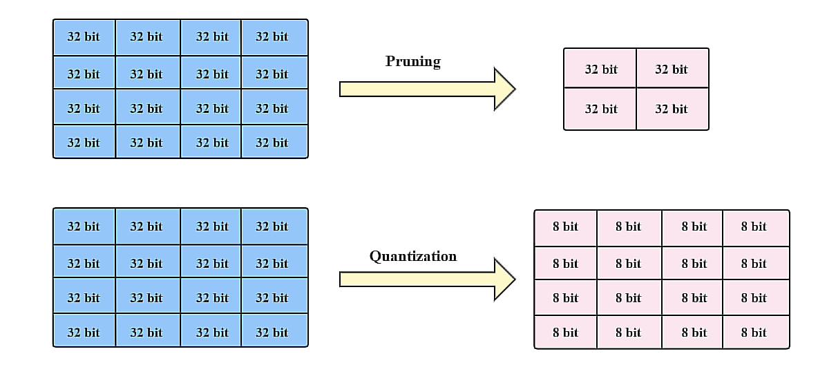
Quantization
Reduce the precision of numbers in your model (e.g., use int8 instead of float32).
Storing weights as 8-bit numbers instead of 32-bit saves 75% memory.
Faster inference, smaller size very effective for edge.

Slide 6
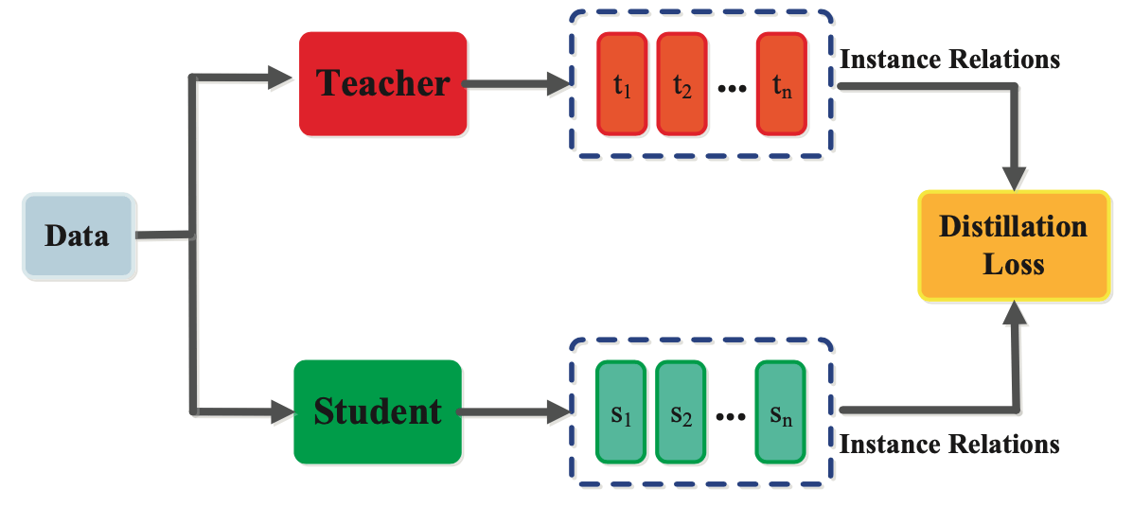
Knowledge Distillation
Train a small “student” model to mimic a larger “teacher” model.
Example:
Large BERT language model distilled into a compact MobileBERT.
Near-big-model accuracy with much smaller models.

Slide 7
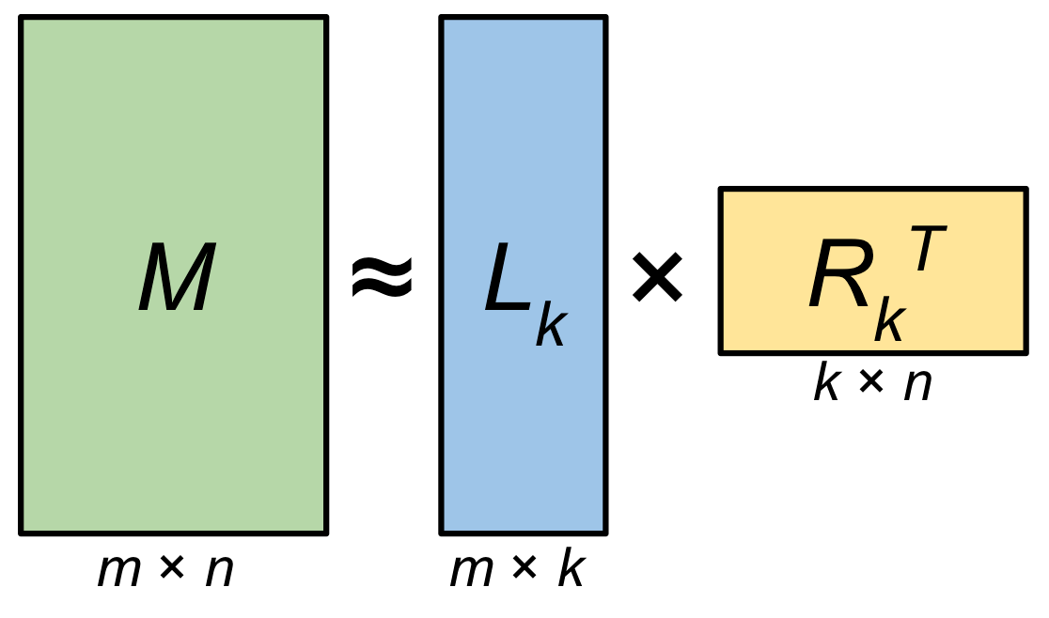
Low-Rank Factorization
Low-rank factorization is a technique used to reduce the computational and memory costs of neural networks by decomposing large weight matrices into smaller, lower-rank matrices.
Reduced Memory Usage: Fewer parameters mean smaller model size.
Faster Inference: Fewer FLOPs due to smaller matrix multiplications.
Better Generalization: Low-rank constraints can act as implicit regularization.

Slide 8
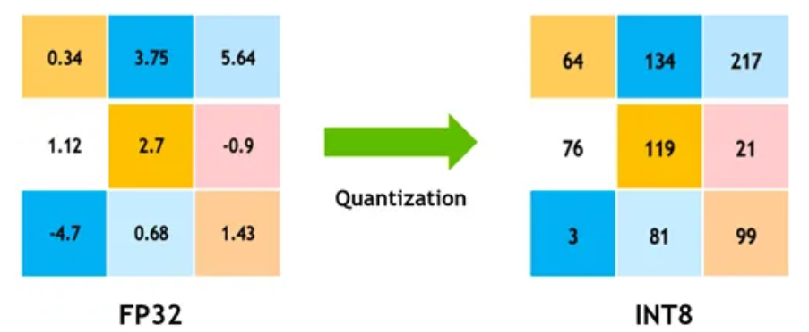
QUANTIZATION
Quantization is a method of reducing size and complexity of a model by converting its weights (which are usually float32 format) to a lower bit precision such as 8 bit , 6 bit and so on.
Float to Integer conversion
Goal of quantization is to reduce the precision of the weights by mapping them into a range that occupies less space.
Quantization mainly helps to reduce the model size so that it can be efficiently deployed onto edge devices

Slide 9
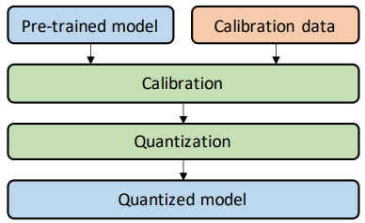
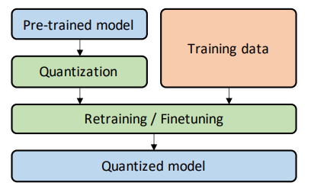
TYPES OF QUANTIZATION
Post-Training Quantization (PTQ) : PTQ is the simplest and fastest method where a trained neural network is compressed after training by reducing the precision of its weights and activations (e.g., from 32-bit floating point to 8-bit integers). This technique doesn’t require retraining and is often used when you want to quickly deploy a model on resource-constrained devices like mobile phones. While it's easy to apply, there may be a small drop in accuracy, especially for complex tasks.
Quantization Aware Training (QAT) : QAT simulates the effects of quantization during the training process itself, so the model learns to adapt to the reduced precision. This leads to better accuracy than PTQ, especially for sensitive tasks like image classification or object detection. However, QAT is more complex to implement and requires retraining the model, making it more time-consuming but more accurate in the end.
Figure 1 : PTQ
Figure 2 : QAT

Slide 10
TYPES OF QUANTIZATION
Dynamic Quantization : Dynamic Quantization is a lightweight form of quantization that only quantizes the weights ahead of time, while the activations are quantized on-the-fly during inference. It works well for models with lots of control flow like RNNs and Transformers (e.g., for text). Since it doesn’t require calibration data or retraining, it’s simple to apply, but it may not be as efficient as static quantization for all workloads.
Static Quantization : Static Quantization quantizes both weights and activations ahead of time by using a calibration dataset to find the appropriate scaling factors. This makes it more efficient than dynamic quantization, especially for image-based models like CNNs. While it requires a small dataset for calibration, it can deliver better performance and accuracy compared to dynamic quantization, especially on edge devices.

Slide 11
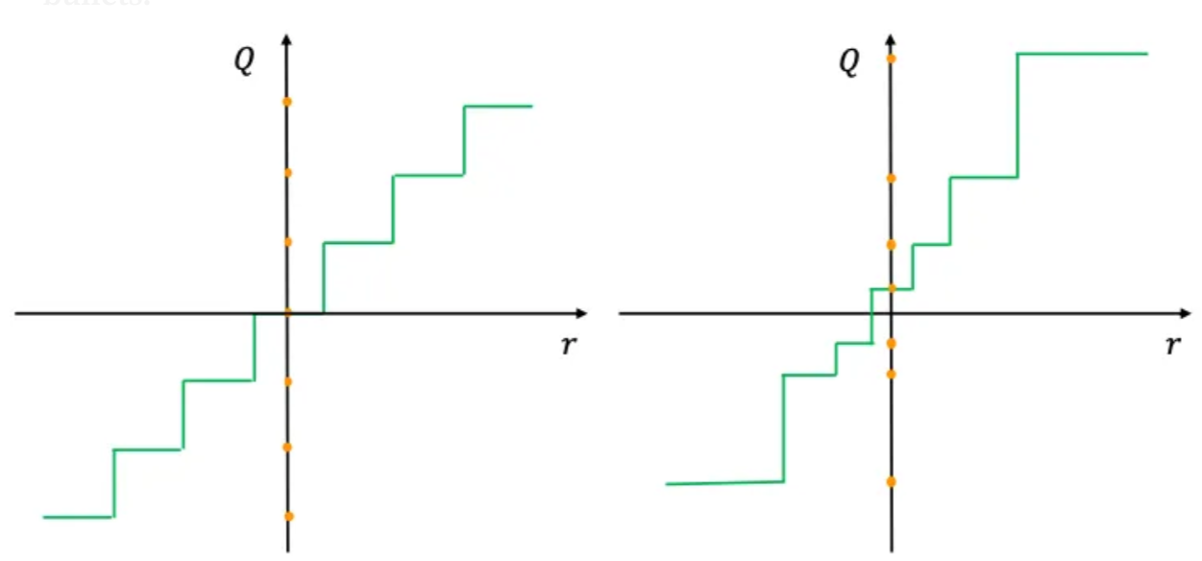
QUANTIZATION SCHEMES
Uniform Quantization :Uniform quantization divides the value range into equal-sized intervals, meaning each step between quantized values is the same. It’s easy to implement and highly efficient on hardware like CPUs and microcontrollers. Because the steps are uniform, converting between floating-point and integer values becomes simple and works well for evenly spread distributions.
Non-Uniform Quantization : Non-uniform quantization uses intervals of varying sizes based on the data distribution. It makes use of smaller steps where data is dense and larger steps where it is sparse. This approach can retain more accuracy, especially for skewed distributions.

Slide 12
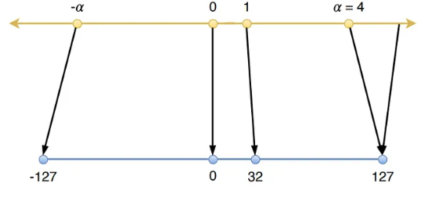
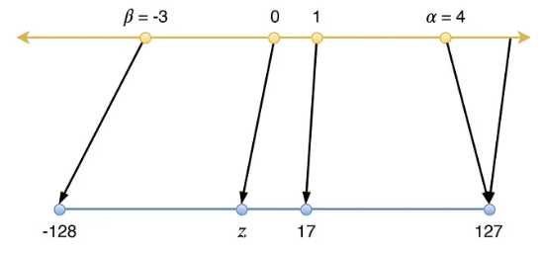
QUANTIZATION SCHEMES
Symmetric Quantization : The quantization range is centered around zero and zero point always maps to 0. It is simple and hardware-friendly often used for weights (which are typically balanced around zero).
Asymmetric Quantization :The quantization range is not centered around zero. It is used when the data is mostly positive or skewed and it includes a zero-point offset to correctly map 0 on to the quantized scale.
Symmetric Quantization
Asymmetric Quantization

Slide 13
CONCLUSION
Quantization is a powerful technique to optimize deep learning models for efficient deployment.
It significantly reduces memory footprint and computation cost without major loss in performance.
Various types like uniform, non-uniform, symmetric, and asymmetric quantization offer flexibility based on the use case.
Proper calibration and techniques like quantization-aware training help maintain model accuracy.
Overall, quantization is essential for bringing AI models to real-world, resource-constrained environments like mobile and edge devices.

