Slide 1
RESUME SCREENING USING MACHINE LEARNING
Sanjana Rayarala (A20548132) Sai Dheeraj Surampally (A20545700) Rahul Narahari (A20545662)

Slide 2
Introduction
In today's fast-paced job market, the process of resume screening and categorization stands as a critical yet time-consuming task for both job seekers and employers. The Resume Screening project is conceived as an innovative solution to address this challenge.
For individuals looking to understand where their expertise and skills fit best in the job market, this system offers clarity and direction.
It categorizes their resume into a specific job category, effectively mapping their qualifications to potential job roles. This feature is particularly beneficial in guiding job seekers towards the roles they are best suited for.

Slide 3
Problem Statement
The primary objective of the Resume Screening project is to develop an automated system for efficiently categorizing resumes into various predefined categories. This system aims to streamline the process of resume screening, making it faster and more accurate. By classifying resumes based on their content, the system assists the users to understand under which category of jobs their resume falls based on their skills thereby providing a user-friendly functionality where, upon classification, users are provided with a convenient link. This link directs them to nearby job postings related to their classified job category, sourced from reliable job search platforms.

Slide 4
High-Level Overview of approach
Machine Learning: The project utilizes machine learning techniques to learn from a dataset of labeled resumes, comparing against various algorithms and choosing the best to train the model to recognize patterns and features in the resumes that correlate with specific categories.
Natural Language Processing (NLP): As resumes are text-heavy documents, the project employs NLP techniques for text preprocessing and feature extraction.
Integration of ML and NLP: The combination of NLP for processing and transforming the resume data and ML for classification forms the backbone of the project. This integrated approach allows the system to effectively understand and categorize the content of each resume.

Slide 5
Work flow
Data gathering
Preprocessing data
Implementing ML algorithms
Choosing the best algorithm based on accuracy metric
Testing on an unseen resume
Training the model

Slide 6
Data Source
Data Source: Kaggle
The dataset was taken from Kaggle (https://www.kaggle.com/datasets/jillanisofttech/updated-resume-dataset). It consists of two columns: Category & Resume
Category consists of the roles of jobs, where as Resume consists of the skills associated to the job role.

Slide 7
Data preprocessing
Text cleaning
Tokenization
Text Transformation
Normalization
Includes removing URLs, special characters, symbols, words starting with # and @
Converts all text to lowercase, which is a common normalization technique to ensure that the same words in different cases are treated uniformly.
Tokenize a given sentence into individual words and then join these tokens back into a string. Useful to standardize the spacing and separation of words and punctuation.
Transforms text data into a format suitable for machine learning models, specifically using the Term Frequency-Inverse Document Frequency (TF-IDF vectorizer) method.

Slide 8
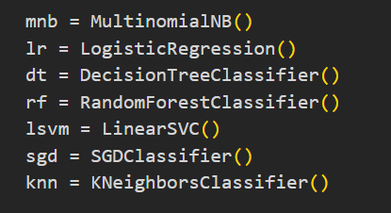
Algorithms
Algorithms
Multinomial
Logistic regression
Decision tree classifier
Random forest Classifier
Linear SVC
SGD classifier
K Neighbours classifier

Slide 9
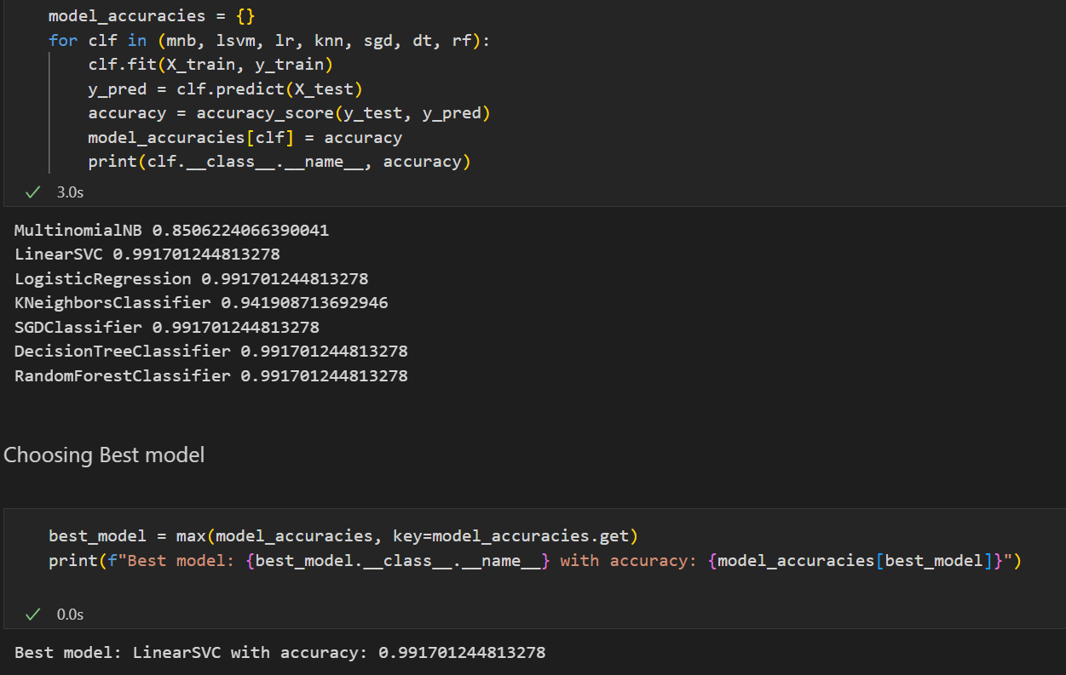
Choosing the best Algorithm
Choosing the best algorithm based on the accuracy metric

Slide 10
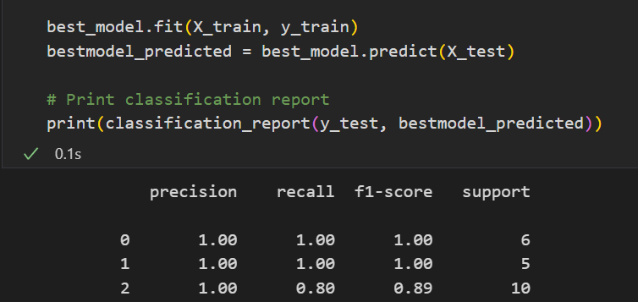
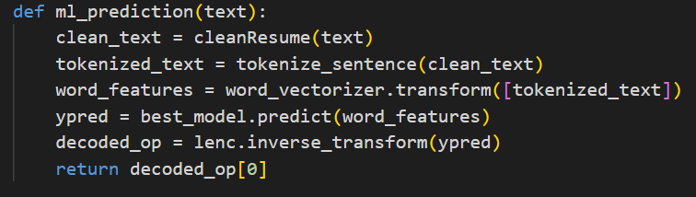
Choosing the best Algorithm
Training using the best algorithm.
Using the model.

Slide 11
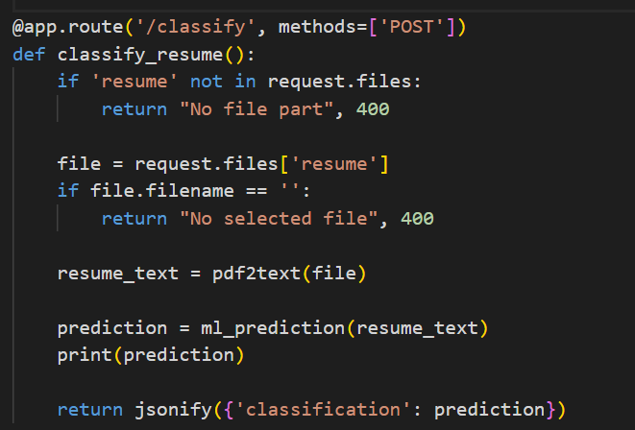
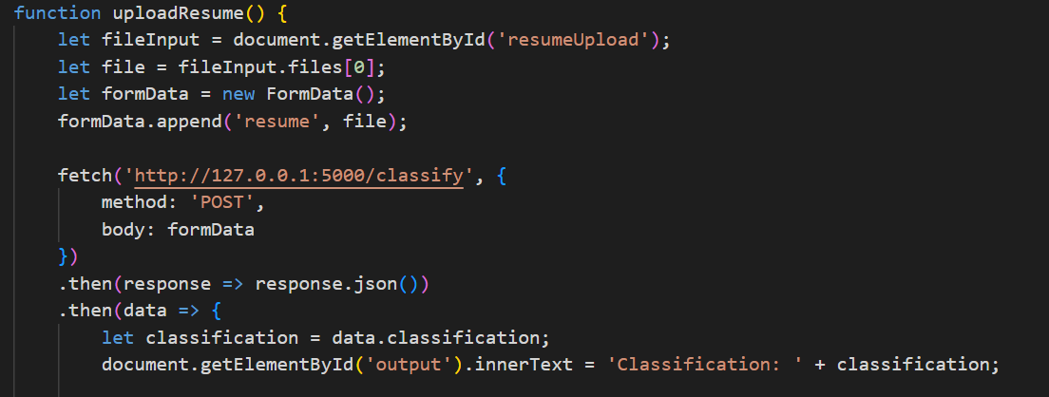
Using the model for Web page
Back-end.
Front-end.

Slide 12
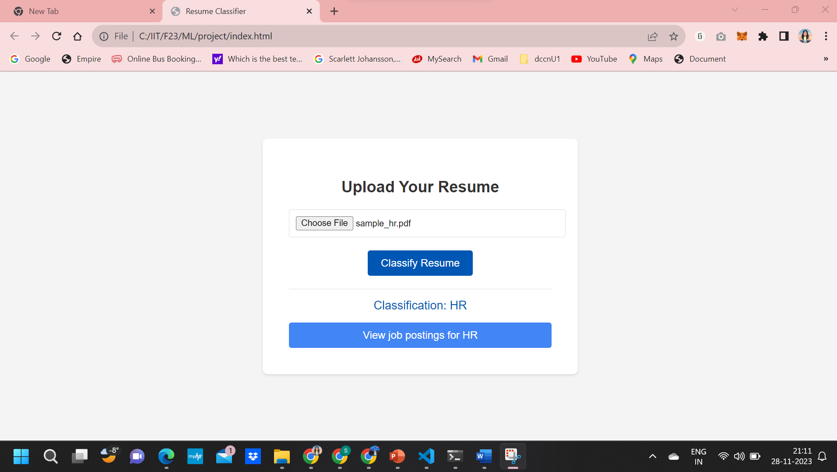
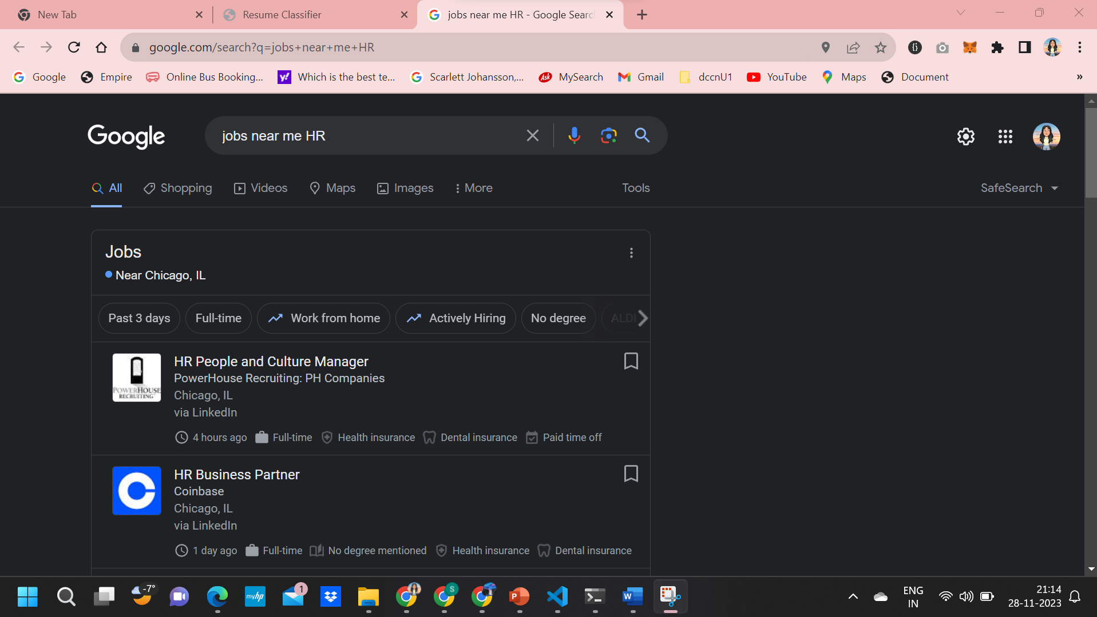
Testing on unseen resume

Slide 13
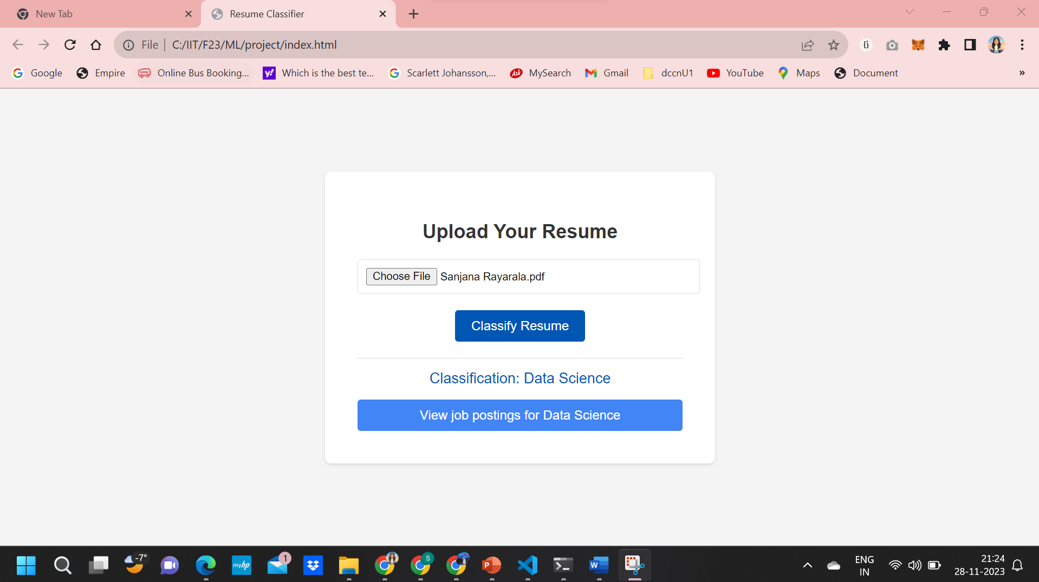
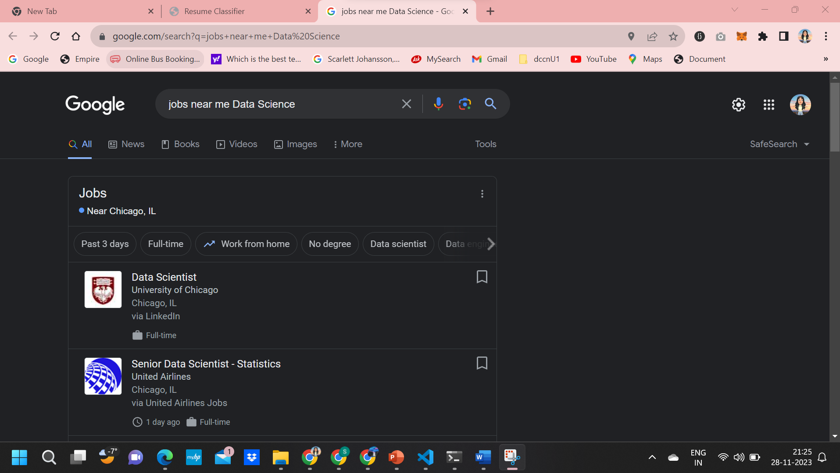
Testing on unseen resume

Slide 14
THANK YOU!
ANY QUESTIONS?

