Slide 1

KAVACH
PROTECTING HER · EMPOWERING ALL
Women's Safety Website
Project Presentation
Member 1 · Member 2 · Member 3 · Member 4 · Member 5
Notes:
Welcome. Replace Member 1–5 with team names.

Slide 2


Introduction
MEMBER 1
The concern
CURRENT VERSION
Women may face unsafe situations while travelling, working, studying or in unfamiliar places.
A prototype
The need
It demonstrates the interface and intended features. It is not a replacement for official emergency services or a guarantee of real-time rescue.
In an emergency, getting help quickly and reaching trusted people can matter most.
Our solution
KAVACH: one simple safety dashboard for SOS, contacts, status, location and demo mode.
Notes:
Why women's safety matters and what KAVACH is. Stress that it is a prototype.

Slide 3
Objectives
MEMBER 1
Build a simple, user-friendly women's safety website
Provide an easily accessible SOS option on the dashboard
1
2
Let users keep a list of trusted emergency contacts
Show the user's safety status in one place
3
4
Offer location-sharing options for emergencies
Include a demo mode to explain and present features
5
6
Create a foundation for advanced safety services later
One dashboard. Quick access.
7
Notes:
Seven objectives that guided the project.

Slide 4





Core Features
MEMBER 2
SOS Emergency Button
Prominent button that starts the emergency-alert process
Trusted Contacts
Add and manage names and numbers of people you trust
Safety Status
Dashboard area showing the current safety status
Location Sharing
Map and GPS controls; needs browser and device permission
Demo Mode
Explore and present features without a real emergency
Notes:
KAVACH is a web-based safety dashboard. These are the five main features of the prototype.

Slide 5





More Modules & Status
MEMBER 2
Also on the interface
Prototype status
Guardian Timer
A module counts as working only if implemented and tested
Incomplete options are future development work
Location depends on browser permission and device settings
Alert delivery depends on connected functions
Fake Call
Stealth Mode
Safe Havens
Incident Log
Notes:
Other modules appear on the interface. Describe them as working only if implemented and tested.

Slide 6

Advantages
MEMBER 3
Simple Dashboard
Quick Access
Contact Management
Key safety options in one place
SOS clearly visible on the main screen
Trusted details kept in the site
Location Awareness
Easy Demonstration
Scope to Improve
A starting point for location safety
Demo mode helps explain the site
Can grow with testing and feedback
Notes:
Six advantages of the current design.

Slide 7
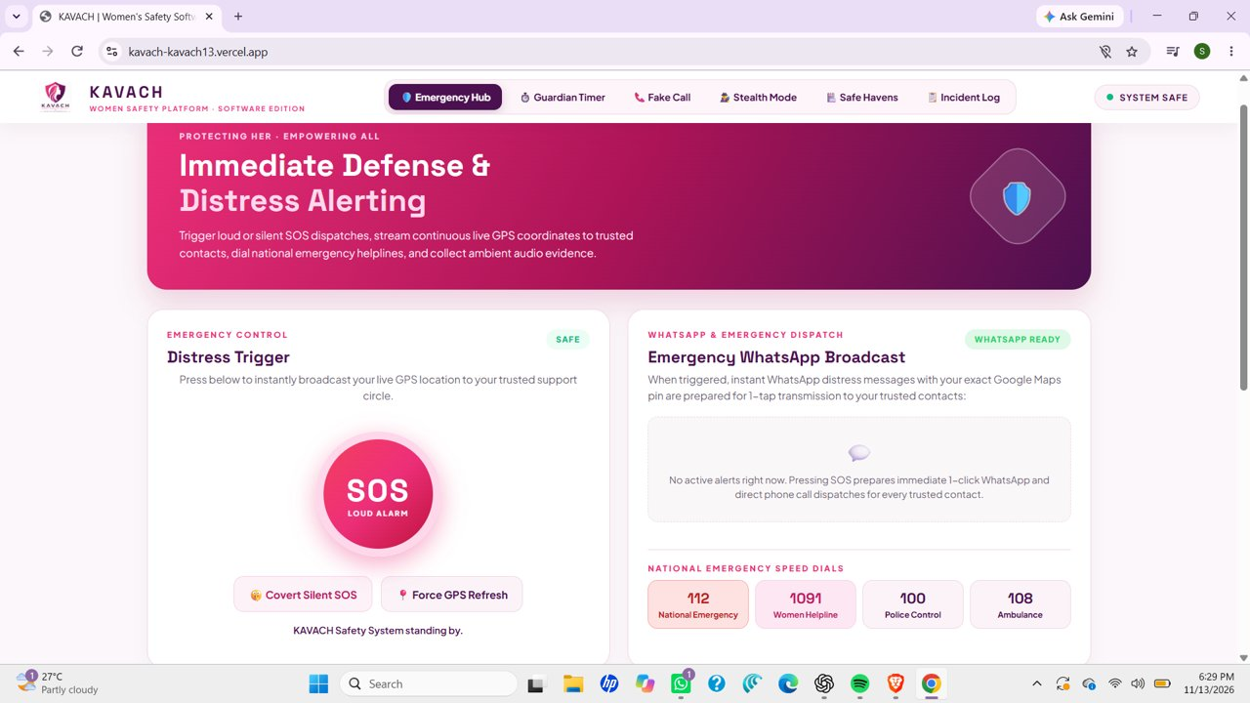
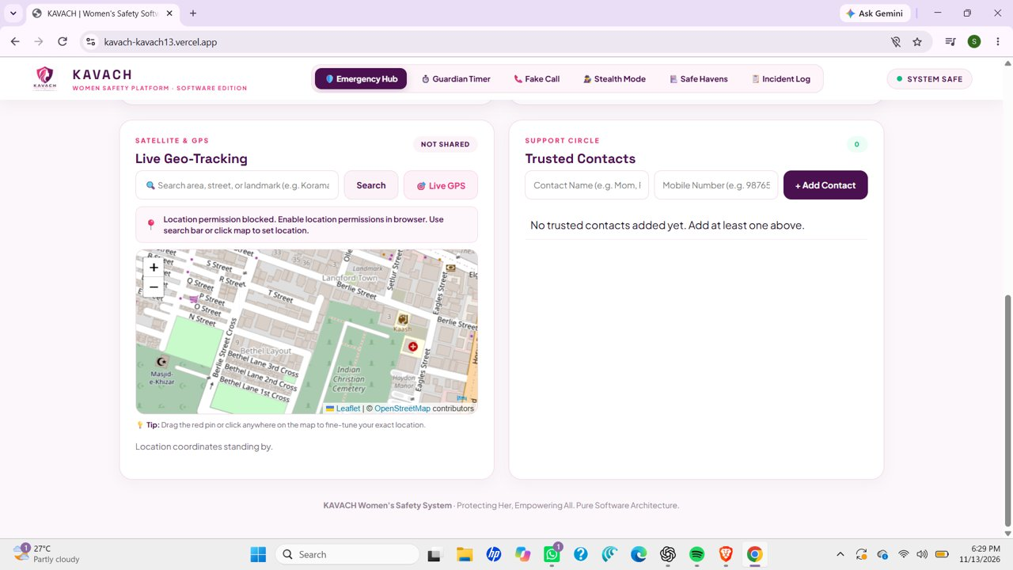
Website Screenshots
MEMBER 3
Fig 5.1 Emergency Hub
Fig 5.2 Location & Contacts
SOS, silent SOS, GPS refresh, WhatsApp broadcast and helplines
Map, GPS controls and add-contact section
Live prototype: kavach-kavach13.vercel.app
Notes:
Fig 5.1 shows the Emergency Hub. In Fig 5.2 location permission is blocked and no contacts are added, so these functions need testing with permissions and sample data.

Slide 8
Upcoming Features
MEMBER 4
Proposed future work, not part of the current prototype
Live Location Sharing
Automatic Alerts
Share location with chosen contacts for a set time, with consent and privacy controls
Optionally notify contacts on SOS or a missed safety check-in
Guardian Timer
Verified Safe Havens
Check-in timer that reminds users to confirm they arrived safely
Verified nearby hospitals, police stations and approved support places
Notes:
These are proposed future developments, not working features of the prototype.

Slide 9



Expanding the Platform
MEMBER 4
Proposed future work, not part of the current prototype
Mobile Application
Emergency-Service Integration
Privacy & Security
Android and iOS app for easier access and carefully tested notifications.
Formal partnerships with authorities or support groups, subject to approval and rules.
Secure storage, consent-based sharing, access controls and data-deletion options.
Notes:
Mobile app, formal integration with emergency services, and stronger privacy and security.

Slide 10


Business Model Idea
MEMBER 5
Free for individuals
Optional paid plans
Sustained growth
Basic KAVACH stays free for individual users.
Safety dashboards and group support for colleges, hostels and companies.
Partnerships and subscriptions fund maintenance and development.
Any paid service comes only after safety, privacy and reliability are tested.
Notes:
Free for individuals; optional paid plans for organisations only after safety, privacy and reliability are tested.

Slide 11

Conclusion
MEMBER 5
What it is
What it shows
What is next
A prototype dashboard with SOS, contacts, status, location controls and demo mode.
A simple website can organise safety tools in one place.
Better reliability, privacy, location services and emergency communication.
A useful foundation for a more complete women's safety platform.
Notes:
Wrap up: prototype now, strong foundation for future.

Slide 12
Thank You
Questions?
kavach-kavach13.vercel.app

