Slide 1


Synopsis Presentation on
Sentiment Analysis of Student Feedback Forms
Guided By: Presented By:
Prof. Pawan Makhija Priyanshu Sharma (0827IT231104)
Rahul Nagar (0827IT231108)
Prahlad Kumawat (0827IT231099)
Sanjana Singh Sengar(0827IT243D10)

Slide 2
Contents
Introduction
  1.1 Overview
  1.2 Purpose
Literature Review
Problem Statement
Proposed Solution
Objectives
Theoretical Analysis
  6.1 Block Diagram
  6.2 Hardware Requirements
  6.3 Software Requirements
Applications
8. Referance

Slide 3
1. Introduction
1.1 Overview
Automatically classifies student feedback into positive, neutral, or negative sentiments using NLP & ML.
Extracts key themes and recurring concerns from unstructured feedback.
Generates summarized, anonymized reports with sentiment breakdowns and keyword trends.
Provides a secure, user-friendly dashboard for administrators to make data-driven decisions.
1.2 Purpose
Automates Feedback Review – Saves time by analyzing feedback automatically.
Provides Clear Insights – Detects sentiment (positive/neutral/negative) & key themes.
Supports Better Decisions – Enables data-driven improvements in teaching & curriculum.
Ensures Fairness & Anonymity – Protects student privacy with unbiased reports.

Slide 4
2. Literature Review
S. No. | Authors | Feature | Method | Advantages | Disadvantages
1 | Charalampos Dervenis, Panos Fitsilis, Omiros Iatrellis, Athanasios Koustelios (2022) | Sentiment Analysis of Student Feedback | NLP-based sentiment classification | Provides insights into student perception of teaching and curriculum | Limited to specific datasets, may not generalize well
2 | F. Dalipi, D. Imran, A. Rehman (2021) | Sentiment Analysis in MOOCs | Machine Learning & NLP techniques | Helps in understanding learners’ attitudes in online courses | Data imbalance issues affect accuracy
3 | T. Shaik, et al. (2023) | Sentiment & Opinion Mining in Education | Deep Learning & Opinion Mining | Handles large-scale educational data, captures opinions effectively | High computational cost, requires large datasets
4 | A. Kastrati, A. Imran, F. Dalipi (2023) | Online Learning Feedback Analysis | NLP + ML in online education context | Enhances quality of e-learning platforms through feedback insights | Domain-specific, limited to online learning only

Slide 5
3. Problem Statement
Manual & Subjective Reviews – Student feedback is analyzed manually, making the process slow, inconsistent, and prone to bias.
Overlooked Insights – Critical concerns, recurring themes, and valuable suggestions are often missed due to lack of objectivity.
Inefficient Mechanisms – Traditional feedback systems face low response rates, lack of motivation, and mistrust in their impact.
Limited Analysis – Manual methods fail to capture overall sentiment trends, comparisons across semesters, and key themes.
Privacy Concerns – Current systems often compromise anonymity, accuracy, and timely reporting, discouraging genuine participation.

Slide 6
4. Proposed Solution
Automated Sentiment Classification – Classify student feedback into positive, neutral, or negative using NLP and machine learning.
Theme & Trend Extraction – Identify key issues and improvement areas in teaching, curriculum, and infrastructure.
Summarized Reporting – Generate anonymized reports with sentiment breakdowns, keyword trends, and semester-wise comparisons.
Privacy & Security – Preserve student anonymity while allowing only authorized staff to review feedback.
User-Friendly Dashboard – Provide administrators with visualization tools for easy decision-making and improved academic quality.

Slide 7
5. Objectives
To classify feedback automatically.
To extract frequently mentioned themes.
To generate anonymized reports.
To help administrators make data-driven decisions.
To preserve student privacy and ensure fairness.

Slide 8
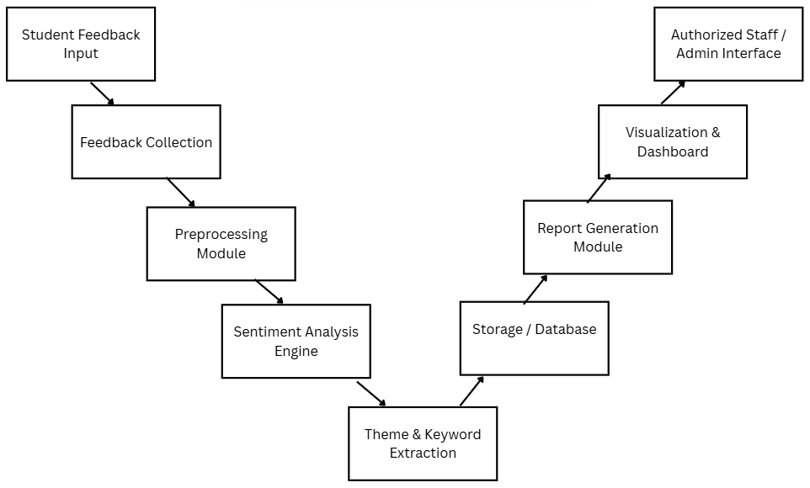
6. Theoretical Analysis
Block Diagram of Text Processing

Slide 9
6. Theoretical Analysis
Hardware Requirements | Software Requirements
Processor: Intel i3 | Operating System: Windows
RAM: Minimum 4 GB (8 GB recommended for faster processing) Hard Disk: 250 GB or more (SSD preferred for better performance) | Frontend: HTML, CSS, React JS Backend: Python 3.13.1 Libraries/Frameworks: VADER (Valence Aware Dictionary for Sentiment Reasoning)(for NLP) PyTorch (for ML) Pandas, NumPy (for data processing) Matplotlib (for visualization & charts) Report Generation Tools: Matplotlib, Plotly
Input Devices: Keyboard, Mouse | Database: MySQL (to store feedback data)
Output Devices: Monitor/Display | IDE: VS Code

Slide 10
Applications
Education Sector – Analyze student feedback to improve teaching quality, curriculum, and campus facilities.
Corporate Training & HR – Understand employee or trainee feedback to enhance workplace culture and training programs.
Customer Service – Evaluate customer reviews to improve products and services.
Healthcare – Analyze patient feedback to improve hospital services and patient experience.
Government & Public Services – Collect and analyze citizen feedback to improve schemes, policies, and public facilities.

Slide 11
GitHub Link
https://github.com/sanjanasengar50/Minor_Project_G20

Slide 12
REFERENCES
Charalampos Dervenis, Panos Fitsilis, Omiros Iatrellis, Athanasios Koustelios, "A Sentiment Analysis of Student Feedback," Department of Business Administration, University of Thessaly, Larisa, Greece, https://www.ijiet.org/vol14/IJIET-V14N4-2074.pdf
F. Dalipi, D. Imran, A. Rehman, "Sentiment Analysis of Students' Feedback in MOOCs," 2021, https://pmc.ncbi.nlm.nih.gov/articles/PMC8459797/
T. Shaik, et al., "Sentiment analysis and opinion mining on educational data," 2023, ScienceDirect, https://www.sciencedirect.com/science/article/pii/S2949719122000036
A. Kastrati, A. Imran, F. Dalipi, "Sentiment Analysis of Students Feedback in Online Learning," 2022, ACM Digital Library, https://dl.acm.org/doi/10.1145/3659677.3659733

Slide 13
Thank You
Queries ?

