Slide 1



Precision Fertiliser and Pesticide Recommendation System
Name: Sanjana Sri Manjunath
AICTE Student ID: STU66a0ea4e860831721821774

Slide 2

Learning Objectives
Understanding Sustainable Farming Practices
Learn how AI can help to reduce the use of harmful fertilizers and pesticides.
Explore ways to protect soil, water, and biodiversity for healthier farming.
Applying Green Skills using AI for Agriculture
Using data of soil, weather, and crops to create accurate fertilizer and
pesticide recommendations.
Build AI models that are efficient and environmentally friendly.
Develop Practical Skills
Work with real agricultural data to solve farming challenges.
Create tools that farmers can easily use to manage their crops better.
Collaborate and Present Solutions
Engage in mentoring and group learning to enhance my project.
Present my solution to industry experts and learn how to make it more effective.
GOAL
Source :
www.freepik.com/

Slide 3
Tools and Technology used
1. Programming Language
Python 3.1.8 – The core language used for implementing ML models, rule-based logic.
2. ML & Data Handling
Scikit-learn – Used for training the crop recommendation model based on soil and weather data.
Pandas – For handling datasets (fertilizer and pesticide recommendations).
NumPy – For numerical computations and array manipulation.
Matplotlib - Create graphs and charts for soil nutrients, rainfall patterns, and crop suggestions.
3. Development Environment
Google Colab - Interactive cloud-based Python environment for development, testing, and
experimentation without local setup.
4. Dataset – Kaggle-”Crop Recommendation dataset”
5. Version Control
Git & GitHub – For tracking code changes, collaboration, and sharing the project repository publicly.

Slide 4
Methodology
Problem Definition Identifying the need for crop, fertilizer, and pesticide recommendations to support sustainable farming.
Data Collection Gathering soil, weather, and crop datasets from open sources
Data Preprocessing Clean, normalize, and structure data for ML modeling and rule-based logic.
ML Crop Recommendation Build and train a classification model using Scikit-learn to suggest suitable crops.
1. Random Forest Classifier
2. SVC(Support Vector Classifier)
3. XGBClasssifier
Fertilizer & Pesticide Suggestion Create rule-based recommendations with eco-friendly alternatives to reduce chemical usage.
Sustainability Tips Providing practical tip like crop rotation and water conservation for long-term soil health.

Slide 5
Problem Statement:
Farmers lack access to accurate, data-driven advice for crop selection and fertilizer and pesticide use.
Overuse of chemical fertilizers and pesticides leads to soil degradation and environmental harm.
Weather and soil conditions vary, making decision-making complex for farmers.
There is limited awareness about sustainable and eco-friendly agricultural practices.
A user-friendly tool is needed to provide real-time recommendations based on soil and climate data.
Helping farmers make informed decisions can improve crop yield and promote long-term soil health.

Slide 6
Solution:
“Precision Fertilizer and Pesticide Recommendation System for Sustainable Agriculture” An AI-based system that helps farmers choose the right fertilizers and pesticides using soil and weather data. The tool provides recommendations that reduce chemical use and promote sustainable farming practices.
Key Features:
Crop prediction based on soil nutrients and climate.
Fertilizer and Pesticide suggestions with eco-friendly alternatives.
Sustainability tips like crop rotation and organic methods.
Promotes sustainable agriculture and improves long-term soil health.
Git URL : https://github.com/sanjanasrimanjunath/Sustainable_Agriculture.git

Slide 7
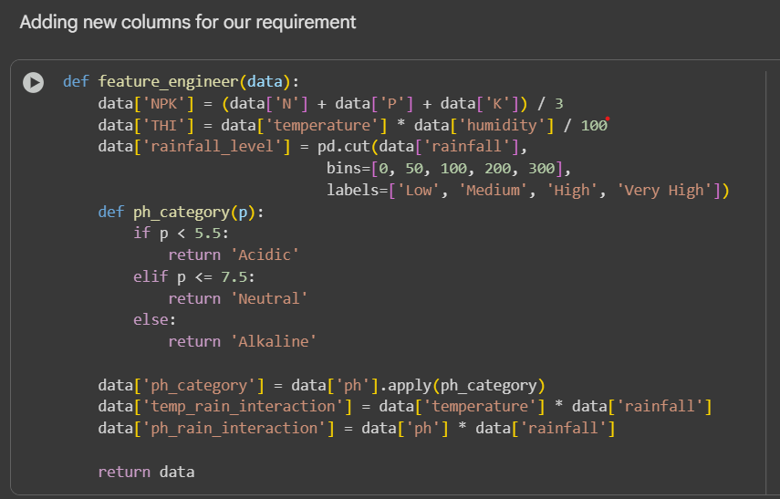
Screenshot of Code:

Slide 8
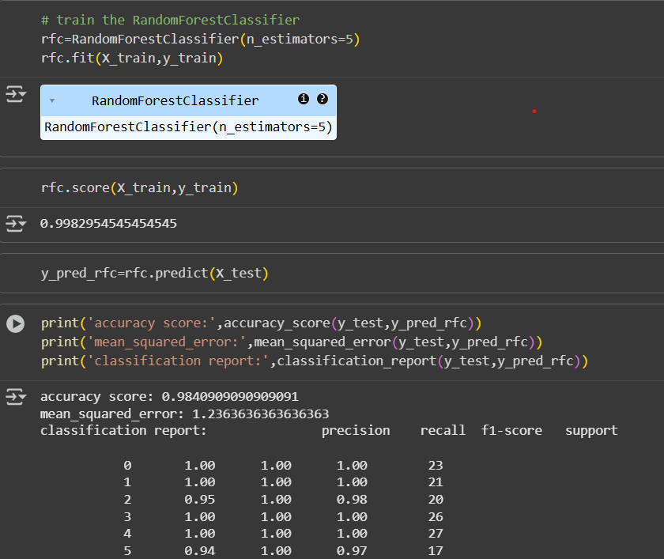
Screenshot of Random Forest Classifier:

Slide 9
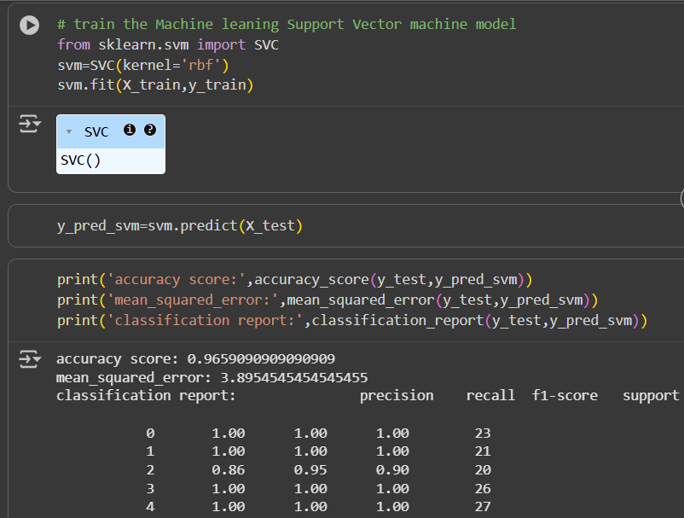
Screenshot of SVC():

Slide 10
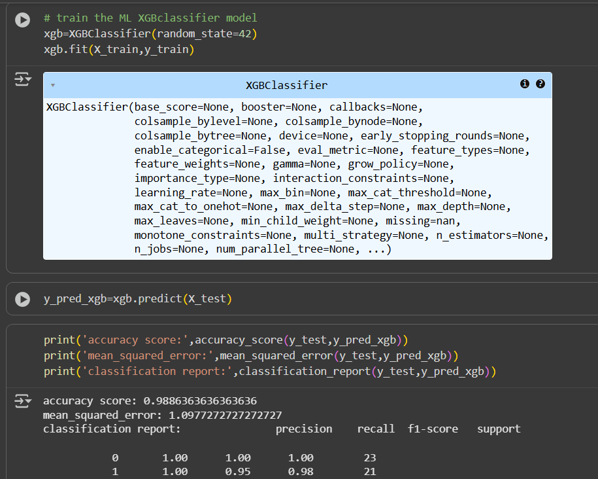
Screenshot of XGBClassifier :

Slide 11
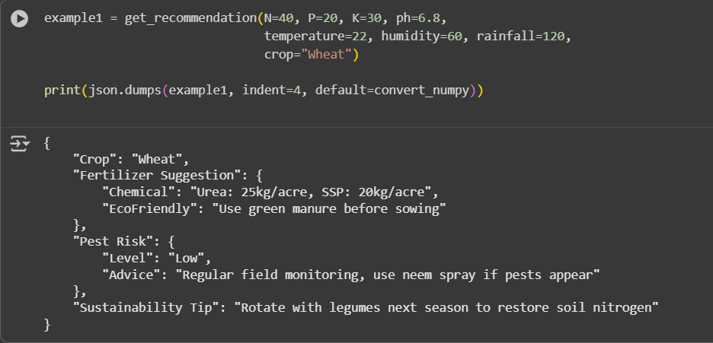
Screenshot of Output:

Slide 12
Conclusion:
This project demonstrates how AI and data-driven methods can empower farmers to make informed decisions while promoting sustainable agriculture. By combining machine learning with expert-driven rules, the system provides fertilizer suggestions, pesticide recommendations and eco-friendly alternatives. The user-friendly interface ensures easy access, helping reduce chemical overuse, improve yields, and support long-term soil health. This solution showcases the potential of technology to drive environmentally responsible farming practices for a better future

