Slide 1
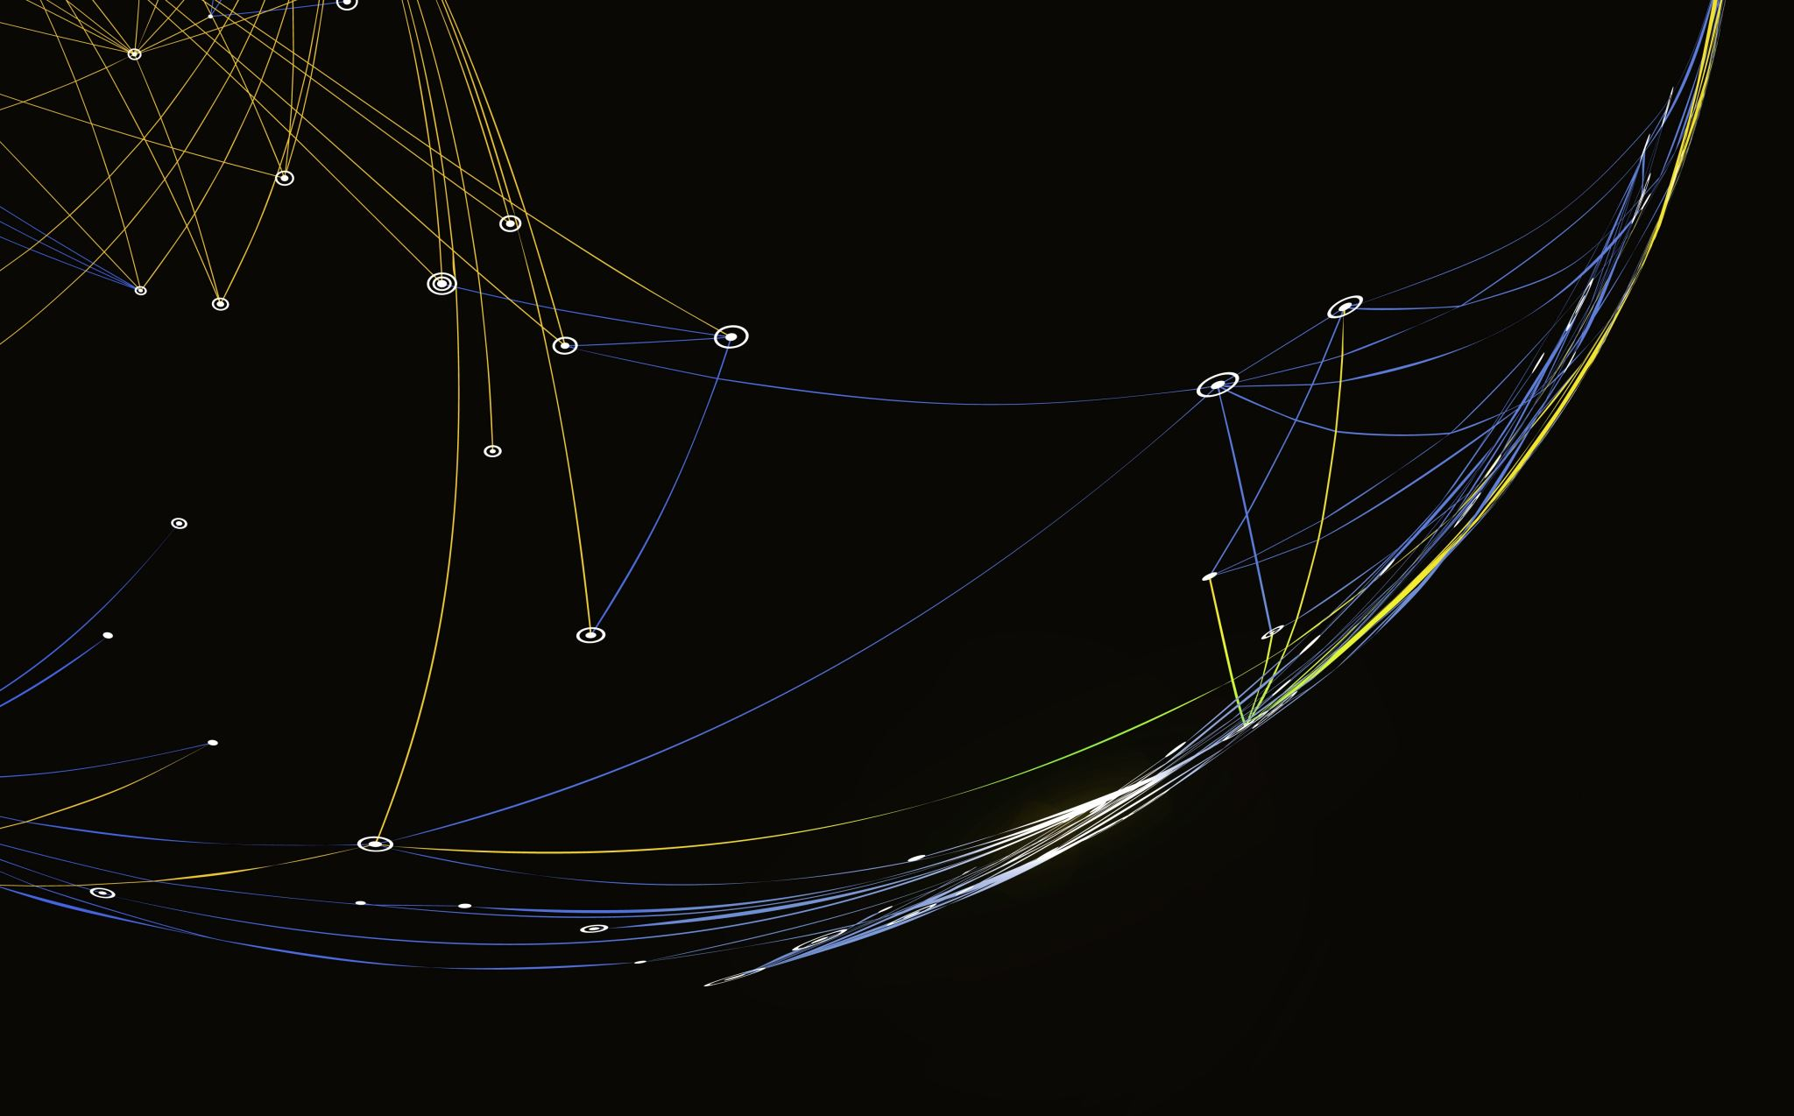
MODELLING AND ANALYSIS OF THE ANSWERFORCE TRIAL PROGRAM
By
Sanjana Suresh

Slide 2
CONTENT
Context and purpose of Analysis
Dataset information
Exploratory Data Analysis
Which customers have converted better
Current trend of how the trial program is doing
Recommendations to improve the trial program
Factors that impact trial program performance
Modelling approach
Potential customers likely to convert
Key findings and insights

Slide 3
Context and purpose of Analysis
Answerforce is an AI product that businesses use to address and manage customer questions on websites such as Online Shopping
Users have a three-month free trial period post which they opt to convert into the paid version of the product
The idea is to provide key insights on how the program is doing, steps to improve the program and to identify likelihood of potential customers to convert to the paid subscription.

Slide 4
DATASET INFORMATION
We have the following information of the trial program users from 2019 and 2020 to perform the analysis and modelling:
Account Attributes:
- Account id, type, activated chatbot or not, converted to paid or not
Account Usage:
- Account id, Date time of clicks, Number of clicks

Slide 5
EXPLORATORY DATA ANALYSIS
DATA PREPROCESSING STAGE
Before proceeding with analysis, the two datasets were merged based on
account id
aggregated to get the total number of link clicks associated with every customer

Slide 6
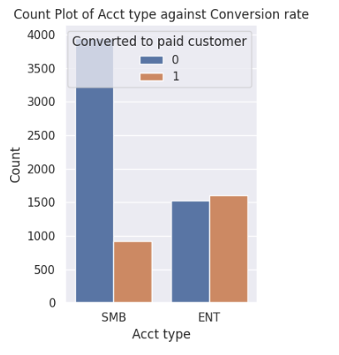
Which customers have converted better?
To visualize this, a count plot was developed on the number of SMB and ENT customers who converted and who did not.
We can derive that only 30% of the SMB customers converted from trial to paid version of the Answerforce subscription.
More than 50% of the ENT customers have converted to paid subscription at the end of the trial period.
Thus, ENT type of customers who have over 1000 employees have a higher likelihood of converting

Slide 7
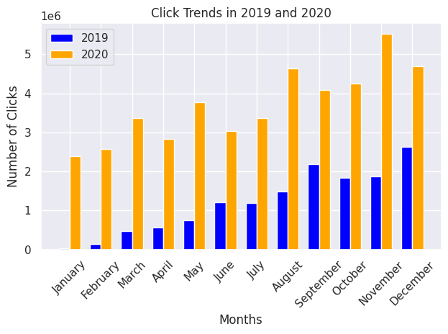
Current trend of how the trial program is doing
From statistical evaluation, there is a strong correlation between the number of clicks and the conversion rate of customers
Monthwise trend in the number of Answerforce clicks is depicted in the graph
INSIGHTS FROM HIGH CLICKS :
August-September - Back to school shopping
November - Black Friday sale and thanksgiving
December - Christmas and New year
2020 – Covid possibly increased online shopping

Slide 8
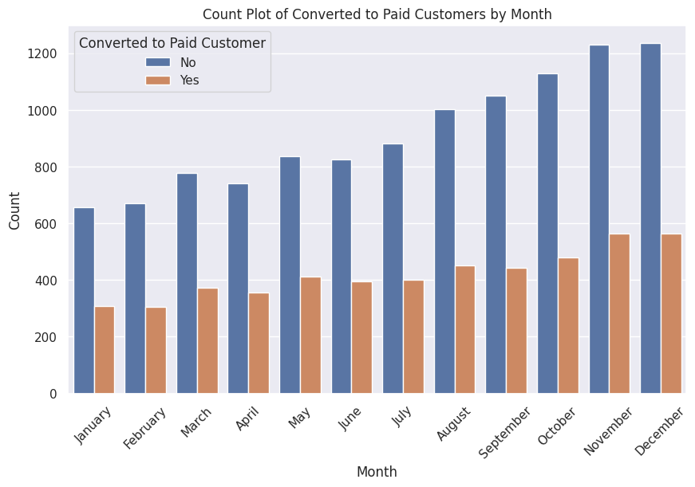
Recommendations to improve the trial program
Promote early enrolment to trial program
We know that month wise trend in clicks indicates more usage during holiday season
Deeper analysis through the given graph of conversion rate based on monthly usage indicates that there is lowest conversion rate during holiday season.
Thus, we need to ensure customers start the trial program early to convert during peak holiday season

Slide 9
Recommendation to Promote early enrolment
Promote early enrollment into the trial program(Say July) through incentives such as:
Providing longer trial program period of 4 months so that by the time the trial version gets over (July-October), it is holiday season and there is a higher probability of them converting to paid version during the peak period
Provide subsidised rates to those customers who enrol in the early bird offer to improve the customer churn rate.
This would enable in making sure customers convert to paid version by the time its peak shopping period

Slide 10
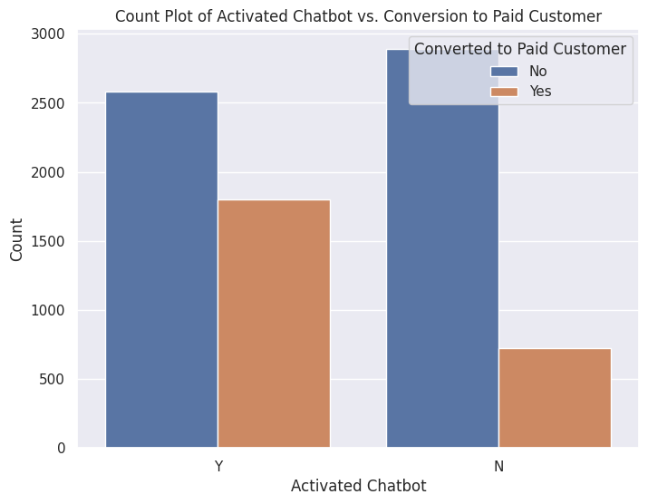
2. Promote Activation of chatbot feature
Given count plot provides a visualisation of customers with or without the chatbot feature and their conversion rates
Its clear that customers who have enabled their chatbot feature and have converted to paid subscription are 60% higher when compared to those who don’t it enabled

Slide 11
Recommendation to enable features
Promote enabling of additional features such as:
Tutorials and popups encouraging users to enable their chatbot features
Including more features in the Answerforce product
Improve the user experience and thereby increasing the chance of conversion.

Slide 12
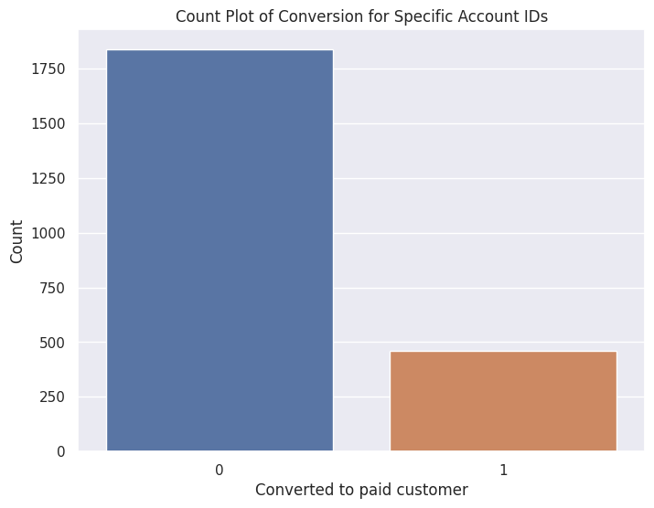
2. Improving product suggestion based on low link click information
It is observed from the dataset that there are customers who have very low link clicks (Range of 0 to 100).
On analysis of the conversion rate of those 2300 odd customers, it is clear approximately 80% of them do not convert
This indicates that low link customers maybe are not satisfied with the user experience

Slide 13
Improving product suggestion based on low link click information
Perform further analysis on what can be done to improve the user experience:
Getting review feedback on what is lacking
Identifying the product interests of those customers and working on improving the product recommendations.
Improve the user experience => Increase Product Usage => Customer Conversion Rate.

Slide 14
Factors that impact trial program performance
From the analysis performed so far, we will focus on the following features to identify the potential customers who are likely to convert to Answerforce’s paid version:
Account type
Activate chat bot
Monthly account usage
Number of link clicks

Slide 15
MODELLING APPROACH
Logistic Regression Model
A regression model was built to predict the potential customers so that we can assess a more precise association between all the factors that impact conversion such as chatbot activation and number of link clicks.
This model was chosen as it produces more quantifiable results such as the log odds of the event happening, that help in evaluating the prediction to a greater extent.

Slide 16
Potential customers likely to convert
The statistical inferences from the Logistic Regression model suggests that:
- If the account type is ENT and chatbot is disabled, log odds for conversion is -0.55.
- When chatbot is enabled, your log odds go up by 0.84
Thus, customers who enable their chatbot feature while using the Answerforce product have a greater likelihood to convert to paid customers.
Any additional clicks by customers increases the log odds to some extent
Thus, customers who have a better user experience with the Answerforce product and use all its features indicated by number of link clicks would potentially convert to paid customers

Slide 17
Key findings and insights
The performance of the Logistic Regression model was better when compared to other models in terms of accuracy and other key metrics during model evaluation. These results align with the recommendations to improve the trial program.
Enterprise customers have a higher likelihood of conversion to paid subscription of the Answerforce product
This analysis clearly indicates the fact that, increased usage of the product in terms of the number of clicks and enabling the chatbot, results in an improvement in the customer churn rate to premium customers

Slide 18
THANK YOU

