Slide 1

Graph Based Route Finder(using graph Theory and shortest path algorithms..)
Presented By:
Pratiksha O. Tiwari
Priyal S. Kattyappa
Sanjana V. Upase
Rucha A. Sangaonkar

Slide 2
Introduction
Route finding is a common real-world problem Used in navigation and map systems. This project finds the shortest path between two locations Implemented using C++ programming language Uses graph theory concepts Emphasizes algorithmic efficiency.
Route finder systems use graph theory to solve real-world navigation problems. Every location is treated as a node, and every connecting road is an edge with an associated cost like distance or time. By analyzing the graph, the system identifies the best possible route for the user. This technology is commonly used in Google Maps, delivery apps, and traffic management systems.

Slide 3
Problem Statement
To find the shortest route between source and destination Locations are represented as nodes Routes are represented as edges Each edge has a distance or cost Manual route calculation is inefficient Need for an automated solution

Slide 4


Graph Representation
Adjacency list saves memory Suitable for sparse graphs
Graph consists of vertices and edges Can be directed or undirected
2
4
Edge weights are stored along with destination nodes
.
1
Edge weights represent distance or time Implemented using adjacency list
3
Each node is assigned a unique index or label
5

Slide 5

Concept of Graph in This Project
Nodes represent locations Edges represent paths between locations .
Weight represents distance or cost Real-world road network modeled as a graph .
Graph simplifies complex routing problems Makes algorithm application easier.

Slide 6
Algorithms Used
Dijkstra’s Algorithm Finds shortest path in weighted graph Breadth First Search (BFS)Used for unweighted graphs Priority queue used for efficiency Ensures minimum distance selection Produces accurate shortest path
Algorithm avoids revisiting nodes with finalized shortest distance. Guarantees optimal shortest path when all edge weights are non-negative

Slide 7
System Flow
Graph is created in C++ program
User enters source location
User enters destination location
Algorithm processes the graph
Shortest route is displayed
Distance of route is also shown

Slide 8
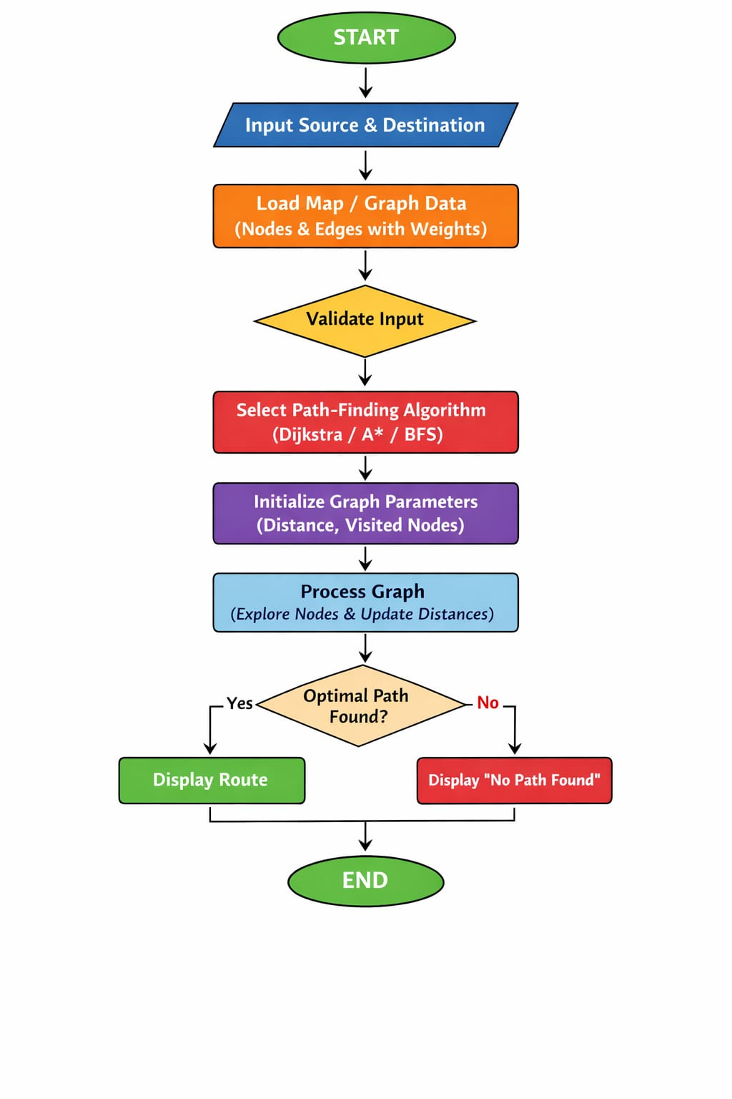

Slide 9
Data Structures Used
Adjacency list for graph storage Priority queue for minimum distance selection Arrays / vectors for distance and visited nodes STL used for implementation Improves performance and readability Reduces coding complexity
Pair structure used to store destination node and edge weight Boolean or integer array used to mark visited nodes

Slide 10
Features of the Project
Simple and efficient logic Easy to modify and extend
Suitable for small and medium networks
Console-based user interaction
Fast route calculation
Clear output display

Slide 11
Applications….
1
2
3
4
5
6
GPS and navigation systems
Delivery and logistics planning
Network routing
Traffic management systems
Emergency service routing
Campus or city map systems

Slide 12
Advantages
50
Efficient shortest path
Calculation Accurate and reliable results
Improves understanding of graph algorithms
Practical real-world application
Reduces manual effort Scalable for future expansion
40
30
20
10
0
Item 1
Item 2
Item 3
Item 4
Item 5

Slide 13
Future Enhancements & Conclusion Future Enhancements
Add real-time map and traffic data
Support multiple routes
Improve user interface
Store data using files or databases
Conclusion:
Graph Based Route Finder solves routing problems effectively C++ ensures fast execution Project strengthens graph and algorithm concepts

Slide 14
Thank you!

