Slide 1
Final Project
SANJANA V
2021506085
BTECH INFORMATION TECHNOLOGY
3/21/2024 Annual Review

Slide 2
PROJECT TITLE
Art Generation using GANs
3/21/2024 Annual Review

Slide 3
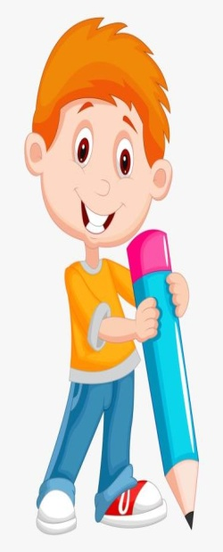

AGENDA
1. Introduction:
- Introducing GANs as a powerful tool for manipulating drawings, allowing for the generation of realistic images from input drawings.
2. Data Preprocessing & Collection:
- Selecting appropriate drawing datasets, considering factors such as diversity, quality, and relevance to the target application and implementing preprocessing steps to prepare the data for training, including normalization, resizing, and augmentation techniques.
3. Model Design & Training:
- Designing a customized GAN architecture tailored specifically for drawing manipulation tasks, with optimized generator and discriminator networks.
4. Evaluation of Performance:
- Defining comprehensive evaluation metrics to assess the quality, fidelity, and diversity of manipulated drawings generated by the GAN model.
5. Deployment & Scaling:
- Developing strategies for deploying the GAN-based drawing manipulation system in production environments, considering factors such as infrastructure requirements, deployment pipelines, and resource allocation.
6. Documentation & Presentation:
- Documenting project methodologies, workflows, and findings in comprehensive documentation for future reference and replication.

Slide 4

PROBLEM STATEMENT
The challenge addressed in this project is to develop a robust framework for generating high-quality and diverse artwork using Generative Adversarial Networks (GANs). Specifically, the project aims to overcome the limitations of existing GAN-based art generation systems, such as mode collapse, training instability, and ethical concerns, to produce visually appealing and ethically sound art pieces. By leveraging advanced techniques in GAN architecture design, loss function optimization, and training stability enhancement, the project seeks to create a reliable and scalable solution for art generation that caters to various applications in digital art, design, advertising, and entertainment. Additionally, the project will explore strategies for addressing ethical considerations surrounding the use of GAN-generated art, including issues related to authorship, copyright, and the prevention of misuse. Through these efforts, the project endeavors to push the boundaries of AI-driven art generation and contribute to the advancement of creative technologies.
3/21/2024 Annual Review

Slide 5
PROJECT OVERVIEW
GANs employs deep learning methods. It is a dexterous way of posing the problem as a supervised learning problem. It is composed of two models namely Generator and a Discriminator.
Two models are trained simultaneously by an adversarial process. A generator ("the artist") learns to create images that look like the dataset while a discriminator ("the art critic") learns to tell real images apart from fakes.
During training, the generator progressively becomes better at creating images that look real, while the discriminator becomes better at telling them apart. The process reaches equilibrium when the discriminator can no longer distinguish real images from fakes.
Key Features:
Generator: The Generator is a neural network that generates the images.
Discriminator: The Discriminator network decided whether the data is fake aka created by the Generator or real i.e. from the original input data.
Gan training:
GAN training has two sections:
Section 1:The discriminator is trained real images and random noise (from an untrained generator).
Section 2:After training the Discriminator, this step uses the predictions from the discriminator. Grants the generator to adjust the weights to try to deceive the discriminator.
3/21/2024 Annual Review

Slide 6
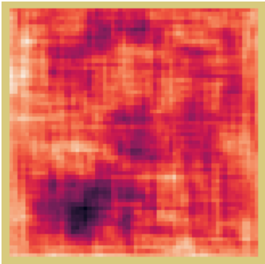
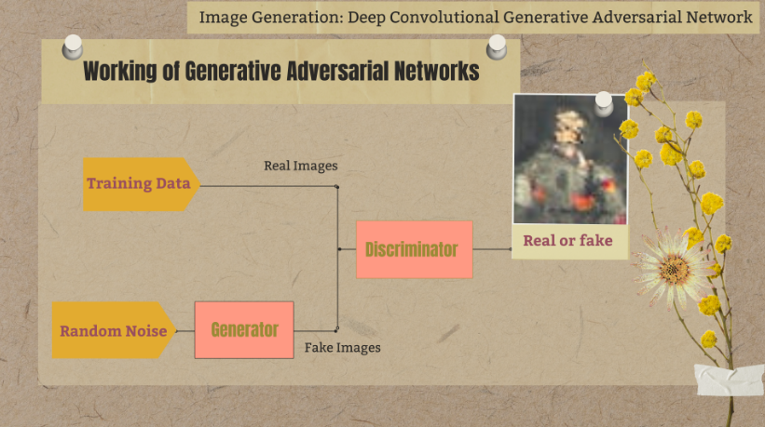
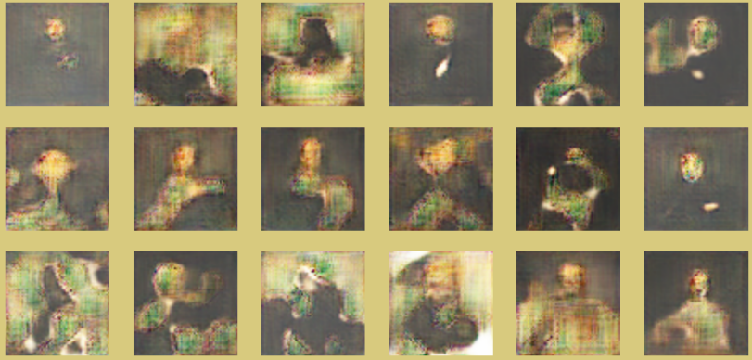
Working :
1. Preprocessing artwork images for uniformity and quality.
2. Designing a generator and discriminator using CNNs.
3. Training the networks iteratively to improve image quality.
4. Using loss functions to guide the training process.
5. Evaluating performance metrics to ensure desired image quality.
6. Generating artwork images from random noise using the trained generator.
7. Refining the system iteratively based on user feedback and trends.

Slide 7

WHO ARE THE END USERS?
1. Artists and Designers:
- Seeking inspiration for their creative projects.
- Interested in generating unique digital artwork.
2. Graphic Designers:
- Looking for novel design elements for graphic design projects.
- Wanting to incorporate AI-generated art into their work.
3. Content Creators:
- In the entertainment industry requiring visuals for various media.
- Interested in leveraging AI-generated art for video games, movies, etc.
4. Marketing Professionals:
- Needing eye-catching visuals for marketing campaigns.
- Interested in using AI-generated art for promotional materials.
5. General Users:
- Individuals curious about AI-generated art.
- Those interested in exploring and experiencing innovative digital artwork.
3/21/2024 Annual Review

Slide 8

YOUR SOLUTION AND ITS VALUE PROPOSITION
The solution involves leveraging Generative Adversarial Networks (GANs) for art generation, enabling users to create unique and visually appealing digital artwork effortlessly. By employing state-of-the-art deep learning techniques, the system can generate high-quality images resembling various art styles, ranging from paintings to sketches.
Value Proposition:
1. Creativity Empowerment:
- Enables artists and designers to explore new creative horizons by providing them with an endless source of inspiration and novel design elements.
2. Time Efficiency:
- Saves time by automating the process of generating art, allowing users to focus more on the conceptualization and refinement of their artistic vision.
3. Diverse Artistic Styles:
- Offers a wide range of artistic styles and genres, catering to the diverse preferences and tastes of users, from traditional paintings to modern digital art.
4. Accessibility:
- Provides accessibility to AI-generated art for both professionals and enthusiasts, democratizing the creation of digital artwork and fostering creativity among a broader audience.
5. Customization Options:
- Provides users with the flexibility to customize parameters such as color schemes, brush strokes, and textures, allowing them to tailor the generated art to their specific preferences and requirements.
3/21/2024 Annual Review

Slide 9

THE WOW IN YOUR SOLUTION
1. Realistic Art Generation: The ability of the system to generate art that closely resembles real artwork astonishes users with its realism and attention to detail.
2. Endless Creativity: Users are amazed by the virtually limitless creative possibilities offered by the system, allowing them to explore diverse artistic styles and concepts effortlessly.
3. User-Friendly Interface: The intuitive and user-friendly interface of the platform makes art generation accessible to users of all skill levels, enabling even beginners to create stunning artwork with ease.
4. Interactive Customization: The interactive customization options empower users to fine-tune and personalize the generated artwork according to their preferences, enhancing their sense of creative control and satisfaction.
5. Time-Saving Automation: Users are impressed by the time-saving automation features of the system, which streamline the art generation process and enable them to produce high-quality artwork in a fraction of the time it would take manually.
3/21/2024 Annual Review

Slide 10
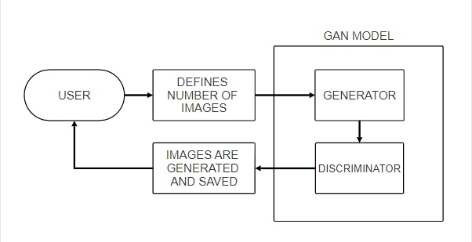
MODELLING
3/21/2024 Annual Review

Slide 11
RESULTS
In the model evaluation phase, observations reveal that the GAN effectively captured patterns within the portrait dataset, demonstrating promising performance. However, further enhancements are warranted to optimize its functionality. Given GANs' inherent data dependency, expanding the dataset size emerges as a priority. The current dataset exhibits numerous inconsistencies, posing challenges for effective learning. Addressing these issues necessitates data cleaning to establish uniformity in portrait styles. Moreover, extending the training duration by increasing the number of epochs can augment model proficiency. Additionally, refining the neural network architecture remains crucial to fortify its robustness and performance. These strategic adjustments aim to bolster the GAN's capabilities and elevate its efficacy in generating high-quality artwork.
Demo Link
3/21/2024 Annual Review

