Slide 1



Exhaustive Analysis of Indian Agriculture using Power BI
- Sanjana

Slide 2

Learning Objectives
Business Value and Features – Power BI enables data-driven decisions with interactive reports, real-time analytics, and AI insights.
Power BI Components – It includes Desktop for report creation, Service for sharing, Mobile for access, and Report Server for on-premises use.
Data Cleaning and Transformation – Power Query cleans and structures data by handling missing values, duplicates, and formatting issues.
AI Insights – Power BI detects anomalies, identifies key influencers, and uncovers trends for better analysis.
Building Dashboards – Create interactive dashboards with charts, KPIs, and filters for dynamic data visualization.
Sharing and Access – View reports on Power BI Service and Mobile, with options for sharing and role-based permissions.
GOAL
Source :
www.freepik.com/

Slide 3
Tools and Technology used:
1. Power BI desktop: Data import, modelling, visualization and dashboard creation.
2.Power Query Editor: Data extraction, cleaning, transformation, merging.
3.Power BI visuals: Bar charts, line charts, maps ,cards and slicers.

Slide 4
Methodology
Data Importing & Preparation – Gather agricultural datasets from various sources like Excel, SQL, or CSV files. Use Power Query to clean, filter, and transform the data, ensuring accuracy and consistency before loading it into Power BI.
Data Modeling & Relationships – Structure the data by defining relationships between different tables, such as crop production, seasons, and regions. Use Primary and Foreign Keys to establish connections, enabling seamless data analysis and filtering.
Visualization & Dashboard Development – Select appropriate visuals such as bar charts for crop-wise production, line graphs for seasonal trends, maps for state-wise distribution, and tables for detailed insights. Arrange these visuals into an interactive Power BI dashboard for easy navigation and deeper analysis.

Slide 5
Problem Statement:
Exhaustive Analysis of Indian Agriculture Sector Using Power BI
India's agricultural sector encounters challenges in maximizing crop production and analyzing regional disparities. This project leverages Power BI to explore agricultural data, emphasizing state-wise and district-wise crop performance, seasonal variations, and annual production trends. The objective is to derive key insights such as crop yield (production per unit area) and identify fluctuations across different regions and seasons. Through interactive visualizations, this project aims to enhance decision-making, optimize agricultural strategies, and contribute to improved productivity and resource management.

Slide 6
Solution:
Data Cleaning & Preparation – Use Power Query to remove irrelevant columns, handle missing values, and ensure data consistency for accurate analysis.
Crop Count Calculation – Use a Card Visualization to display the total number of unique crops in the dataset.
State-wise Production Analysis – Utilize a Bar or Column Chart to show total crop production per state, making it easy to compare performance across regions.
Crop-wise Production Analysis – Create a Pie Chart or Bar Chart to visualize the total production of each crop, highlighting the most and least cultivated crops.
Season-wise Production Analysis – Use a Tree Map to sum up production per season, providing insights into the most productive seasons for different crops.
Annual Production Trends – Implement a Line Chart to track production trends over the years, helping to identify growth patterns or declines in agricultural output.
Dashboard Creation – Combine all visualizations into an interactive Power BI Dashboard, allowing users to filter by state, district, season, or crop for deeper insights.

Slide 7
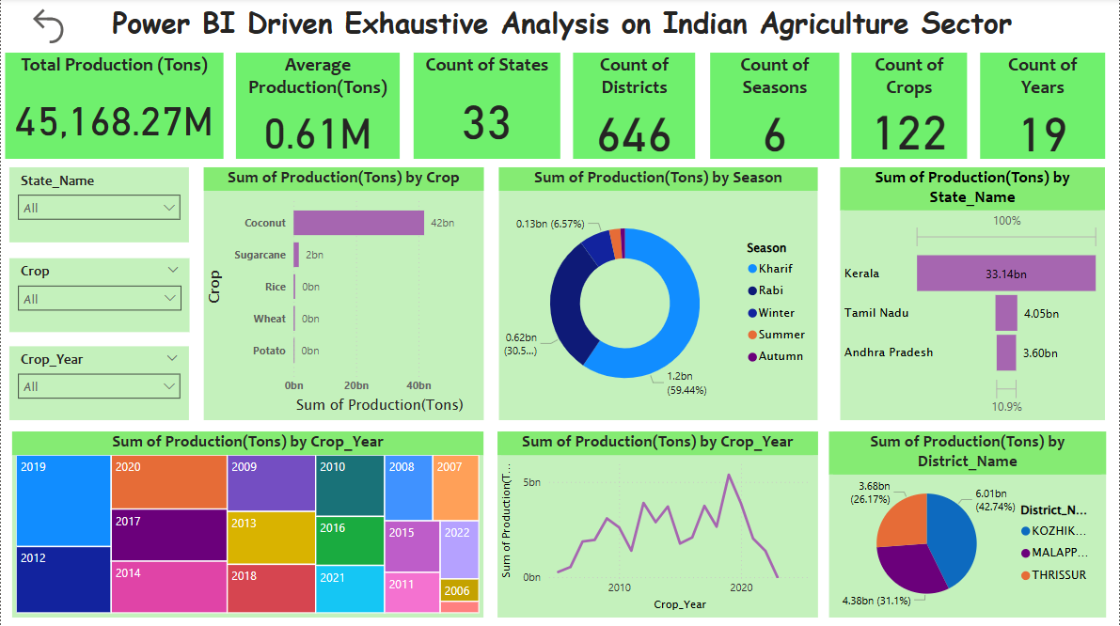
Screenshot of Output:

Slide 8
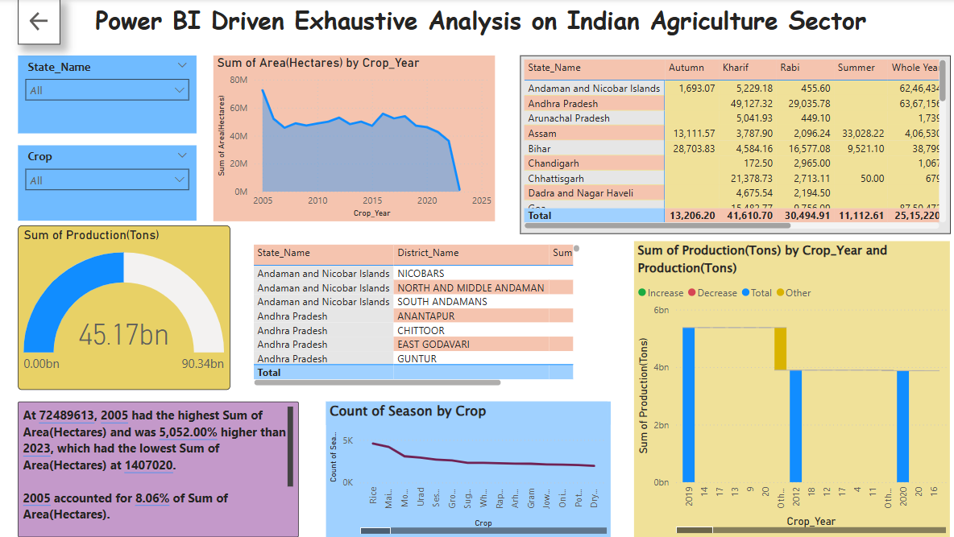

Slide 9
Conclusion:
The Power BI analysis of Indian agriculture provides detailed insights into crop production trends across states and seasons. By visualizing the total production for each season, it becomes easier to identify peak harvesting periods and understand which crops thrive in specific climates. State-wise production analysis highlights regional strengths and areas that require additional support or resources. The count of crop varieties grown in different regions offers a broader perspective on agricultural diversity and how it shifts with the seasons. These insights help optimize crop planning, allocate resources efficiently, and support data-driven decision-making. Ultimately, this analysis contributes to better agricultural policies, improved productivity, and a more sustainable farming approach in India.

