Slide 1
Computer Aided Detection and Diagnosis of Breast Cancer
Sanja Stanisic, matr. 800409

Slide 2
Contents
1 Breast Cancer
2 Mammography
3 Materials - Dataset
4 Methods
4.1 GUI Application for Radiologists
4.2 Machine Learning Techniques in Breast Cancer Detection and Diagnosis
5 Results
6 Conclusions

Slide 3
WHO - Breast Cancer Data
2020
There were 2,3 million women diagnosed with breast cancer and 685 000 deaths globally. As of the end of 2020, there were 7.8 million women alive who were diagnosed with breast cancer in the past 5 years, making it the world’s most prevalent cancer.
The strongest risk factor
Female gender is the strongest risk factor Only 0.5-1% of breast cancers occur in men.

Slide 4
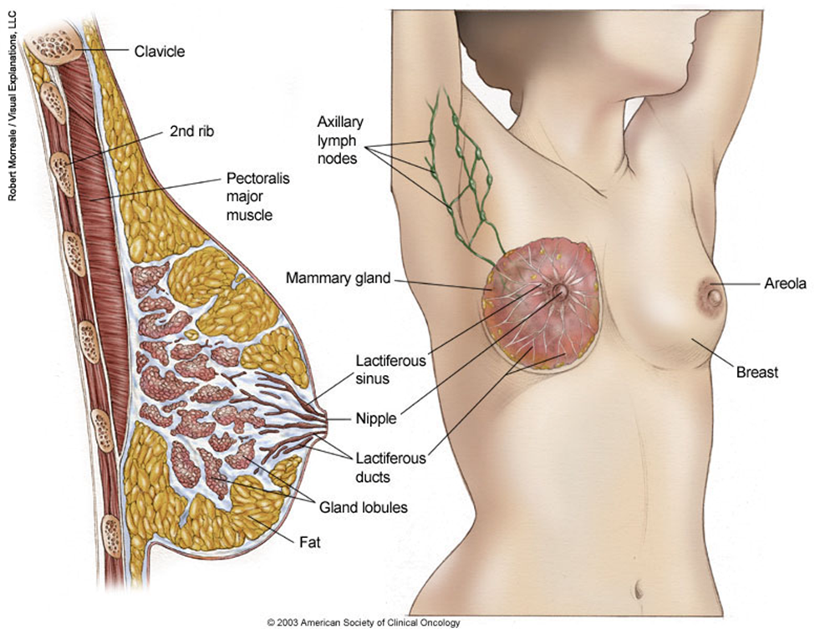
Breast cancer
Breast cancer arises in the lining cells (epithelium) of the ducts (85%) or lobules (15%) in the glandular tissue of the breast.
Initially, the cancerous growth is confined to the duct or lobule (“in situ”) where it generally causes no symptoms and has minimal potential for spread (metastasis).
Over time, these in situ (stage 0) cancers may progress and invade the surrounding breast tissue (invasive breast cancer) then spread to the nearby lymph nodes (regional metastasis) or to other organs in the body (distant metastasis). If a woman dies from breast cancer, it is because of widespread metastasis.

Slide 5
Breast Cancer
The cancer’s stage is calculated based on three clinical characteristics T, N, and M:
T - the size of the tumor and whether or not it has grown into nearby tissue
N – number of lymph nodes positive for malignancy
M – presence of distant metastasis
Treatment: surgery, radiotherapy and medication (chemotherapy, hormonal and/or targeted biological therapy)
Early detection and state-of-the-art cancer treatment are the most important strategies to prevent deaths from breast cancer
Getting regular screening tests is the most reliable way to detect breast cancer early.
1
2.
3.
4.
5.

Slide 6
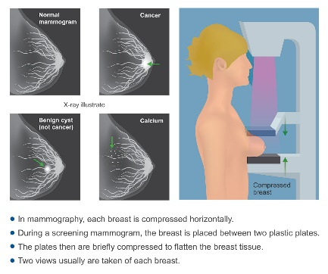
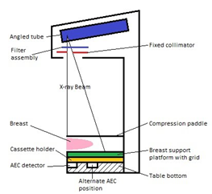
Mammography is the most efficient tool to help detect breast cancer, especially at its earliest stage. It is a process of using low-energy X-rays to examine the human breast and identifying abnormalities, typically through detection of characteristic masses or microcalcifications.
In order to standardize mammography reports, American College of Radiology (ACR) introduced Breast Imaging-Reporting and Data System, BI-RADS. BI-RADS is a quality control system, but in day-to-day usage this term refers to the mammography assessment categories. It is used by medical professionals to evaluate the patient's risk of developing breast cancer.
Computer Aided Detection and Diagnosis of Breast Cancer
1 Breast Cancer
2 Mammography
3 Materials - Dataset
4 Methods
5 Results
6 Conclusions

Slide 7
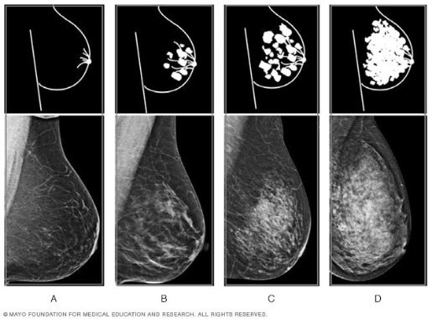
mammography
BI-RADS Assessment Categories
BI-RADS Breast Density Levels
1.
0: Incomplete
1: Negative
2: Benign
3: Probably benign
4: Suspicious
5: Highly suggestive of malignancy
6: Known biopsy – proven malignancy
Mostly fatty
Scattered fibroglandular density
Heterogeneously dense
Extremely dense
2.
2
3.
4.
5.

Slide 8
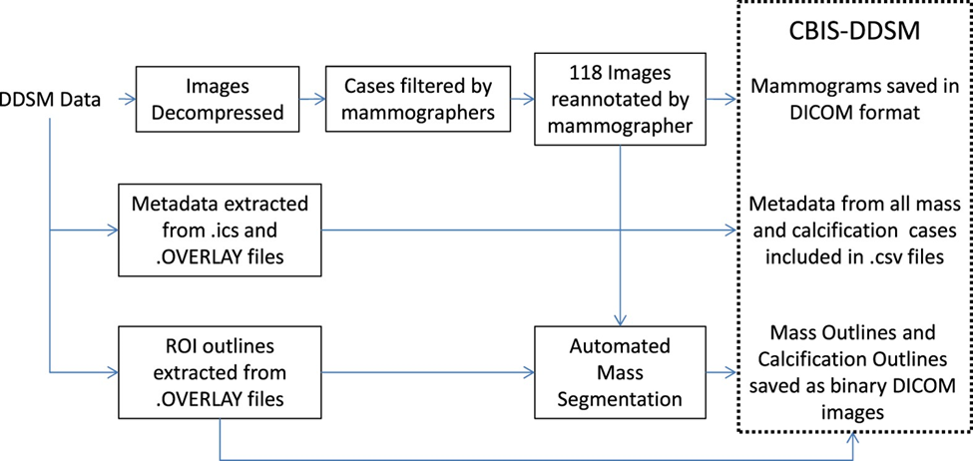
materials: dataset
Upgrading The Original Database
The dataset used in this project is CBIS-DDSM (Curated Breast Imaging Subset of DDSM) available at
https://wiki.cancerimagingarchive.net/display/Public/CBIS-DDSM
It is an updated and standardized version of the Digital Database for Screening Mammography (DDSM), a database of 2.620 scanned film mammography studies.
It contains normal, benign, and malignant cases with verified pathology information.
This collection is structured such that each participant has multiple patient IDs.
The data set contains 753 calcification cases and 891 mass cases..
2.
3

Slide 9
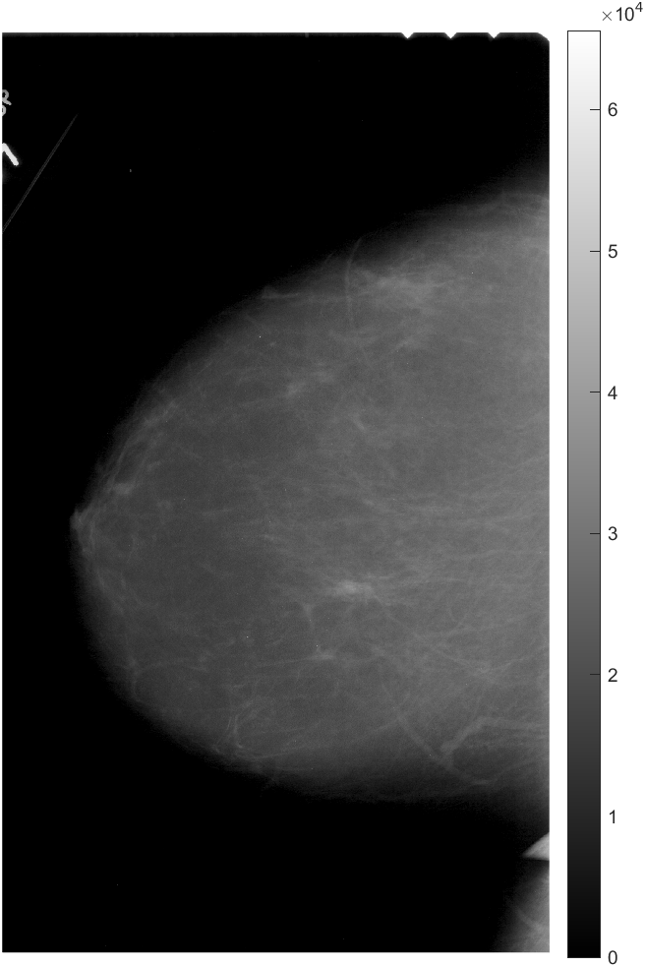
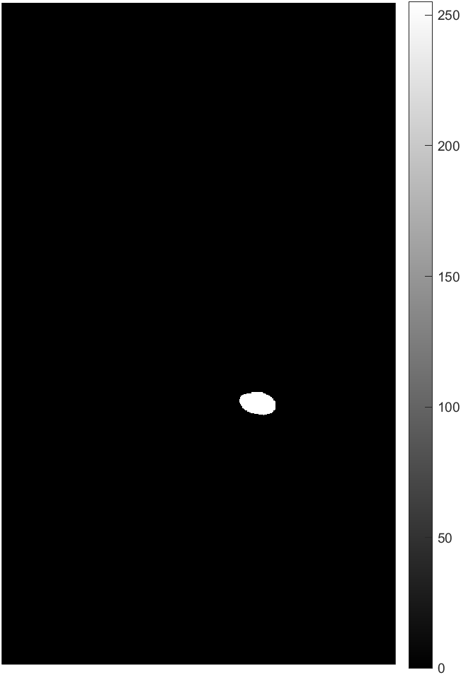
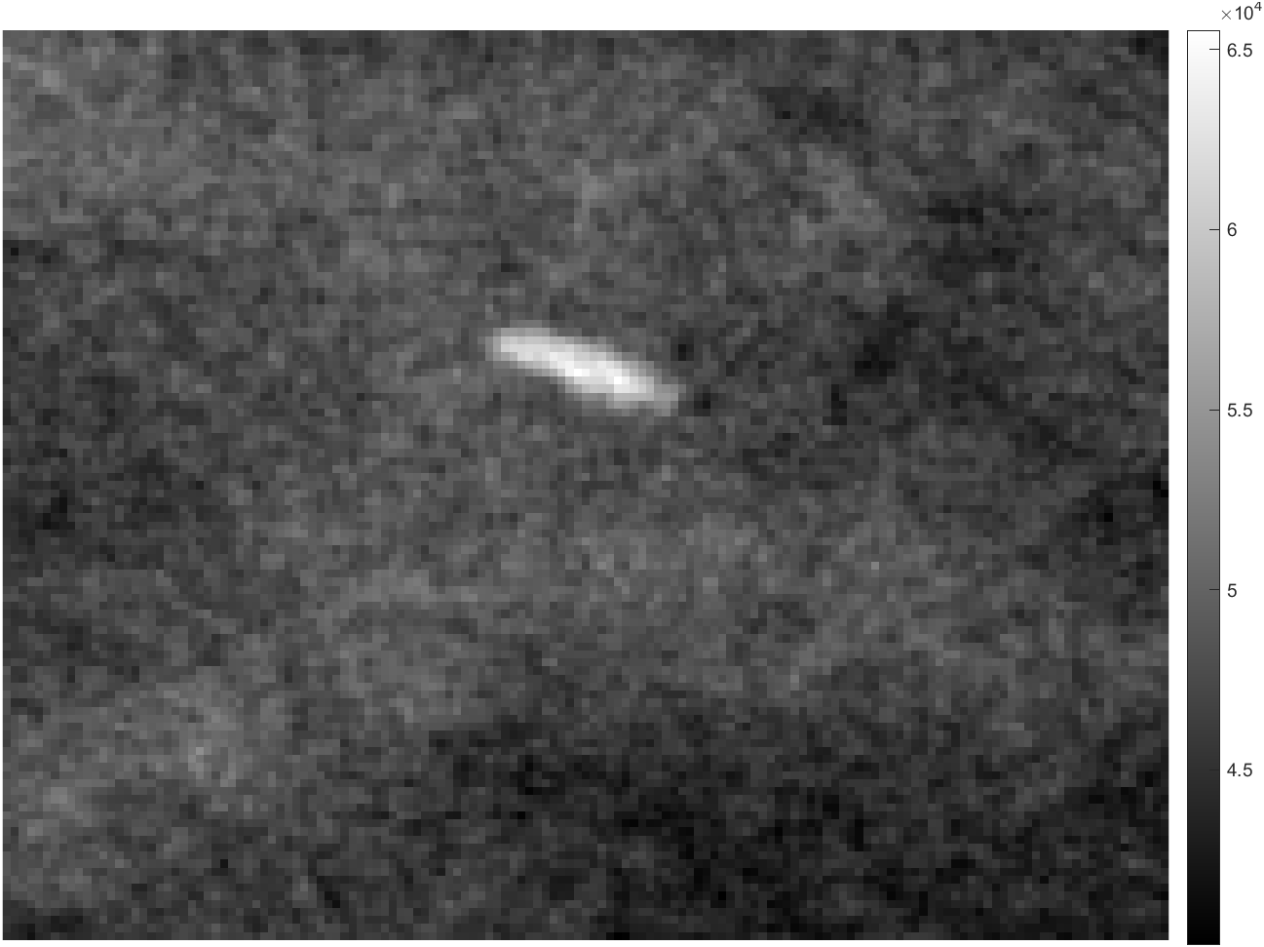
Dataset: Images & .csv metadata files
Full mammography
ROI
Cropped Image
.csv
Patient ID: the first 7 characters of images in the case file
Density category
Breast: Left or Right
View: craniocaudal (CC) or mediolateral-oblique (MLO)
Number of abnormalities for the image (This is necessary as there are some cases containing multiple abnormalities.
Mass shape (when applicable)
Mass margin (when applicable)
Calcification type (when applicable)
Calcification distribution (when applicable)
BI-RADS assessment
Pathology: Benign, Benign without call-back, or Malignant
Subtlety rating: Radiologists’ rating of difficulty in viewing the abnormality in the image
Path to image files
Lorem

Slide 10
methods
Dataset pre-processing
1.
Given the size of the dataset, in this project only the data related to calcifications were analysed. There were 753 calcification cases. As requested the data relating to cases classified as “benign with call-back” were removed, downsizing the dataset to 1311 instances, i.e. 1311 images where the dimensions of the ROI mask corresponded to the dimensions of the full images.
2.
Pixel size
4.
The images in this datasets are in DICOM format, but they are digitized analog images and not digital images. Therefore the information about pixel size, pixel spacing and slice thickness were not provided. However, this database was analyzed in many papers, so as suggested in scientific literature¹ the pixel size was set at 1 pixel = 50 µm, while slice thickness was set at 1 mm as in digital tomosynthesis.
4
¹ Ragab DA, Sharkas M, Marshall S, Ren J. 2019. Breast cancer detection using deep convolutional neural networks and support vector machines. PeerJ 7:e6201

Slide 11
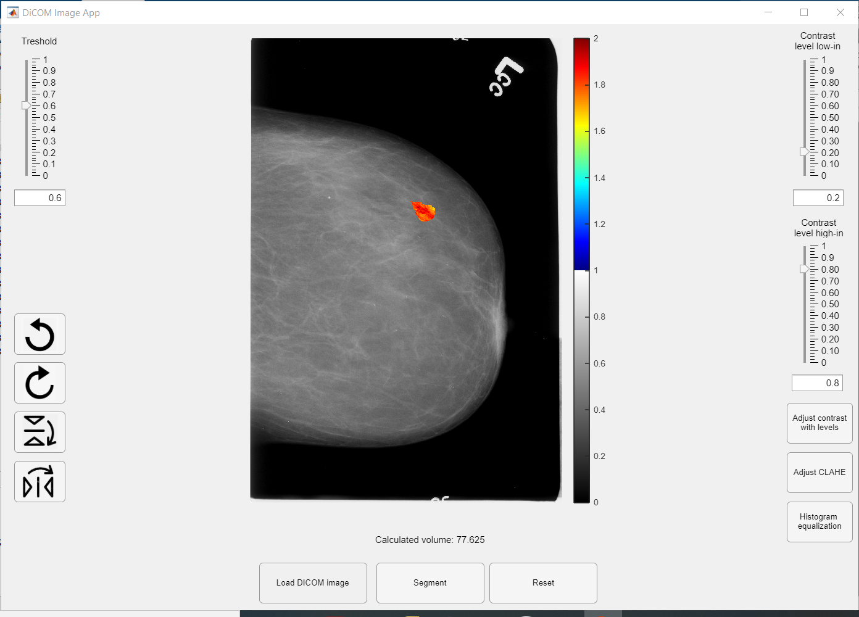
Gui application
Add a brief introduction of your section here.
1 Breast Cancer
2 Mammography
3 Materials - Dataset
4 Methods
4.1 GUI Application
5 Results
6 Conclusions

Slide 12
Machine Learning Techniques in Breast Cancer Detection and Diagnosis
Detection of subclinical breast cancer on screening mammography is challenging as an image classification task because the tumors themselves occupy only a small portion of the image of the entire breast. For example, a full-field digital mammography image is typically 4000 × 3000 pixels while a potentially cancerous region of interest (ROI) can be as small as 100 × 100 pixels.
Challenge: automated segmentation of ROI. This dataset contains automatically segmented ROI masks.
These mask were overlaid over full mammography images to extract potential lesions. Following morphological measurements of the lesions were calculated:
Lesion Volume, Lesion Area, Spherical Disproportion, Sphericity, and Surface to Volume Ratio
1 Breast Cancer
2 Mammography
3 Materials - Dataset
4 Methods
4.2 ML Tools & Diagnosis
5 Results
6 Conclusions

Slide 13
Classification models
Binary Classification
1.
This is a binary classification problem with classes being BENIGN and MALIGNANT.
2.
Feature Selection
Classification based only on morphological measurements is compared to the classification which includes both morphological measurements and features obtained from metadata: breast density, BI RADS assessment, calcification type and calcification distribution.
3.
4.
Applied Methods
4.2
The following classification methods were applied: kNN, Naïve Bayes, SVM with linear kernel, SVM with radial kernel and Random Forest.
5.
Validation
10 - fold cross-validation was applied to evaluate the performance of the classifiers.

Slide 14
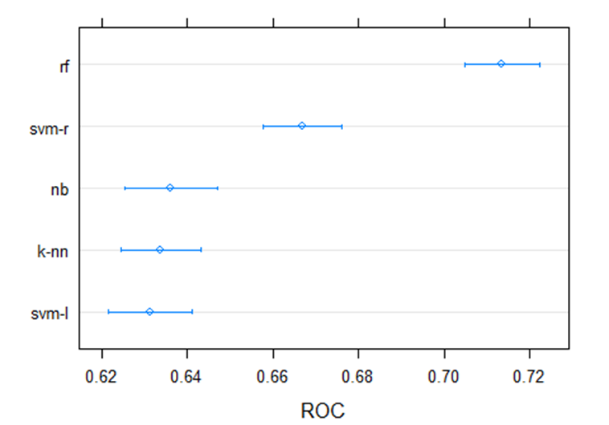
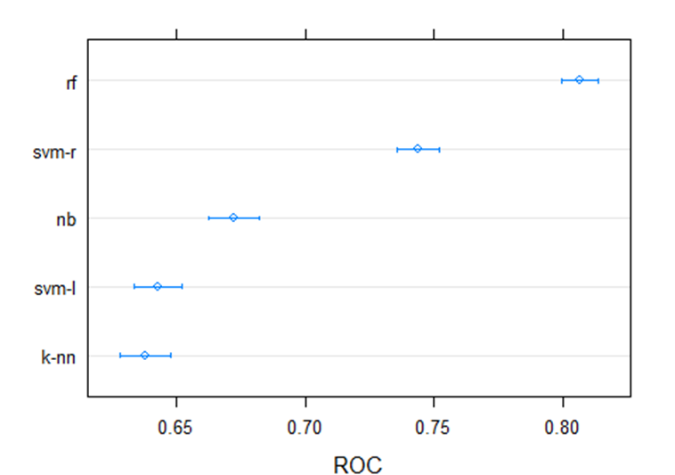
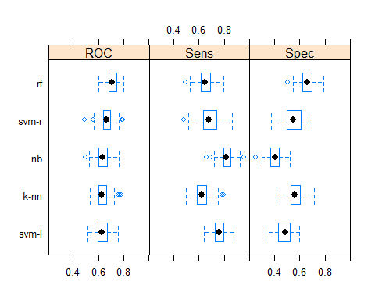
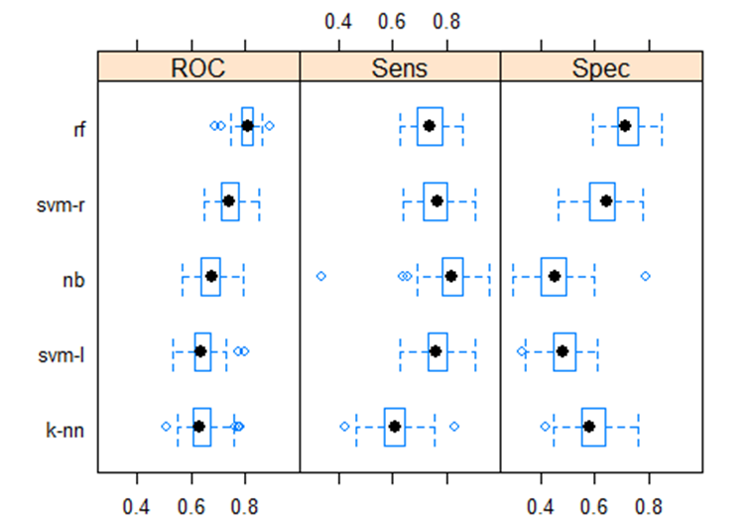
Results
Only morphological features
All features
1.
2.
3.
4.
5.
5

Slide 15
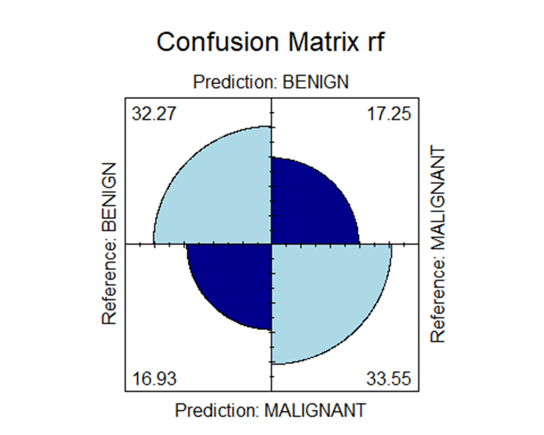
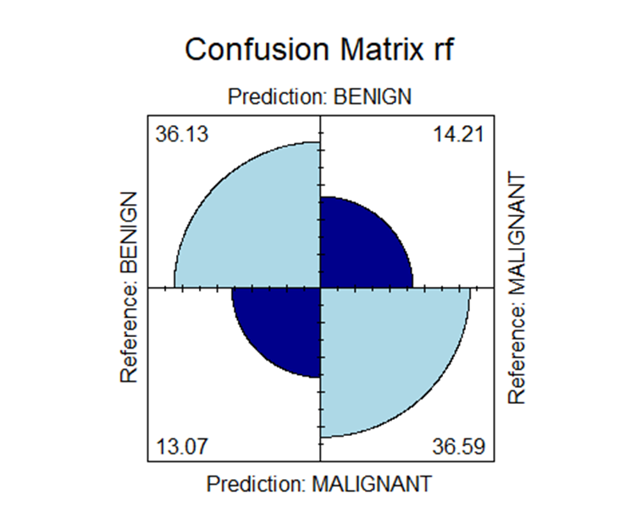
Results – Random Forest
Only morphological features
All features
1.
2.
3.
4.
5.
5

Slide 16
conclusions
Classification is significantly better when the features from metadata are included in the process.
This classification is not good enough to be used for clinical purposes, not even for screening mammographies.
In terms of pathology classification, scientific papers treating the same dataset didn’t obtain significantly better results, apart from specificity. According to the open literature the best classification model is convolutional neural networks.

Slide 17
BIBLIOGRAPHY
Lee, R., Gimenez, F., Hoogi, A. et al. A curated mammography data set for use in computer-aided detection and diagnosis research. Sci Data 4, 170177 (2017).
Ragab DA, Sharkas M, Marshall S, Ren J. 2019. Breast cancer detection using deep convolutional neural networks and support vector machines. PeerJ 7:e6201
Kupersmith, J., Breast Cancer Detection Algorithm https://jordankupersmith.github.io/its_not_a_tumor/projectdetails/
https://www.who.int/news-room/fact-sheets/detail/breast-cancer
https://www.cancer.net/cancer-types/breast-cancer
https://wiki.cancerimagingarchive.net/display/Public/CBIS-DDSM
https://senologiadiagnostica.it/mammografia/

