Slide 1
Design and Implementation of a
Lexical Analyzer for Source Code Tokenization
Compiler Design – Review 1
Project Evaluation (24CS2235F) | A.Y. 2026–2027
V Sanjay Bhaargav | P Rahul | Mvs Aasrith | M Rishikesh
Guide: Dr. P Krishna Kishore
1
Notes:
Design and Implementation of a Lexical Analyzer for Source Code Tokenization
Our project is about designing a lexical analyzer.
It is the first phase of a compiler.
It reads source code and divides it into meaningful units called tokens.

Slide 2
1. Introduction
Lexical analysis is the first and one of the fundamental phases of a compiler.
It converts source code into a sequence of meaningful tokens.
The lexical analyzer identifies keywords, identifiers, operators, constants, delimiters, and other lexical elements.
It also detects invalid or unrecognized sequences.
The project provides a practical demonstration of how source code is processed before syntax analysis.
2
Notes:
Lexical analysis is the first step in the compilation process.
It reads the source code and identifies different elements like keywords, variables, operators and numbers.
Each identified element is called a token.
It also finds invalid symbols or words that do not follow the lexical rules.

Slide 3
2. Problem Statement
Manual analysis of source code can be complex and time-consuming.
This becomes more difficult when dealing with large programs.
There is a need for a simple system that can automatically scan source code and classify its lexical components.
The system should also identify common lexical errors and present the analysis in an understandable form.
3
Notes:
Analyzing source code manually is difficult and takes more time.
This becomes even harder when the program contains many lines of code.
So, we need a system that automatically scans the code and identifies different tokens.
It should also detect errors and display the results clearly.

Slide 4
3. Proposed System
Develop a simple and efficient lexical analyzer for source code tokenization.
Accept source code as input and scan it character by character.
Identify lexemes using predefined lexical rules.
Classify lexemes into appropriate token categories.
Generate a structured token table containing lexeme, token type, and line information.
Provide token statistics and detect common lexical errors.
4
Notes:
We propose to develop a simple and efficient lexical analyzer.
It takes source code as input and scans it character by character.
It identifies and classifies elements like keywords, identifiers and operators.
Finally, it displays a token table, token statistics and detected errors.

Slide 5
4. Proposed Methodology / Workflow
Source Code
Character-by-
Character Scan
Lexeme
Identification
Token
Classification
Token Table +
Statistics
Error
Detection
Input → Scan → Identify Lexemes → Classify Tokens → Display Results → Detect Errors
5
Notes:
First, we give the source code as input to the system.
The system scans the code character by character and identifies lexemes.
Then, it classifies each lexeme into its correct token type.
Finally, it displays the token table, statistics and any errors found.

Slide 6
5. Key Compiler Design Concepts
Lexical Analysis – converts source characters into meaningful tokens.
Tokenization – breaks source code into token units.
Lexeme – the actual character sequence identified from the source code.
Regular Expressions – used as part of the lexical rules for recognizing patterns.
Finite Automata – demonstrates pattern recognition used in lexical analysis.
Lexical Error Detection – identifies invalid or unrecognized sequences.
6
Notes:
Lexical analysis converts source code into meaningful tokens.
Tokenization means dividing the source code into smaller units.
A lexeme is the actual word or symbol found in the source code.
Regular expressions and finite automata help recognize different token patterns and identify invalid sequences.

Slide 7
6. Expected Output
Token Table
Lexeme
Token Type
Line Information
Error Detection
Common lexical errors
Invalid / unrecognized sequences
Token Statistics
Useful statistics
for understanding the analysis
7
Notes:
The system displays the identified tokens in a table.
The table contains the lexeme, token type and line number.
It also identifies invalid or unrecognized sequences in the code.
Token statistics are displayed to show the total number and types of tokens.

Slide 8
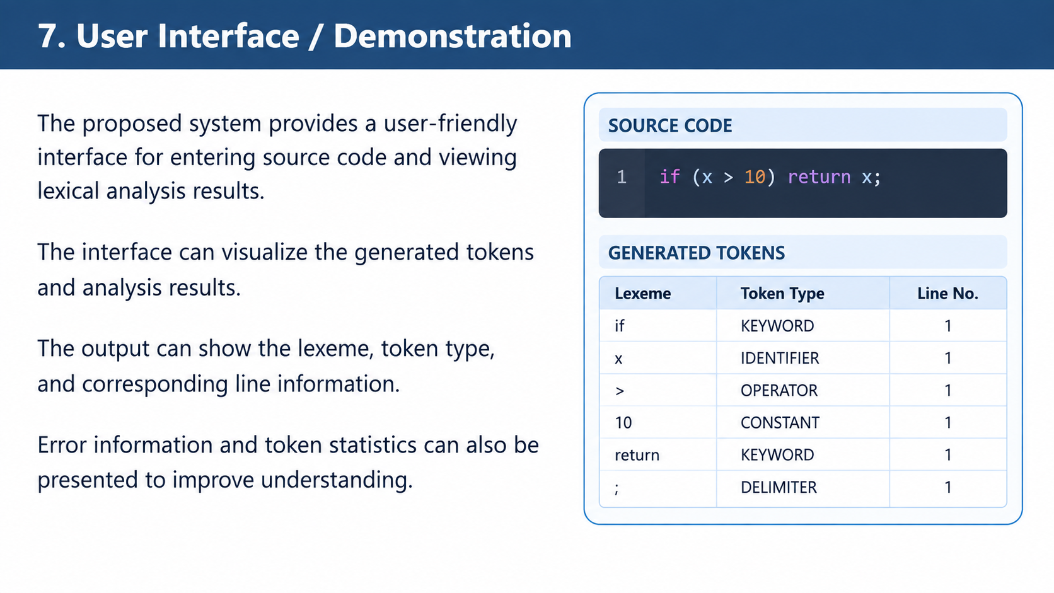
Notes:
This project helps us understand how the lexical analysis phase works in a compiler.
It gives practical knowledge of tokenization and lexical rules.
It connects theoretical concepts like regular expressions and finite automata with programming.
It also shows how source code is prepared for the next phase, called syntax analysis.

Slide 9
8. Project Significance
Demonstrates the working of the lexical analysis phase of a compiler.
Helps students understand tokenization and lexical rules in a practical way.
Connects Compiler Design concepts such as regular expressions and finite automata with an implementation.
Shows how source code is prepared for the next compiler phase: syntax analysis.
Provides a visual representation of tokens and analysis results.
9
Notes:
Our project focuses on developing a lexical analyzer for source code.
It automatically scans the code, identifies lexemes and classifies them into tokens.
It also provides error detection and token statistics.
Overall, this project helps us understand the practical working of lexical analysis.

Slide 10
9. Conclusion
The proposed project focuses on designing and implementing a lexical analyzer for source code tokenization.
It automatically scans source code, identifies lexemes, classifies tokens, and generates structured analysis results.
The system also supports lexical error detection and token statistics.
Overall, the project provides a practical demonstration of important Compiler Design concepts.
10
Notes:
This slide shows the important terms related to our project.
Lexical analysis, tokenization, lexemes and tokens are the main concepts.
Regular expressions and finite automata are used for recognizing patterns.
These are the basic concepts required to understand our lexical analyzer.

Slide 11
10. Keywords / Core Terms
Lexical Analysis
Compiler Design
Tokenization
Lexeme
Tokens
Regular Expressions
Finite Automata
Lexical Analyzer
11

Slide 12
THANK YOU
8

