Slide 1
QUANTUM MACHINE LEARNING
Quantum Machine Learning Early Disease Prediction Presentation
A hybrid classical–quantum kernel learning framework using PCA, Fidelity Quantum Kernel and QSVC
DATASET
QUANTUM MODEL
OUTPUT
UCI Heart Disease
Cleveland • 303 instances • 13 features
4-feature PCA representation
ZZFeatureMap + FidelityQuantumKernel + QSVC
Binary classification:
No Heart Disease / Heart Disease
V. Sanjay Bhaargav — 2420030014
P. Rahul — 2420030368
M.V.S Aasrith — 2420030573
Guide: Dr. Siripuri Divya, Assistant Professor, Department of CSE, KLEF
Conference Project Presentation • 2026
01

Slide 2
1. Problem Statement
Why explore quantum kernels for disease classification?
THE CHALLENGE
OUR APPROACH
RESEARCH QUESTION
Medical datasets often contain mixed feature scales and nonlinear relationships. A useful classifier must handle preprocessing, dimensionality, and class separation in a reproducible pipeline.
Build a controlled hybrid pipeline: classical preprocessing → low-dimensional representation → quantum feature mapping → quantum-kernel classification.
Can a Fidelity Quantum Kernel + QSVC provide a practical classification workflow for heart-disease data after dimensionality reduction?
02

Slide 3
2. Dataset & Target
UCI Heart Disease — Cleveland
DATASET PROFILE
REPRESENTATIVE FEATURES
• 303 patient records
• 13 input features
• Classification task
• Mixed categorical, integer and real-valued features
• Original target: 0–4
• For this project: binary target
0 → No heart disease
1 → Heart disease present
Age • Sex • Chest pain type • Resting blood pressure • Cholesterol • Maximum heart rate • Exercise-induced angina • ST depression • Slope • CA • Thal
PREPROCESSING
Missing values are converted to numeric NaN and imputed using feature medians. The target is converted to binary presence/absence before train-test splitting.
03

Slide 4
3. Proposed Architecture
End-to-end hybrid classical–quantum pipeline
UCI Heart
Dataset
Cleaning +
80:20 Split
Standardize
13 Features
PCA
13 → 4
Quantum
Kernel
QSVC +
Evaluation
QUANTUM CORE
4 PCA components → 4-dimensional quantum feature representation → ZZFeatureMap → FidelityQuantumKernel → QSVC. The kernel evaluates state overlap and supplies the similarity structure used by the classifier.
04

Slide 5
4. Methodology
Five controlled stages from raw data to prediction
01
Data Preparation
Load Cleveland data; convert missing entries; median imputation; binary target.
02
Feature Scaling
StandardScaler fitted only on training data; same transformation applied to test data.
03
Dimensionality Reduction
PCA compresses 13 features to 4 components for the quantum representation.
04
Quantum Classification
ZZFeatureMap + FidelityQuantumKernel + QSVC.
05
Evaluation
Accuracy, precision, recall, F1-score and confusion matrix.
05

Slide 6
5. Quantum Machine Learning Core
How the quantum kernel enters the classifier
QUANTUM FEATURE MAP
FIDELITY QUANTUM KERNEL
QSVC
The four PCA components are encoded into a 4-qubit ZZFeatureMap.
The circuit creates a quantum representation φ(x) of each classical input vector.
For two encoded states, the kernel is based on their state overlap:
K(x,y) = |⟨φ(x)|φ(y)⟩|²
This produces a similarity measure for classification.
QSVC extends the classical SVC workflow by accepting a quantum kernel.
It uses the resulting kernel similarities to separate the two disease classes.
06

Slide 7
6. Classical Baseline vs Quantum Model
Why include a classical SVC?
CLASSICAL SVC
QUANTUM QSVC
Input: 4 PCA components
Kernel: RBF
Training: fixed 120-sample subset
Role: baseline reference
The baseline establishes how the same reduced feature representation performs without the quantum kernel.
Input: same 4 PCA components
Kernel: FidelityQuantumKernel
Training: same fixed 120-sample subset
Role: quantum-kernel experiment
The same 61-sample held-out test set is used for both models.
07

Slide 8
7. Implementation
Python + scikit-learn + Qiskit Machine Learning
SOFTWARE STACK
KEY IMPLEMENTATION SNIPPET
Python
Pandas / NumPy — data handling
Scikit-learn — split, scaling, PCA, SVC, metrics
Qiskit — quantum circuits
Qiskit Machine Learning — FidelityQuantumKernel + QSVC
Matplotlib — confusion matrix and comparison visualization
feature_map = ZZFeatureMap(
feature_dimension=4,
reps=2,
entanglement="linear"
)
quantum_kernel = FidelityQuantumKernel(
feature_map=feature_map
)
qsvc = QSVC(
quantum_kernel=quantum_kernel
)
08

Slide 9
8. Execution Flow
What is demonstrated during the live implementation
Run
python main.py
Input
303 × 13
Heart Disease data
Preprocess
Clean → split → scale
Reduce
PCA: 13 → 4
Models
SVC + QSVC
Output
Metrics + matrix + graph
IMPORTANT EXPERIMENTAL DETAIL
Both SVC and QSVC use the same stratified 120-sample training subset; the same 61-sample test set is retained for evaluation.
09

Slide 10
9. Results
Final matched-run results: 120 training samples per model and 61 test samples.
Metric
Classical SVC
QSVC
Accuracy
88.52%
44.26%
Precision
86.21%
31.25%
Recall
89.29%
17.86%
F1 Score
87.72%
22.73%
Final values from the latest matched SVC–QSVC experiment.
10

Slide 11
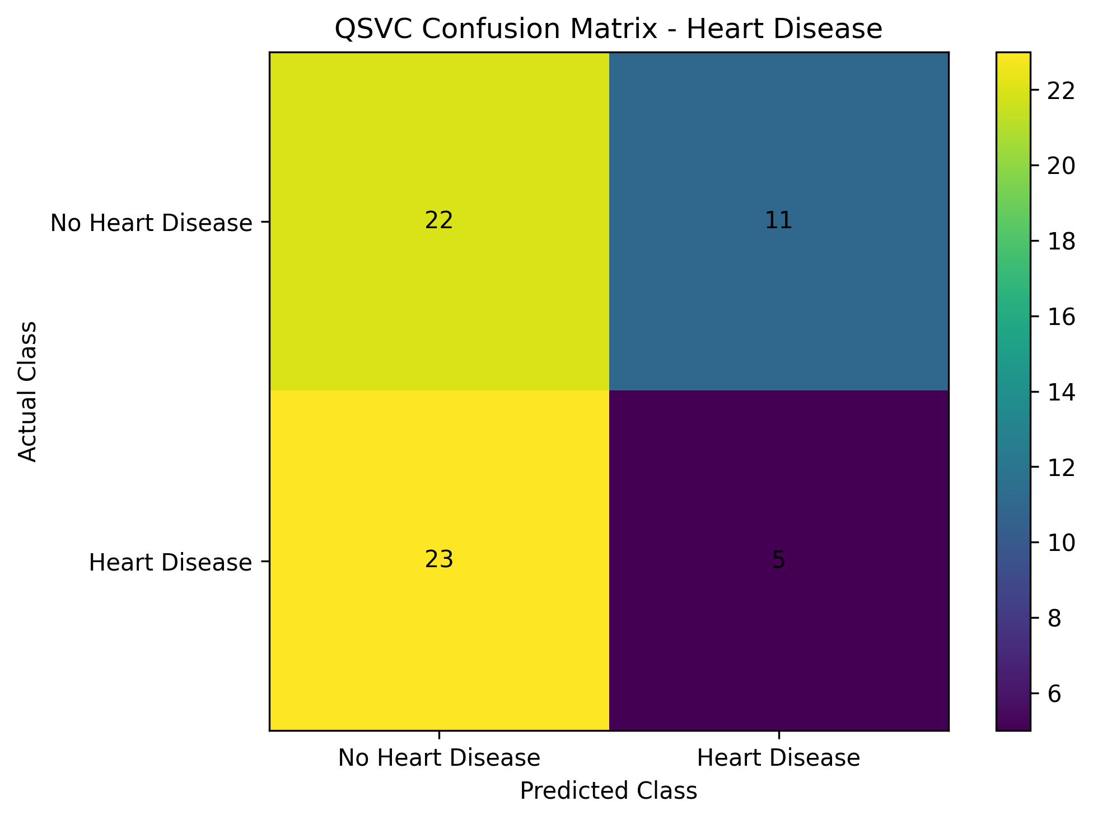
10. Confusion Matrix
QSVC classification on the held-out test set
Predicted →
No Disease
Disease
22
11
Actual ↓
23
05
11

Slide 12
11. Performance Comparison
SVC vs QSVC — based on the same held-out test set
1.SVC_vs_QSVC_Heart_Disease_Comparison.png
2. Final metric table from Heart_Disease_QML_Results.csv
Compare accuracy, precision, recall and F1-score using the same matched training subset and held-out test set.
INTERPRETATION
The experiment demonstrates how a quantum-kernel classifier can be integrated into a standard ML pipeline.
Both models use the same fixed 120-sample training subset for a controlled comparison. Results are interpreted as a proof-of-concept evaluation, not evidence of quantum advantage.
12

Slide 13
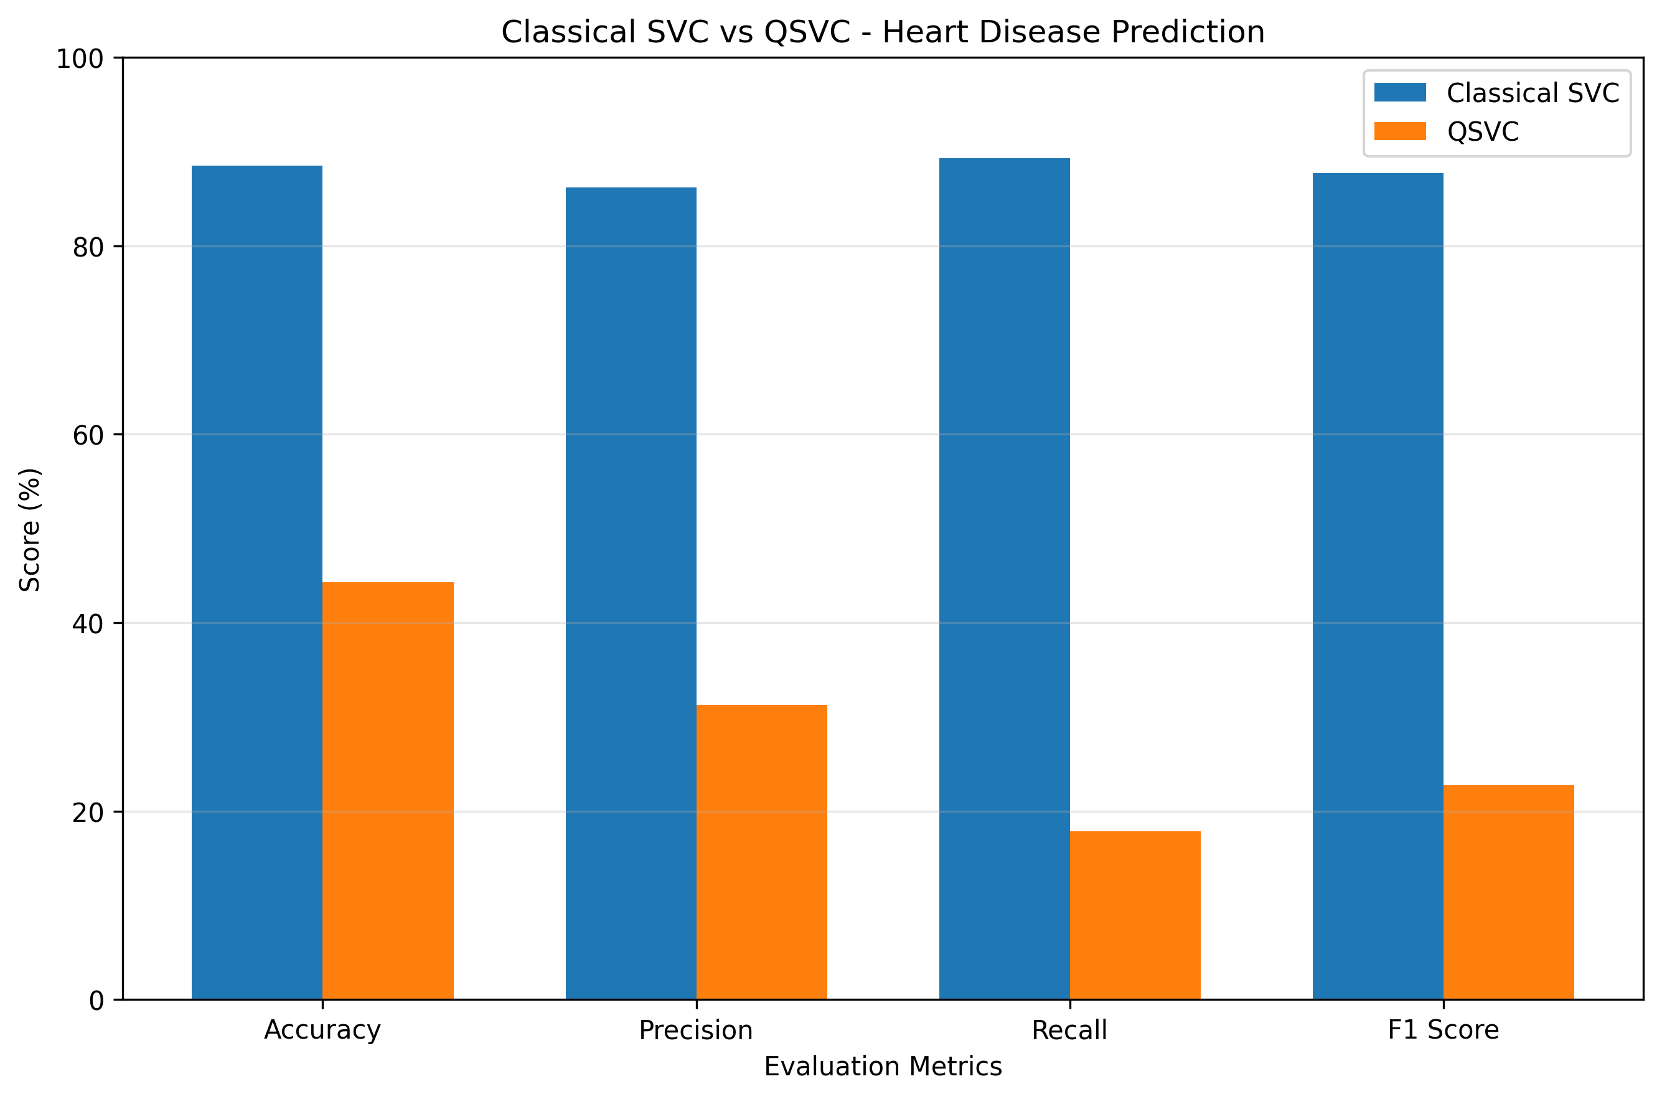
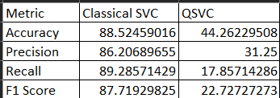
Final Performance Comparison
Final Results

Slide 14
12. Key Findings & Limitations
What the implementation demonstrates
KEY FINDINGS
LIMITATIONS
• A complete classical–quantum classification pipeline was implemented.
• PCA reduced the 13-feature input to 4 quantum-ready features.
• FidelityQuantumKernel was integrated with QSVC.
• The same held-out test set is used for evaluation.
• Metrics and confusion matrix provide transparent model assessment.
• Dataset size is modest (303 records).
• QSVC simulation is computationally expensive.
• Both models use a fixed 120-sample training subset.
• No claim of clinical validation is made.
• Broader quantum-advantage studies require larger datasets, multiple configurations, and hardware experiments.
13

Slide 15
13. Conclusion & References
From classical medical data to quantum-kernel classification
CONCLUSION
REFERENCES
The project demonstrates a reproducible hybrid workflow for heart-disease classification.
Classical preprocessing makes the dataset suitable for a compact quantum representation. The Fidelity Quantum Kernel then provides the similarity function used by QSVC.
The implementation establishes a practical foundation for future work with larger datasets, hardware execution, kernel optimization and broader matched classical–quantum benchmarks.
1. UCI Machine Learning Repository — Heart Disease Dataset.
archive.ics.uci.edu/dataset/45/heart+disease
2. Qiskit Machine Learning — FidelityQuantumKernel documentation.
qiskit-community.github.io/qiskit-machine-learning
3. Qiskit Machine Learning — Quantum Kernel Learning tutorial.
qiskit-community.github.io/qiskit-machine-learning/tutorials/03_quantum_kernel.html
4. Qiskit Machine Learning — QSVC documentation.
14

