Slide 1

Library Fine Management System
SOA Project Review-1
Team Members Name:V Sanjay Bhaargav Roll Number:2420030014 Name:M Rishikesh Roll Number:2420030012 Name:MVS Aasrith Roll Number:2420030573
 | Under the Guidance of Dr. Navyatha Ravi Associate Professor, Department of Computer Science and Engineering, KLH CSE Bowrampet Campus

Slide 2
Outline of Project Work
Introduction
Problem Statement
Literature Survey
Problem Gap Identification
Objectives
Innovation, Creativity & Novelty
Feasibility & Project Plan
Conclusion & Future Work

Slide 3
Problem Statement
Traditional library fine management is often handled through manual records or tightly coupled systems, which can lead to calculation errors, delayed fine updates, difficulty in tracking payments, and limited visibility of fine history. The proposed Library Fine Management System provides a centralized and secure way to calculate, manage, track, and clear overdue fines.
The system follows a Service-Oriented Architecture using independent microservices for authentication, member management, fine management, and notifications. REST APIs, JWT authentication, Eureka service discovery, and Spring Cloud Gateway enable secure and scalable communication between services.

Slide 4
Objectives
• Develop a microservices-based Library Fine Management System using Spring Boot.
• Automatically calculate fines based on overdue books and configured fine rules.
• Provide secure authentication and role-based access using JWT and Spring Security.
• Manage fine creation, update, payment, waiver, and fine-history records.
• Provide notifications for pending/overdue fines through email or in-app alerts.
• Use Eureka, Spring Cloud Gateway, REST APIs, MySQL, Postman, Docker, and GitHub Actions.

Slide 5
Literature Survey
Authors | Title of the Paper | Methodology | Inferences | Limitation / Future Work
Gannamraju et al. [1] | Radio Frequency Identification and Internet of Things-Based Smart Library Management System (2021) | RFID tags/readers, ESP8266, MySQL database and web portal for automated issue/return, transaction tracking and fine details. | Automates library transactions and provides fine information for students and staff, reducing manual work. (InderScience) | Mainly focuses on RFID/IoT-based automation; fine management is included as part of the overall system rather than as an independent service.
Yang & Lin [2] | New Generation Library Service Platform Based on Microservices (2020) | Microservice-based architecture for a next-generation library service platform, with modular and independently expandable services. | Shows that microservices can make library platforms more flexible, open and easier to expand. (libraryjournal.com.cn) | Focuses on the overall library service platform; a dedicated fine-management workflow is not the primary focus.
Smetanenko & Kulakovska [3] | Book Library Management System Based on Cloud Microservices AWS (2024) | Cloud-based microservices using AWS, Node.js, TypeScript, Docker and JWT for a distributed library system. | Demonstrates that microservices can provide scalability, reliability, security and flexible adaptation in library management. (proconference.org) | Uses a cloud/Node.js technology stack rather than a Java Spring Boot SOA implementation; dedicated fine-management functionality is not the main focus.

Slide 6
Problem Gap Identification
• Existing library systems mainly concentrate on book cataloguing, issue/return, RFID tracking, and general automation.
• Fine calculation and payment are often treated as a small feature rather than an independent service.
• Monolithic implementations can make individual modules harder to scale, maintain, and deploy independently.
• There is a need for a dedicated fine-management workflow with secure APIs, service discovery, gateway routing, and separate data ownership.
• The proposed system addresses this gap through independent microservices and a database-per-service approach.

Slide 7
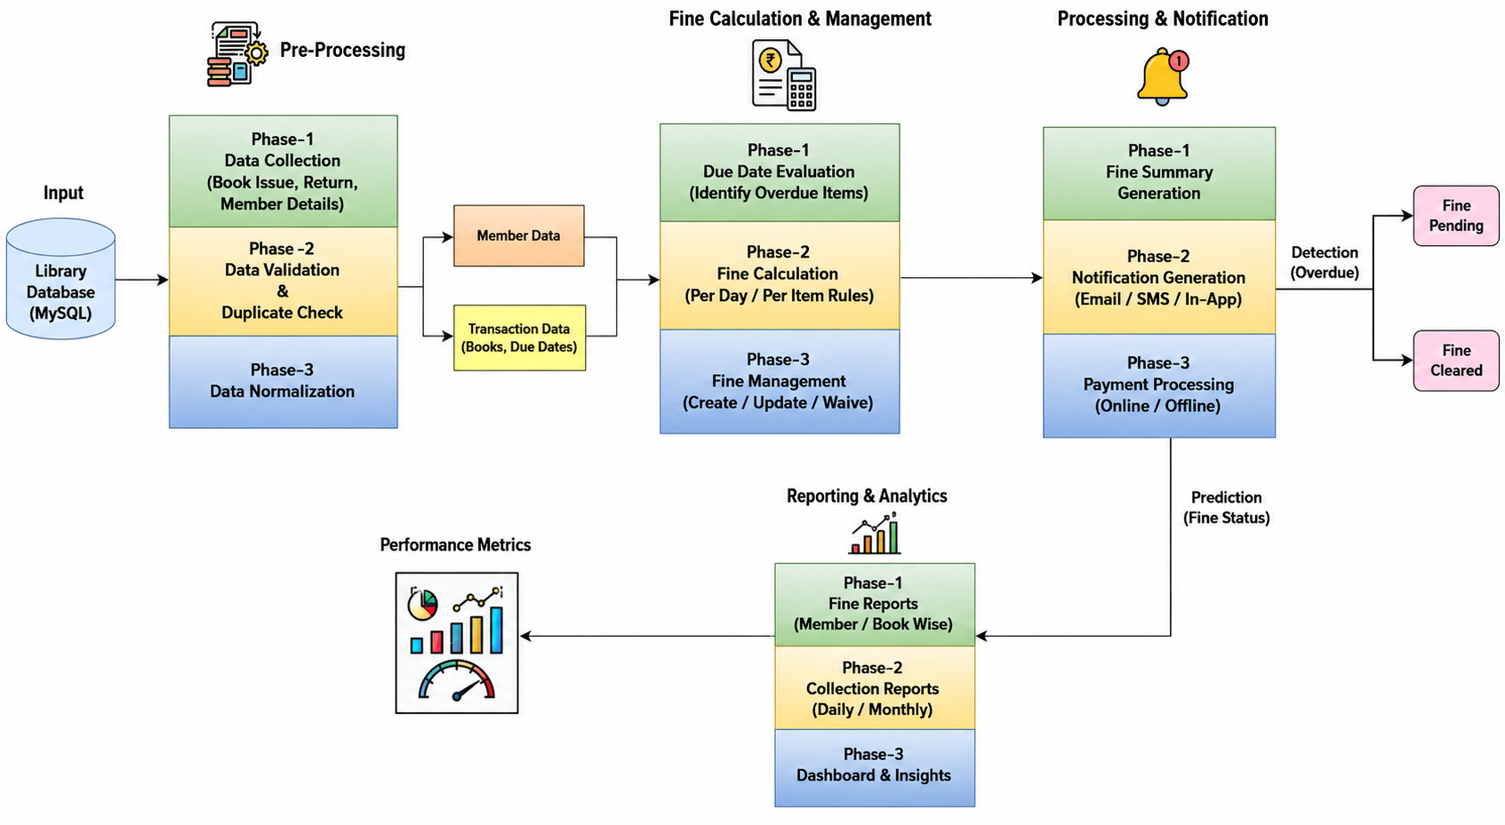
Innovation, Creativity, and Novelty
• Fine Management as an independent microservice.
• Automatic overdue-fine calculation using configurable rules.
• JWT-based authentication with role-based authorization.
• Eureka service discovery and Spring Cloud Gateway for API routing.
• Separate MySQL database for each service.
• Notification service for pending-fine reminders.
• REST APIs tested using Postman with unit and integration testing.

Slide 8
Feasibility and Project Plan
FEASIBILITY AND PROJECT TIMELINE
Feasibility Explanation:
The proposed Library Fine Management System is technically feasible using Java, Spring Boot, Microservices, MySQL, REST APIs, JWT, Eureka, Spring Cloud Gateway, Postman, GitHub, and Docker. The system can be developed incrementally by implementing and integrating independent services.
Phase
Work
Timeline
Phase 1
Requirements & Literature Survey
Week 1
Phase 2
System Design & Microservices Architecture
Week 2
Phase 3
Spring Boot Services & Database
Weeks 3–4
Phase 4
JWT, Eureka, Gateway & Notifications
Week 5
Phase 5
Testing, Docker, GitHub Actions & Documentation
Week 6
Expected Outcome: A secure, modular and maintainable SOA-based system for fine calculation, tracking, payment and notifications.

