Slide 1
Update Track – Software Update Tracking System

Slide 2
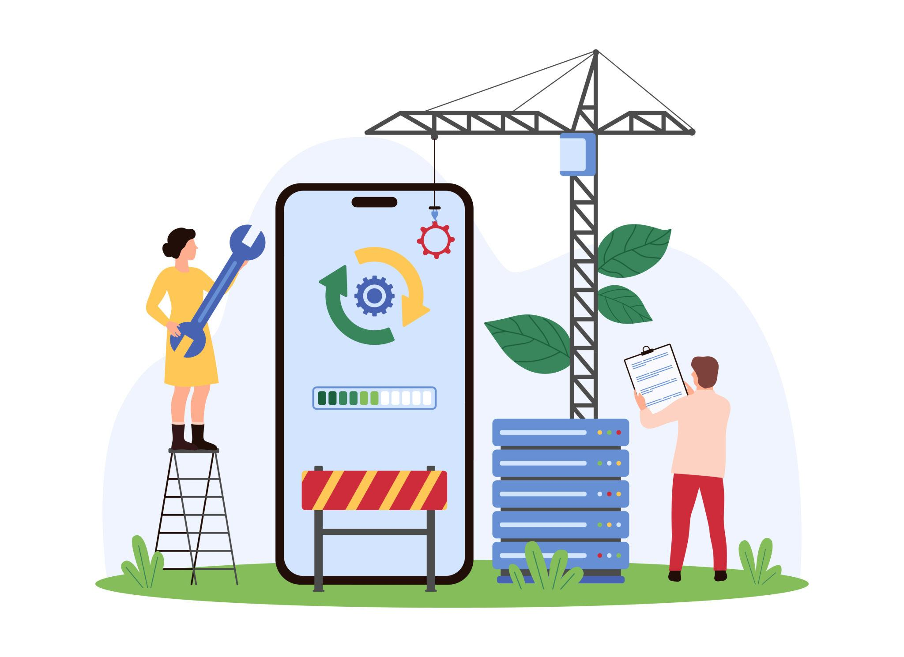
Problem Statement
Users don’t know whether apps are updated
No centralized system to track updates
Manual checking is time-consuming

Slide 3
Proposed Solution
Developed UpdateTrack web application
Tracks software versions
Shows updated or outdated status
Provides update links

Slide 4

Features
Search applications
Add to favorites
Remove from favorites
Update links for outdated apps
Dynamic data using JSON

Slide 5
Technologies Used
HTML
CSS
JavaScript
GitHub (for JSON data)
Netlify (for deployment)

Slide 6
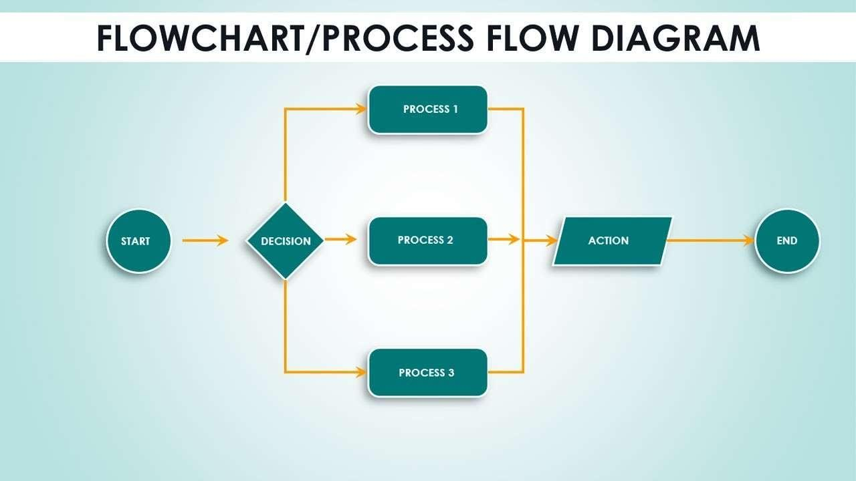
System Workflow
Fetch data from JSON file
Compare current and latest versions
Display update status
Provide update link

Slide 7
Implementation Steps
Designed UI using HTML & CSS
Added logic using JavaScript
Implemented search functionality
Used localStorage for favorites
Connected GitHub JSON using fetch

Slide 8

Conclusion
Simple and user-friendly application
Helps users track software updates
Useful real-world project

