Slide 1
SPIKE: Spiking Transformers for Neuromorphic AI
SC’26 | Chicago, Illinois | Nov 18, 2026
U.S. Department of Energy Genesis Mission Phase 1 Project
Prasanna Date (PI), Xi Zhang, Sanjay Das, and Emily Herron
Oak Ridge National Laboratory
Notes:
Phase I proposal for DE-FOA-0003612. One line: we are building transformers that run on neuromorphic hardware, end to end.

Slide 2
THE CHALLENGE
AI Is Powerful, but Power-Hungry
01 THE PROMISE
AI is Awesome!
An unprecedented tool for science and technology.
02 ALGORITHM
Transformers are expensive
The transformer model itself is costly to compute.
03 HARDWARE
Needs GPUs, lots of them
Modern AI runs on vast fleets of GPUs.
04 ENERGY
GPUs are power hungry
AI runs on GPUs in data centers that consume Megawatts (city-scale) power.
05 DEMAND
AI demand is ever-increasing
Demand for AI is exponentially increasing.
06 INFRASTRUCTURE
The grid can’t keep up
Even with every GPU we could wish for, there is not enough power in the grid to support them.
Scaling AI further means making it radically more energy-efficient.
Notes:
AI is an unprecedented tool, but it needs GPUs, and lots of them. GPUs are power hungry, and AI runs in data centers that draw megawatts, city-scale power. Even if we had every GPU we could wish for, there is not enough power in the grid to support them. On top of that, the transformer itself is an expensive model to compute. Takeaway: scaling AI further means making it radically more energy-efficient.

Slide 3
THE SOLUTION
Neuromorphic Computing as a Solution
THE PARADIGM
Brain-inspired, energy-efficient computing
Neurons and synapses communicate with spikes, so energy is spent only when something happens.
1,000–10,000× less power
Event-driven operation uses far less power than CPUs or GPUs.
No von Neumann bottleneck
Processing and memory are colocated, so data is not transferred back and forth.
Intrinsic parallelism
Expensive computations run efficiently in parallel.
Turing-complete: it can compute everything CPUs and GPUs can, presumably at a fraction of the cost.
Notes:
Neuromorphic computing is a brain-inspired, energy-efficient computing paradigm. Three properties drive the advantage: event-driven operation (1,000 to 10,000 times less power than CPUs or GPUs), colocated processing and memory (no von Neumann bottleneck), and intrinsic parallelism. It is Turing-complete, so nothing is given up in capability.

Slide 4
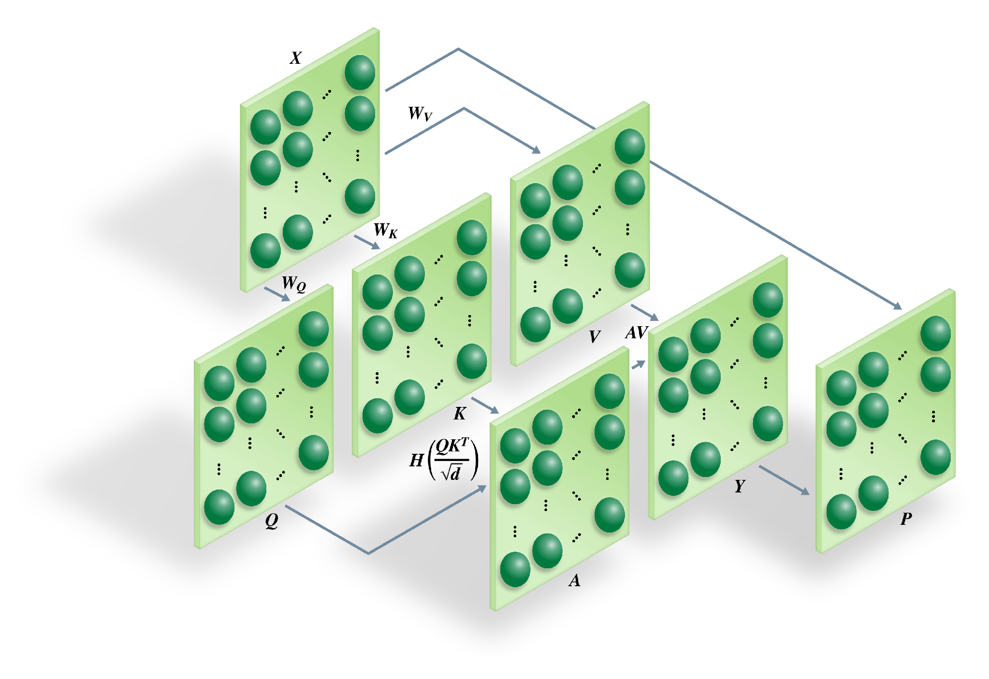
Transformers, Attention, and Spiking Attention
Spiking Attention Mechanism
Transformers, Large Langague Models (LLMs)
Attention Mechanism
Spiking Attention Mechanism
Every circle is a LIF neuron; every arrow a set of synapses.
Spatial encoding reaches full precision in a single timestep.

Slide 5
SCIENTIFIC INNOVATION
Prior Work and Our New Approach
Current literature
Our approach
Rate-coded inputs
Floating-point softmax retained in the attention layer
Not fully spiking; cannot be mapped directly to neuromorphic hardware.
Spatial encoding: two’s complement and virtual neuron encoding
Heaviside step function in place of softmax
Every layer spikes, enabling end-to-end deployment on a neuromorphic processor for the first time.
Notes:
This is the scientific core of the proposal. Published spiking transformers keep a floating-point softmax, so they are not fully spiking. Replacing softmax with the Heaviside step function and rate coding with spatial encoding is what makes end-to-end deployment possible.

Slide 6
SPIKING AI
Spiking AI: Fully Spiking Transformers
Current Approaches
Our Approach
Spiking Attention Mechanism
Rate-coded inputs
Floating-point softmax retained in the attention layer
Not end-to-end, only a few spiking layers
Trained on GPUs
Spatial encoding: two’s complement and virtual neuron encoding
Heaviside step function in place of softmax
Not fully spiking: cannot be mapped directly to neuromorphic hardware.
Every layer spikes, enabling end-to-end deployment on a neuromorphic processor for the first time.
Every circle is a LIF neuron; every arrow a set of synapses.
Spatial encoding reaches full precision in a single timestep.
Notes:
Current spiking transformers use rate-coded inputs and keep a floating-point softmax in the attention layer, so they are not fully spiking and cannot be mapped directly onto neuromorphic hardware. Our approach uses spatial encoding (two’s complement and virtual neuron encoding) and replaces softmax with the Heaviside step function, so every layer spikes. The spiking attention mechanism: every circle is a LIF neuron, every arrow a set of synapses; spatial encoding reaches full precision in a single timestep.

Slide 7
OUR PLAN
SPIKE Project Objectives in Phase 1
01 ORNL
Spiking AI
Fully spiking transformers built around the spiking attention mechanism (SAM), designed to run end to end on neuromorphic hardware.
02 ORNL
HPC-Scale Simulator
HyperNeuro: a distributed spiking neural network simulator for Frontier, using MPI, OpenMP, and HIP on AMD GPUs.
03 DUKE UNIVERSITY
Digital Neuromorphic Hardware
A CMOS integrate-and-fire neuron circuit with leak, designed and simulated in Cadence.
04 UNIVERSITY OF DELAWARE
Ferroelectric Neuromorphic Hardware
Ferroelectric FeFET synapses (TiN/HfZrO/TiN stack), modeled and simulated in Synopsys TCAD.
Notes:
Four objectives, in two phases of work in parallel: spiking AI at ORNL, the HPC-scale simulator (HyperNeuro) at ORNL, digital neuromorphic hardware design at Duke, and ferroelectric neuromorphic hardware design at the University of Delaware.

Slide 8
SCOPE
Six Project Objectives across Phase 1 & Phase 2
01 ORNL · PHASE 1
Develop and test SAM
Single-head spiking self-attention in HyperNeuro, tested on binary and Cora datasets.
02 DU & UD · PHASE 1
Simulate primitive circuits
CMOS digital LIF-based circuit design and simulation at Duke; ferroelectric design/simulation at UDel.
03 ORNL · PHASE 2
Scalable learning algorithm
Scalable surrogate gradient-based learning algorithm for spiking neural networks implemented in HyperNeuro.
04 ORNL · PHASE 2
Develop spiking transformers
Multi-head SAM plus fully connected spiking layers, tested on GLUE, COCO, and MCI.
05 DU & UD · PHASE 2
Chip tape out / fabrication
Tape out the CMOS-based digital neuromorphic chip designed at Duke and fabricate the ferroelectric neuromorphic chip designed at UDel.
06 DU & UD · PHASE 2
Run SAM on hardware
Validate SAM on the digital and ferroelectric neuromorphic platforms.
Notes:
Six objectives across two phases. Objectives 1 and 2 run in parallel in Phase 1 and feed everything downstream.

Slide 9
TODAY’S DEMO
Overview of This Demo
Simulation and Spiking AI · ORNL
Hardware · Duke and Delaware
1
2
3
4
5
HyperNeuro
SNNs vs ANNs
Spiking Attention Mechanism
Spiking Attention on Digital Hardware
Ferroelectric Neuromorphic Primitives
HPC-scale simulator for spiking neural networks
Spiking vs artificial neural networks: accuracy and energy compared
QKV Attention built from spiking threshold neurons
Digital LIF neurons and synapses on FPGA (eventually, ASIC)
Ferroelectric neuron and synapse circuit simulation
Emily Herron
ORNL
Xi Zhang
ORNL
Sanjay Das
ORNL
Prasanna Date
for Duke University
Prasanna Date
for Univ. of Delaware
Notes:
Five demos, from software to hardware. HyperNeuro (Emily Herron): the HPC-scale simulator for SNNs. SNNs vs ANNs (Xi Zhang). The spiking attention mechanism (Sanjay Das). Then the hardware: digital neuromorphic circuits with Duke and ferroelectric neuromorphic primitives with the University of Delaware (both Prasanna Date).

Slide 10
IMPACT
Toward AI-Driven Autonomous Laboratories
Integrated with the Genesis Mission and run on the American Science Cloud, spiking foundational models will analyze scientific data in real time at an unprecedented rate and scale.
Biotechnology
Materials science
Next-generation computing
National security
Prasanna Date · datepa@ornl.gov
Collaborators welcome
Notes:
Close on the mission tie-in: spiking foundational models on the American Science Cloud, analyzing scientific data in real time. Invite collaborators.

Slide 11
PHASE 1 EXIT CRITERIA
Decision Gate Metrics
>73%
SAM testing accuracy on Cora, within 10% of the conventional attention mechanism.
Digital circuit simulation for the LIF-based SNNs
Ferroelectric circuit simulation for LIF-based SNNs
Named mitigations for each risk
FPGA emulation if no foundry is available; redundant synapse arrays with majority-voting readout if device variability exceeds tolerance.
All simulation tools will be released open source.
Notes:
Three concrete Phase 1 exit criteria. 73% is within 10% of the conventional graph attention network baseline. Risks are small and have named mitigations.

Slide 12
Overview
Overview of the SPIKE Project | Prasanna Date
HyperNeuro Demo | Emily Herron
Spiking v/s Artificial Neural Networks Demo | Xi Zhang
Spiking Attention Mechanism Demo | Sanjay Das
Digital Hardware Demo | Prasanna Date (On Behalf of Duke University)
Ferroelectric Emerging Hardware Demo | Prasanna Date (On Behalf of University of Delaware)

Slide 13
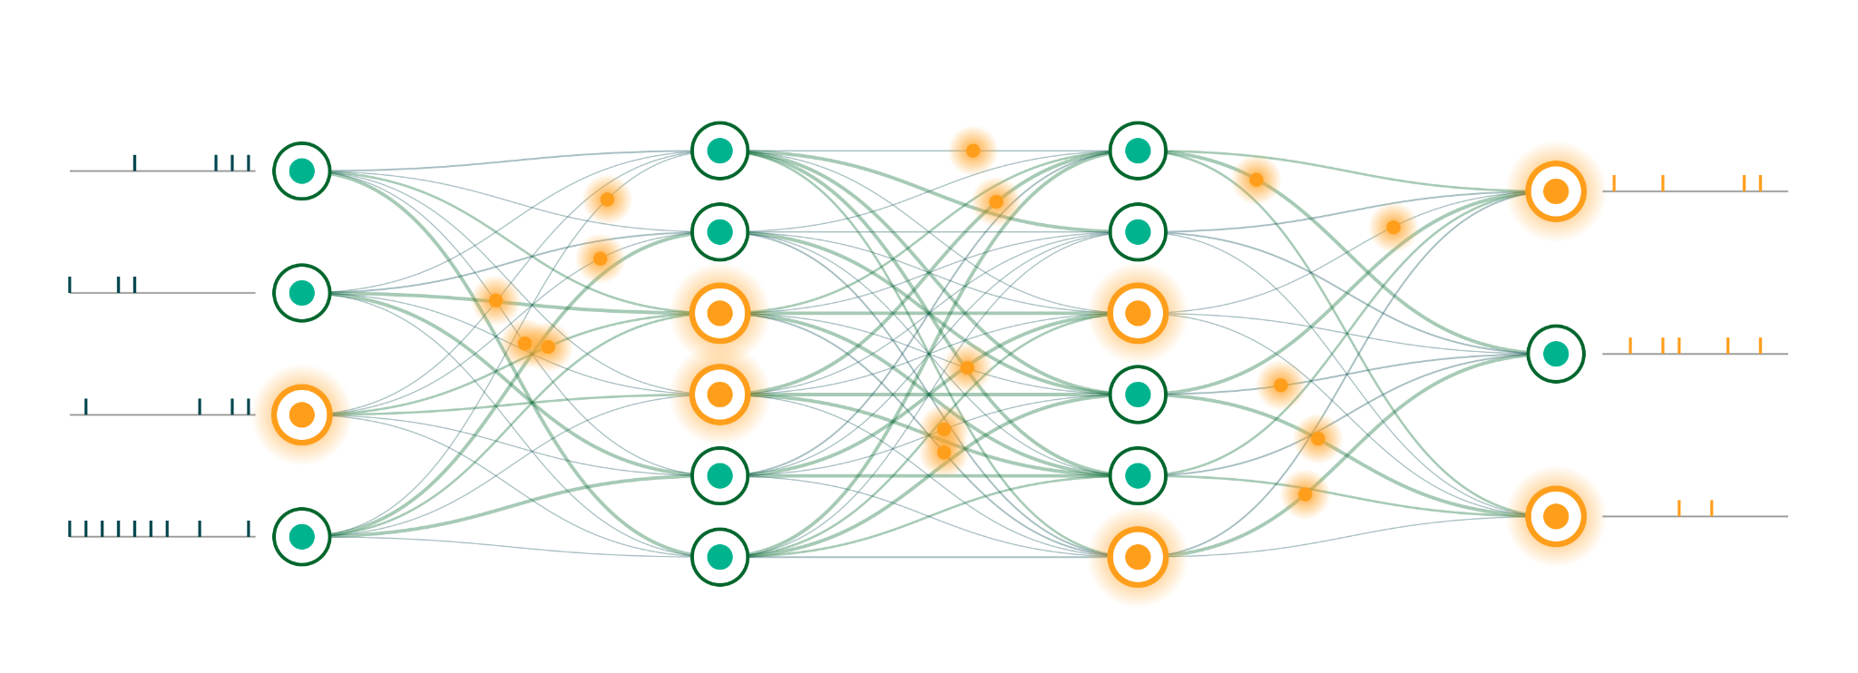
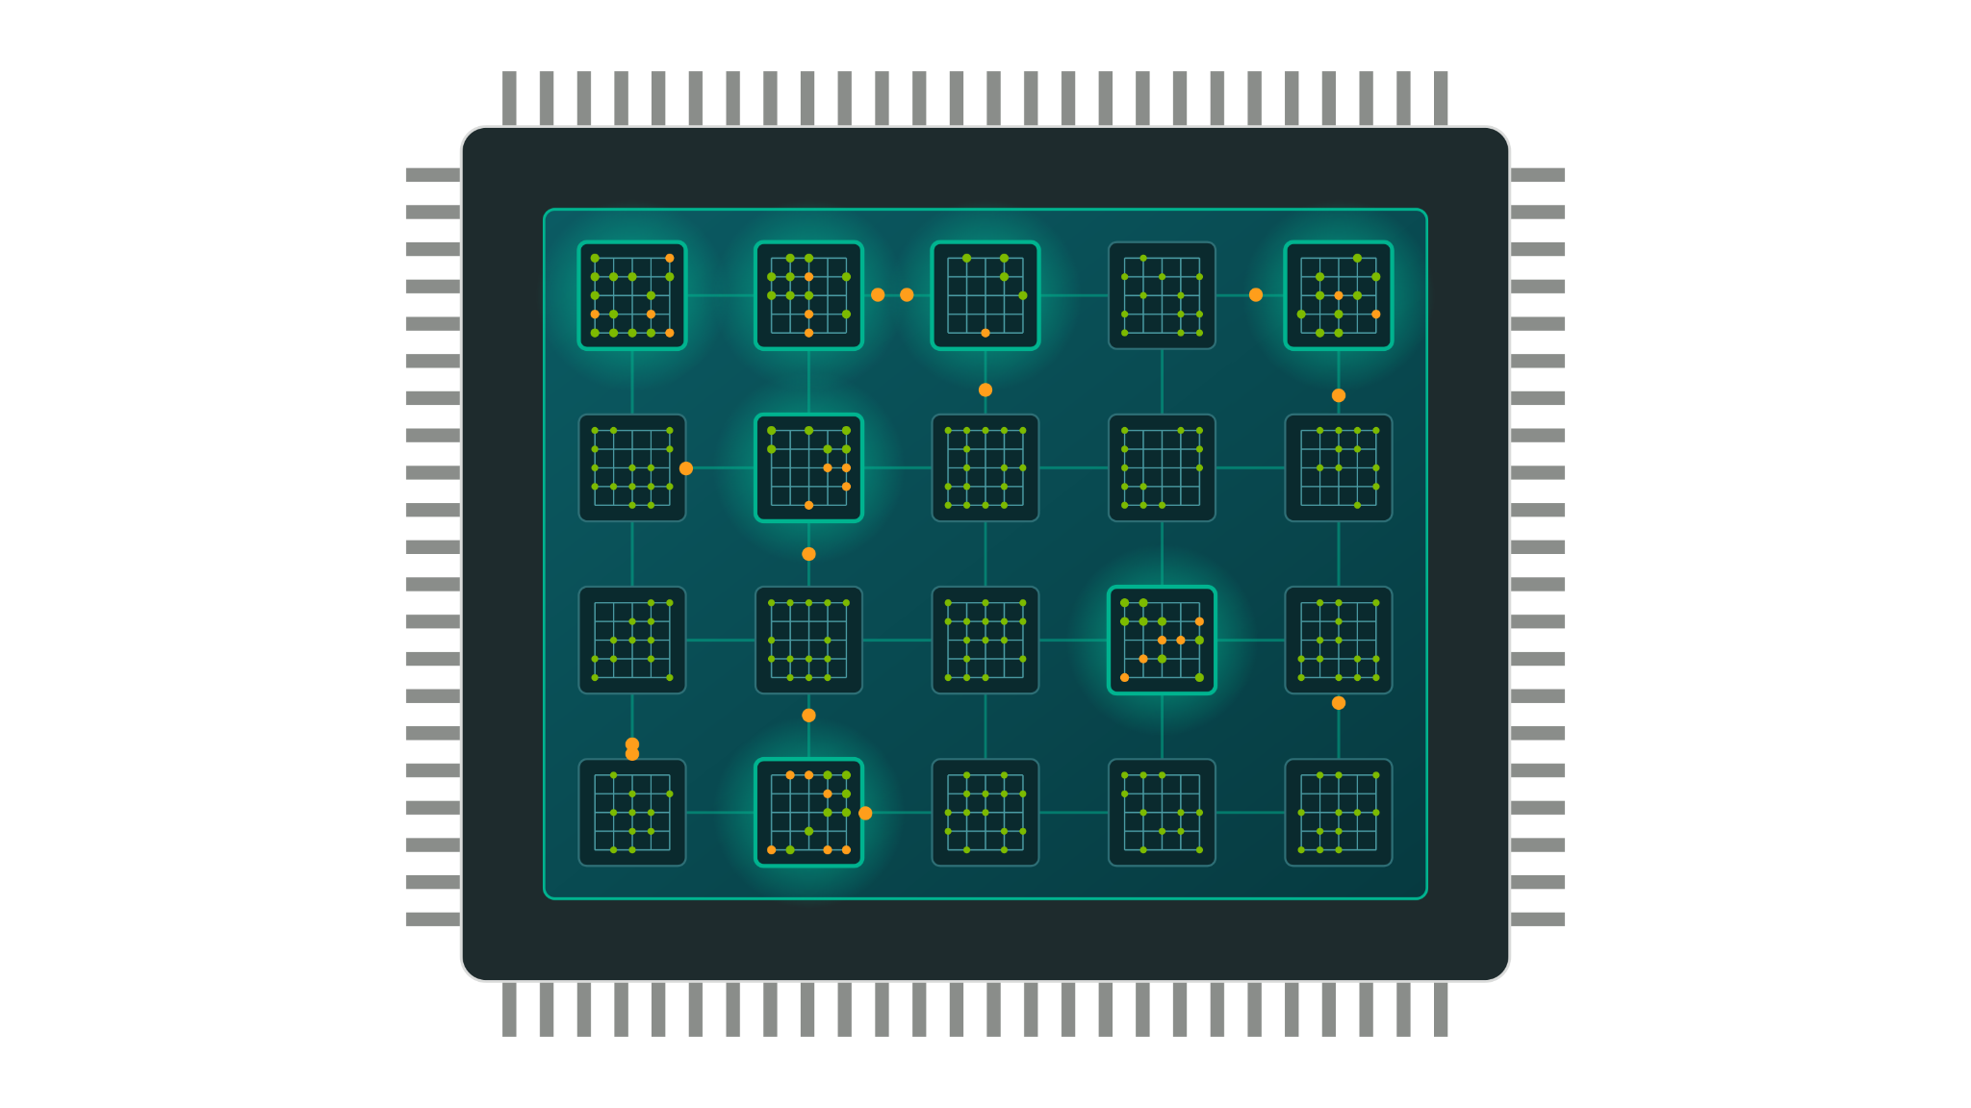
THE BACKGROUND
Spiking Neural Networks and Neuromorphic Computing
Spiking Neural Networks
The ‘software’
Closer to biological neural networks
Energy-efficient AI models
Neuromorphic Computing
The ‘hardware’
Brain on a chip
Non von Neumann computing paradigm

Slide 14
THE PROBLEM
The Cost of Attention
Conventional Transformers
Spiking Transformers
High operational cost
Computationally expensive
Consume vast amounts of power (MW)
Lower cost, comparable accuracy
Higher speed, lower latency
Low power consumption (kW)
Notes:
Transformers underpin tools like ChatGPT but carry a high operational cost. Our target is the same accuracy at a fraction of the power.

Slide 15
RATIONALE
Why Neuromorphic Hardware
1,000–10,000× Less Power
Event-driven operation
Less power consumed than CPUs or GPUs.
No von Neumann Bottleneck
Colocated processing-memory
Bypasses the processing-memory bottleneck of the von Neumann architecture.
Better Performance
Intrinsic Parallelism
Expensive computations run efficiently in parallel.
Neuromorphic computing is Turing-complete: it can perform all computations CPUs and GPUs can, presumably at a fraction of the cost.
Notes:
Three properties of neuromorphic processors drive the advantage. And neuromorphic computing is Turing-complete, so nothing is given up in capability.

Slide 16
SCIENTIFIC INNOVATION
Prior Work and Our New Approach
Current literature
Our approach
Rate-coded inputs
Floating-point softmax retained in the attention layer
Not fully spiking; cannot be mapped directly to neuromorphic hardware.
Spatial encoding: two’s complement and virtual neuron encoding
Heaviside step function in place of softmax
Every layer spikes, enabling end-to-end deployment on a neuromorphic processor for the first time.
Notes:
This is the scientific core of the proposal. Published spiking transformers keep a floating-point softmax, so they are not fully spiking. Replacing softmax with the Heaviside step function and rate coding with spatial encoding is what makes end-to-end deployment possible.

Slide 17
OBJECTIVE 1 — ORNL
The Spiking Attention Mechanism
Every circle is a LIF neuron; every arrow a set of synapses.
Spatial encoding reaches full precision in a single timestep.
Similarity computed with our spiking binary matrix multiplication algorithm.
Notes:
Walk the flow: input X is spatially encoded, projected into query, key and value matrices of LIF neurons, similarity computed with our binary matrix multiplication algorithm, thresholded by the Heaviside function, then added back to X.

Slide 18
OBJECTIVE 2 — DUKE & DELAWARE
Neuromorphic Circuit Primitives
Duke · Digital Neuromorphic Design
Delaware · Ferroelectric Neuromorphic Design
CMOS circuit designed and simulated in Cadence
Two-rail differential current integration with threshold voltage scaling
Neuron leak added to emulate temporal decay of membrane potential
TiN/HfZrO/TiN FeFET stack simulated in Synopsys TCAD
BSIM modeling to refine the ferroelectric memory window
TiO₂ channel and gate metals optimized through controlled annealing
~8,000 neurons, all-to-all connected
~1,000 neurons, all-to-all
Notes:
The hardware half of Phase 1. Duke advances an existing compute-in-memory integrate-and-fire circuit by adding leak. Delaware builds ferroelectric synapses on a TiO2 FeFET stack.

Slide 19
SCOPE
Six Project Objectives
01 ORNL · PHASE 1
Develop and test SAM
Single-head spiking self-attention in HyperNeuro, tested on binary and Cora datasets.
02 DU & UD · PHASE 1
Simulate primitive circuits
CMOS digital LIF-based circuit design and simulation at Duke; ferroelectric design/simulation at UDel.
03 ORNL · PHASE 2
Scalable learning algorithm
Scalable surrogate gradient-based learning algorithm for spiking neural networks implemented in HyperNeuro.
04 ORNL · PHASE 2
Develop spiking transformers
Multi-head SAM plus fully connected spiking layers, tested on GLUE, COCO, and MCI.
05 DU & UD · PHASE 2
Chip tape out / fabrication
Tape out the CMOS-based digital neuromorphic chip designed at Duke and fabricate the ferroelectric neuromorphic chip designed at UDel.
06 DU & UD · PHASE 2
Run SAM on hardware
Validate SAM on the digital and ferroelectric neuromorphic platforms.
Notes:
Six objectives across two phases. Objectives 1 and 2 run in parallel in Phase 1 and feed everything downstream.

Slide 20
MONTHS 1–6
Phase 1 Milestones
Time | ORNL | Duke University | University of Delaware
1 mo | Single-head self-attention formulated in the spiking domain | LIF neuron architecture specification | Material-level TCAD modeling
2 mo | SAM implemented in SuperNeuroMAT | Transistor-level circuit sizing | Process and architecture optimization
3 mo | SAM tested on the binary dataset | Threshold voltage scaling logic implemented | Physical characterization and testing
4 mo | SAM tested on the Cora dataset | Pulse width and reset verification | Compact model extraction
5 mo | SAM fine-tuned to increase accuracy | Functional corner analysis | Integrated array simulation
6 mo | Demo: accuracy above 73% on Cora | Demo: digital LIF neuron circuit simulation | Demo: ferroelectric synapse circuit simulation
Notes:
The nine-month plan. Note the parallel tracks: software at ORNL, circuits at Duke and Delaware, converging on month-6 demos.

Slide 21
9 MONTHS TO 4 YEARS
Phase 2 Roadmap
Year 1
Year 2
Year 3
Year 4
Scalable learning algorithm developed and tested at ORNL
Digital neuron chip taped out at Duke
Ferroelectric synapse chip fabricated at Delaware
HPC simulator built in C and Python with MPI, OpenMP and HIP
Neuron and synapse chips integrated on a PCB into a mixed-signal platform
Spiking transformer developed with scalable learning on the HPC simulator
SAM implemented on the neuromorphic platform
Spiking transformer validated on MAG240M and MCI
SAM validated on hardware using the binary dataset
Notes:
Years two through four. Software scales up at ORNL while the chips are taped out, fabricated and integrated at Duke and Delaware.

Slide 22
PHASE 1 EXIT CRITERIA
Decision Gate Metrics
>73%
SAM testing accuracy on Cora, within 10% of the conventional attention mechanism.
Digital circuit simulation for the LIF-based SNNs
Ferroelectric circuit simulation for LIF-based SNNs
Named mitigations for each risk
FPGA emulation if no foundry is available; redundant synapse arrays with majority-voting readout if device variability exceeds tolerance.
All simulation tools will be released open source.
Notes:
Three concrete Phase 1 exit criteria. 73% is within 10% of the conventional graph attention network baseline. Risks are small and have named mitigations.

Slide 23
WHO DOES THE WORK
Team and Facilities
Oak Ridge National Laboratory
Duke University
University of Delaware
Prasanna Date, Xi Zhang
Transformers, spiking graph neural networks, and SuperNeuroMAT, the R&D 100 award-winning SNN simulator.
OLCF: Frontier, the first exascale system, plus Discovery. ALCC allocation already in hand.
Hai Li
Electronic design automation; neuron circuits for in-sensor processing and synapse circuits for compute-in-memory.
Center for Computational Evolutionary Intelligence: full circuit and system test bench.
Yuping Zeng
Thin-film fabrication of TiO₂ ferroelectric devices, including a novel wide-memory-window FeFET technology.
UD Nanofabrication Facility: device design, fabrication and integration.
Weekly one-hour virtual meetings on progress, challenges and milestones.
Notes:
Three groups, complementary expertise, and the facilities already in place. Total year-one budget is $750,000. Weekly one-hour virtual meetings coordinate the work.

Slide 24
IMPACT
Toward AI-Driven Autonomous Laboratories
Integrated with the Genesis Mission and run on the American Science Cloud, spiking foundational models will analyze scientific data in real time at an unprecedented rate and scale.
Biotechnology
Materials science
Next-generation computing
National security
Prasanna Date · datepa@ornl.gov
Collaborators welcome
Notes:
Close on the mission tie-in: spiking foundational models on the American Science Cloud, analyzing scientific data in real time. Invite collaborators.

Slide 25
TODAY’S DEMO
Overview of This Demo
Simulation and Spiking AI · ORNL
Hardware · Duke and Delaware
1
2
3
4
5
HyperNeuro
SNNs vs ANNs
Spiking Attention Mechanism
Spiking Attention on Digital Hardware
Ferroelectric Neuromorphic Primitives
HPC-scale simulator for spiking neural networks
Spiking vs artificial neural networks: accuracy and energy compared
QKV Attention built from spiking threshold neurons
Digital LIF neurons and synapses on FPGA (eventually, ASIC)
Ferroelectric neuron and synapse circuit simulation
Emily Herron
ORNL
Xi Zhang
ORNL
Sanjay Das
ORNL
Prasanna Date
for Duke University
Prasanna Date
for Univ. of Delaware
Notes:
Five demos, from software to hardware. HyperNeuro (Emily Herron): the HPC-scale simulator for SNNs. SNNs vs ANNs (Xi Zhang). The spiking attention mechanism (Sanjay Das). Then the hardware: digital neuromorphic circuits with Duke and ferroelectric neuromorphic primitives with the University of Delaware (both Prasanna Date).

Slide 26





HyperNeuro is a distributed, exascale simulator for spiking neural networks
C engine, Python interface
One Frontier node
The simulation core is written in C; a Python package exposes it to users.
GPU
GPU
GPU
GPU
CPU · OpenMP
Three levels of parallelism
neuron updates: leak, threshold, reset, refractory
GPU
GPU
GPU
GPU
MPI between nodes, OpenMP across CPU cores in a node, HIP for GPU acceleration in a node.
8 GPUs · HIP
Built for Frontier and Lux
synapse updates: weight integration, STDP
Heterogeneous CPU + GPU supercomputers at ORNL.
MPI between nodes
Design goal
node 2
node 3
… ~9,400
Hundreds of billions of neurons and hundreds of trillions of synapses, efficiently.
Frontier · Lux: CPU + GPU nodes at ORNL
Notes:
MPI handles inter-node communication, OpenMP provides intra-node parallelism on CPUs (neuron updates), and HIP provides GPU acceleration inside a node (synapse updates).

Slide 27
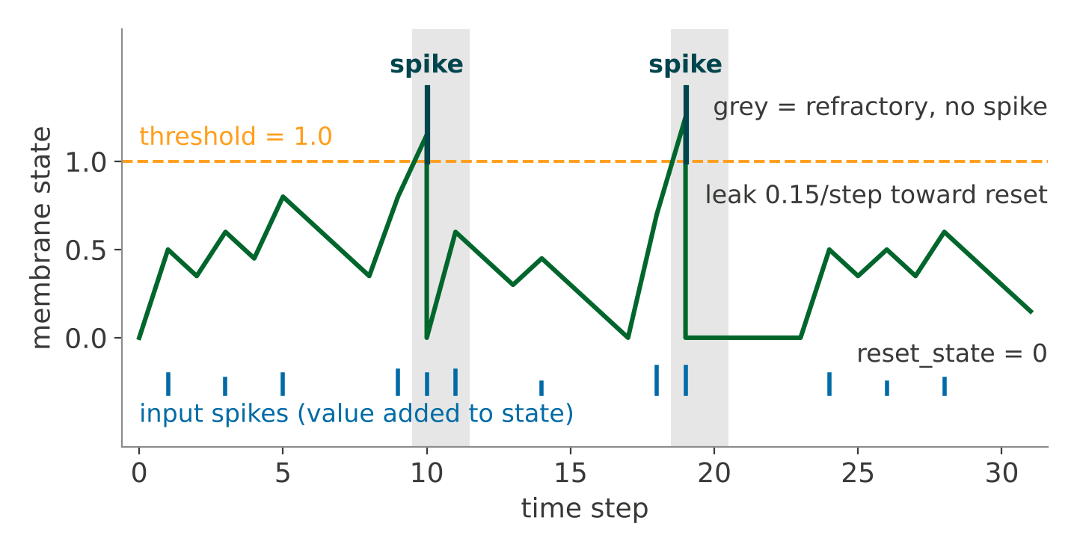
HyperNeuro features leaky integrate-and-fire neurons and synapses at precision choices
weight · delay
stdp_enabled
pre
post
pre fires at step t → post receives the weight at t + delay
Neurons
Synapses
LIF: threshold, leak, reset state, refractory period.
Weight, delay, STDP flag; all-to-all and self connections.
Learning
Precision
One neuron, recorded from the engine step by step: threshold 1.0, leak 0.15, reset 0, refractory period 2. Above threshold it spikes, resets, and cannot fire during the refractory countdown.
Optional STDP: Δw set by pre/post spike timing.
float16/32/64; 32- or 64-bit indices; set at build time.
Notes:
Neurons: LIF with threshold, leak, reset state, and refractory period. Synapses: weight, delay, STDP flag. Precision and index width are build-time options (HYPERNEURO_PRECISION, HYPERNEURO_INT). The trace was recorded by running the engine one step at a time on a single neuron.

Slide 28

One time step has seven phases: neuron operations on CPUs, synapse operations on GPUs
1
2
3
4
5
6
7
Leak
Integrate
Threshold
Refractory
Reset
Record
STDP
state →
reset_state
by leak
state +=
input[t] +
Wᵀ·spikes[t−1]
spike =
state >
threshold
in countdown:
spike = 0,
count −1
spiked:
state =
reset_state
spike_train
.append(
spikes)
W +=
enabled ⊙
Δw(history)
Two MPI calls per time step: N-sized all-reduces hidden behind compute
compute
CPU + GPU
integrate
leak
input
wait ①
state += · fire
fill slot
STDP
wait ②
Σ local synapses, O(S/P)
O(N/pr)
spikes due
reset, refractory
own spikes
all local synapses, O(S/P · TS)
network
MPI, async
① row SUM · N/pr floats
② column SUM · N/pc ints
One time step on one rank
neuron operations: CPUs, OpenMP
synapse operations: GPUs, HIP
Neurons on CPUs
Synapses on GPUs
Two MPI calls a step
Leak, threshold, spike, reset, refractory: OpenMP threads, O(N / pr) per rank.
Weight integration and STDP in HIP: sums over local synapses, O(S / P), activity-independent.
Asynchronous N-sized all-reduces, started before and finished after compute.
Notes:
Steps 2 and 7 are synapse operations on GPUs (HIP); the rest are neuron operations on CPUs (OpenMP). The leak is clamped at reset_state. Each time step makes only two MPI calls.

Slide 29
Neurons and synapses are spread block-cyclically over a pr × pc grid of MPI ranks
Worked example: 2 × 3 ranks, 12 neurons
Synapse matrix
grid row 0
rank 0
rank 1
rank 2
pre →
post % pr
= 0
post 0 2 4 6 8 10
pre 0 3 6 9
post 0 2 4 6 8 10
pre 1 4 7 10
post 0 2 4 6 8 10
pre 2 5 8 11
24 of 144 pairs
24 of 144 pairs
24 of 144 pairs
post
↓
grid row 1
rank 3
rank 4
rank 5
post % pr
= 1
post 1 3 5 7 9 11
pre 0 3 6 9
post 1 3 5 7 9 11
pre 1 4 7 10
post 1 3 5 7 9 11
pre 2 5 8 11
24 of 144 pairs
24 of 144 pairs
24 of 144 pairs
Color = rank storing (pre → post). Each rank holds 1/(pr·pc) of the matrix.
grid col 0 · pre % pc = 0
grid col 1 · pre % pc = 1
grid col 2 · pre % pc = 2
N / pr
N / pc
S / (pr·pc)
output neurons per rank
input neurons per rank
synapses per rank
owned by row post % pr; replicated across the pc ranks of a row
pre side: pre % pc == col; shared down a grid column
every (pre → post) pair has exactly one home rank
Notes:
Neurons and synapses are distributed over a 2D grid of MPI ranks (pr x pc, set with SNN(pr=, pc=) or HYPERNEURO_PR / HYPERNEURO_PC). Output neurons are split along rows and input neurons along columns, block-cyclically.

Slide 30
Only two MPI calls per time step: N-sized all-reduces hidden behind compute
compute
CPU + GPU
integrate
leak
input
wait ①
state += · fire
fill slot
STDP
wait ②
Σ local synapses, O(S/P)
O(N/pr)
spikes due
reset, refractory
own spikes
all local synapses, O(S/P · TS)
network
MPI, async
① row SUM · N/pr floats
② column SUM · N/pc ints
One time step on one rank
neuron operations, CPUs
synapse operations, GPUs
Reduction 1: the dot product
Reduction 2: next step's spikes
A rank holds input only from its own column's pre-neurons; the row SUM adds the rest.
Every rank in the row then holds identical states and fires in lockstep; no state is ever sent.
Each rank writes its own spikes into the next ring slot, zeros elsewhere; one owner per neuron, so SUM is exact.
Starts before STDP, which reads only older slots, so the STDP pass hides the latency.
Notes:
Both MPI calls are asynchronous all-reduces of N-sized vectors. flt16 widens the row reduction to float over the wire. Square grids minimise the larger message.

Slide 31



A thin Python layer over the unchanged C engine keeps all network state in C
Python package pip install
libhyperneuro.so one shared library
User script
hyperneuro API
hyperneuro.SNN
snn.py
ctypes binding
_lib.py
C shim
hn_capi.c
C engine
MPI, OpenMP, HIP
Same script on every rank
The Python API, plus bulk calls and views
49 C functions; no compiled extension
Validates input; errors become exceptions
LIF + STDP on a pr × pc grid
Network lives in C
Every call collective
Errors as exceptions
Python keeps no copy. neuron_states and synaptic_weights are live views of the engine's arrays.
Every rank runs the whole script; builds, simulates, and reads are collective and return the full network.
The shim validates every argument and returns HN_* codes, identically on every rank; the engine never exits.
Notes:
A user script calls the hyperneuro API. hyperneuro.SNN turns it into hn_* calls through ctypes; the C shim validates and forwards to the engine, which does all MPI, OpenMP, and HIP work. The engine holds every byte of network state.

Slide 32
The Python API: build a network, add spikes, simulate, and read it back on any number of ranks
Run settings
import hyperneuro as hn
snn = hn.SNN()
a = snn.create_neuron(threshold=0.5, leak=1.0)
b = snn.create_neuron(threshold=1.0)
snn.create_synapse(a, b, weight=2.0, delay=3,
stdp_enabled=True)
snn.add_spike(0, a, 1.0)
snn.stdp_setup(Apos=[0.5, 0.25],
Aneg=[-0.1, -0.05])
snn.simulate(20)
print(snn.ispikes.sum(), snn.weight_mat())
HYPERNEURO_PR, _PC | process grid, or SNN(pr=, pc=)
HYPERNEURO_NUM_GPUS | GPUs per rank, or SNN(num_gpus=)
OMP_NUM_THREADS | OpenMP threads per rank
HYPERNEURO_LIB | which libhyperneuro.so to load
Build options
HYPERNEURO_PRECISION | flt16 | flt32 | flt64
HYPERNEURO_INT | int32 | int64
HYPERNEURO_HIP | ON | OFF (AMD GPU build)
snn = hn.SNN(seed=1) # bulk calls
snn.create_neurons(10_000, thresholds=(0.5, 1.5))
snn.create_synapses(prob=0.001, weights=(0, 0.2))
snn.add_spikes([0, 0], [0, 1], 2.0)
snn.simulate(20)
snn.local_neurons()["state"] # view, no copy
# 8 × 8 grid on 64 ranks
srun -n 64 env HYPERNEURO_PR=8 \
HYPERNEURO_PC=8 python my_script.py
Notes:
Scripts run SPMD: every rank runs the whole script, and every call that builds, changes, simulates, or reads the network is collective. Build options: HYPERNEURO_PRECISION, HYPERNEURO_INT, HYPERNEURO_HIP.

Slide 33
Worked example: a spike travels down a three-neuron chain one step at a time
All neurons: threshold 0.5, leak ∞, reset 0, refractory 0
snn = snm.SNN()
ids = [snn.create_neuron(threshold=0.5)
for _ in range(3)]
a, b, c = ids
snn.create_synapse(a, b, weight=1.0)
snn.create_synapse(b, c, weight=1.0)
snn.add_spike(0, a, 1.0)
snn.simulate(4); print(snn.spike_train)
input spike, value 1.0, at step 0
n0
w = 1.0
n1
w = 1.0
n2
step | after leak (∞: all 0) | add inputs and Wᵀ · spikes[t−1] | state > 0.5 ? | spikes[t] | state after reset
0 | 0 0 0 | 1.0 0 0 (input to n0) | n0 | 1 0 0 | 0 0 0
1 | 0 0 0 | 0 1.0 0 (w · spike n0) | n1 | 0 1 0 | 0 0 0
2 | 0 0 0 | 0 0 1.0 (w · spike n1) | n2 | 0 0 1 | 0 0 0
3 | 0 0 0 | 0 0 0 | none | 0 0 0 | 0 0 0
Engine output: [[1,0,0],[0,1,0],[0,0,1],[0,0,0]]. With leak ∞ each neuron fires once, one step after its predecessor.
Notes:
The chain was run with the engine to confirm the table: spike_train is [[1,0,0],[0,1,0],[0,0,1],[0,0,0]]. A pre-synaptic spike at step t is delivered at step t+1 (delay 1).

Slide 34


Validated rank for rank: the same network gives identical spikes and weights on every process grid
Unit tests
Grids with exact parity
pr × pc, one dot per MPI rank
73 shim and SNN-layer tests pass on 1 rank; 71 on 2 × 2, 1 × 4, and 4 × 1 grids, on the int32 and flt16 builds, and on the HIP build with 1 and 2 GPUs per rank.
1 × 1
1 × 4
MPI rank parity
4 × 1
One random network on every rank, five phases. Spikes, states, refractory countdowns, and STDP weights match exactly on every grid from 1 × 1 to 4 × 4, including 16 ranks across two Frontier nodes, CPU and GPU.
2 × 2
2 × 4 · two nodes
Memory
3 × 5 · 15 ranks
4 × 4 · 16 ranks, two nodes
A 100,000-neuron, 1,000,000-synapse network is built, simulated, and read back; nothing in Python grows with it.
Seeds broadcast from rank 0; random values are a hash of seed and global ID, so every grid builds the same network.
Notes:
Validation status (ABI 4, Frontier, PrgEnv-amd 8.6.0, ROCm 6.2.4, Cray MPICH 8.1.31): unit tests pass on 1 rank (73) and on 2x2, 1x4, 4x1 grids, int32 and flt16 builds, and the HIP build with 1 and 2 GPUs per rank. mpi_parity.py passes exactly on every grid from 1x1 to 4x4, including 3x5 on 15 ranks and 4x4 on 16 ranks across two nodes.

Slide 35
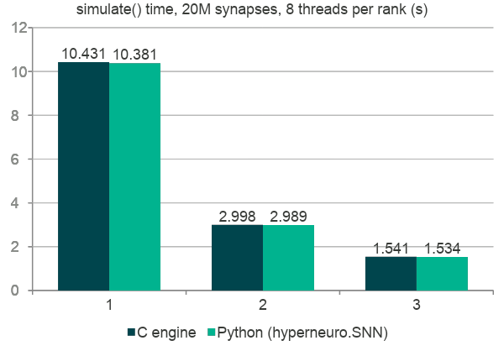
Measured on Frontier: Python matches the C engine, and a 2 × 4 grid over two nodes is 6.8× faster than one rank
Per-call overhead
100k synapses, 8 threads, median of 5 runs (s)
Phase | C engine | Python
create_synapse, one at a time | 0.009 | 0.363
20k element reads | 0.000 | 0.165
5k element writes | 0.000 | 0.057
Read a whole attribute | 0.0004 | 0.0022
simulate, 100 steps | 0.082 | 0.082
Peak RSS (MB) | 78 | 105
simulate() costs the same from Python as from C. Element access is 1.5 to 2× slower through ctypes; use the bulk calls.
All runs on Frontier.
Notes:
All runs on Frontier. Python column is HyperNeuro through hyperneuro.SNN; C engine column makes the same calls directly in C. 20M synapses: a 2x4 grid over two nodes is 6.8x faster than one rank.

Slide 36
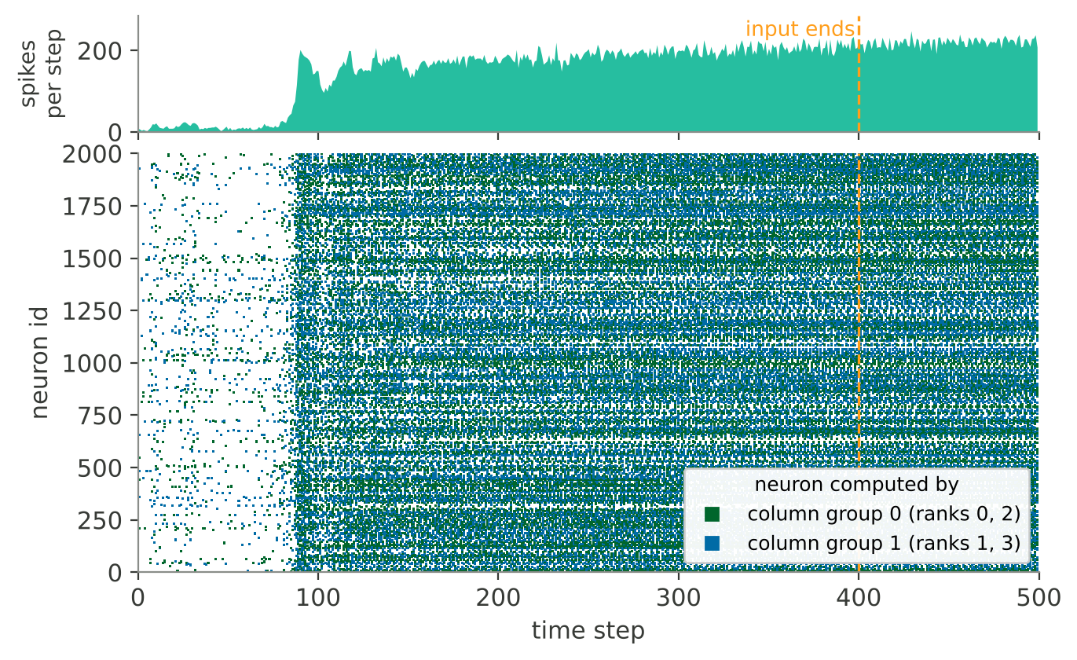
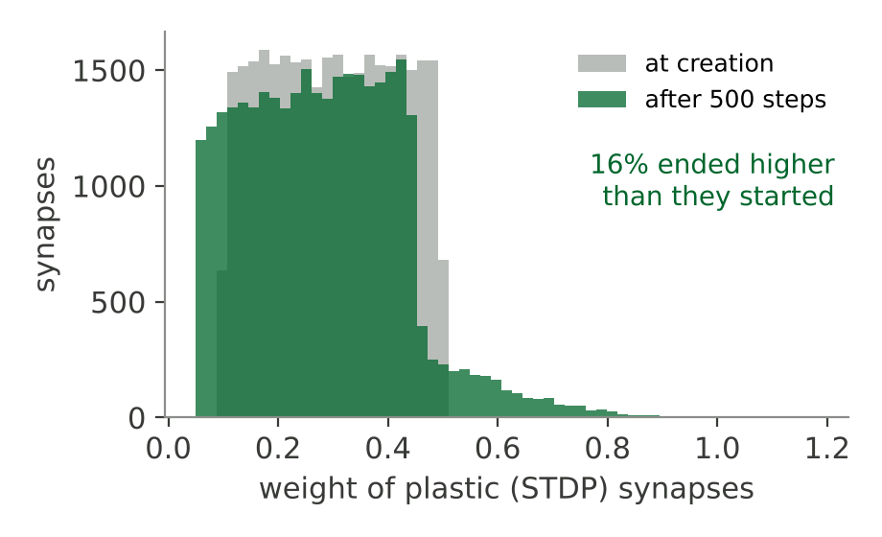
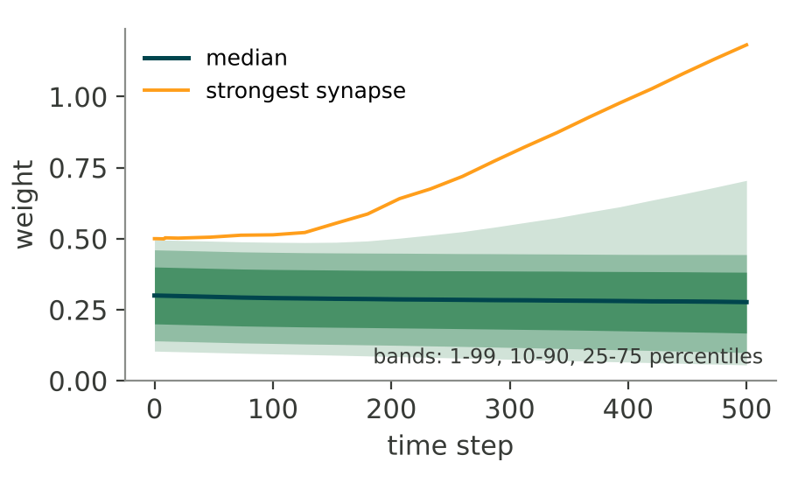
A finished run: 2,000 neurons on a 2 × 2 grid
sample_run.py on a 2 × 2 grid: 2,000 LIF neurons, 39,788 synapses, STDP on excitatory synapses, input for 400 of 500 steps, 81,186 spikes. Raster colour = column group of ranks; right: plastic weights and the weight train.
Notes:
This run reproduces the documented small sample. Counts match the README exactly (2,000 neurons, 39,788 synapses, 81,186 spikes; 16% of plastic weights end higher). Timings are not shown because this run was not on Frontier.

Slide 37
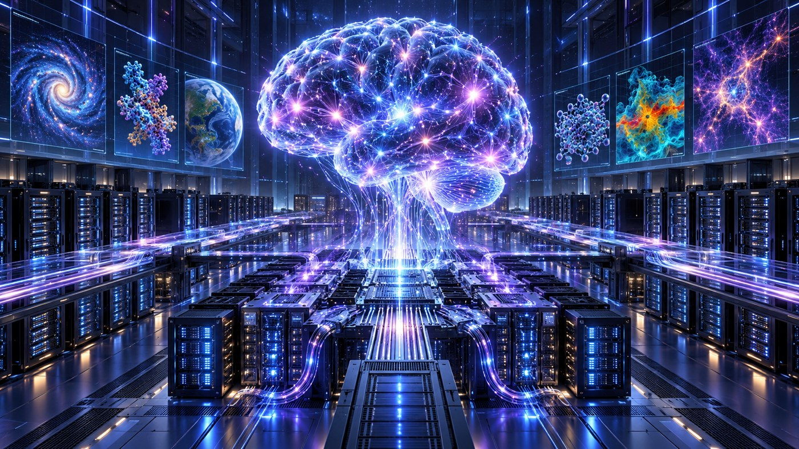
Target scale: 100 billion neurons and 100 trillion synapses, about the scale of a human brain
100 B
100 T
~9,400
8
neurons
synapses
Frontier nodes
GPUs per node
Status The full-scale run has not been completed. Runs have been performed at 16 and 64 Frontier nodes; the full-scale figures are extrapolated from those.
The human brain: ~86 billion neurons and ~100 trillion synapses. The target is the same scale.
extrapolated
16 nodes
64 nodes
~9,400 nodes
run
run
full scale, not run yet
Notes:
Target: 100 billion neurons and 100 trillion synapses on about 9,400 Frontier nodes with 8 GPUs each. Status: runs at 16 and 64 nodes have been completed; the full-scale numbers are extrapolated.

Slide 38
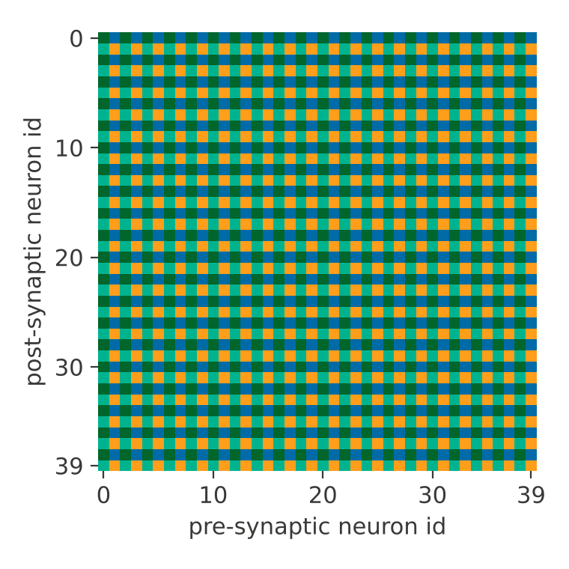



hyperneuro.viz and the run viewer show where every neuron and synapse lived, the spikes, and the weights
Network
Force or placement layout; neurons coloured by rank, node, GPU, or firing rate; synapses by weight or storing rank.
Spikes
The raster zoomed to the active steps, with spikes per step above it.
Weights
Percentile bands over time, strengthening events, and the weight matrix in placement order.
Rank storing synapse (pre → post) in the 2 × 2 run, first 40 neurons, from the block-cyclic rules.
from hyperneuro import viz
snn.simulate(1000)
viz.export(snn, "run.json")
# collective; rank 0 writes
Costs a run nothing: export reads the finished state once. Figures export at 89 to 183 mm as SVG or PNG.
Notes:
hyperneuro.viz writes one JSON bundle the run viewer in dashboard/ opens. The export gathers the whole network, so it is meant for runs up to roughly 10,000 neurons and 100,000 synapses.

Slide 39
Scaling study on Frontier and Lux: from today's runs to 10¹⁴ synapses
Now
Phase 1
Phase 2
Phase 3
Runs so far
On-node layout
Strong scaling
Full scale
16- and 64-node Frontier runs; full scale extrapolated
Ranks × GPUs per rank at N = 10⁵ and 10⁶; Frontier and Lux
N = 10⁷, S = 10¹⁰ on 1 to 256 nodes
10¹¹ neurons, 10¹⁴ synapses on ~9,400 Frontier nodes
Synapses per network, log scale
filled: run · open: planned
sample run
4 × 10⁴
Frontier 2 × 4 grid
2 × 10⁷
Phase 2 target
10¹⁰
Full scale, about a brain
10¹⁴
10⁴
10⁶
10⁸
10¹⁰
10¹²
10¹⁴
spiking SGC on Cora
~8.8 × 10⁴
Research question Can one MPI + OpenMP + HIP engine carry the same Python API from a laptop to 10¹⁴ synapses on ~9,400 Frontier nodes with identical results?
Notes:
Phases: on-node layout (ranks x GPUs per rank at N = 10^5 and 10^6, Frontier and Lux); strong scaling (N = 10^7, S = 10^10, 1 to 256 nodes); full scale (10^11 neurons, 10^14 synapses, ~9,400 Frontier nodes).

Slide 40


HyperNeuro supports spiking AI models, learning-rule studies, and non-ML neuromorphic applications
Spiking AI models
Learning at scale
Non-ML applications
Spiking Transformers and spiking LLMs, developed at scale and deployed on neuromorphic hardware.
STDP and surrogate gradient descent tested on networks larger than one node allows.
Non-machine-learning uses of SNNs and neuromorphic computing.
Develop spiking AI models at scale on HyperNeuro
Deploy on neuromorphic hardware
Energy-efficient AI
Notes:
Uses: spiking AI models deployable on neuromorphic hardware; learning rules like STDP and surrogate gradient descent on very large networks; non-ML applications. The Cora example reaches val 0.7980 and test 0.8160 on one rank.

Slide 41
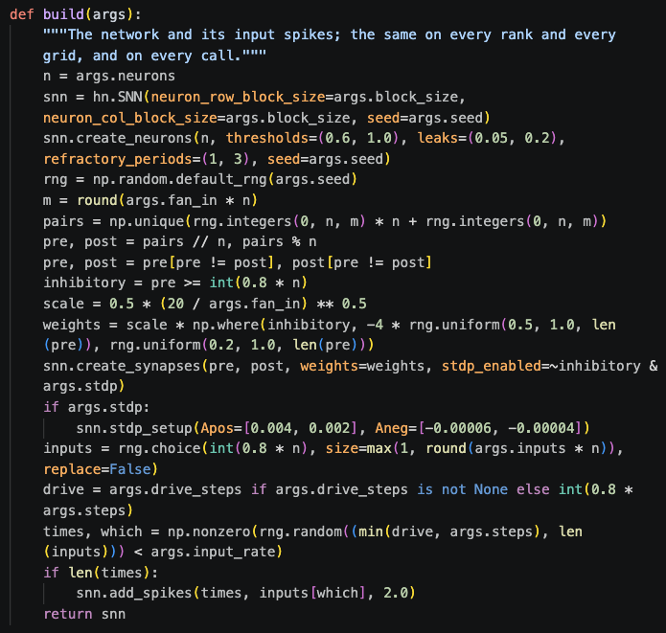



Demo: four Frontier batch jobs that end with a bundle for the run viewer
Job | Where it runs | Network
small_cpu | 1 node, 2 × 2 CPU ranks | 2,000 neurons, ~40,000 synapses, 500 steps
two_nodes | 2 nodes, 2 × 4 grid, 7 OpenMP threads per rank | 10,000 neurons, ~100,000 synapses, 500 steps
gpu | 1 node, 2 × 2 grid, 2 GPUs per rank (all 8) | 10,000 neurons, ~100,000 synapses, 500 steps
sgc_cora | 1 node, 2 × 2 CPU ranks, 7 threads each | spiking SGC on Cora: 9,565 neurons, ~88,000 synapses
Submit
Copy
View
sbatch from the repository root
scp runs/*.json.gz to a laptop
open dashboard/ in a browser
build() in sample_run.py: the same network on every rank and every grid
Notes:
The first three jobs run sample_run.py on every rank: a recurrent network from one seed, 3% of neurons driven by random input spikes for the first 400 steps, then an export. Each bundle includes a weight history recovered by replaying the run.

Slide 42
Spiking vs Artificial Neural Networks Demo
Xi Zhang

Slide 43
TODAY’S DEMO
Overview of This Demo
Simulation and Spiking AI · ORNL
Hardware · Duke and Delaware
1
2
3
4
5
HyperNeuro
SNNs vs ANNs
Spiking Attention Mechanism
Spiking Attention on Digital Hardware
Ferroelectric Neuromorphic Primitives
HPC-scale simulator for spiking neural networks
Spiking vs artificial neural networks: accuracy and energy compared
QKV Attention built from spiking threshold neurons
Digital LIF neurons and synapses on FPGA (eventually, ASIC)
Ferroelectric neuron and synapse circuit simulation
Emily Herron
ORNL
Xi Zhang
ORNL
Sanjay Das
ORNL
Prasanna Date
for Duke University
Prasanna Date
for Univ. of Delaware
Notes:
Five demos, from software to hardware. HyperNeuro (Emily Herron): the HPC-scale simulator for SNNs. SNNs vs ANNs (Xi Zhang). The spiking attention mechanism (Sanjay Das). Then the hardware: digital neuromorphic circuits with Duke and ferroelectric neuromorphic primitives with the University of Delaware (both Prasanna Date).

Slide 44
OVERVIEW · SPIKING VS CONVENTIONAL
Same accuracy, less energy
Conventional graph network (GNN)
Matrix Multiplications
Learns by backpropagation, over many epochs
Energy: every multiply-accumulate
Our spiking network
End-to-end Spiking
Learns on the network itself: STDP in one pass, then R-STDP
Energy: every spike and every synaptic event
vs
Same task, same data: classify the nodes of seven standard graphs (citation, co-purchase, co-author) from a few labels.
The same accuracy on 7 graphs, at 3–33× less energy per prediction and 15–1,000× less energy to learn (estimates).
Notes:
(45 s) One question: can a spiking network do the job of a conventional graph neural network with the same accuracy, at less energy, learning included? Left, the conventional way: each node's features are combined with its neighbours' by matrix products on a GPU, the network learns by backpropagation over many epochs, and every multiply-accumulate costs energy. Right, ours: the same combining is done by spikes crossing synapses that follow the citations, the network learns on itself by local rules, STDP in one pass and then R-STDP, and energy is spent only when a neuron spikes and when a spike reaches a synapse. Same task and data for both: classify the nodes of seven standard graphs from a few labels. The answer, which the rest of the talk unpacks: the same accuracy on all seven graphs, 3 to 33 times less energy per prediction on five of them, and 15 to 1,000 times less energy to learn. All energies are estimates from operation counts.

Slide 45
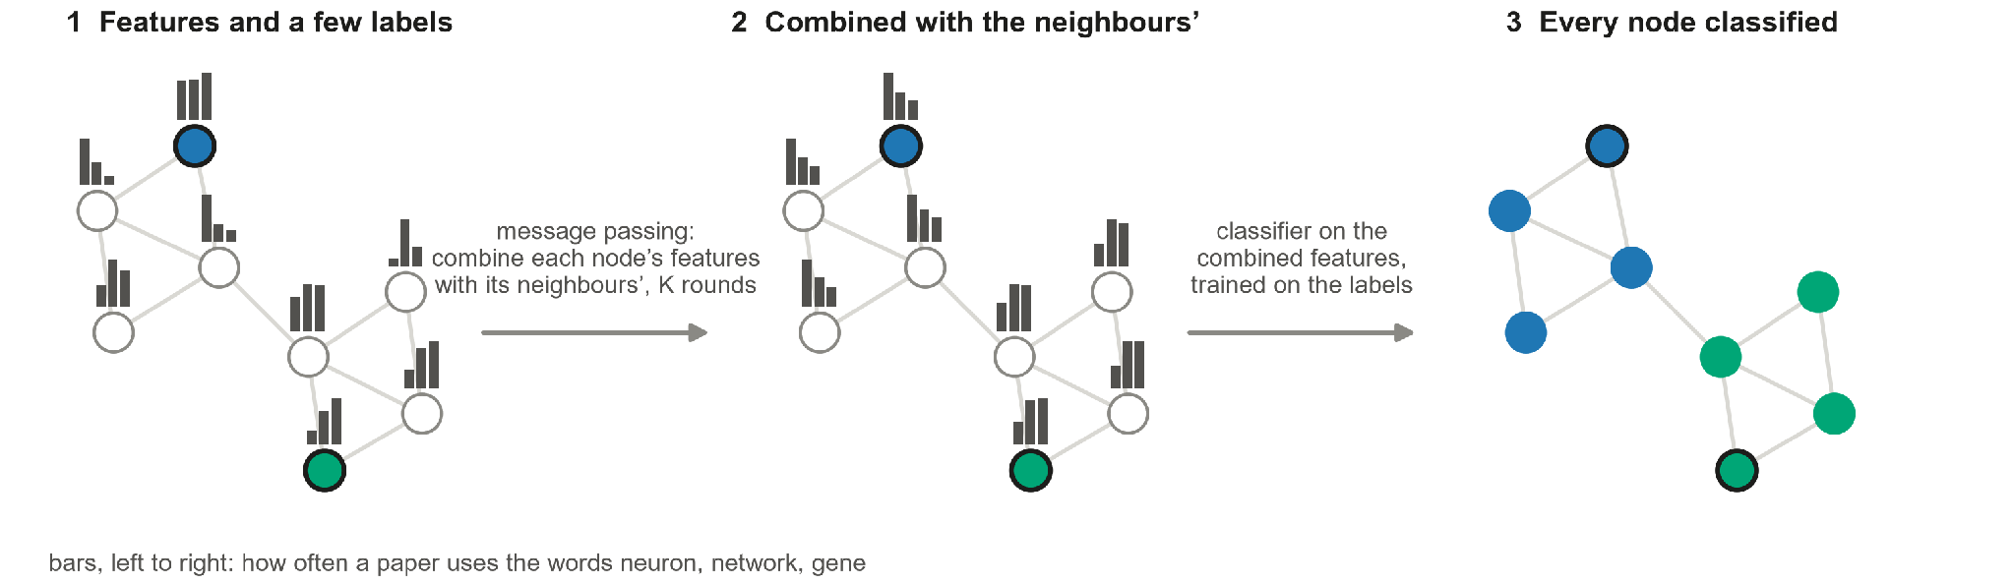
LEARNING ON A GRAPH
Learning on graphs: features plus connections
Graph neural networks (GCN, GAT, …)
Our Benchmarks
Data whose connections carry information: citation and social networks, chemistry, language, vision
Many tasks: node and graph classification, text classification, user geolocation, relation extraction (Wu et al. 2019)
7 datasets: citation (Cora, CiteSeer, PubMed), Amazon co-purchase (Photo, Computers) and co-author (CS, Physics) graphs; 2,708 to 34,493 nodes, 3 to 15 classes
Our demonstration: node classification on seven standard graphs; Cora: 2,708 papers, 5,278 citations, 1,433 words, 7 topics, 140 labels
Notes:
(45 s) Part 1 is about learning on graphs: data where the connections between items carry information. Graph neural networks such as GCN and GAT are the standard tools, used for citation and social networks, chemistry, language and vision, and for tasks from node and graph classification to text classification, user geolocation and relation extraction. The picture is the recipe on a toy citation graph. Step 1: every node has features, here how often a paper uses three words, and only two nodes are labelled. Step 2: message passing. In this talk the term means one thing: each node combines its own features with those of its neighbours, weighted by the graph, and K rounds reach the neighbours K hops away; a weighted average is the simplest such combination. Linked papers end up with similar features. Step 3: a classifier on the combined features, trained on the two labelled nodes, classifies every node. Our benchmark is the standard one, node classification on seven graphs; the running example is Cora: 2,708 papers, 5,278 citations, 1,433 words, 7 topics, 140 labels.

Slide 46
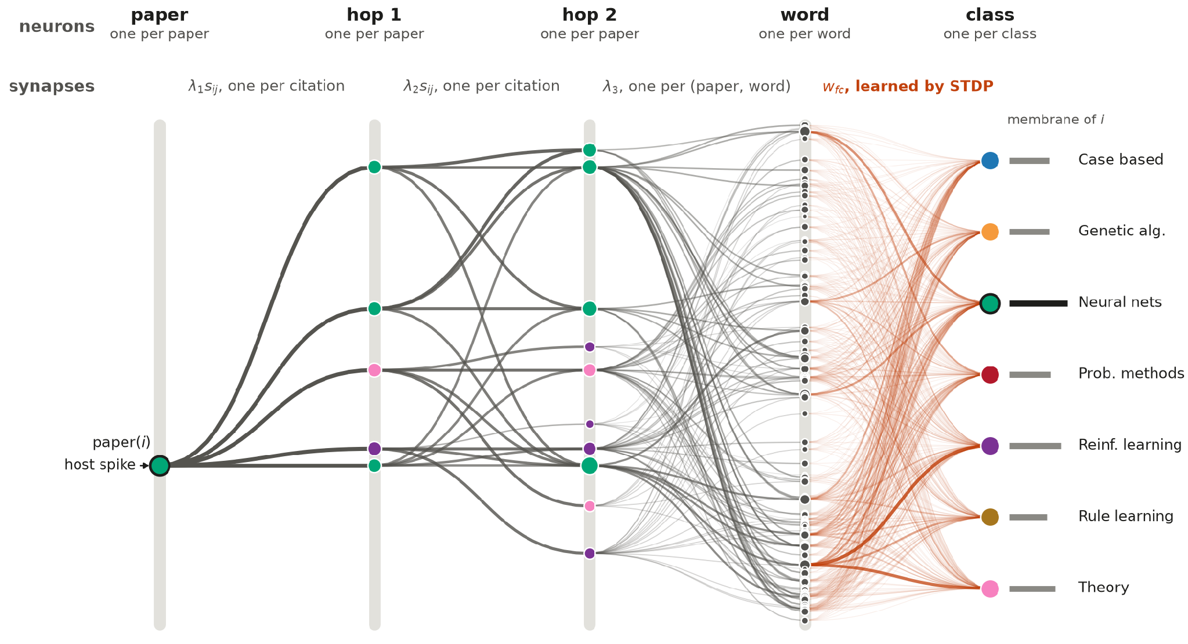
THE NETWORK
The network, layer by layer
Size, for K hops
layer
neurons
synapses in
paper
N
–
hop 1 … K
N each
E each
word
F
one per (paper, word)
class
L
F × L, learned
N papers · E citations, both ways, plus self loops · F words · L classes
Cora, K = 2: N = 2,708, E = 13,264, F = 1,433, L = 7, so 9,564 neurons and 85,775 synapses
Drawn: the neurons one paper’s spike reaches. Only the orange synapses learn.
Notes:
(55 s) The network, layer by layer. One neuron per paper in the paper layer and again in each hop layer, one per word and one per class. One spike selects the paper to classify. Its spikes cross the citation synapses: hop 1 reaches its neighbours, and after K hop layers the papers up to K hops away. Each reached paper then drives the neurons of the words it uses, so a word neuron sums that word over the papers reached. Each class neuron scores its class from the word spikes, through synapses that are the only part learned, by STDP and then R-STDP; the highest score wins. Sizes, for K hops: N neurons per paper layer and hop layer, F word neurons, L class neurons; each hop layer has E synapses, one per citation in both directions plus self loops, the word layer one per (paper, word) pair, and the learned block F times L. We show Cora with K = 2: N = 2,708 papers, E = 13,264, F = 1,433 words, L = 7 classes, so 9,564 neurons and 85,775 synapses, built once from the graph. Drawn: only the neurons that one paper's window reaches. Next, the video: how the network runs, then the two ways the orange synapses learn, STDP in one pass and R-STDP.

Slide 47
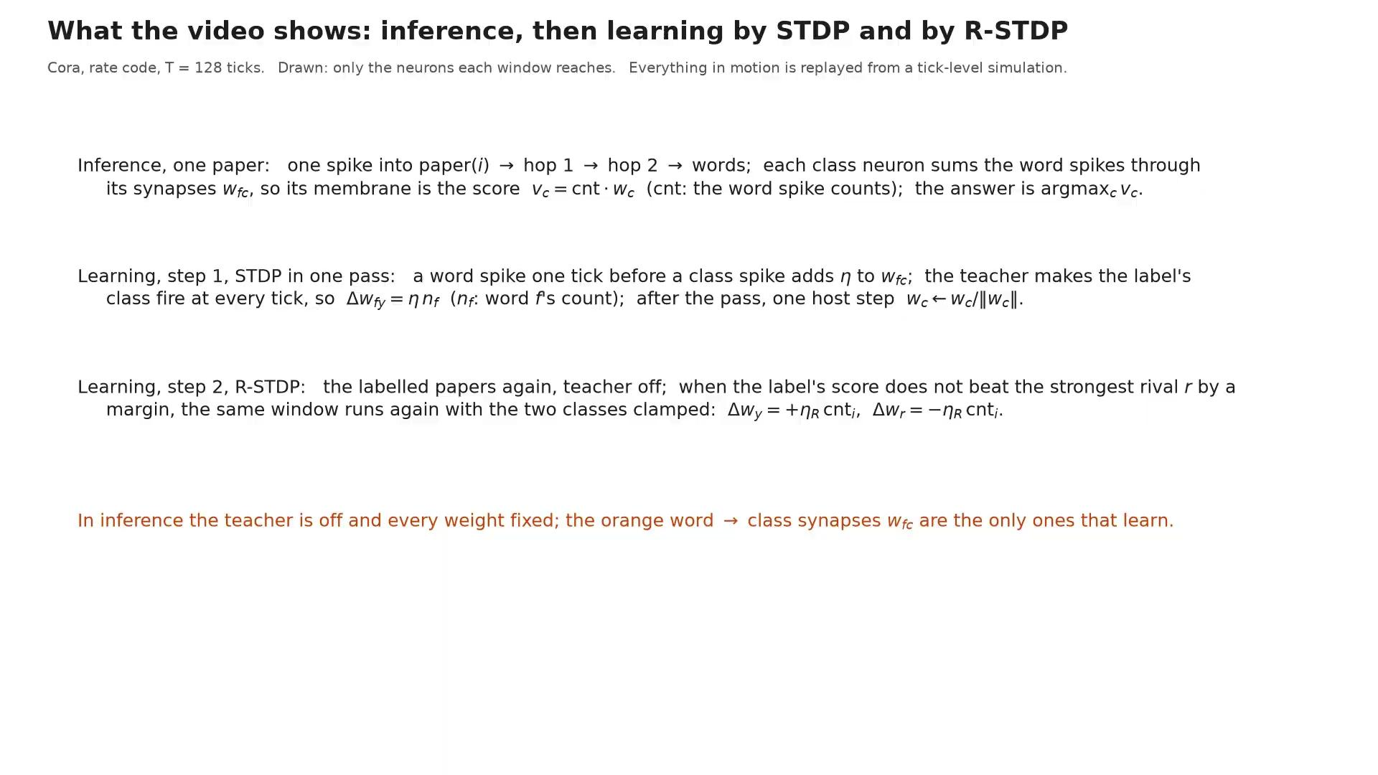
DEMO VIDEO
Notes:
(about 2 min 16 s, set by the video) One opening card lists what the video shows, with the two learning rules in one line of math each; then four parts, inference first. Inference on one paper: the host sends one spike into the paper's neuron; spikes spread to the papers it cites and that cite it (hop 1), then one more hop (hop 2); those papers' words fire; the class neurons integrate the word spikes through the learned synapses, and the one with the most input is the answer. Learning by STDP, one labelled paper tick by tick: the teacher makes its class neuron fire every tick, and every word spike that arrives just before a class spike strengthens that word-to-class synapse by a fixed step; then the pass over the 140 labelled papers, which writes each class's summed word counts, and the one host step, scaling each column to unit length. Learning by R-STDP: the labelled papers again, teacher off, and the network's own answer sets the sign. When the label's class does not win by a margin, the same window runs again with the label's class strengthened and the strongest rival weakened: paper 10's decision and correction windows, the whole first pass and the passes after it. On Cora, 79 corrections in the first pass, 26 in the sixth and last; test accuracy 78.1 to 80.0 percent. Energy, at 20 pJ per spike and 0.9 pJ per synaptic event (the counters on the right tally the spikes and the synaptic deliveries): Cora, rate code, inference about 59 nJ per paper, against about 111 nJ for a conventional GNN. Learning (our estimate): one STDP pass about 9.4 µJ with the rate code, 1.5 µJ with the one-spike code; R-STDP's passes about 94 µJ (one-spike code); training the leanest GNN by gradient descent about 1.5 mJ.

Slide 48
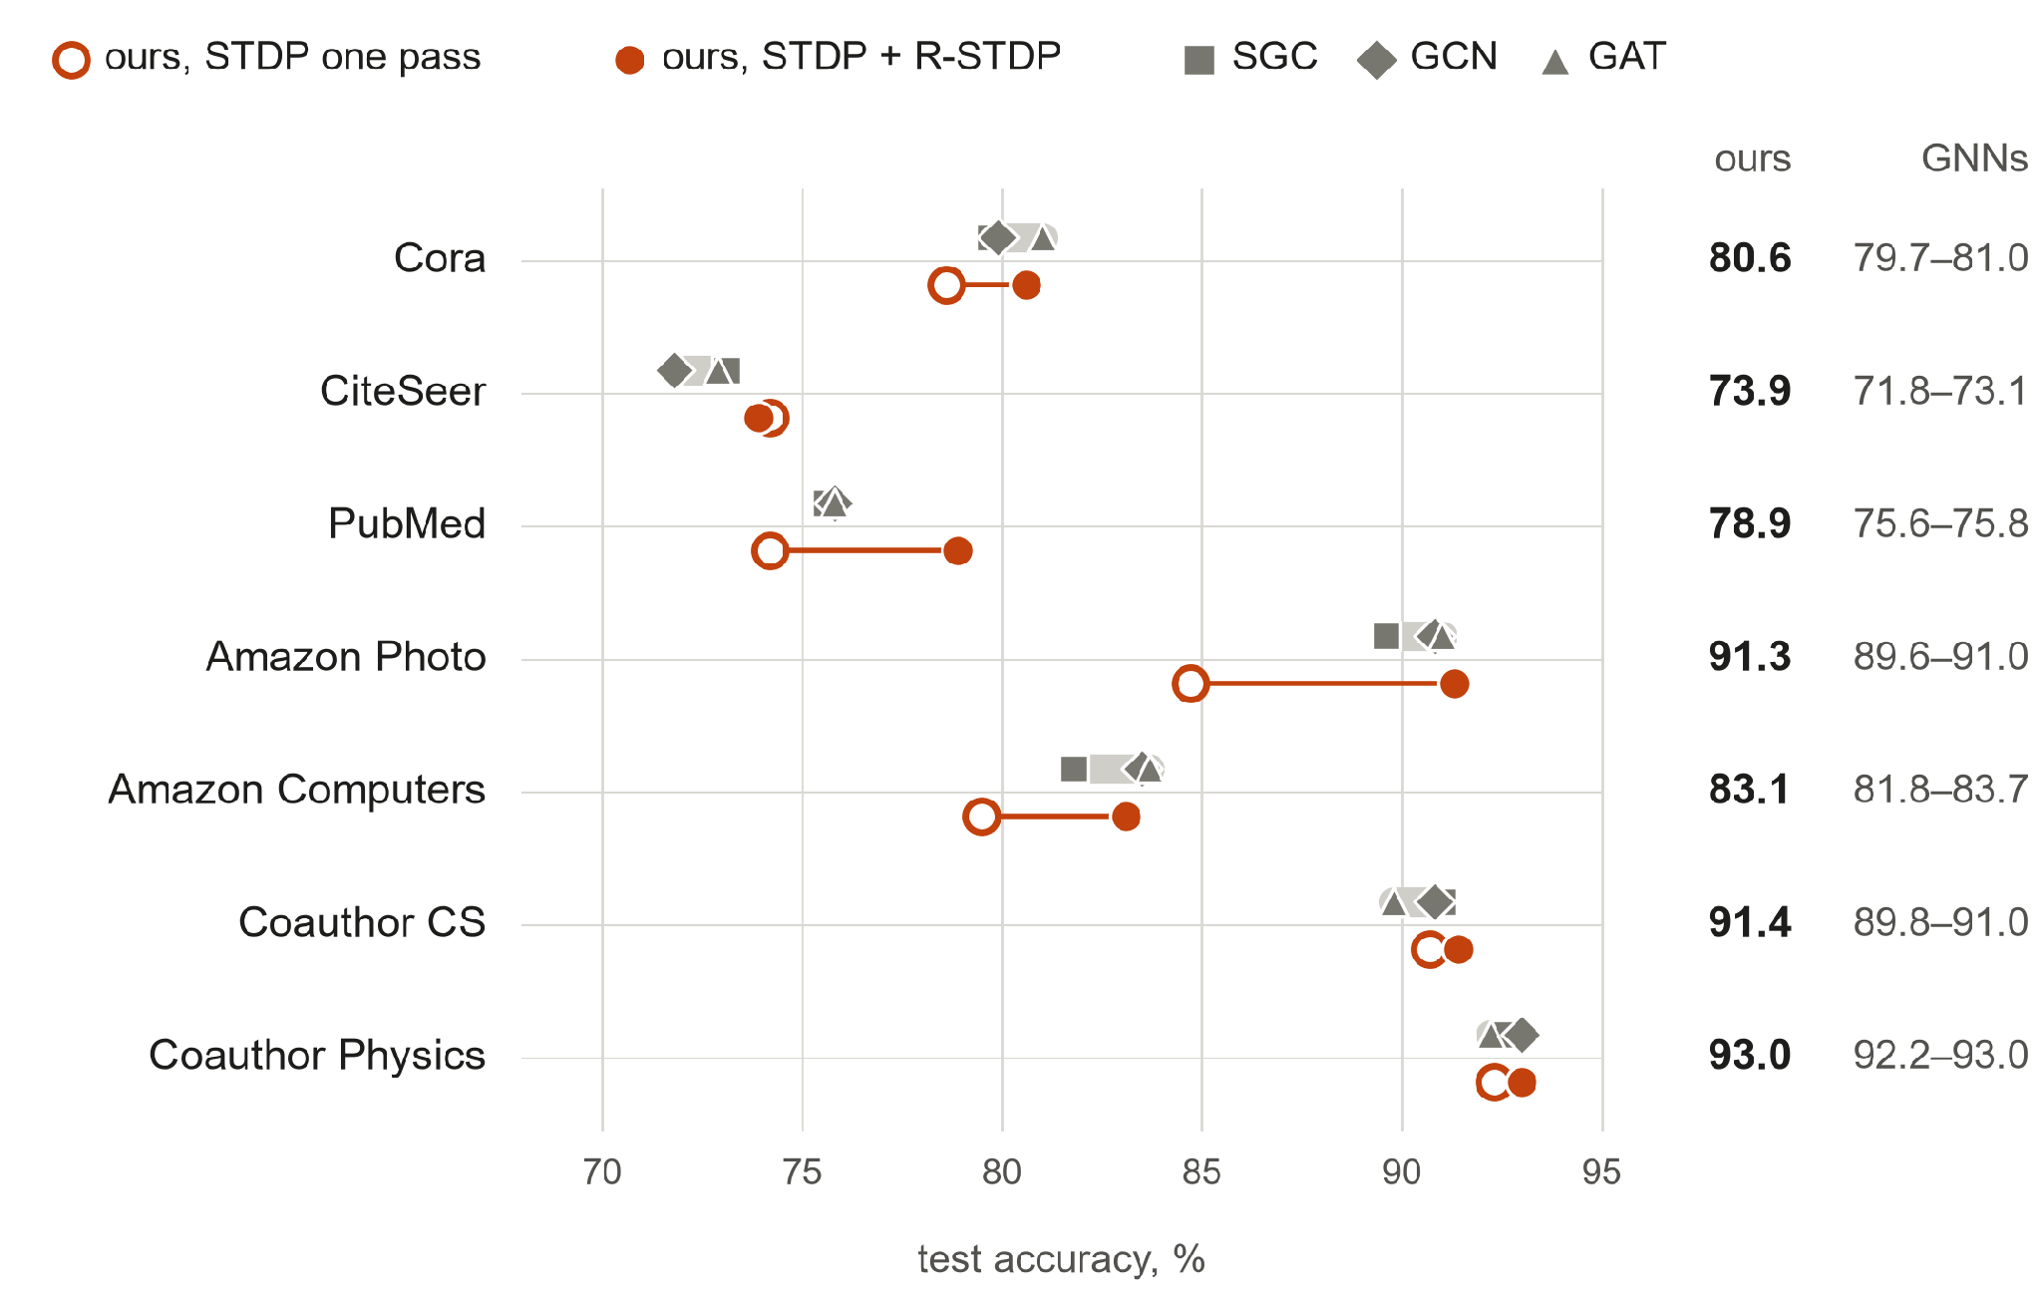
SAME ACCURACY
Same accuracy as three standard GNNs
7 of 7
graphs where ours is inside the range of SGC, GCN and GAT, or above it; within 0.6 point of the best on every graph
R-STDP closes the gap where one STDP pass falls short: Cora, PubMed and the Amazon graphs.
Mean test accuracy over 100 random splits of each graph, same splits and preprocessing for all methods; GCN, GAT and SGC rerun with standard libraries.
Notes:
(50 s) Same accuracy, first: our network against three standard graph neural networks, SGC, GCN and GAT. Each row is a graph; the grey bar spans the three GNNs, orange is ours, open after one STDP pass, filled after R-STDP. On all seven graphs ours lands inside the GNNs' range or above it, within 0.6 point of the best of the three everywhere. Why the accuracy matches: the spikes compute exactly the two-hop message passing of SGC, so the network sees the same combined features; only the classifier is learned differently, by local rules instead of gradient descent. One STDP pass is already inside the range on CiteSeer and the co-author graphs; R-STDP closes the gap on Cora, PubMed and the two Amazon graphs. All methods run on the same 100 random splits of each graph with the same preprocessing, so the comparison is controlled.

Slide 49
LESS ENERGY · THE WHOLE PIPELINE
Energy: count the whole pipeline
GNN on a GPU
Spiking GNN, usual pipeline
Ours
Learning
Backpropagation on a GPU, hundreds of epochs
Surrogate gradients on a GPU, through every time step: about 1.27× the ANN’s training energy (SATA)
STDP, then R-STDP, on the network itself; the host only compares answer and label
Onto the chip
Stays on the GPU
Trained off-chip, weights copied over; every update means retraining off-chip
Nothing to copy: it learns where it runs
Message passing
Matrix products on the GPU
Often on a host, before the first spike: ≈ 65 nJ per node on Cora; graph layers can dominate (SGNNBench)
Spikes along the citation synapses
Energy studies warn that counting only spikes overstates the savings of spiking networks: data movement, graph layers and off-chip training are left out.
Dampfhoffer et al., IEEE TETCI 2023 · Bhattacharjee et al., ICASSP 2024 · Yan et al., arXiv 2409.08290 · Yin et al. (SATA), 2022 · SGNNBench, arXiv 2509.21342
Our count, as in the video
energy = spikes × 20 pJ
+ synaptic events × 0.9 pJ
everything the network does, learning included; a synaptic event is one spike arriving at one synapse
Notes:
(45 s) The energy, as the video counted it: each spike about 20 pJ and each synapse it reaches about 0.9 pJ. Spikes and synapses are the core of the count. But energy studies have warned that counting only the spikes of the deployed network flatters spiking networks, because the costly steps happen elsewhere (Dampfhoffer et al. 2023; Bhattacharjee et al. 2024; Yan et al.). Three such steps matter here. Learning: spiking networks are usually trained on a GPU with surrogate gradients through every time step, which can cost more than training the equivalent conventional network (about 1.27 times in the SATA study). Getting onto the chip: the trained weights are copied to the device, and any update means retraining off-chip. Message passing: most spiking graph networks compute it on a host before the first spike, and graph layers can dominate the energy (SGNNBench); on Cora that step alone is about 65 nJ per node, counted like the GNN. Our network has none of these: it learns on itself by STDP and R-STDP, the host only comparing R-STDP's answers with the labels, there is nothing to copy, and message passing is spikes along the citation synapses. So our count covers everything the network does, learning included.

Slide 50
LESS ENERGY · CORA
Less energy, counted spike by spike
Conventional GNN
Ours, rate code (the video)
Ours, one-spike code
One prediction
one paper, mean over the test papers
111 nJ
message passing: 14,038 MACs
classifier: 10,031 MACs
24,069 MACs × 4.6 pJ
59 nJ
2,178 spikes × 20 pJ = 43.6 nJ
17,072 events × 0.9 pJ = 15.4 nJ
8.5 nJ
310 spikes × 20 pJ = 6.2 nJ
2,595 events × 0.9 pJ = 2.3 nJ
Learning
from the 140 labelled papers
1.5 mJ
message passing once, then 100 epochs of gradient descent
319 M MACs × 4.6 pJ
9.4 µJ
one STDP pass: 342 k spikes, 2.6 M events, 257 k weight updates
1.5 µJ
one STDP pass: 54 k spikes, 384 k events, 39 k weight updates
R-STDP after it: + 94 µJ
Two ways to send a number in spikes
Rate code: a neuron sends q by firing about q times in 128 ticks. One-spike code: it fires once, and the earlier it fires, the larger q. Same accuracy (within 2 points), about 7× fewer spikes.
Unit energies, 45 nm estimates
Multiply-accumulate 4.6 pJ; synaptic event (one spike arriving at one synapse) 0.9 pJ; spike 20 pJ; weight update 0.9 pJ. Memory traffic left out on both sides (Horowitz 2014).
Notes:
(60 s) Less energy, counted on Cora, the way the video counts it. Top row, one prediction. The GNN does multiply-accumulates: about 14,000 per paper to combine the neighbours' features over two hops, and about 10,000 for the classifier, 24,069 in all at 4.6 pJ each: 111 nJ. Ours spends energy only on spikes, about 20 pJ each, and on synaptic events, one spike arriving at one synapse, 0.9 pJ each. With the rate code, the one in the video, that is 59 nJ per paper. With the one-spike code, where each neuron fires at most once and the timing carries the value, it is 8.5 nJ (the paper rounds it to 9): more than 12 times less than the GNN, at the same accuracy. Bottom row, learning from the 140 labelled papers. The GNN combines the features once and then trains its classifier by gradient descent for 100 epochs: about 319 million multiply-accumulates, 1.5 mJ. Our network learns in one STDP pass on itself: 9.4 µJ with the rate code, 1.5 µJ with the one-spike code, about a thousand times less; R-STDP's extra passes add about 94 µJ, still about 15 times less. The unit energies are standard 45 nm estimates; memory traffic is left out on both sides, so these are estimates, not measurements. The learning numbers are our own count from the runs, not the paper's.

Slide 51
SUMMARY
Same accuracy, less energy
SAME ACCURACY
Same accuracy
as SOTA GNNs, on seven standard graphs
The spikes compute the graph network's message passing on the citation synapses; STDP and R-STDP learn the classifier on the network itself.
LESS ENERGY
Less energy
per prediction, and far less to learn
Counted per spike and per synaptic event, learning included: no backpropagation, no surrogate gradients, nothing trained off-chip and copied over. The energies are estimates.
Notes:
(30 s) In short: a spiking network does the job of a graph neural network, learning included. The same accuracy as GCN, GAT and SGC on seven standard graphs, because the spikes compute the same message passing and local rules learn the classifier on the network itself. Less energy per prediction and far less energy to learn, counted per spike and per synaptic event, with no backpropagation, no surrogate gradients and nothing trained off-chip. All energies are estimates. Thank you.

Slide 52
Spiking Attention Mechanism Demo
Sanjay Das

Slide 53
TODAY’S DEMO
Overview of This Demo
Simulation and Spiking AI · ORNL
Hardware · Duke and Delaware
1
2
3
4
5
HyperNeuro
SNNs vs ANNs
Spiking Attention Mechanism
Spiking Attention on Digital Hardware
Ferroelectric Neuromorphic Primitives
HPC-scale simulator for spiking neural networks
Spiking vs artificial neural networks: accuracy and energy compared
QKV Attention built from spiking threshold neurons
Digital LIF neurons and synapses on FPGA (eventually, ASIC)
Ferroelectric neuron and synapse circuit simulation
Emily Herron
ORNL
Xi Zhang
ORNL
Sanjay Das
ORNL
Prasanna Date
for Duke University
Prasanna Date
for Univ. of Delaware
Notes:
Five demos, from software to hardware. HyperNeuro (Emily Herron): the HPC-scale simulator for SNNs. SNNs vs ANNs (Xi Zhang). The spiking attention mechanism (Sanjay Das). Then the hardware: digital neuromorphic circuits with Duke and ferroelectric neuromorphic primitives with the University of Delaware (both Prasanna Date).

Slide 54
Transformer attention: each word decides what to look at
"it" asks: who am I referring to?
Why we chose attention
It is the engine of modern AI.
Language, vision and science models are built on it.
The
cat
drank
the
milk
because
it
It is the hardest part to run on spikes.
Matching and weighting need softmax and multiplications, which event-driven hardware avoids.
3%
55%
8%
3%
25%
6%
attention weight of "it" on each earlier word (made-up numbers; a transformer learns them)
A spike-friendly version is testable.
Binary matching and copying can be built from threshold neurons and checked on every input.
1 Ask
Each word forms a question (Q), a label (K) and content (V).
2 Match
Compare the question with every label.
3 Weigh
Scores become percentages that add to 100 (softmax).
4 Blend
Mix the contents in those proportions.
Notes:
Picture a sentence: 'The cat drank the milk because it ...'. To understand the word 'it', the model has to look back and decide which earlier words matter. In a transformer every word does this at once: the word 'it' asks a question (its Query: who or what am I referring to?), every earlier word has a label (its Key), and the model scores how well the question fits each label. The scores are turned into percentages that add up to 100 (that is the softmax); here 'cat' gets the most, 55 percent, and 'milk' 25. Finally 'it' blends the content (the Values) of the words in those proportions, so it now carries information about the cat.; a real transformer learns them from data. In symbols the whole thing is softmax of Q times K-transpose, divided by the square root of the dimension, times V. WHY WE CHOSE ATTENTION, three reasons: it is the engine of modern AI (language, vision and science models); it is the hardest part to run on spikes because matching and weighting need a softmax and multiplications, which event-driven hardware avoids; and a spike-friendly version, with binary matching and copying, can be built from threshold neurons and checked on every possible input. We do not claim our demo is a full transformer; it keeps the idea (ask, match, copy) and replaces the soft weights with binary gates.

Slide 55
A token-prediction puzzle in binary
token 0
token 1
token 2
token 3
1 + 2 = 3
3 mod 4 = 3
1
2
3
0
➜
01
10
11
00
Target token 3, as two output spikes:
matters
matters
distractor
distractor
1
spike
1
spike
256
2 of 4
2 spikes
possible inputs (4 words, 4 values each), so every case can be tested
words matter. The other two are distractors the model must ignore
carry the answer. Silence means 0 at tick 5, so 00 is valid
Small enough to check completely, hard enough to need matching.
Notes:
We design a toy task. A 'token' is a small symbol; here each token is a two-bit word, a value from 0 to 3. The model sees four tokens and must predict the next one. The example on screen is 1, 2, 3, 0: 1 + 2 = 3, and 3 mod 4 = 3, which is bits 1 1, so BOTH output neurons spike. The last two tokens are distractors that never affect the answer, so the model has to learn to look at the right tokens. There are only 4 x 4 x 4 x 4 = 256 possible inputs, so every case can be tested. Output convention: two spikes, most significant bit first, read at tick 5; a silent output means bit 0, so 00 is a perfectly valid answer. the model has 404 neurons, 1,313 synapses, six logical ticks.

Slide 56
From soft attention to a spike-friendly lookup
Attention is a lookup
What changes for spikes
Each token asks a question (Query), wears a label (Key) and carries content (Value). The model matches the question against the labels and copies the content of the best matches.
Soft becomes binary.
A transformer weighs every word with percentages. We use match or no match.
Label (Key) | Content (Value) | Matches question 42?
17 | 200 | no
42 | 55 | YES
99 | 130 | no
8 | 7 | no
Weighting becomes a gate.
Multiplying content by a weight becomes an AND gate: copy only where matched.
Softmax goes away.
No normalization is needed. Each neuron simply fires at its threshold.
Question 42 → copy the content of the matching label: 55
Illustration: exact-match lookup. A constructive example, not the trained model.
Notes:
the previous-section picture showed soft attention, this is the version we build. Attention is a lookup. Each token asks a question (the Query), wears a label (the Key) and carries some content (the Value). The model compares the question with every label and copies the content of the best matches. Table on screen: the question is 42; the labels are 17, 42, 99 and 8; only the second label matches, so we copy its content, 55. This table is an illustration from a small constructive reference (exact-match lookup on 8-bit numbers), NOT the trained model. WHAT CHANGES FOR SPIKES, three substitutions: soft percentages become match or no match; weighting by multiplication becomes an AND gate that copies content only where there is a match; and the softmax disappears because each neuron simply fires at a threshold. Our trained demo does a learned, feature-wise version of this matching rather than exact-number lookup, and it is not a full transformer.

Slide 57
Attention in four moves, and how each becomes spikes
1
Ask
2
Match
3
Copy
4
Decide
Each token forms a question (Q), a label (K) and content (V).
Compare each question with each label, feature by feature.
Where a match happens, pass along that token's content.
A small readout adds up the evidence.
Word 3 = bits 1 1 → Q = 1 1
Q = 1 0 vs K = 1 1: first agrees, second differs → 1 match
match AND content bit = 1 → feature fires
sum +493 > 0 → output spike
In spikes: Three small layers of threshold neurons.
In spikes: XNOR gate neurons. Two silent inputs also agree, so a clock is needed.
In spikes: AND gate neurons: 256 interaction features.
In spikes: Two output neurons with integer weights.
Not softmax: matching is binary and featurewise, so every step is a neuron that fires or stays silent.
Notes:
The mechanism, at a high level, in four moves, each with a tiny example and the matching spike circuit. ASK: every token forms three short bit-vectors: a question (Q), a label (K) and content (V), using small layers of threshold neurons. MATCH: compare each question with each label feature by feature. Example: question 1 0 against label 1 1: the first feature agrees (1 and 1), the second does not (0 and 1), so one match. In spikes this is an XNOR gate; note that two SILENT inputs also count as agreeing, which is why the circuit needs a clock to produce a spike for 'both silent'. COPY: where a match happens, pass on that token's content: match AND value bit. That gives 256 interaction features in this demo. DECIDE: a small readout adds up integer weights of the features that fired; a positive sum makes the output neuron spike. Honest point: this is attention-style matching, not conventional softmax attention and not a Transformer; every step is a neuron that fires or stays silent.

Slide 58
On our example, [1, 2, 3, 0], every token gets a Q, K and V
Token
Word
Q (question)
K (label)
V (content)
How a neuron decides
word 3 = bits 1 1:
weighted sum > 0
→ Q = 1 1
(signed int8 weights)
token 0
1 = 01
0
1
1
1
1
0
token 1
2 = 10
1
0
0
0
1
1
token 2 (distractor)
3 = 11
1
1
1
1
1
1
token 3 (distractor)
0 = 00
0
0
0
0
0
0
Real spike values from the published model. Each Q, K or V neuron fires if its weighted sum of the word’s two bits is above zero. Q, K and V share just 12 learned integer weights.
Notes:
These are the actual spike values of the published INT8 model for the example 1, 2, 3, 0. Each word is two bits, fed into three tiny layers: Q, K and V each have a 2x2 matrix of signed integer weights, and each output is a threshold neuron that spikes if its weighted sum is above zero. Together Q, K and V have only 12 unique learned weights. Read the table: word 1 (bits 0 1) gets Q = 0 1, K = 1 1, V = 1 0; word 3 (bits 1 1) gets Q = 1 1, K = 1 1, V = 1 1; the all-zero word gets all zeros. These projections are learned integers, not a copy of the input.

Slide 59
Match each question with each label, then copy the content
Worked example
Token 2 asks 1 1.
Token 0’s label is 1 1.
Both features agree: 2.
Token 2 asks 1 1, token 1’s label is 0 0: nothing agrees: 0.
Label of token →
Then, copy
Each match bit is combined with a content bit (AND).
4 × 4 × 4 × 2 × 2 = 256 interaction features.
Both output neurons read all 256 features, with no subset. For this input, 80 of the 256 fire.
Question ↓
token 0
token 1
token 2
token 3
token 0
1
1
1
1
token 1
1
1
1
1
token 2
2
0
2
0
token 3
0
2
0
2
Number of features that agree (0, 1 or 2)
Notes:
The match grid for 1, 2, 3, 0: for every pair of tokens, count how many of the two learned features agree between one token's question and the other's label. Agreement is XNOR: both 1 or both 0. Worked example from the real values: token 2 asks 1 1, token 0's label is 1 1, both features agree, count 2; token 2 against token 1's label 0 0, nothing agrees, count 0. Tokens 0 and 1 ask questions that agree with every label on exactly one feature, so their rows are all ones. Next, the COPY move: each match bit is ANDed with a content bit from every value token, giving 4 x 4 x 4 x 2 x 2 = 256 interaction features. Unlike the earlier 64-weight demo, BOTH output neurons read ALL 256 features: there is no feature subset and no prior knowledge about which tokens matter. For this input the grid has 16 matches and the V values have 5 ones, so 16 x 5 = 80 of the 256 interaction neurons fire at tick 4.

Slide 60

Decide: 512 weights turn 256 features into two output spikes
Most significant bit
+35
1
spike
Least significant bit
+493
1
spike
0
sum of int8 weights of the features that fired
Output spikes 1 1 = the number 3 = 1 + 2 mod 4. Positive sum fires; no argmax, no host step.
Notes:
DEEP DIVE. The readout is two output neurons, one per answer bit, each connected to ALL 256 interaction features with learned signed-integer weights: 2 x 256 = 512 weights. A feature that fired contributes its weight; a silent one contributes nothing. A positive sum makes the output neuron spike at tick 5. For 1, 2, 3, 0 the most-significant-bit neuron sums to +35 and the least-significant-bit neuron to +493, so both spike: output 1 1 = 3 = (1 + 2) mod 4. There is no argmax and no host step. Note the sums are wide: INT8 weights do not imply INT8 sums, which matters for any hardware port.

Slide 61
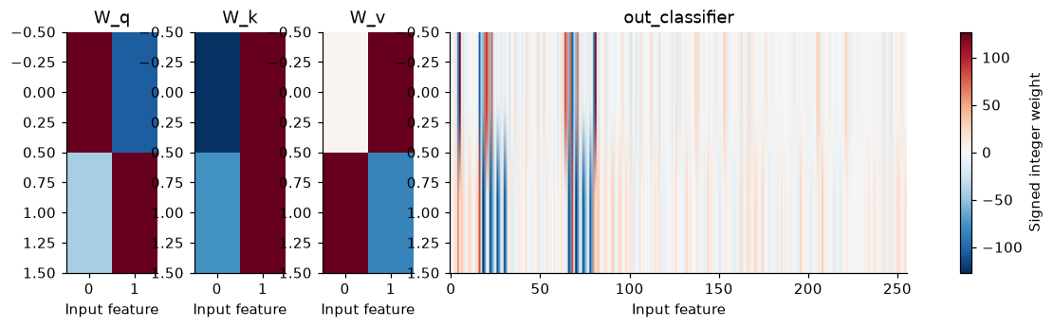
How the model learned: integer weights from the start
Round to integers
Training keeps decimal shadow weights, but every forward pass uses their int8 codes (−127 to 127).
Learn through the rounding
The learning signal is passed straight through the rounding and the hard spike: the same trick as in Act 1.
Train everything together
Warm-started from the original float toy, then Q, K, V and the readout are trained together for 150 epochs.
Pinned and hash-verified
Git commit 6e39381. Circuit SHA-256 772eba83… checked before use.
The notebook loads this trained checkpoint. It does not retrain or replace the published circuit.
Result: 524 integer weights
Q, K and V share 12. The readout has 512 (2 outputs × 256 features).
Caveat: training used this same finite domain, so exact verification shows a faithful circuit, not generalization. All 256 features feed the readout: no feature subset.
Notes:
Learning is gradient-based, but the deployed weights must be small signed integers (int8, -127 to 127), because that is what the spiking circuit holds. Training keeps decimal shadow weights, but every forward pass uses their rounded, clipped int8 codes, and the learning signal passes straight through the rounding and through the hard spike (spike if the sum is above zero): the straight-through estimator. Positive per-output scales can be removed before a zero-threshold decision without changing any bit. The model was warm-started from the original float toy and trained for 150 quantization-aware epochs, with Q, K, V and the classifier all updated. Result: 12 unique weights for Q, K and V, plus a 512-weight classifier: 524 in total. The heat maps show them. The notebook loads the pinned checkpoint and does not retrain, because retraining could create a different FPGA reference. Caveat: training used the same finite domain, so exact verification is not evidence of generalization.

Slide 62
The same attention, built from 404 neurons in six ticks
tick 0
tick 1
tick 2
tick 3
tick 4
tick 5
Input
Q, K, V
Match helpers
XNOR
Interaction
Readout
8
24
64
32
256
2
neurons
neurons
neurons
neurons
neurons
neurons
5 spikes
14 spikes
21 spikes
21 spikes
80 spikes
2 spikes
spikes shown are for the example input 1, 2, 3, 0. Six logical ticks do not imply six FPGA clock cycles.
Supporting circuitry, counted too: 16 relays hold the content spikes until the matches are ready, and 2 clock neurons make the "both silent" match possible.
8 + 24 + 64 + 32 + 256 + 2 + 16 + 2 = 404 neurons, 1,313 synapses.
Notes:
The whole exported circuit, stage by stage, with spike counts for the example 1, 2, 3, 0. Tick 0: the input bits spike plus a clock (5 spikes). Tick 1: 24 Q, K and V neurons plus the second clock (14 spikes). Tick 2: 64 match-helper neurons, an 'active' gate for both-on and an 'inverse' gate for both-off, plus the first relays holding the value spikes (21 spikes). Tick 3: 32 XNOR neurons plus the second relays (21 spikes). Tick 4: 256 interaction neurons, match AND value (80 spikes). Tick 5: 2 output neurons, both spiking (2 spikes). Supporting circuitry is counted: 16 relays and 2 clock neurons. 8 + 24 + 64 + 32 + 256 + 2 + 16 + 2 = 404 neurons; 1,313 synapses, all with one-tick delay. Note: the notebook prints the whole raster rather than per-tick totals; these per-tick counts were derived from the example's displayed Q, K, V values using the circuit's own structure (matches x value ones at tick 4), a derivation that reproduces the measured counts of the earlier demo exactly.

Slide 63
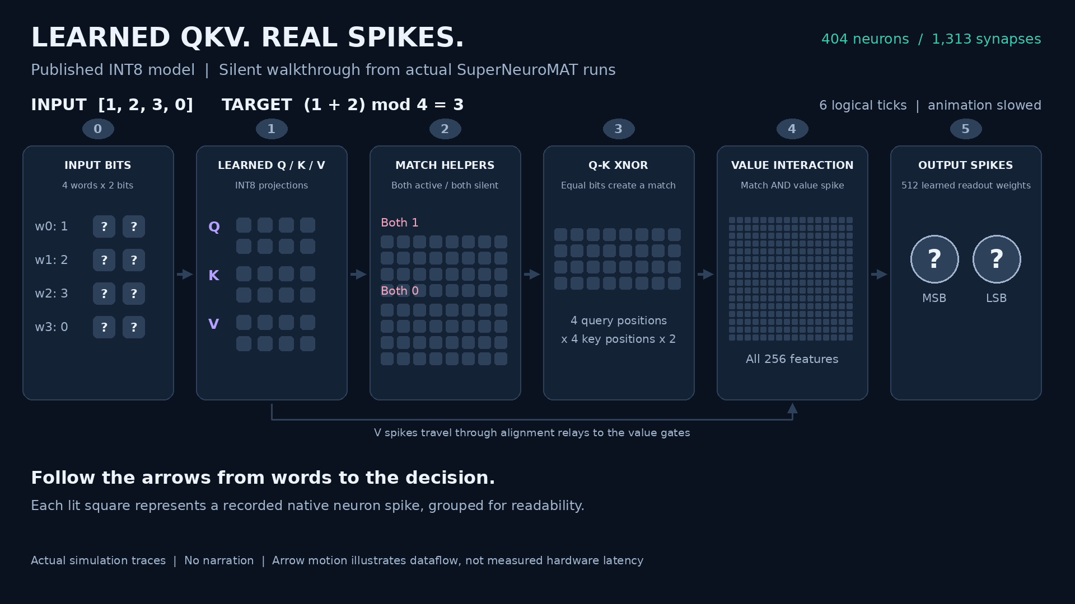
Notes:
This learned QKV model computes using spikes. Four two-bit words enter the circuit, and the task is to add the first two, modulo four. Learned integer weights transform each word into query, key and value features. Query and key features match when both fire or both remain silent. XNOR neurons express those matches as spikes, which then gate value spikes to create 256 interaction features. Two learned readouts produce the output bits: one, one—the answer is three. Now the inputs change: one plus three, modulo four, equals zero. The same circuit processes the new patterns, and neither output neuron fires. At the designated output tick, silence correctly represents zero. Every illuminated feature comes from an actual spiking simulation. All 256 possible inputs were verified, including intermediate spike patterns. The complete circuit uses 404 neurons and 1,313 synapses across six logical ticks, slowed here for explanation. Hardware energy savings remain to be measured.

Slide 64
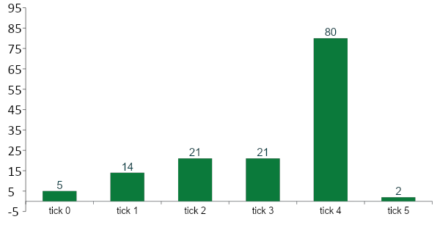
Every spike for one prediction: 143 of 404 neurons
143 of 404
neurons fire for this input (35%)
155.5
average spikes over all 256 inputs
632.0
average spike deliveries per prediction
Spikes per tick for the example input 1, 2, 3, 0. Tick 4 holds the 256 interaction neurons.
Notes:
Spikes per tick for 1, 2, 3, 0: 5, 14, 21, 21, 80 and 2, 143 in total, about 35 percent of the 404 neurons; tick 4, where the 256 interaction neurons live, is the busiest. Across all 256 inputs the notebook measures an average of 155.5 spikes and 632.0 spike deliveries per prediction (a delivery is one spike arriving at one downstream neuron, counted as spikes times fan-out). The per-tick counts for this one input were derived from its displayed Q, K and V values; the averages are measured. This is much less sparse than the Cora demo, and we say so honestly.

Slide 65
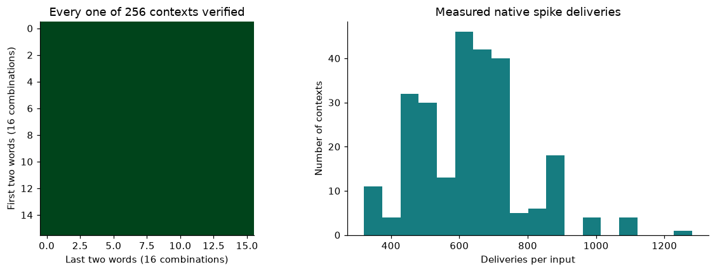
All 256 possible inputs, predicted exactly
256 / 256
inputs predicted exactly
0
mismatches at any stage
524
The exact published circuit, loaded from its hash-verified file, matches the integer reference and the trained network on all 256 inputs: every stage, relay and clock, plus two extra silent ticks.
unique learned weights
Scope: a finite task whose inputs were also used when fitting. This shows an exact fit and a faithful spiking copy, not generalization.
Notes:
\We did not sample: we ran every one of the 256 possible inputs. The left panel is the verification grid, all 256 contexts, all green. The notebook compares three things on every context: an independent integer reference, the trained network, and the exact published circuit loaded from its hash-verified file. Full neuron traces are checked, including input neurons, the unnamed alignment relays, clock propagation, and two extra silent ticks. Everything agrees, 100 percent accuracy. The right panel shows the measured spike deliveries per input, about 630 on average. Scope, stated plainly: this is exact verification over a finite domain that training also used; it is not evidence of generalization or of a competitive arithmetic circuit.

Slide 66
524 learned weights, but 1,313 physical synapses
Unique learned weights: 524
512
Native synapses: 1,313
512
753
Q
K
V
Classifier
Fixed logic, clocks and relays
Each 2×2 projection is repeated for four tokens (4 weights become 16 synapses). The full readout adds 512, and match gates, clocks and delay relays add 753 more. Parameter count alone says little about circuit cost. (The separate 64-weight demo has 865 synapses and is a different model.)
Notes:
Parameters, physical synapses and activity are three different quantities. This published model has 524 unique learned weights: 4 each for Q, K and V (12 in all) and 512 for the classifier. But the circuit has 1,313 synapses. Each 2x2 projection is repeated across four tokens, so 4 weights become 16 physical edges for each of Q, K and V; the full readout is 512 edges; and the remaining 753 are fixed logic and alignment: match gates, clocks and delay relays. All 1,313 weights, including the fixed logic, satisfy signed INT8 constraints. SuperNeuroMAT stores numeric weights in simulator arrays, so INT8 constraints do not mean the Python simulator runs an INT8 hardware kernel. This is the full 512-weight readout; the separate 64-weight demo has 865 synapses and is not this model.

Slide 67
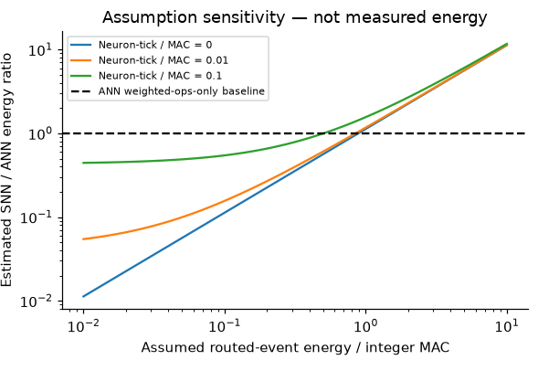
Energy: no measurement, so we show the sensitivity
632
average spike deliveries per prediction in the native circuit (measured)
560
weighted operations in a compact integer ANN: 48 projection + 512 classifier
≈ 0.89
The SNN wins only if one delivery costs less than about 0.89 integer MACs (about 0.50 if each neuron-tick costs 0.1 MAC)
No energy was measured. The ANN’s 32 XNOR, 256 AND and 26 threshold operations are unpriced, and direct modulo-add hardware would be far simpler. Spike communication alone does not guarantee lower energy.
Notes:
CORE SLIDE. Be candid. There is no physical energy measurement for this circuit, so the notebook shows an assumption-sensitivity analysis instead of a joule figure. The comparison baseline is the same function in a compact integer network: 48 projection plus 512 classifier weighted operations, 560 in all; its XNOR (32), AND (256) and threshold (26) operations are left unpriced, and direct modulo-add hardware would be much simpler. The spiking circuit delivers 632.0 spikes per prediction on average, so with the notebook's formula ratio = (632 x event cost + 404 x 6 x neuron-tick cost) / 560, the SNN breaks even when one delivery costs about 0.89 of an integer MAC if neuron updates are free, about 0.85 if each neuron-tick costs 0.01 MAC, and about 0.50 if it costs 0.1 MAC. Routing cost includes weight access, and supporting spikes are counted. Message: spikes are not automatically cheaper; a real conclusion needs device measurements on the target hardware.

Slide 68
What an FPGA port must match
1
Use the pinned JSON neuron and edge order, signed weights and exact dynamics.
Matched artifact
404 neurons
1,313 synapses
6 logical ticks
524 learned weights (512 in the classifier)
100% exhaustive accuracy, 256 of 256
2
Accumulate in a wide signed type: INT8 weights do not imply INT8 sums.
3
Inject only the eight input bits plus the clock; compute every intermediate in the circuit.
4
Sample both output bits at logical tick 5: silence means zero, so 00 is a valid result.
5
Match all 256 reference contexts and the intermediate stage and timing traces.
6
Report FPGA cycles, memory and measured power separately from logical ticks and estimates.
Notes:
DEEP DIVE. The notebook ends with an acceptance checklist for hardware reproduction: use the pinned neuron and edge order, signed weights and exact dynamics; accumulate in a sufficiently wide signed type, because INT8 weights do not imply INT8 sums; inject only the eight input bits and the clock and compute every intermediate in the circuit; sample both output bits at logical tick 5, where silence means zero and 00 is valid; match all 256 reference contexts plus the intermediate stage and timing traces; and report FPGA cycles, memory and measured power separately from logical ticks and estimates. The matched artifact is the published model: 404 neurons, 1,313 synapses, six ticks, 524 learned weights, 100 percent exhaustive accuracy, Git commit 6e39381. Six logical ticks do not imply six FPGA clock cycles.

Slide 70
Digital Hardware Demo
Prasanna Date (in collaboration with Duke University)

Slide 71
TODAY’S DEMO
Overview of This Demo
Simulation and Spiking AI · ORNL
Hardware · Duke and Delaware
1
2
3
4
5
HyperNeuro
SNNs vs ANNs
Spiking Attention Mechanism
Spiking Attention on Digital Hardware
Ferroelectric Neuromorphic Primitives
HPC-scale simulator for spiking neural networks
Spiking vs artificial neural networks: accuracy and energy compared
QKV Attention built from spiking threshold neurons
Digital LIF neurons and synapses on FPGA (eventually, ASIC)
Ferroelectric neuron and synapse circuit simulation
Emily Herron
ORNL
Xi Zhang
ORNL
Sanjay Das
ORNL
Prasanna Date
for Duke University
Prasanna Date
for Univ. of Delaware
Notes:
Five demos, from software to hardware. HyperNeuro (Emily Herron): the HPC-scale simulator for SNNs. SNNs vs ANNs (Xi Zhang). The spiking attention mechanism (Sanjay Das). Then the hardware: digital neuromorphic circuits with Duke and ferroelectric neuromorphic primitives with the University of Delaware (both Prasanna Date).

Slide 72
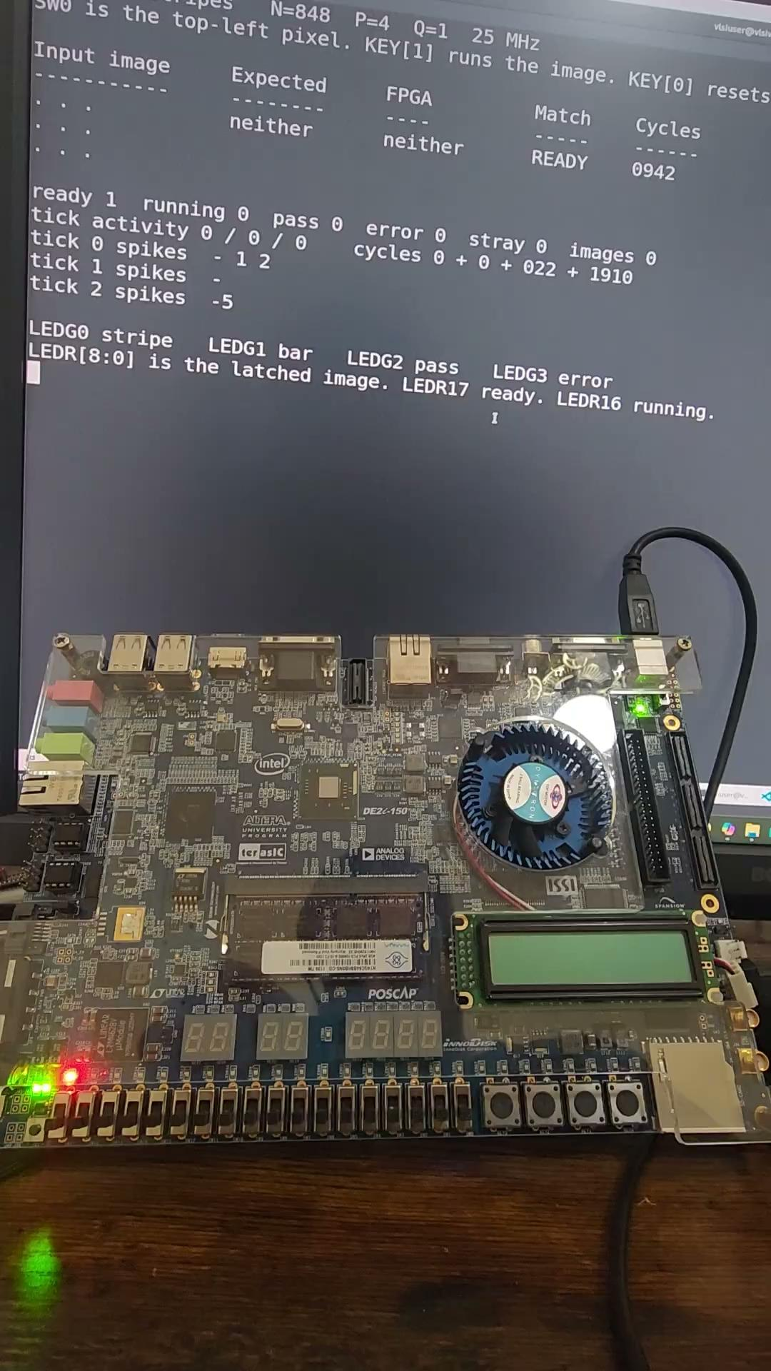
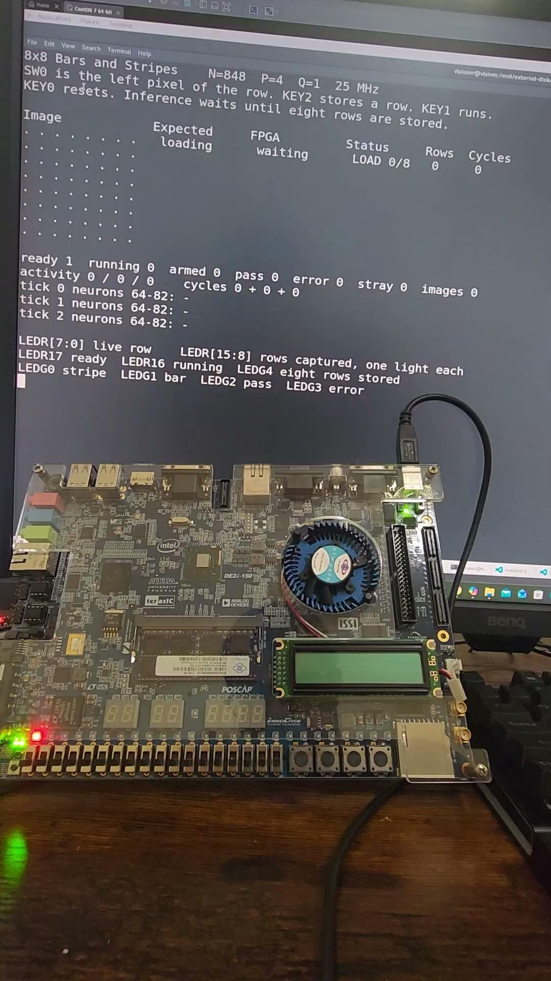
Digital Hardware Demo

Slide 73
Thin Film & Ferroelectric Transistor
Emerging Technology Hardware Demo
Prasanna Date (in collaboration with University of Delaware)

Slide 74
TODAY’S DEMO
Overview of This Demo
Simulation and Spiking AI · ORNL
Hardware · Duke and Delaware
1
2
3
4
5
HyperNeuro
SNNs vs ANNs
Spiking Attention Mechanism
Spiking Attention on Digital Hardware
Ferroelectric Neuromorphic Primitives
HPC-scale simulator for spiking neural networks
Spiking vs artificial neural networks: accuracy and energy compared
QKV Attention built from spiking threshold neurons
Digital LIF neurons and synapses on FPGA (eventually, ASIC)
Ferroelectric neuron and synapse circuit simulation
Emily Herron
ORNL
Xi Zhang
ORNL
Sanjay Das
ORNL
Prasanna Date
for Duke University
Prasanna Date
for Univ. of Delaware
Notes:
Five demos, from software to hardware. HyperNeuro (Emily Herron): the HPC-scale simulator for SNNs. SNNs vs ANNs (Xi Zhang). The spiking attention mechanism (Sanjay Das). Then the hardware: digital neuromorphic circuits with Duke and ferroelectric neuromorphic primitives with the University of Delaware (both Prasanna Date).

Slide 75
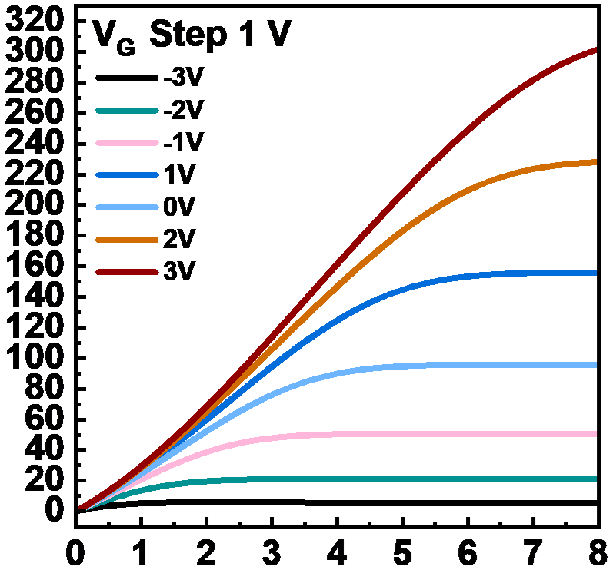
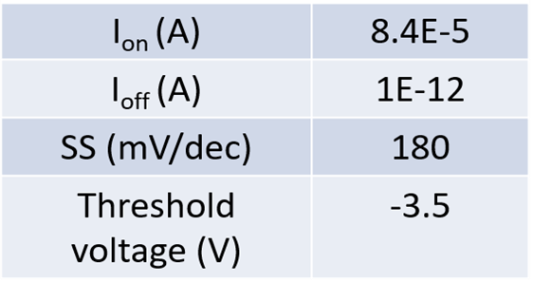

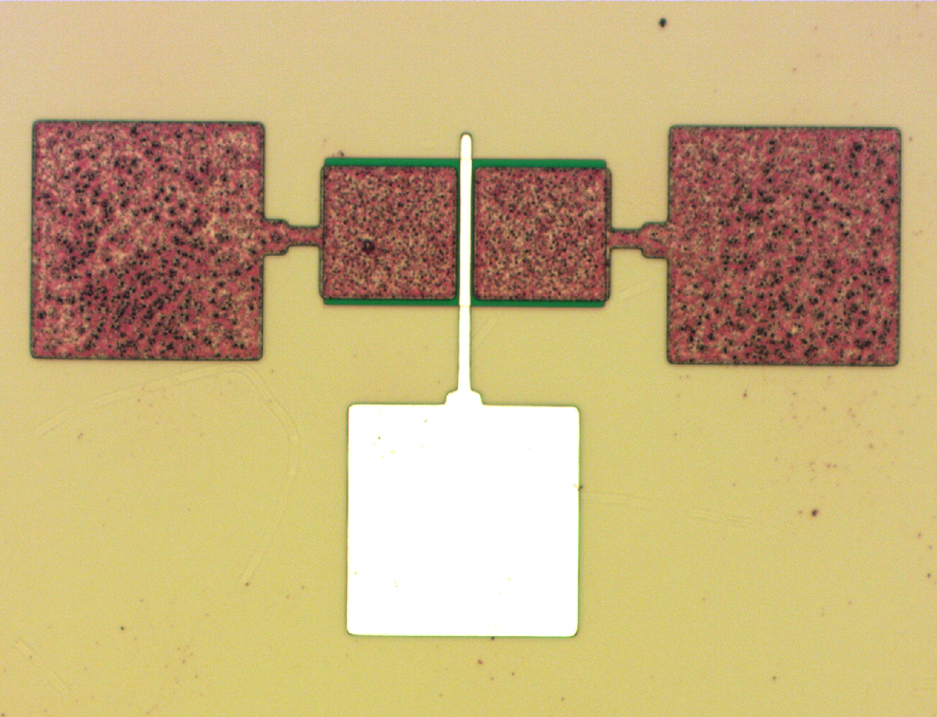
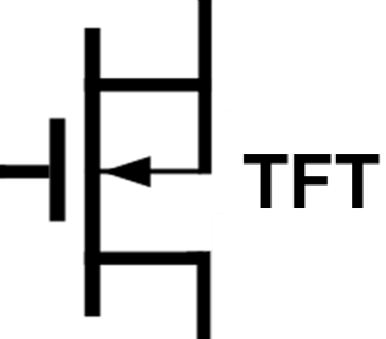


TiO₂Thin Film Transistor (TFT) – Fabrication & Characterization
Performance Parameters
G
ZrO₂
S
D
TiO₂
SiO₂
Si
S
D
G
TFT Device material stack cross-section, fabricated device, performance parameters, circuit symbol, and current versus voltage characterization results.
Fabricated TFT devices achieve over 10⁷ turn on/off ratio.
70 μm
Notes:
Here, we are showing the schematic and microscope image of the fabricated top-gated thin film transistor with Ion/Ioff ratio of 8e-7 and subthreshold slope of 180mV/dec; The device exhibits a normally on characteristic. The device exhibits an excellent output current dependence on the input gate voltage.

Slide 76
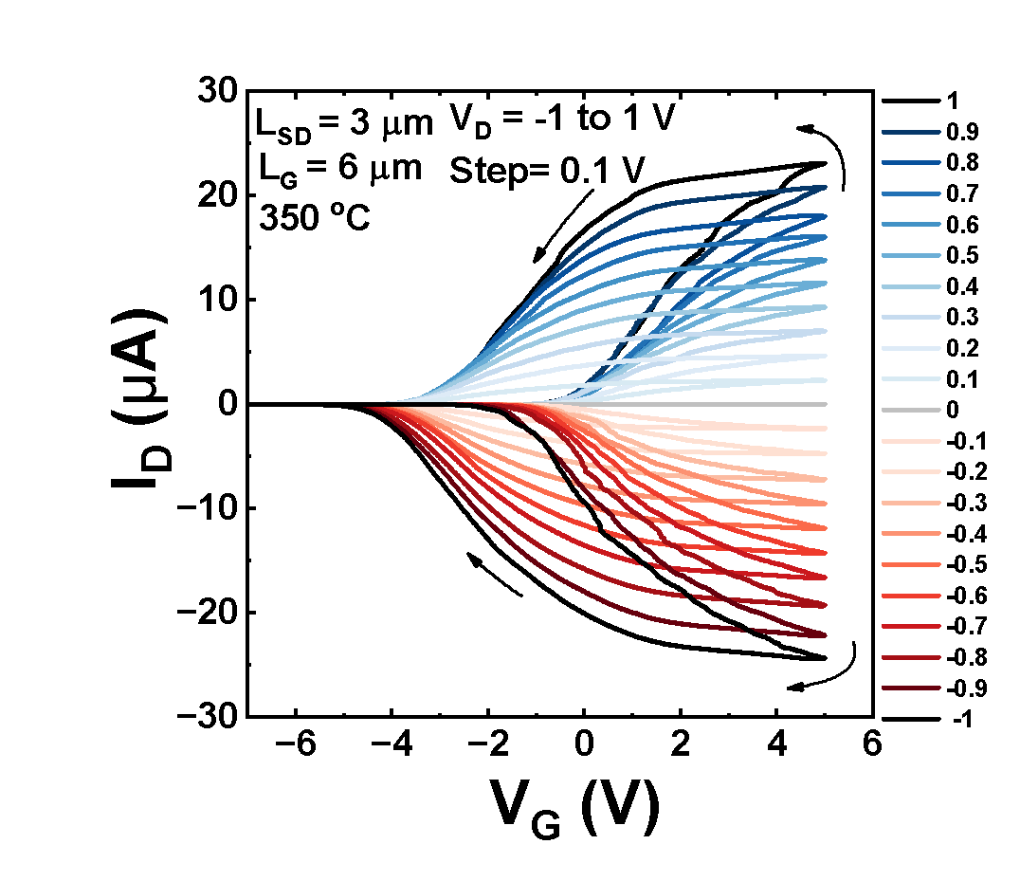
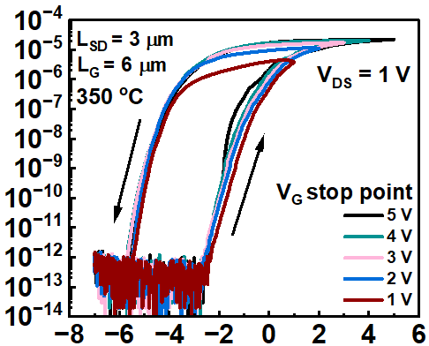

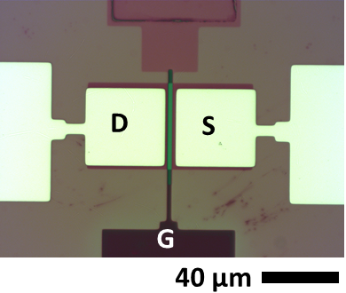
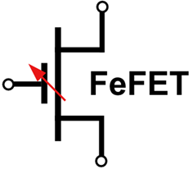

Ferroelectric Transistor (FeFET) – Fabrication & Characterization
S
D
TiO₂
HfO₂
HfZrO₂
TiN (G)
SiO₂
Si
FeFET Device material stack cross-section, fabricated device, current saturation as function of V_{D}, circuit symbol, memory window (I_{on} vs I_{off}) and current versus voltage characterization results showing ~5 memory states.
Fabricated FeFET devices achieve over 10⁹ turn on/off ratio.
Notes:
This slide shows the microscope picture and the schematic of our fabricated ferroelectric field effect transistor. The transfer curves at various VD are shown, indicating the multiple conductance states capability when used in circuits; At the same time, for a fixed VD, the transfer property is characterized with different positive gate voltage range, an indication of the strong gate control capability on the conduction states.

Slide 77
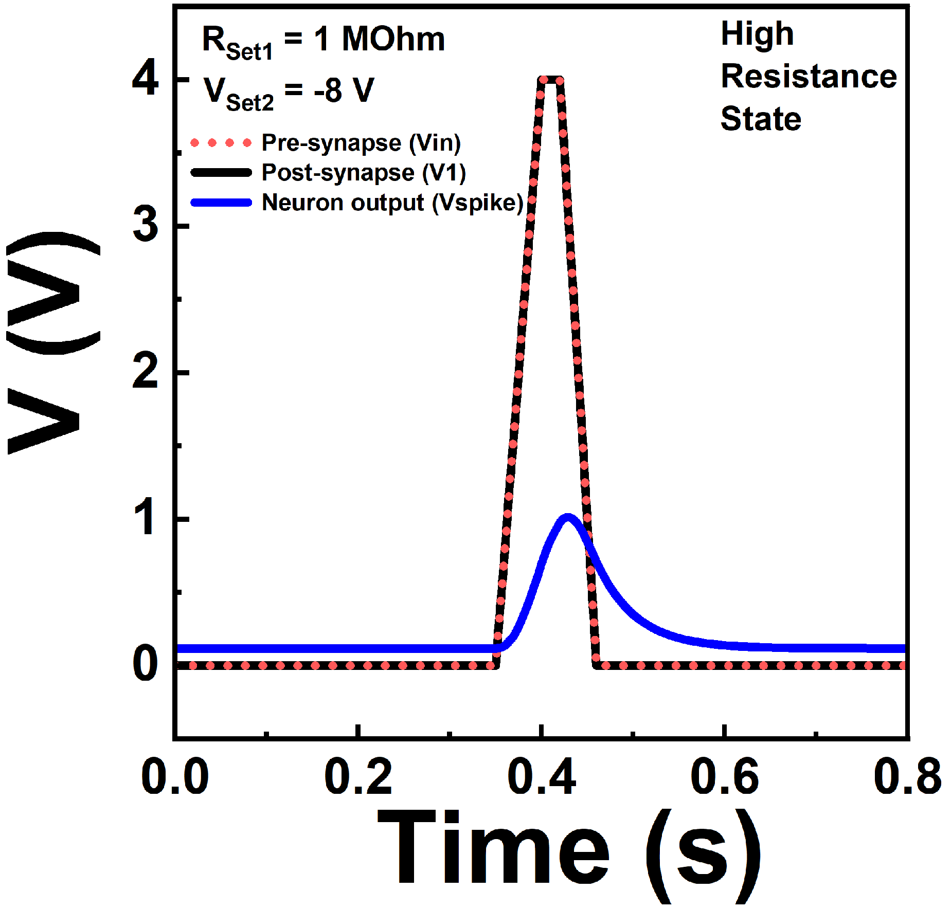
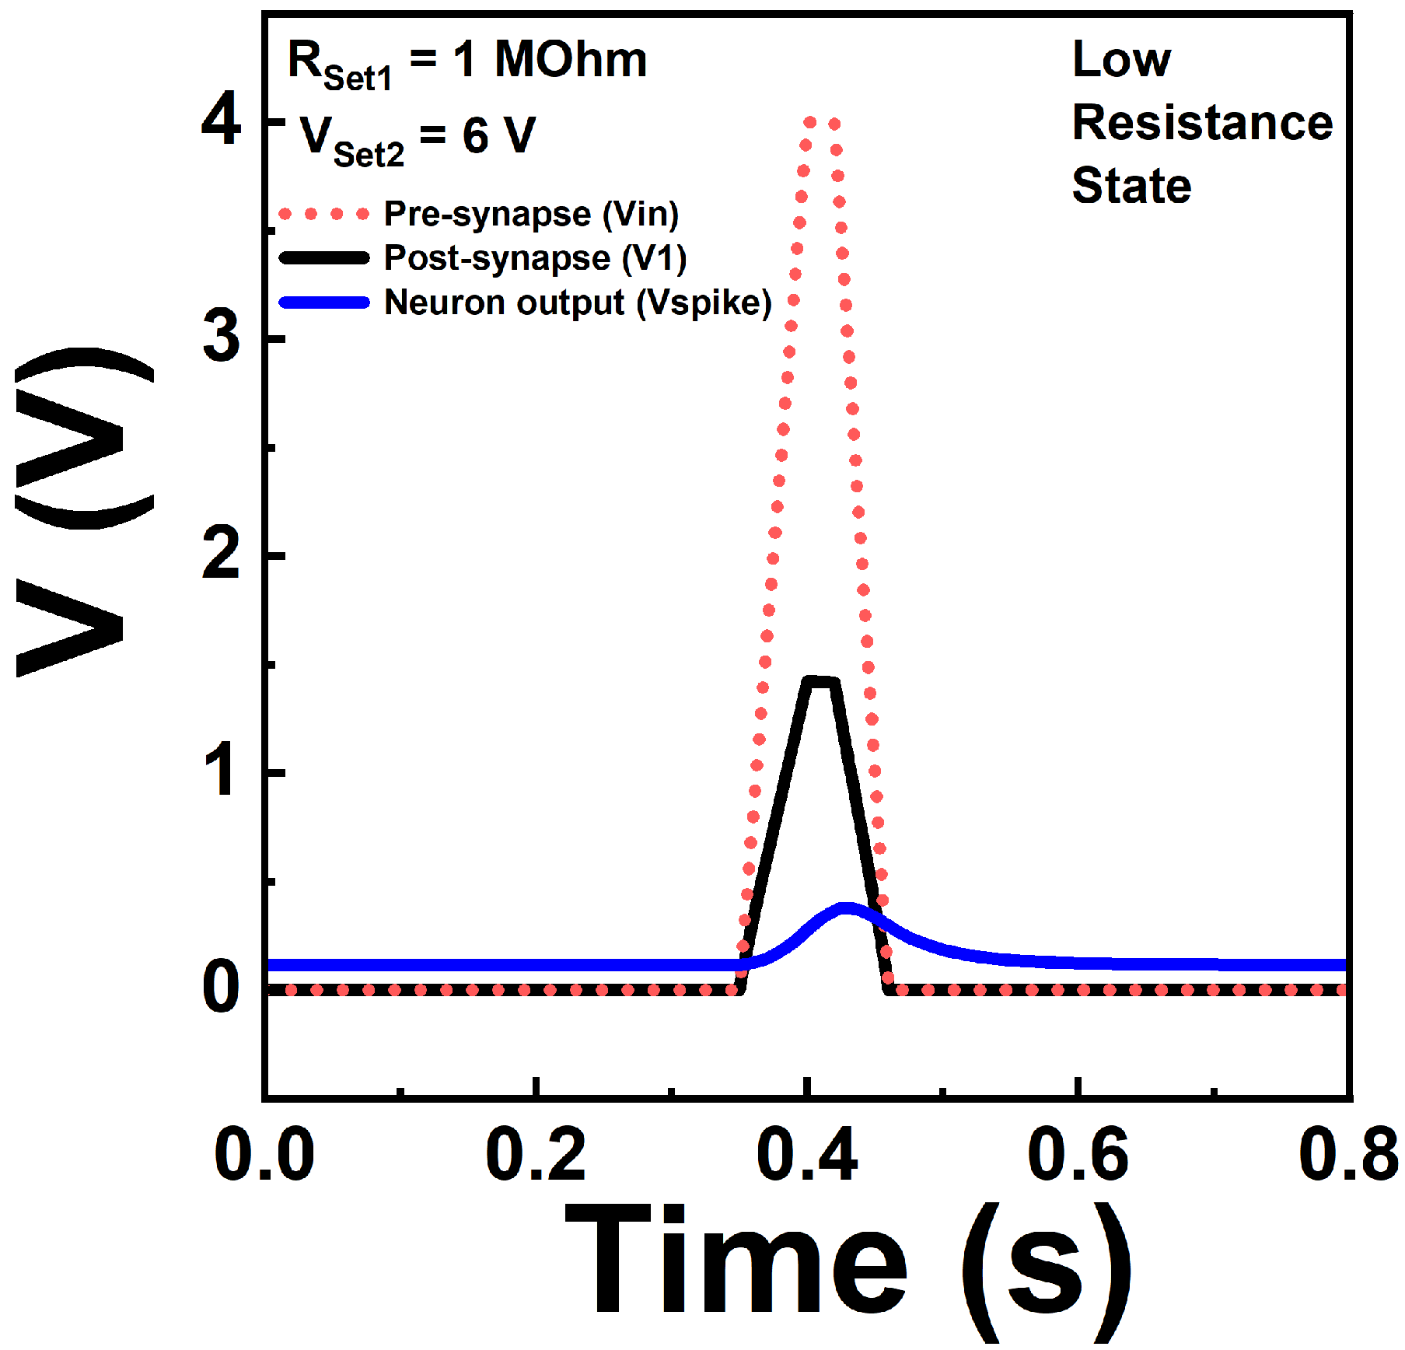
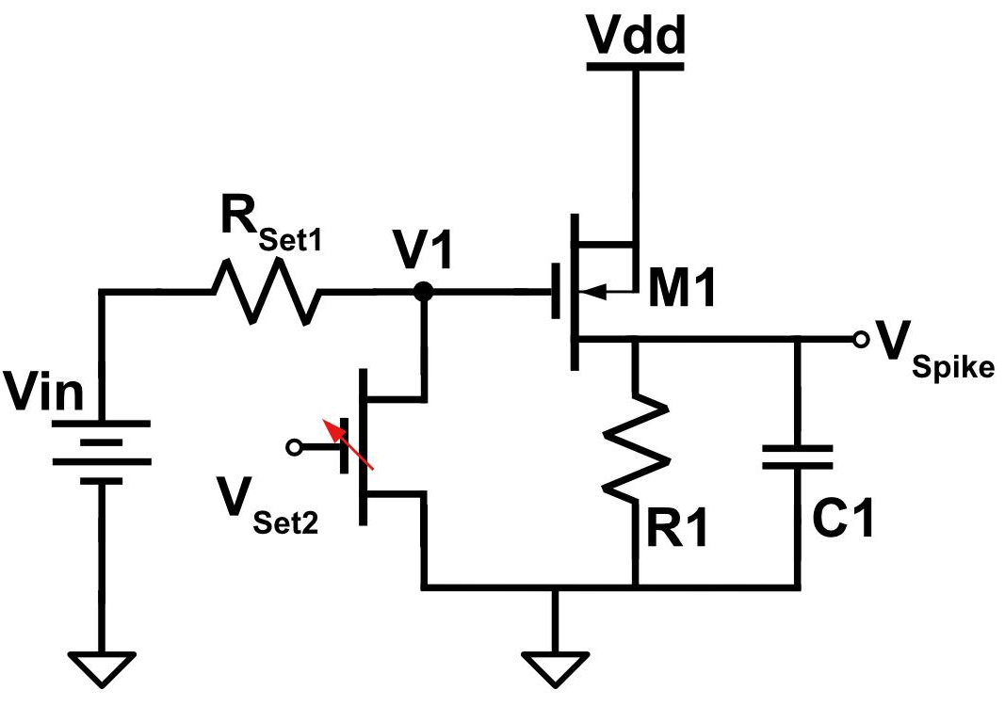
FeFET Synapse – TFT Spiking Neuron: Circuit Design & Simulation Results
Spiking Neuron Simulation Results
Summary of Results: FeFET (synapse) and TFT (neuron) circuit design and simulation results for High/Low synaptic connection strength values demonstrating modulation and control of ouput spiking neuron activity as function of synaptic connection strength. Both equal pre-synaptic input spikes (Vin).
Next Step: Fabrication of fully integrated synaptic (FeFET) and neuron (TFT) circuit at University of Delaware Nano-Fabrication facility.
Notes:
This slide shows a simulation results when use TFET as neuron and FeFET as the synapse in the circuit; The tunable FeFET synaptic conductance property enables the tunability in the post-synapse voltage height and influence on the delay time in neuron spike. The circuit show the how the output neuron spike can be modulated (be made strong or weak) by the state on/off of the synapse (FeFET).

Slide 78
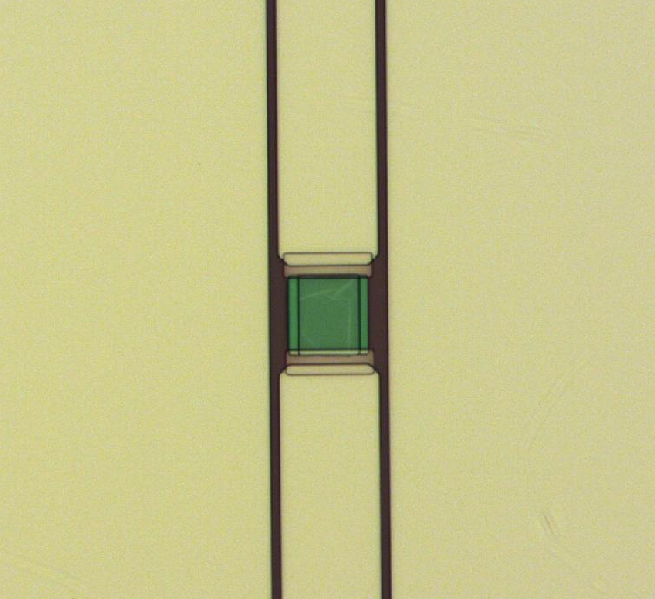
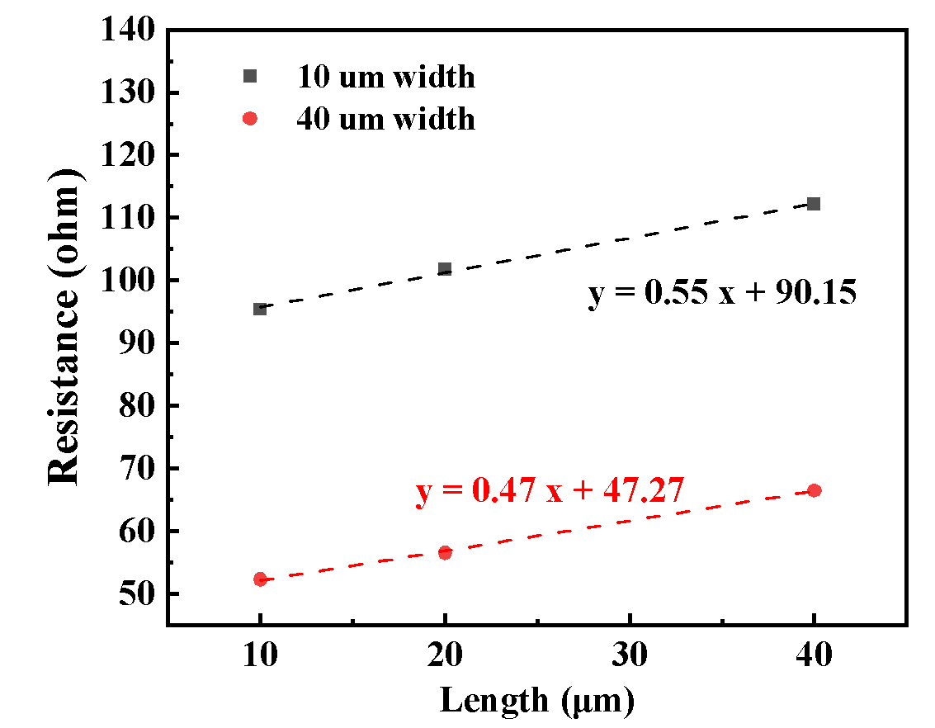
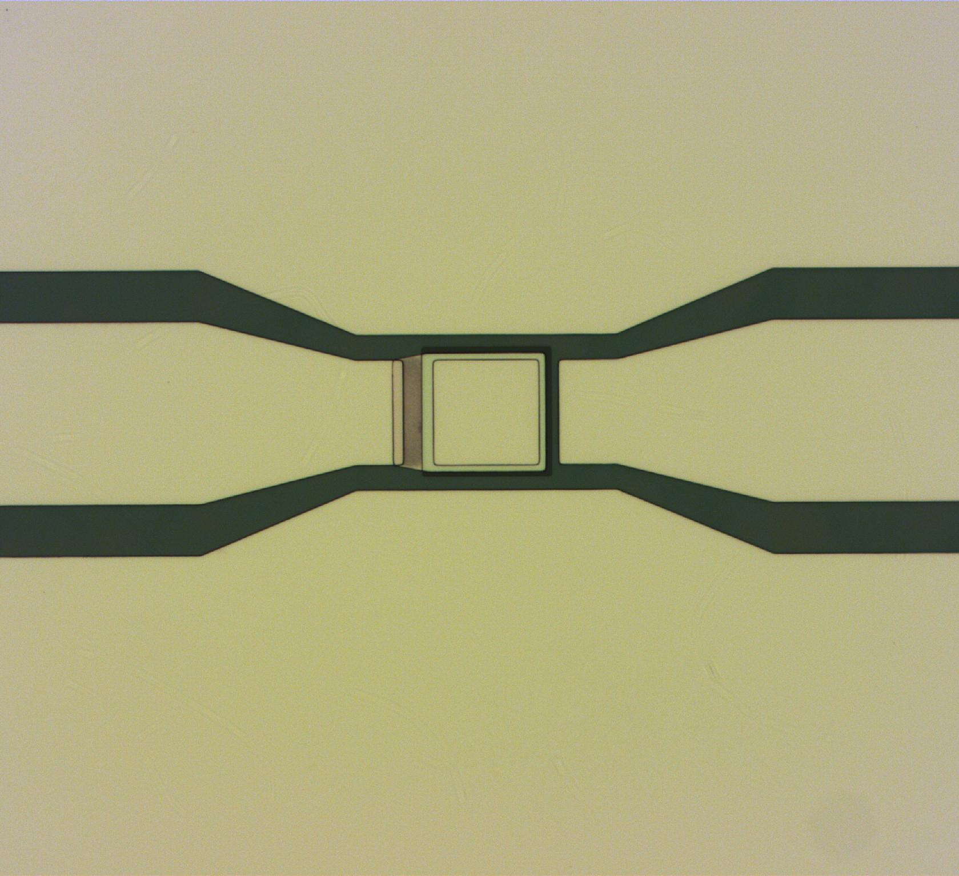
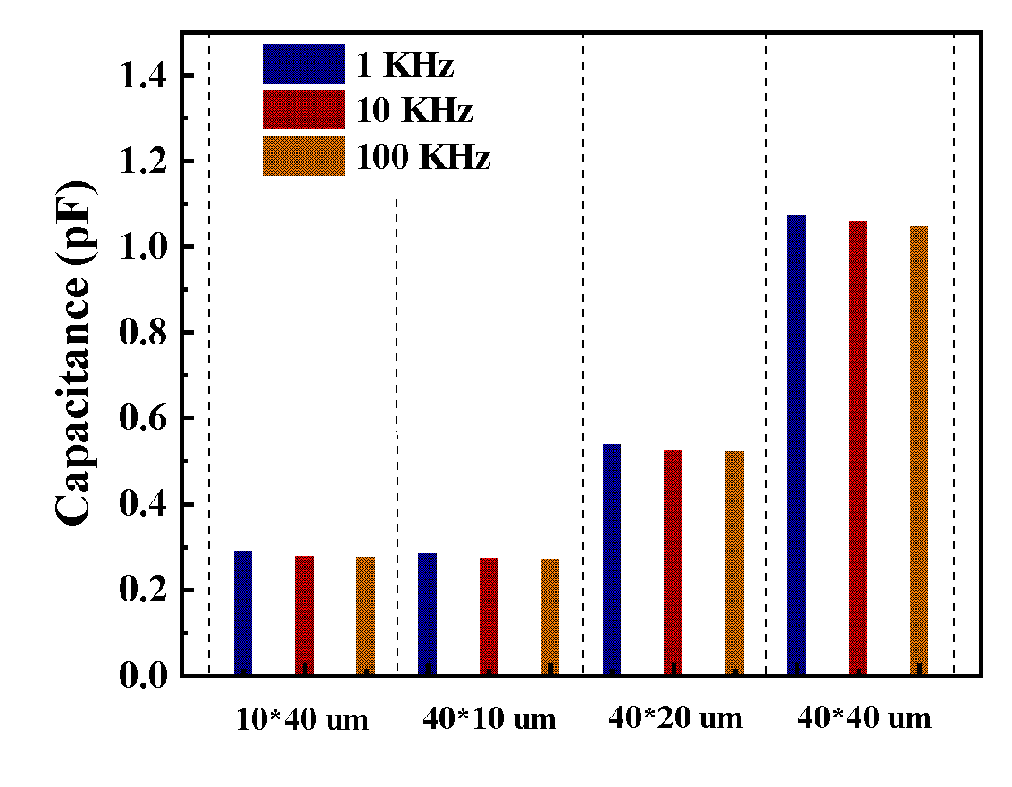
Capacitors & Resistors – Fabrication & Characterization
Cr/Pt = 25 nm /5 nm
Sheet resistance: ~ 16 Ω/sq
Contact resistance (related with area):
~ 3 to 4 × 10⁻⁵ Ω·cm²
Resistor
SiN_{x} 75nm, Dielectric constant: ~ 5.56
Frequency dependence: ~ 1.49%
Surface parasitic capacitance: 13~20 fF.
Capacitor
Notes:
Here we are showing the fabricated capacitor and resistor lumped elements at the University of Delaware Nano Fabrication Facility that will be integrated in the proposed neuron & synaptic circuits. They include capacitors and resistors. Resistors exhibit a sheet resistance of 16ohm/sq; Capacitor based on SiNx shows a capacitance of 13~20fF.

Slide 79


Collaborators
Prasanna Date (PI)
Xi Zhang
Sanjay Das
Emily Herron
Hai Li (Co-PI)
Abdulkarim Alorf
Yuping Zeng (Co-PI)
Elia Palmese
Austin Biaselli
Ziyu Ouyang
Tuofu Zhama
Robinson Pino
Special thanks to Thomas Potok (Oak Ridge National Laboratory)!

Slide 80
Thank You!
SC’26 | Chicago, Illinois | Nov 18, 2026
U.S. Department of Energy Genesis Mission Phase 1 Project
Prasanna Date (PI), Xi Zhang, Sanjay Das, and Emily Herron
Oak Ridge National Laboratory
Notes:
Phase I proposal for DE-FOA-0003612. One line: we are building transformers that run on neuromorphic hardware, end to end.

