Slide 1
#01-Walmart-Retail-Dashboard
File created on: 17-May-22 11:50:14 PM

Slide 2
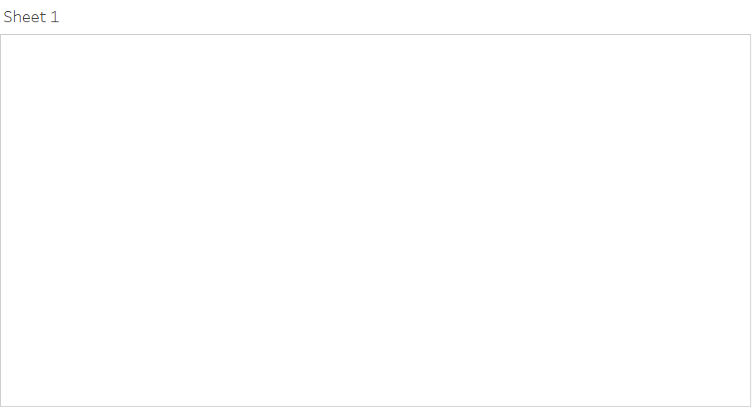

Slide 3


Slide 4
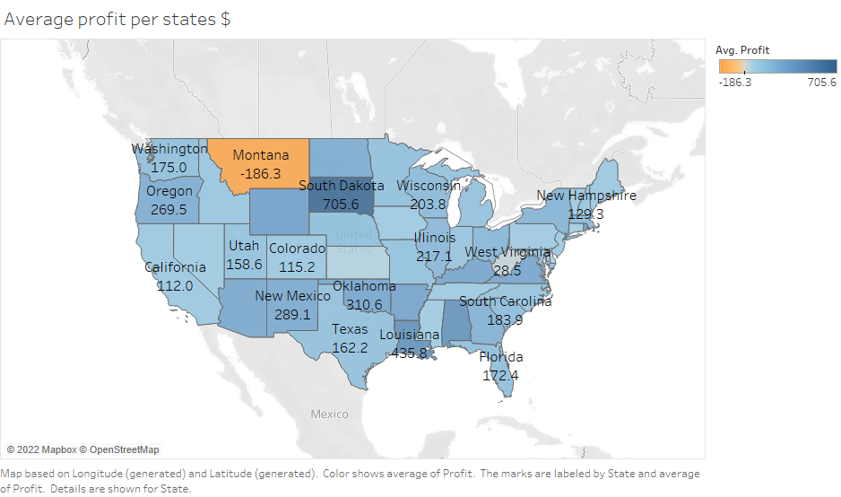

Slide 5
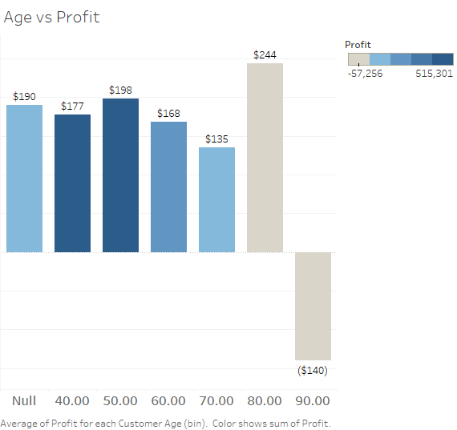

Slide 6


Slide 7


Slide 8
