Slide 1


SMART INDIA HACKATHON 2026
TITLE PAGE
Problem Statement ID – SIH26153
Problem Statement Title- AI based Network Attack Forecasting from Network Traffic Data
Theme - Blockchain & Cybersecurity
PS Category - Software
Team ID - SIH26-A0H-T182
Team Name - EDITH

Slide 2
AI-Based Network Attack Forecasting from Network Traffic Data
EDITH
Problem Resolution :
◆ Moves beyond traditional IDS by forecasting malicious activity instead of only classifying individual flows as benign or malicious.
◆ Learns temporal and sequential attack behaviour, capturing how reconnaissance can evolve into initial access and lateral movement.
◆ Provides defenders with early warning of likely attack progression, enabling proactive response before compromise is completed.
◆ Supports enterprise and Critical Information Infrastructure environments using open-source network telemetry.
IDEA / SOLUTION :
Implementation of an AI-based Network World Model that learns the temporal evolution of network traffic and forecasts attack progression before compromise.
◆ Multi-level traffic analysis using flow-level and packet-level network features
◆ Temporal World Model using LSTM/Transformer to learn network state-transition dynamics
◆ K-step forward simulation to predict future network states and estimate infiltration probability
◆ MITRE ATT&CK stage mapping to forecast attacker progression such as Reconnaissance, Initial Access and Lateral Movement
◆ Explainable AI identifies the traffic features and patterns driving each prediction
Unique Value Propositions (UVP) :
◆ Predict Before Compromise — proactive rather than reactive defence
◆ Network World Model — learns evolving network behaviour
◆ Attack Progression Forecasting — predicts future attack stages
◆ Explainable AI — shows why an attack is being forecast
◆ Fully Offline Prototype — open-source datasets and tools

Slide 3
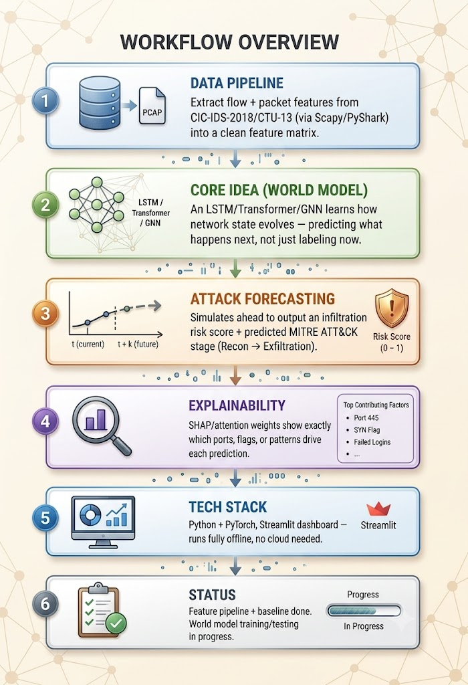
TECHNICAL APPROACH
EDITH
Data Pipeline: Extract Flow + packet-level network features from CIC-IDS-2018 and CTU-13 (via Scapy/PyShark) into a clean feature matrix.
Core Idea (World Model): An LSTM/Transformer learns how network state evolves — predicting what happens next, not just labeling now.
Attack Forecasting: Simulates ahead to output an infiltration risk score + predicted MITRE ATT&CK stage (Recon → Exfiltration).
Explainability: SHAP/attention weights show exactly which ports, flags, or patterns drove each prediction.
Tech Stack: Python + PyTorch, Streamlit dashboard — runs fully offline, no cloud needed.
PROCESS FLOW ARCHITECTURE

Slide 4
FEASIBILITY AND VIABILITY
EDITH
Technical Feasibility
Public datasets: CIC-IDS-2018 & CTU-13
Proven sequence models: LSTM/Transformer
Open-source tools: Python, PyTorch, Scapy/PyShark
Financial Feasibility
Open-source tools and datasets
No proprietary APIs or cloud dependency
Low-cost offline prototype
Operational Feasibility
Works with network traffic and telemetry
MITRE ATT&CK provides standardized attack mapping
Streamlit dashboard enables easy analyst interpretation
CHALLENGES Prediction Uncertainty
Attackers may change or skip stages, causing incorrect forecasts and false alerts.
Real-Time Performance
High-volume telemetry creates latency and processing challenges.
Evolving Attack Patterns
Historical datasets may not fully represent novel real-world attacks.
SOLUTIONS Adaptive Forecasting Sequence-based World Model + confidence scoring + dynamic thresholds to manage uncertainty.
Efficient Pipeline Sliding-window processing + lightweight inference for continuous low-latency forecasting.
Continuous Adaptation Periodic retraining + multi-dataset validation + MITRE mapping to handle evolving threats

Slide 5
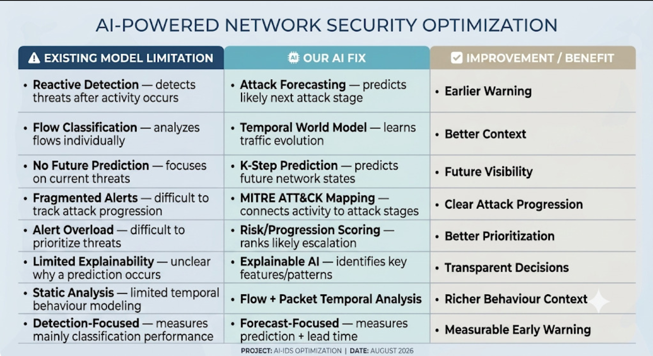
IMPACT AND BENEFITS
EDITH
.
Benefits of the Solution:
Social: Improves protection of user data and trust in digital services
Economic: Reduces financial losses and manual effort in threat monitoring
Technological: Shifts security from reactive to forecast-assisted, with explainable predictions
Potential Impact on Target Audience:
Security Teams::
Earlier Warning: Forecasts likely attack progression before the next stage.
Alert Prioritization: Ranks threats using progression risk and confidence.
Organizations:
Proactive Response: Gives teams time to investigate before escalation.
Threat Visibility: Tracks how suspicious network behaviour evolves.
Critical Infrastructure:
Early Attack Indication: Highlights likely progression toward subsequent stages.
Offline Deployment: Supports environments without external cloud/API dependencies.

Slide 6
RESEARCH AND REFERENCES
EDITH
World Models & Predictive AI ○ Recurrent World Models Facilitate Policy Evolution (NeurIPS, 2018) ○ KillChainGraph: ML Framework for ATT&CK Prediction (arXiv, 2025) ○ Learning the APT Kill Chain: Attack Stage Estimation (arXiv, 2026)
Sequence Modeling for Network Traffic ○ On the Evaluation of Sequential ML for NIDS (ARES, 2021) ○ Transformers in Time Series: A Survey (arXiv, 2022) ○ E-GraphSAGE: GNN-based Intrusion Detection (IEEE NOMS, 2022)
Explainable AI ○ A Unified Approach to Interpreting Model Predictions — SHAP (NeurIPS, 2017) ○ Graph Neural Networks for Intrusion Detection: A Survey (IEEE Access, 2023)
Standards & Knowledge Bases ○ MITRE ATT&CK Framework ○ CAPEC — Common Attack Pattern Enumeration ○ CVE / NVD — National Vulnerability Database
Datasets Referenced ○ CIC-IDS2017/2018 — Canadian Institute for Cybersecurity (UNB) ○ CTU-13 — Stratosphere IPS, CTU University

