Slide 1
Hastily ALERT!
TEAM MEMBERS:
Sandhya
Suryakala
Gowri Alekya
Sanjay
Umaparvathidevi
TEAM:
SUGS_S

Slide 2





Project Space 4.0
Attended ADITYA
Attended Thub
Attended College classes
Attendance
status

Slide 3
Project Space 4.0
Introduction
This project is about sending an alert through email after tapping attendance for the trainees. As we are DevOps team we developed an 2-tier desktop application which is designed to run on a computer and use the system resources to perform. The application has been deployed in the Docker Containers.

Slide 4

The main idea of this project is to send an alert through email notification so that the trainee can immediately check their attendance status. Along with that segregated data of attended trainees is also sent to their respective colleges with just a click. The trainer can also create an event and can take the attendance of the trainees and just by tapping on the send button he can send the data to the colleges of their respective students.
Project Space 4.0

Slide 5
Project Space 4.0
Abstract
Mentors:
Bobby sir
Surya Ashok sir
This is a desktop application which we was built using python programming, Tkinter and SMTP libraries for development. We have used docker tool for deployment of the application.
The result of this application sends a notification to the email of the trainee and a segregated data will be sent to their respective colleges.

Slide 6



Tools used
Project Space 4.0
Python

Slide 7
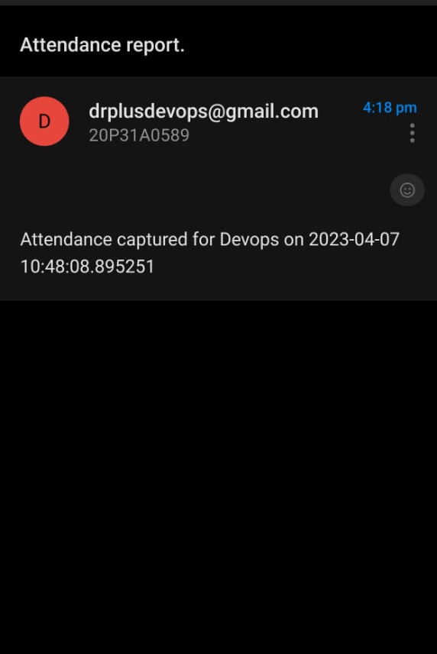
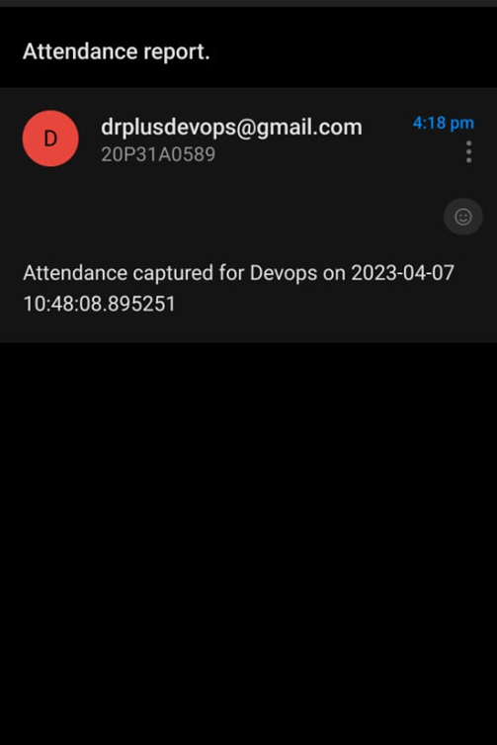
Main Features:
Project Space 4.0
Instant notification through Email
Auto data segregation and emailing to respective colleges
Instantaneous event addition
Eliminated the manual attendance tracking

Slide 8
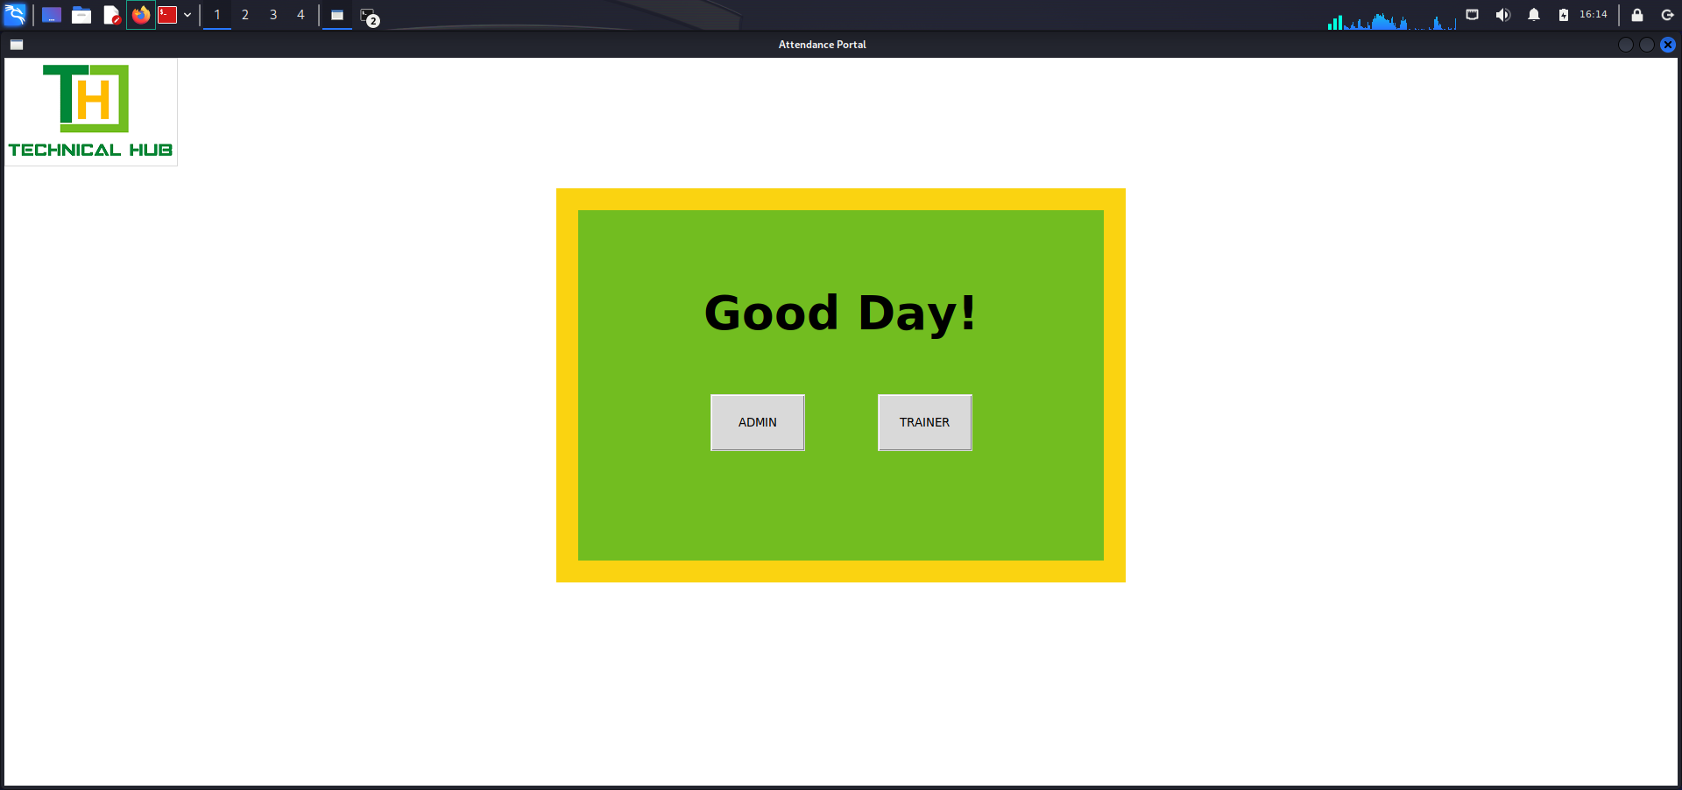
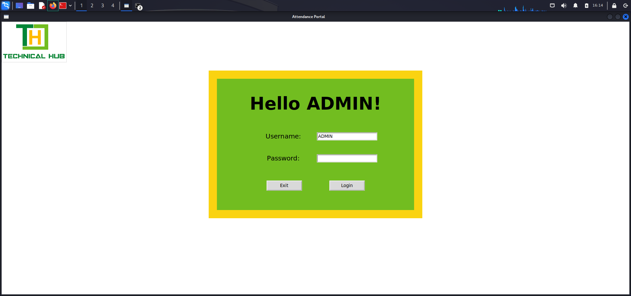
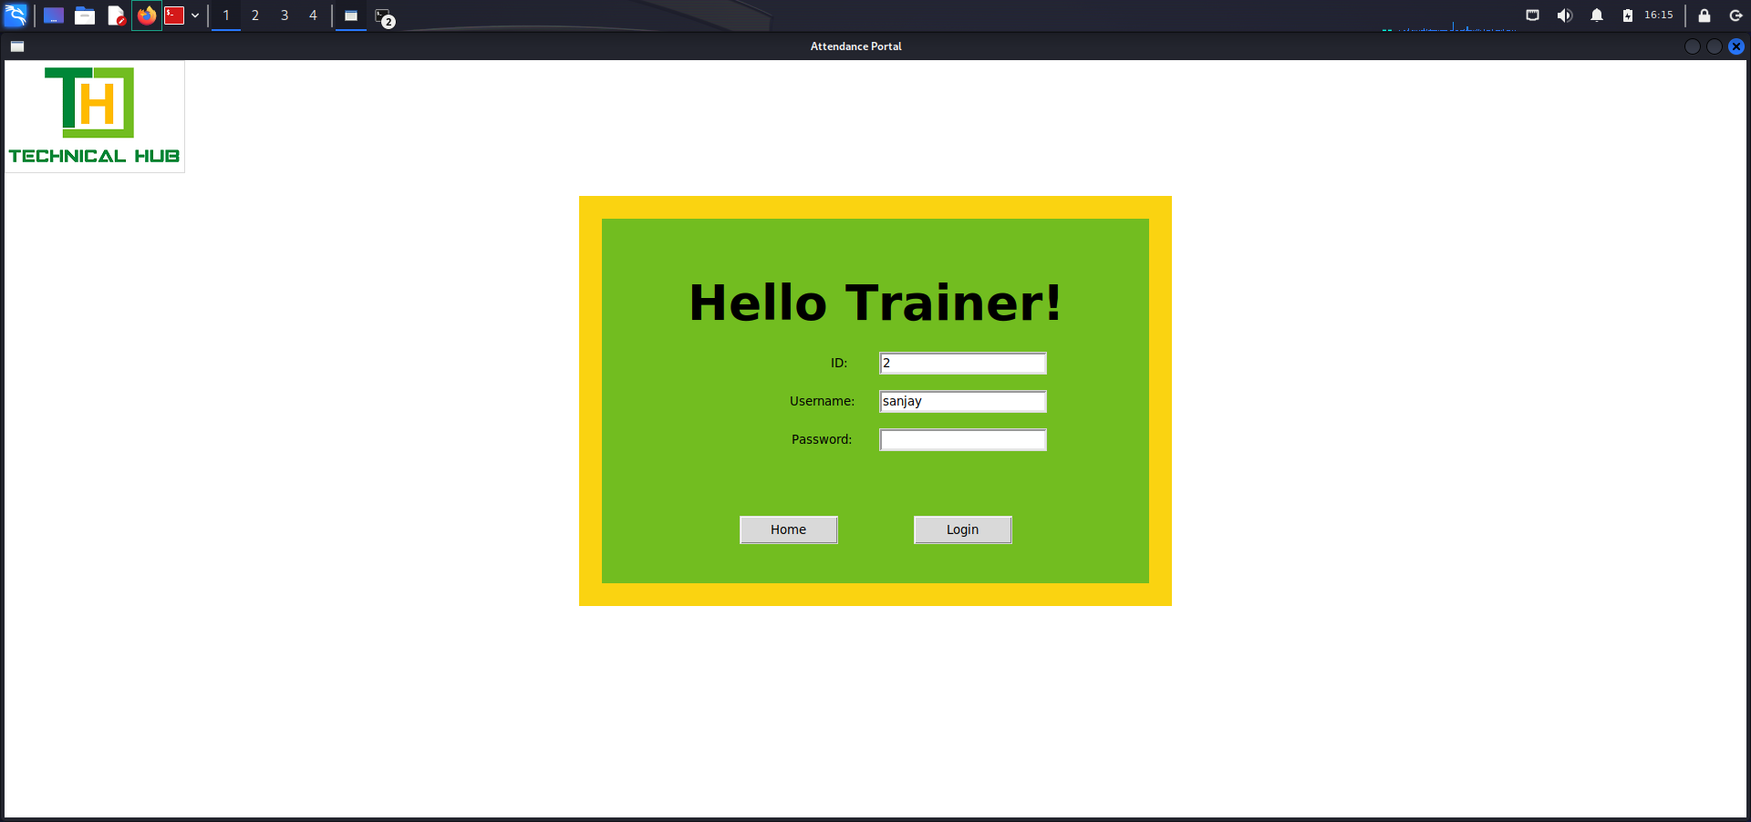
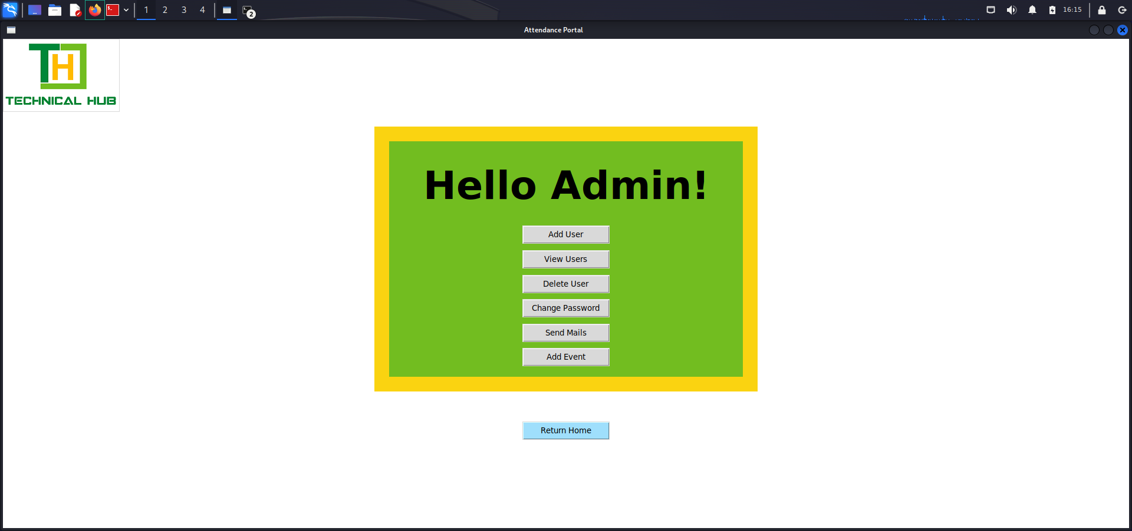
Proof of project:
Project Space 4.0

Slide 9
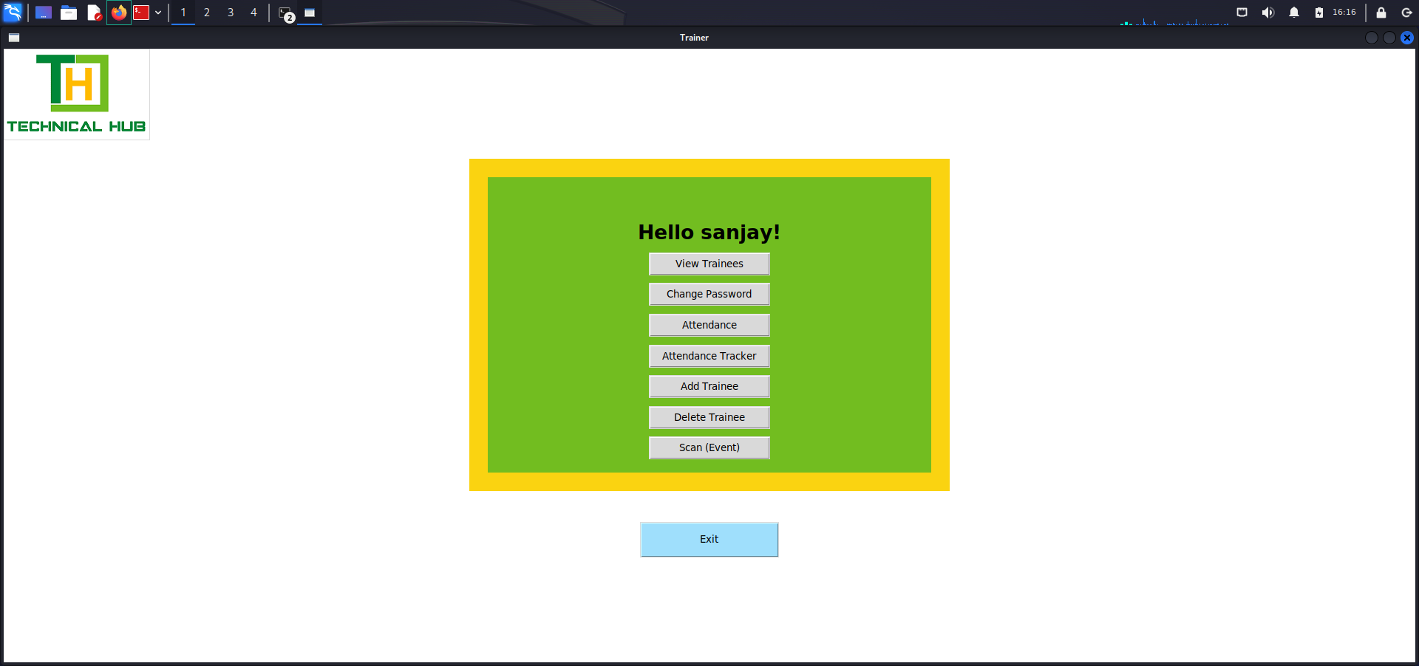
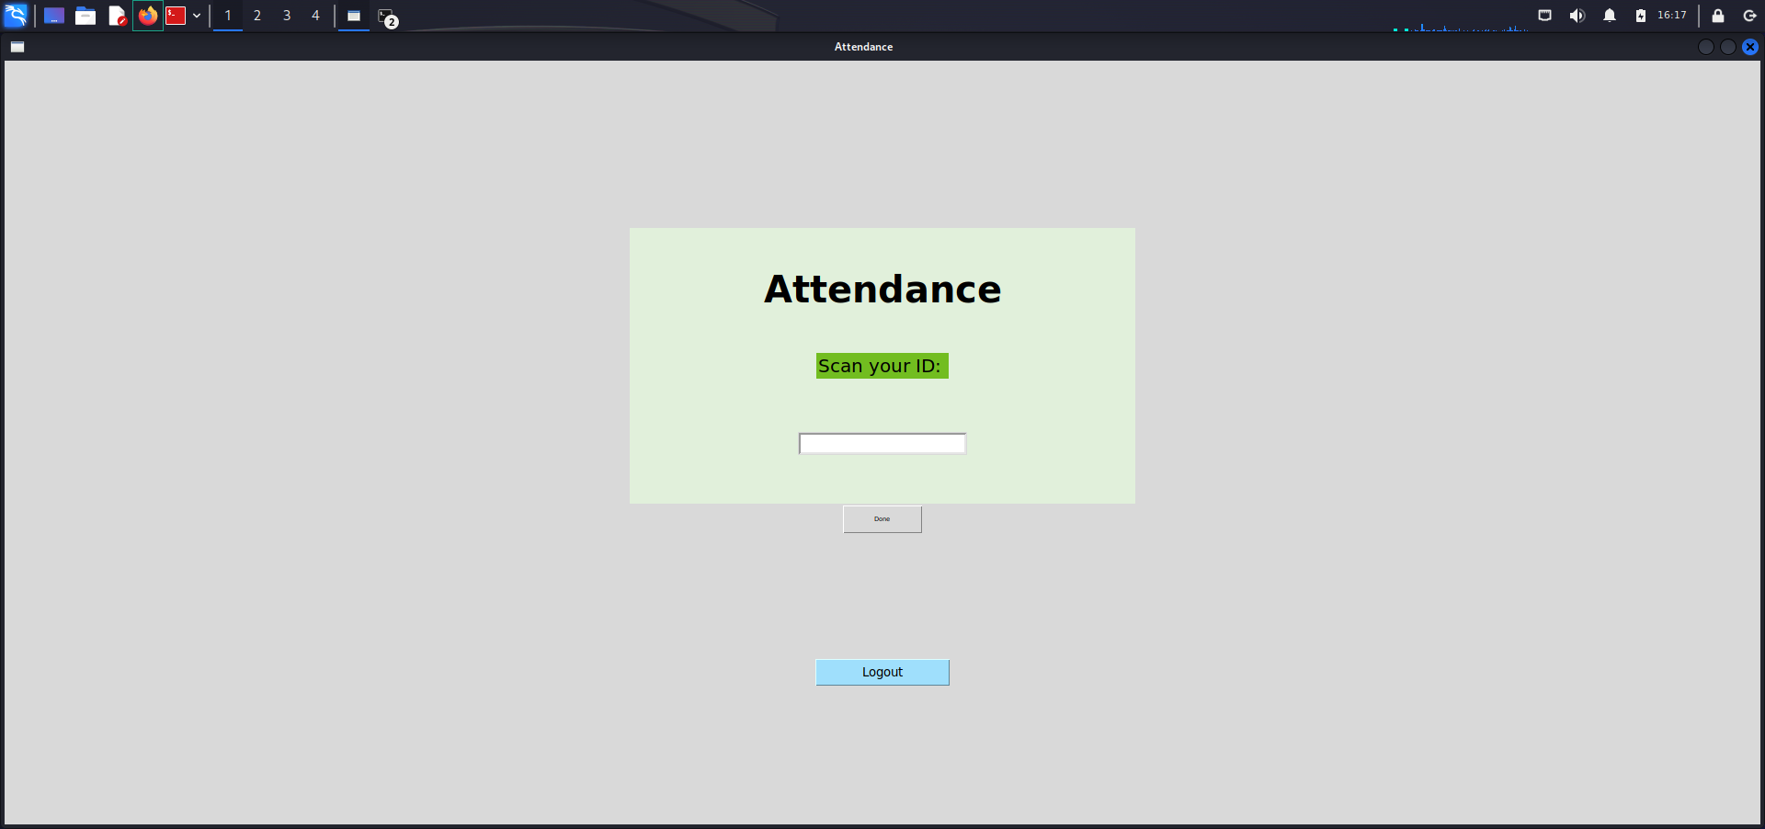
Proof of project:
Project Space 4.0

Slide 10
Thank You

