Slide 1
Hackathon Project Final Presentation
February 1st, 2026
Prosper Petroleum Engineers
Tejas Dasa, Saksham Agarwal, Puranjay Prashanth, Vivaan Moharir, Sanjay Rajjan
Cockrell School of Engineering
College of Natural Sciences

Slide 2
Executive Summary
The objective was to predict 3-year cumulative oil production by integrating well logs, production history, and seismic-derived sand proportion maps. Our team conducted extensive exploratory data analysis to clean the data, applied advanced signal processing to denoise seismic features, and developed an optimized XGBoost regressor for forecasting. We learned that applying a combined median and Gaussian filter to the sand proportion map significantly improved feature signal-to-noise ratio, leading to more robust model performance. Going forward, we recommend deploying this denoising pipeline and investigating additional spatial features to further reduce prediction uncertainty.

Slide 3
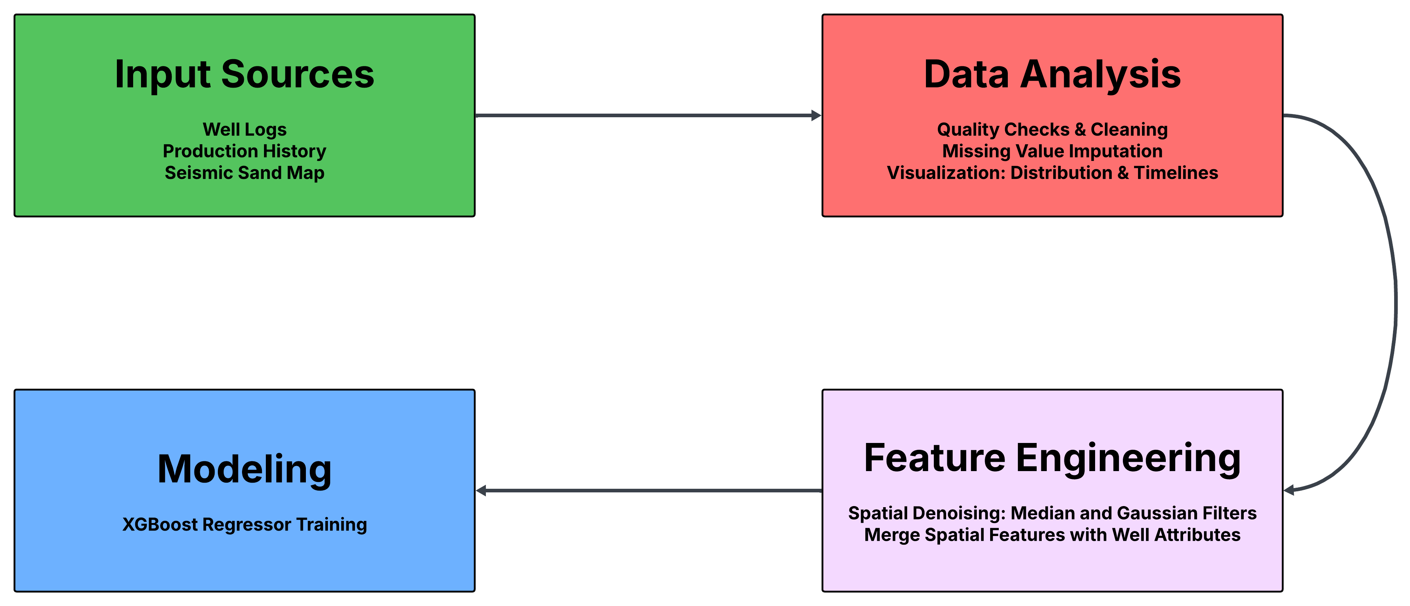
Workflow

Slide 4
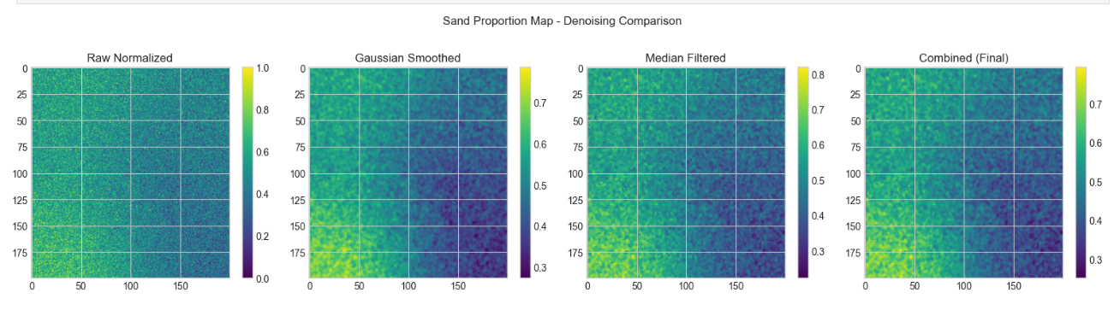
Hybrid "Seismic-Image" Processing
Instead of treating the geological sand proportion map as a data table, we treated it as an image. This led to us implementing a Sequential Filter Pipeline (Median Filter → Gaussian Filter). This accounts for two types of noise: spikes (handling by Median) and high frequency instrumentation noise (handled by Gaussian).

Slide 5
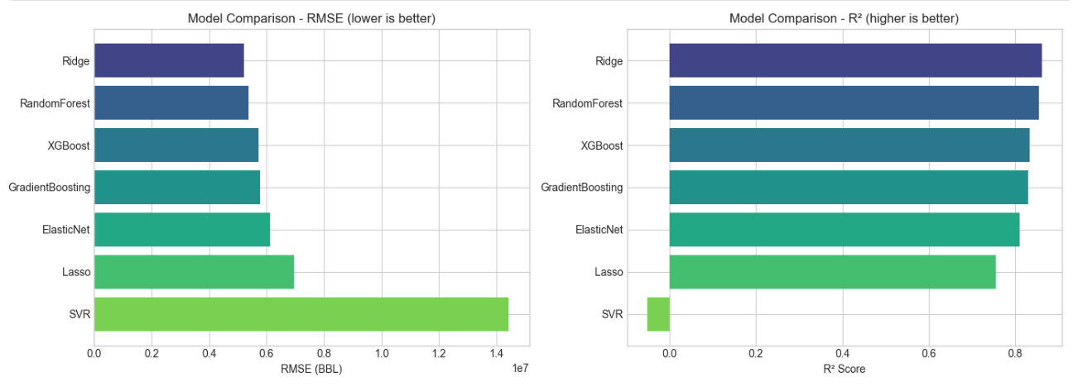
Why XGBoost Regressor
We observed that the oil production data is non-linear and distinctively non-Gaussian. This is because geological patterns don't follow a straight line, meaning doubling the porosity doesn't guarantee double the oil.
For this dataset size deep learning may overfit, and so we chose XGBoost as it has an optimal balance of variance as well as native feature importance scores. This allows us to accurately determine the production potential of a well.

Slide 6
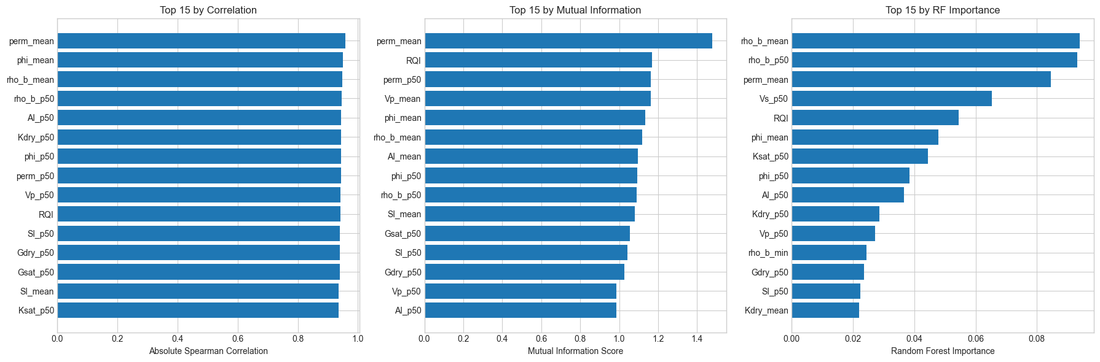
Feature Selection & Engineering
Oil production data often contains highly collinear well log curves (like Gamma Ray and Resistivity), which can confuse tree-based models and dilute feature importance. Instead of using all available logs, we employed a Mutual Information (MI) approach to capture non-linear dependencies between geological features and the production target. This method allowed us to retain only the features that provided unique, additive information while discarding redundant signals, resulting in a more robust and interpretable model.

Slide 7
Critical Results and Learnings
Our exploratory analysis revealed distinct temporal clustering in drilling campaigns, necessitating time-aware validation splits to prevent historical bias from skewing predictions for modern wells.
Simultaneously, we found that raw seismic data suffered from high variance that obscured geological signals.
By implementing a combined median-Gaussian denoising filter, we successfully improved the signal-to-noise ratio, which forced the model to prioritize true geological drivers over measurement artifacts.

Slide 8
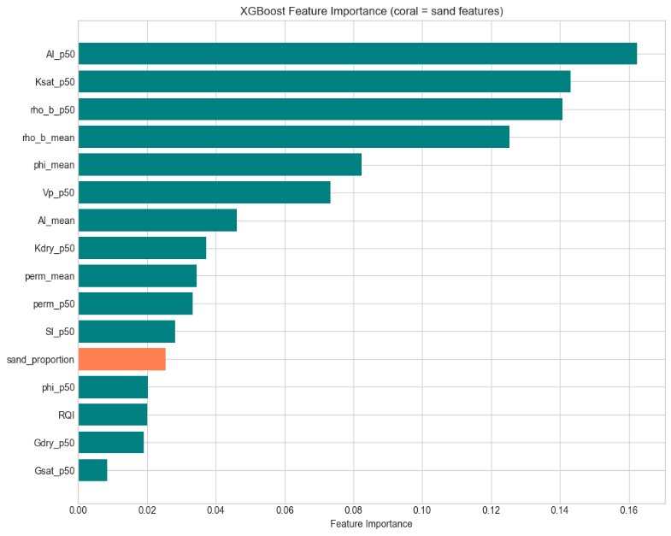

Slide 9
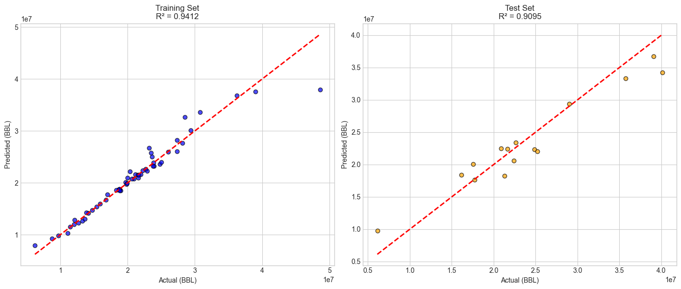
Results and Discussions

Slide 10
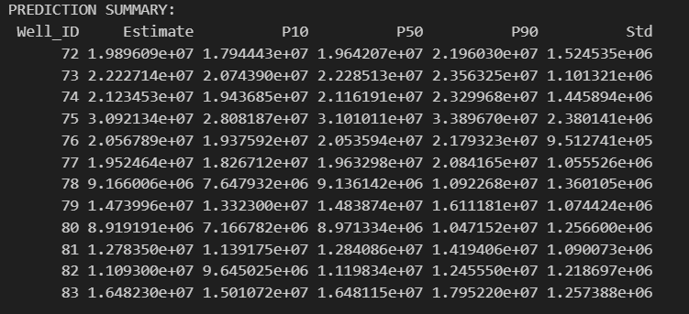
Results and Discussions

Slide 11
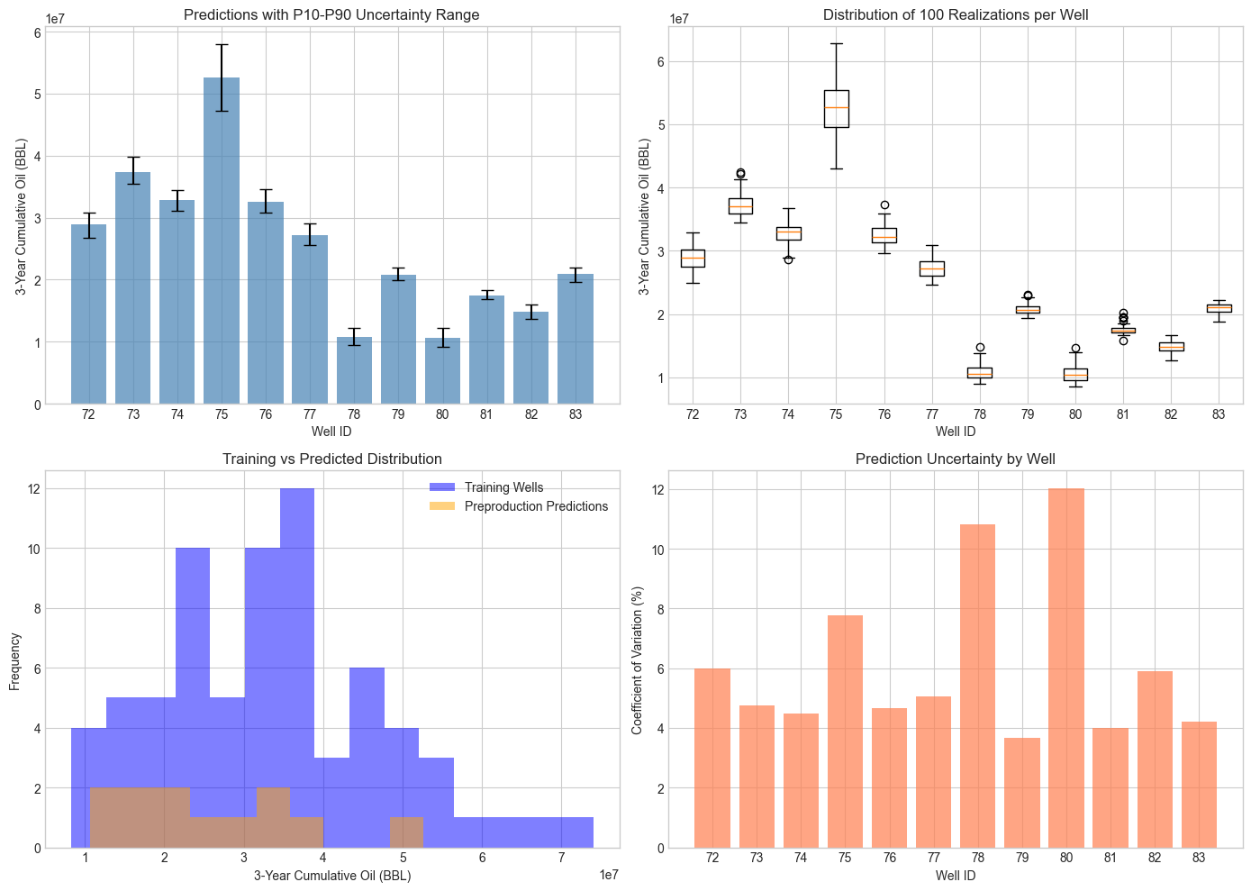
Results and Discussions

Slide 12
Feedback
Our team discovered that applying a hybrid filter to seismic images clears up noisy data, helping the model focus on real geological features rather than errors. We also found that drilling happens in specific time clusters, so we had to be careful with how we tested the model to avoid letting it "cheat" by learning from future trends.
We enjoyed the challenge of combining picture-based seismic data with standard spreadsheets, but next year we want to use better statistical methods to predict a range of possible outcomes instead of just a single number.

