Slide 1
Appium
Agenda
What is Appium?
How Appium works?
Protocol used by Appium!
Architecture.
Prerequisite for setup the Appium.
Appium on Android.
Get to know about selector.
Test the App!
By Sanjay R B

Slide 2

Appium!
Appium is a mobile test automation framework (and tool) for native, hybrid and web apps for iOS and Android.
It is the server written by the NODE.JS and it is a open source testing tool for all cross platform.
Initially it is an command line interface which can be install by node package manager (npm)
Now a days developers created the desktop application Appium server.

Slide 3
How APPIUM Works?
Appium is an 'HTTP Server' written using a Node.js platform and drives iOS and an Android session using Webdriver JSON wire protocol.
When Appium is downloaded and installed, then a server is set up on our machine.
It receives connection and command request from the client and executes that command on mobile devices (Android / iOS).
It responds back with HTTP responses. Again, to execute this request, it uses the mobile test automation frameworks to drive the user interface of the apps.

Slide 4
Protocol used by Appium!
Appium used the JSON Wire Protocol. The JSON Wire Protocol is specially developed by the WebDriver developer for testing the webpages or websites with the great testing tool call selenium.
We use mobile JSON Wire Protocol, it is the extension to the selenium JSON Wire Protocol.
It is a JSON Object with key – value pair which caries the complete information about the communication.
With the help of this protocol, Appium communicate with the client , server, sessions, UI elements, physical device or emulator.

Slide 5




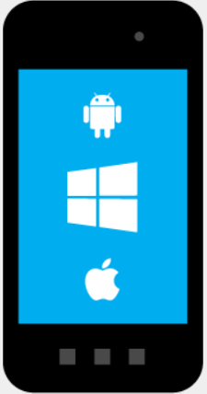
XCUITest
iOS 9.3 <
UIAutomation
iOS 9.3 >
UiAutomator/UiAutomator2
WinAppDriver

Slide 6
Prerequisite to use APPIUM
Install ANDROID SDK (Studio) - link
Install JDK (Java Development Kit) – link
Node Js - link
Java IDE (Eclipse JEE) - link
Selenium Server Standalone- link
Appium Client Libraries - link
Install Appium Desktop (Server) or npm install -g appium - link
Genymotion (Emulator) – link
Maven Repository (Where you get all lib files) - link

Slide 7
Steps to perform a simple native testing:
Set the System Environment Variable for ANDROID_HOME & JAVA_HOME
Download Selenium stand alone server and java client for Appium.
Open Eclipse IDE & add Libraries which we have downloaded before.
Connect Device with USB debugging on or start an emulator.
Create your own Test Class.
- Add DesiredCapabilites for your device and apk.
- Write the test case as test functions.
- Run the test.
6. Run the Appium Server with Host and Port. Run the Test Case.

Slide 8
Run the Test

Slide 9
Thank You
Automation Make Testing Cool….

