Slide 1
Customer Support – Automation of ticket creation and response based on the mail (RPA)
Team members:
Sam Dany R
Ramshankaran Y
Prathvik S
Sanjay R B
Faculty Guide:
Ms. R Jayashree
Department of CSE, KGiSL Institute of Technology, Coimbatore

Slide 2
Abstract Eliminate manual intervention in ticket creation, so raise a ticket based on the complaint mail. If the details are incomplete (e.g. customer id is missing), send a mail to customer asking for missing details and Link the subsequent responses from the customer to the original ticket. Recognize the bounced mails and initiate appropriate action via sending auto response to template-based mails (complaints/queries) i.e. no free text.
Department of CSE, KGiSL Institute of Technology, Coimbatore

Slide 3
Area Introduction-Existing system
User needs specific solutions to the problem arise.
Queries are send to the system for processing it.
Each queries arrived assigns a unique ticket.
A big support team available to solve the problems.
Queries are stored in queues which are equally partitioned and assigned to each members in the team.
Team has a great stress when solving the same queries repeatedly.
Department of CSE, KGiSL Institute of Technology, Coimbatore

Slide 4
Proposed System
Advantages over existing method:-
Effective in both Installation and Working with the Queues.
Previously solved solutions are stored in a separate Database.
When same queries arise by the other users, then it match to the saved results.
This makes the Ticketing System Faster Comparatively.
Applies certain algorithms (Sequential / Priority) to process the queries even more faster.
Splits entire queries by word tokenization.
Missing Details and Fraud are identified by NLP, then Updates the information to existing tickets accordingly.
Department of CSE, KGiSL Institute of Technology, Coimbatore

Slide 5
Advantage
Traditional IT companies has a lag over the automation which can be overcomes by this system.
Even smaller companies can easily adopt to this ticketing system due to reduced cost and man power.

Slide 6
future enhancements
This eliminate the process of sending the mails regarding thein complete data (e.g. customer id is missing) to the customer.
The system which has this RPA workflow can be considered as a hub system and this hub plays as a role of routing the tickets to the particular persons system(node) according to their domain. This overcomes the process of installation of this workflow in all the system.

Slide 7
Literature Review
Drawbacks of existing methods
Inaccurate solutions provided to the customers.
If any missing details or any fraud, system is not much effective to overcome it.
In case the details given by the customer is insufficient, System will response with unwanted result.
Doesn’t follow any specific methods in solving the customer request (FIFO, Round Robin, Priority Queue).
Department of CSE, KGiSL Institute of Technology, Coimbatore

Slide 8
Module Split up Module 1: Mail Trigger Module 2: Process Mail Module 3: Check Mail Module 4: Database Connection
Department of CSE, KGiSL Institute of Technology, Coimbatore

Slide 9
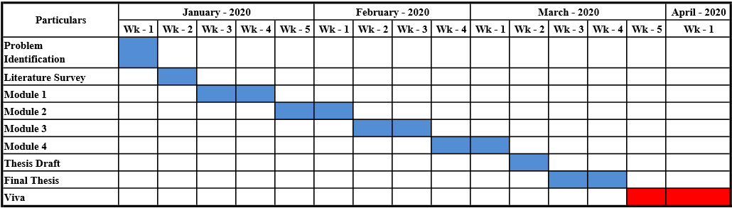
Project Planner / Timeline chart)
Department of CSE, KGiSL Institute of Technology, Coimbatore

Slide 10
Data flow Diagram – Level 0
Raise Tickets
Notification to
authorised person
User
Keyword Database

Slide 11
Data flow Diagram – Level 1
End-User
send mail
If exist
yes
User
database
no
ticket
Support team

Slide 12
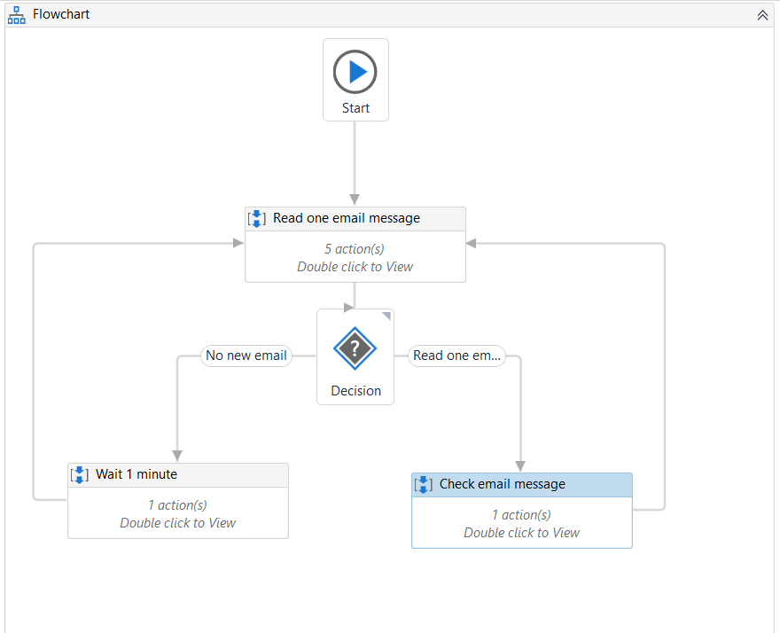
Mail Sequence:
Department of CSE, KGiSL Institute of Technology, Coimbatore

Slide 13
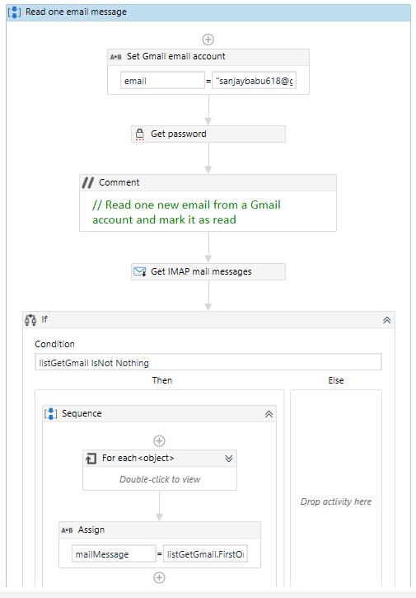
Read one mail

Slide 14
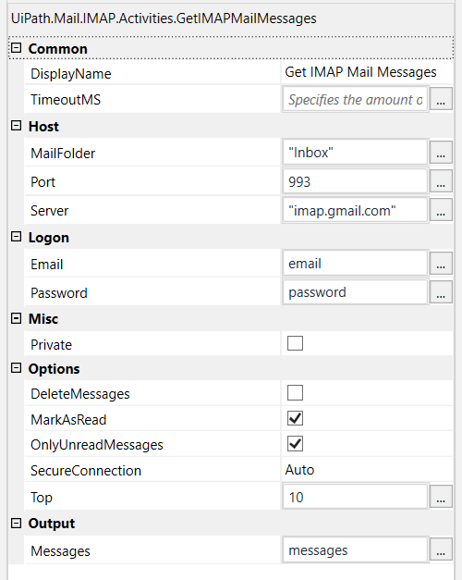
Activities
Department of CSE, KGiSL Institute of Technology, Coimbatore

Slide 15
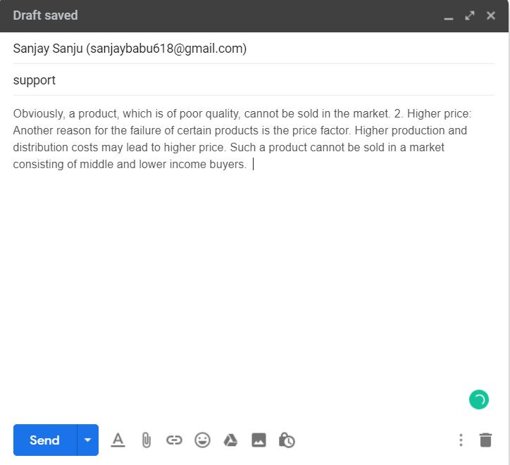
Query to customer support

Slide 16
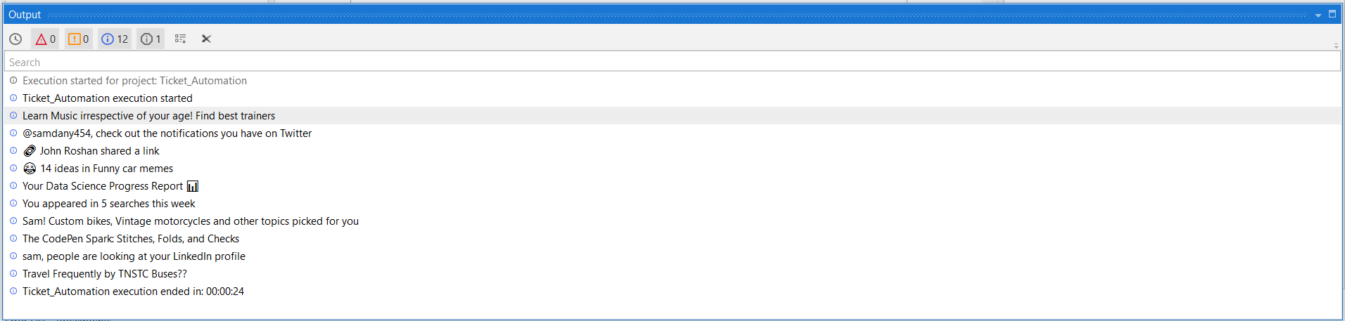
Output
10 Mail subjects
Department of CSE, KGiSL Institute of Technology, Coimbatore

Slide 17
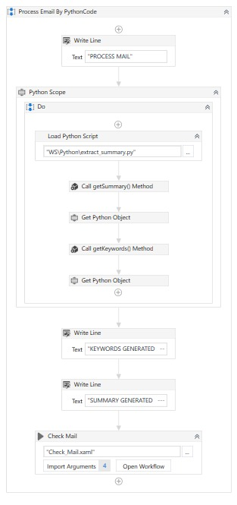
Process Mail

Slide 18
Text Summarization Steps
Convert Paragraphs to Sentences
Text Pre-processing
Tokenizing the Sentences
Find Weighted Frequency of Occurrence
Replace Words by Weighted Frequency in Original Sentences
Sort Sentences in Descending Order of Sum
Department of CSE, KGiSL Institute of Technology, Coimbatore

Slide 19

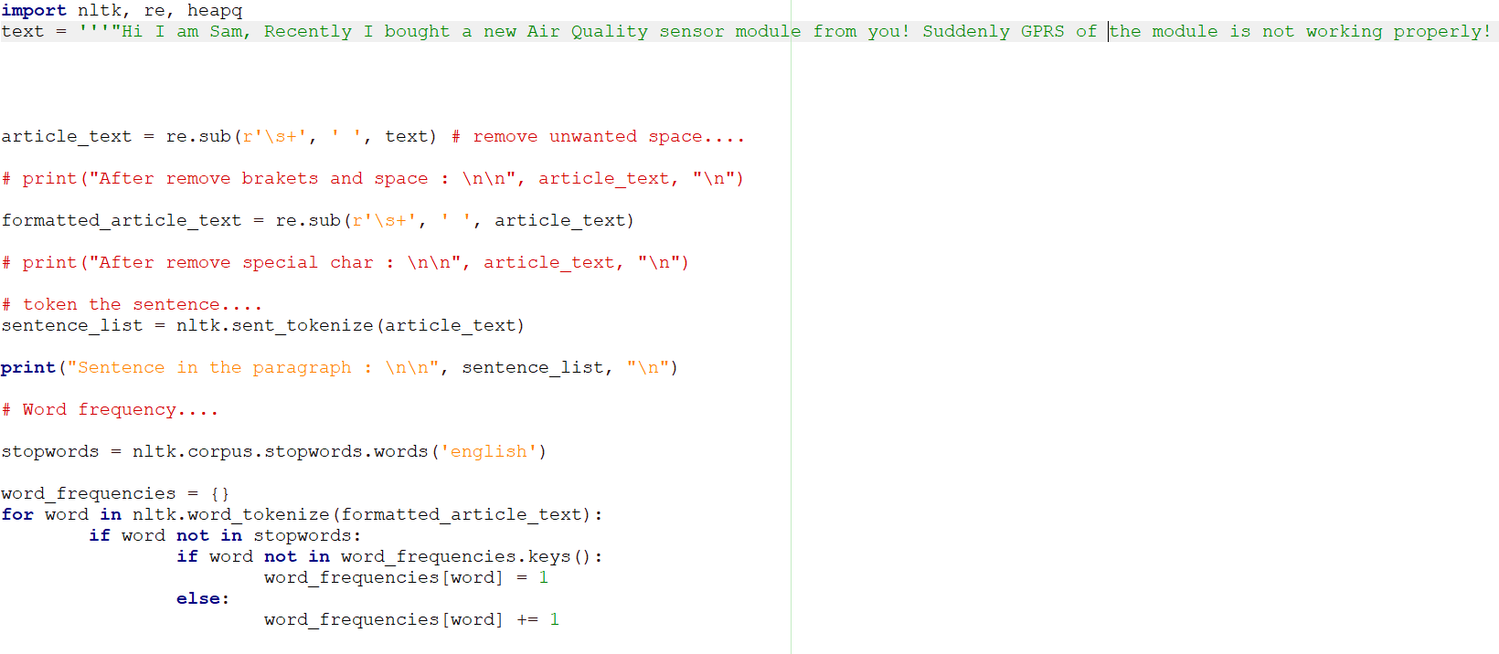
1
2
3
4
Department of CSE, KGiSL Institute of Technology, Coimbatore

Slide 20
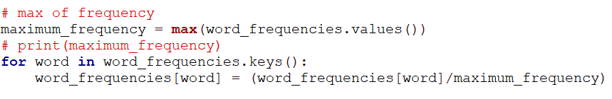
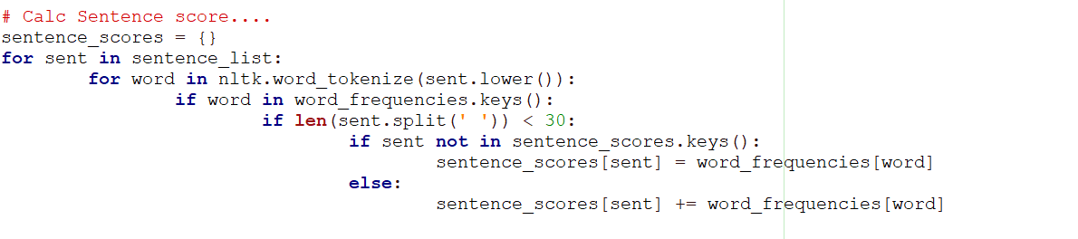

Slide 21
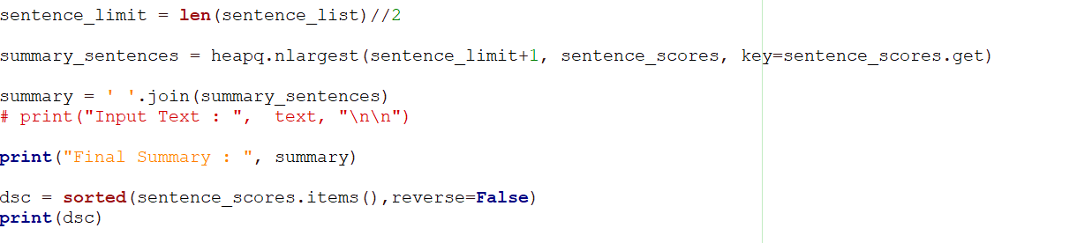

Slide 22
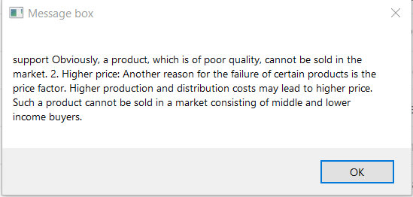
Text summary

Slide 23
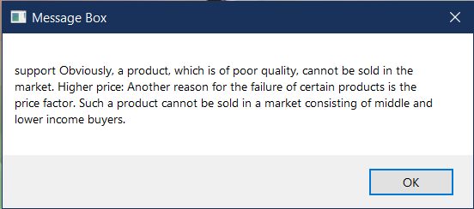
Extract summary

Slide 24
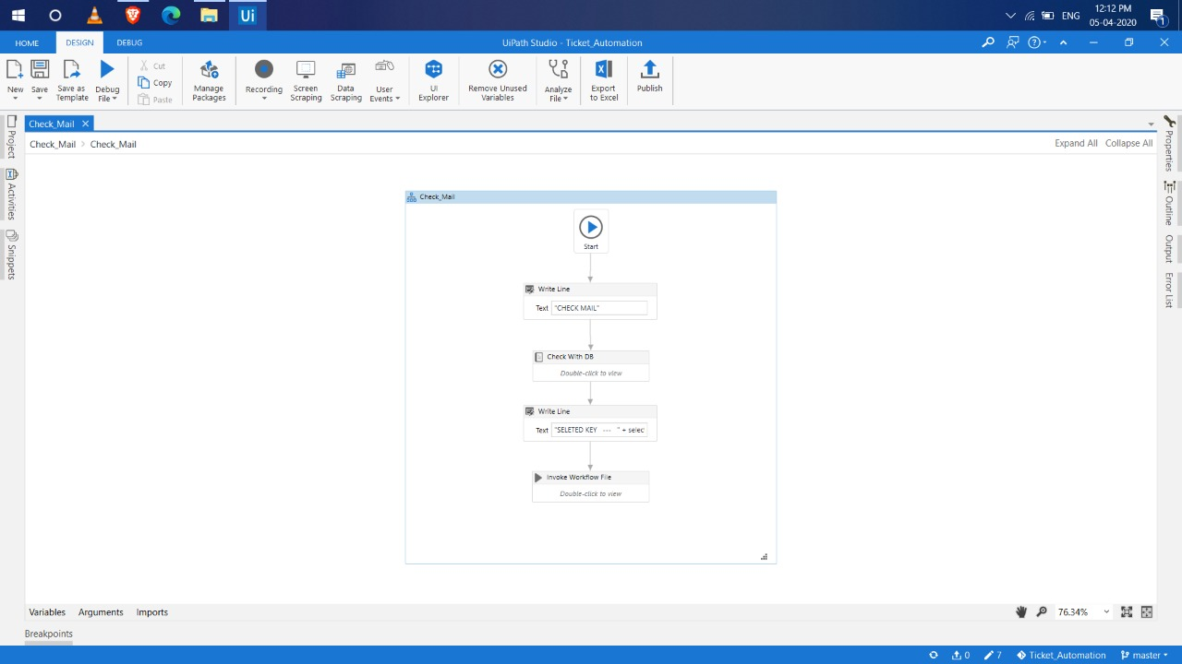
Check Mail
Department of CSE, KGiSL Institute of Technology, Coimbatore

Slide 25
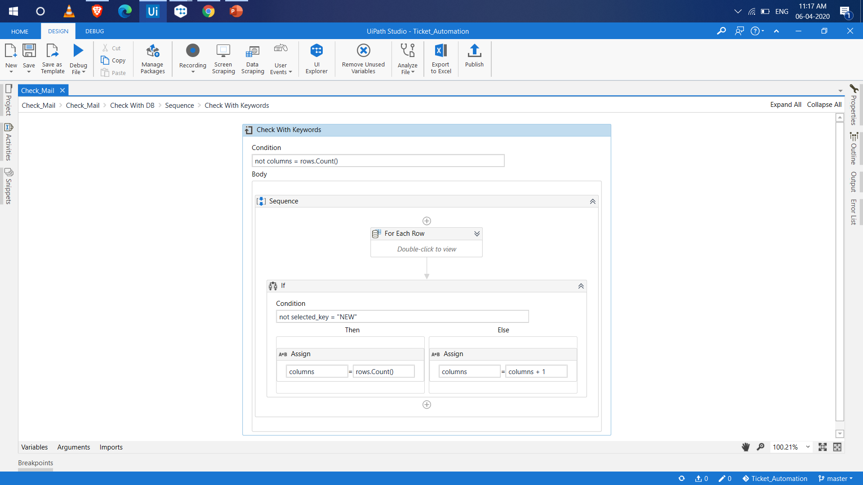
Keyword to keyword match:

Slide 26
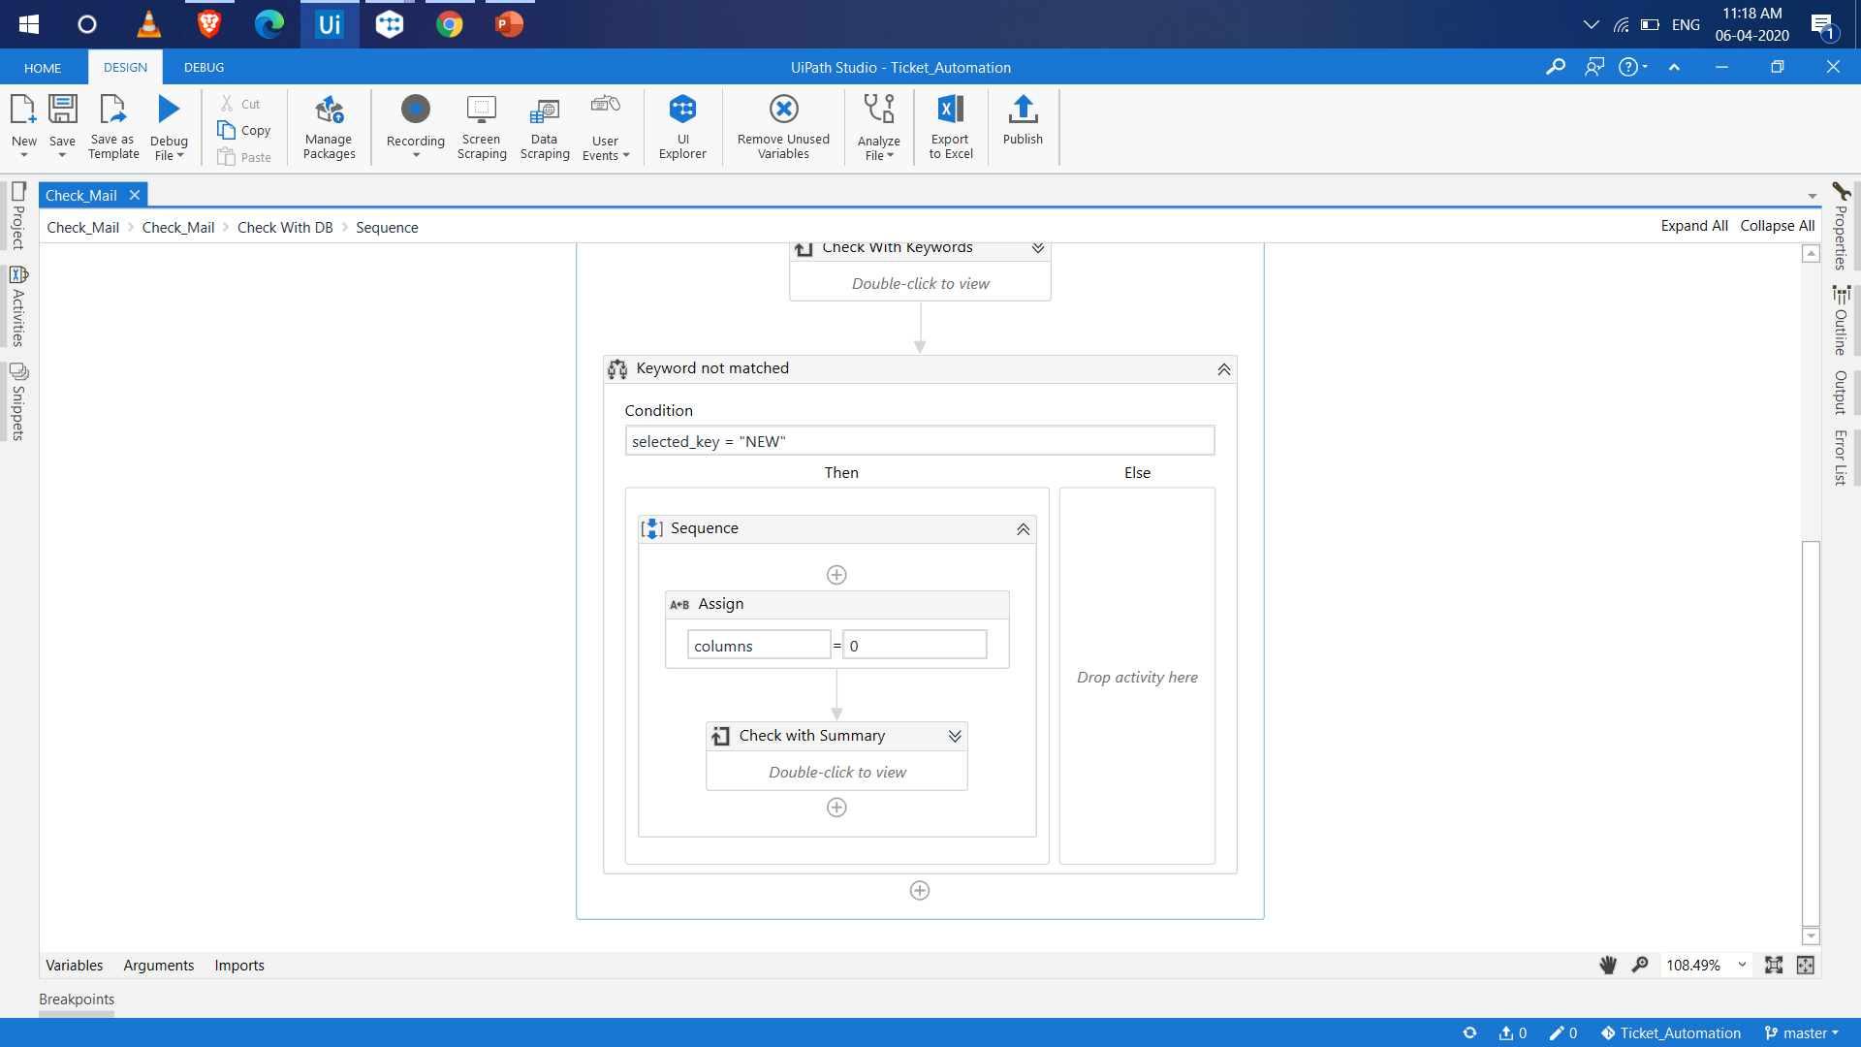
Keyword to summary match:

Slide 27
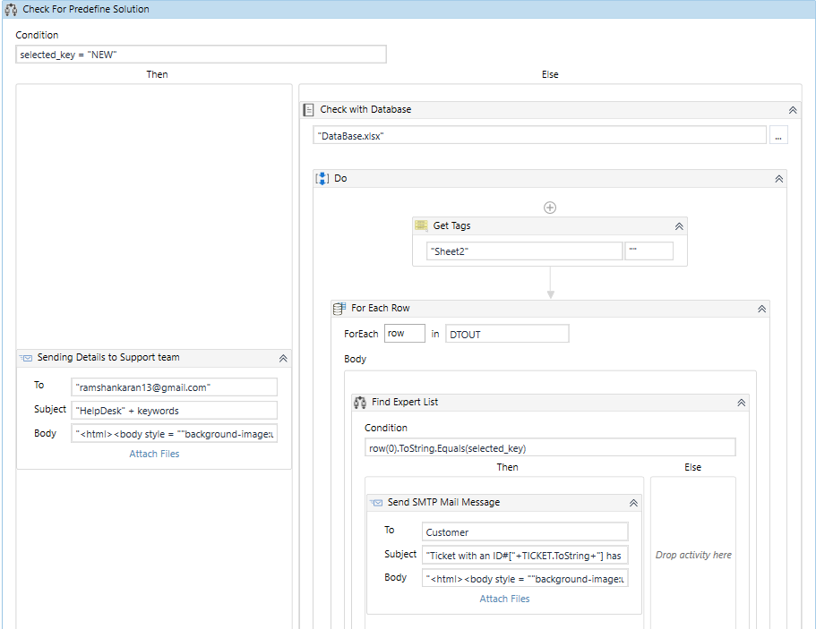
Data Store
Department of CSE, KGiSL Institute of Technology, Coimbatore

Slide 28
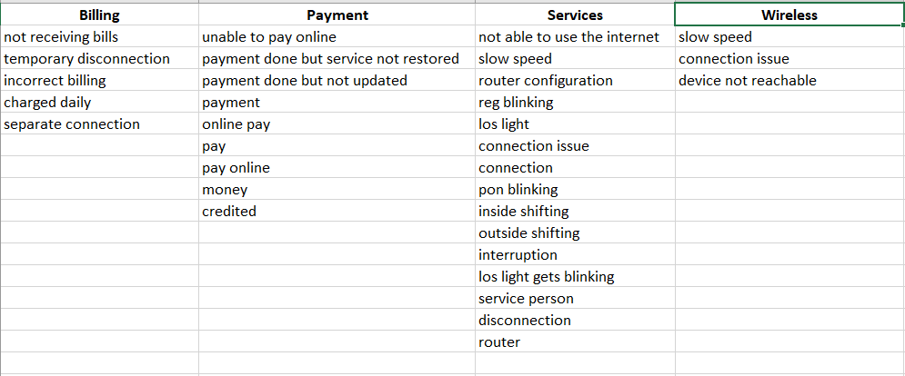
Database (Excel)
Department of CSE, KGiSL Institute of Technology, Coimbatore

Slide 29
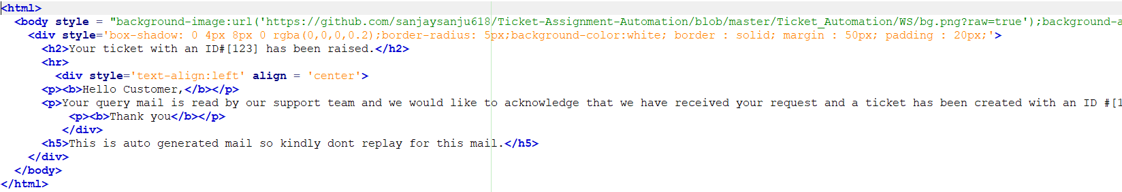
Template Mail
Department of CSE, KGiSL Institute of Technology, Coimbatore

Slide 30
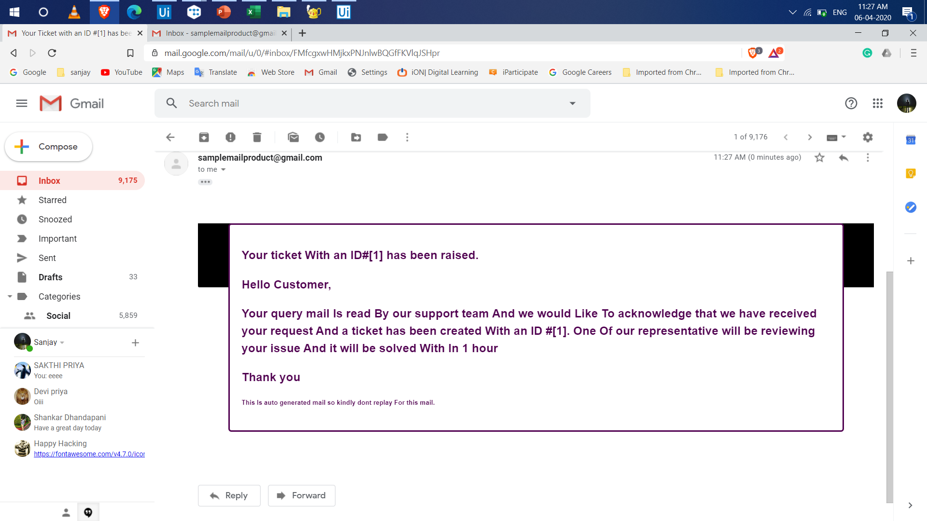
Ticket Raising
Department of CSE, KGiSL Institute of Technology, Coimbatore

Slide 31
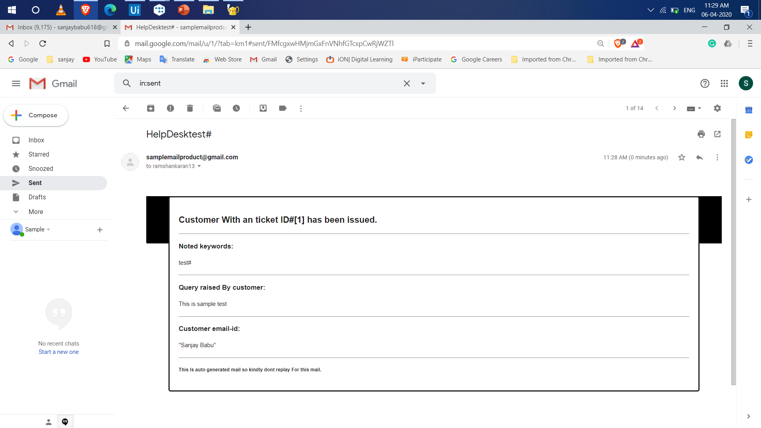
Support Team
Department of CSE, KGiSL Institute of Technology, Coimbatore

Slide 32
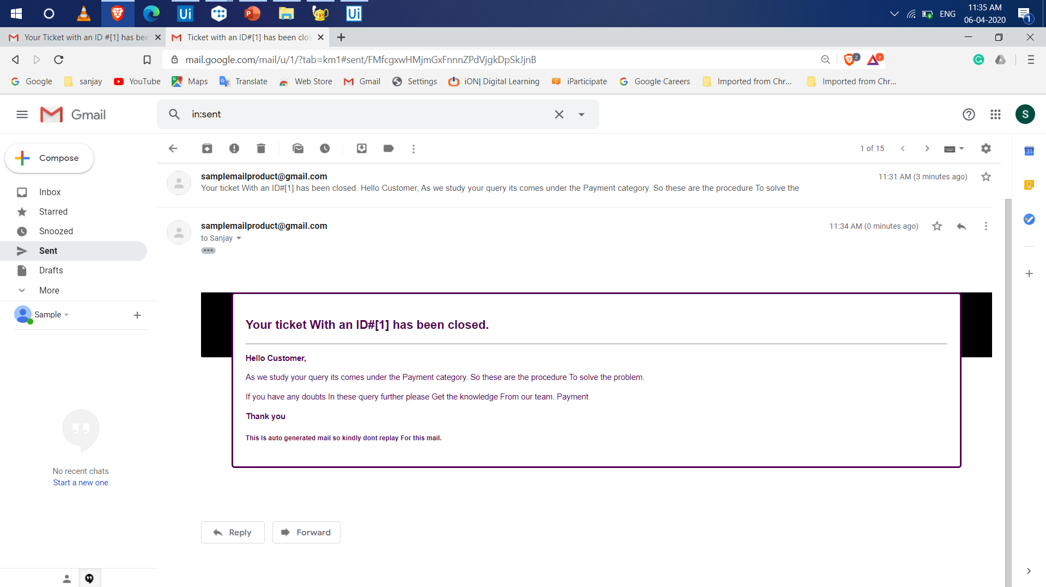
Ticket Closing
Department of CSE, KGiSL Institute of Technology, Coimbatore

Slide 33
References
https://help.teamsupport.com/1/en/topic/ticket-automation - Ticket Automation
https://www.uipath.com/blog/use-cases-it-transformation-rpa?hs_amp=true – Uipath
https://www.nltk.org/ - NLP
GitHub link – https://github.com/sanjaysanju618/Ticket-Assignment-Automation
Department of CSE, KGiSL Institute of Technology, Coimbatore

