Slide 1
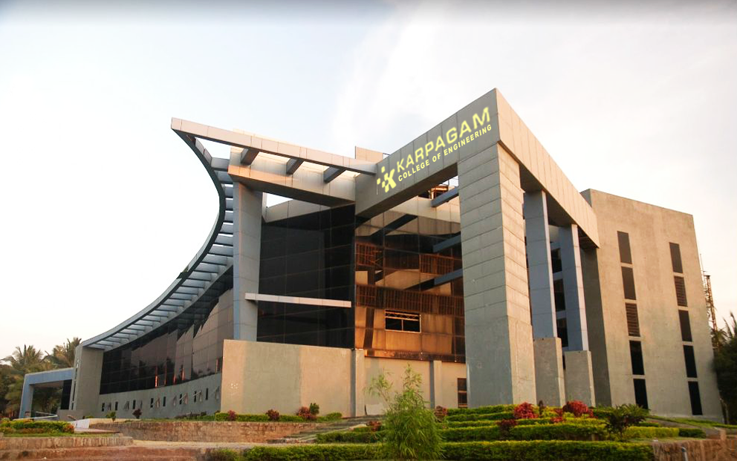

VIRTUAL HERBAL GARDEN
Name of the student:
MOHAMMED ADEL RAHMAN(717822P232)
M POOTHESH(717822P239)
K M KAVINKUMAR(717822P225)
S MUTHUKRISHNAN(717822P234)
Guide Name:
Dr. S ARUL ANTRAN VIJAY
Associate Professor
Department of Computer Science and Engineering

Slide 2
Introduction
To create an interactive platform for exploring and learning about medicinal plants used in the AYUSH systems (Ayurveda, Yoga, Unani, Siddha, Homeopathy).Plants play a central role in traditional healing systems for preventing and treating diseases.To bridge traditional plant knowledge and modern technology, making it accessible globally.Many medicinal plants are under threat due to over-harvesting, climate change, and lack of awareness.A virtual 3D space where users can explore and learn about different medicinal plants.
Through this platform, we aim to raise awareness of the therapeutic properties and historical significance of these plants, empowering individuals to integrate holistic health practices into their daily lives. Let's delve into the journey of blending technology with tradition for wellness and education.

Slide 3
Abstract
The Virtual Herbal Garden is an innovative, interactive platform designed to educate users about the medicinal plants used in traditional Indian medicine, particularly under the AYUSH (Ayurveda, Yoga & Naturopathy, Unani, Siddha, and Homeopathy) system. This platform serves as an online resource for exploring, learning, and engaging with the rich diversity of herbs and plants with medicinal properties, promoting holistic health and wellness.
Through a user-friendly interface, the Virtual Herbal Garden offers detailed information on plant species, their medicinal uses, cultivation techniques, and health benefits. It serves as an educational tool for students, practitioners, researchers, and enthusiasts, fostering appreciation and integration of AYUSH principles in daily life while leveraging technology for greater accessibility and understanding of natural remedies.

Slide 4
Problem Statement
The knowledge and accessibility of traditional medicinal plants used in AYUSH practices are often limited due to lack of awareness, difficulty in identifying plants, and inadequate resources for learning about their applications. Many individuals interested in natural remedies struggle to understand which plants may benefit specific health issues, how to grow them, and how to use them safely.
Additionally, the fragmented and scattered information on AYUSH medicinal plants makes it difficult for healthcare practitioners, students, and the general public to access credible, consolidated resources. The lack of an interactive platform that bridges the traditional knowledge of AYUSH with modern technological tools and user-friendly educational approaches poses a challenge to raising awareness and ensuring the preservation of this invaluable heritage

Slide 5
Objective
Educate users on the medicinal properties, historical uses, and applications of various plants within AYUSH systems. Provide an easy-to-navigate, interactive resource that makes knowledge about traditional medicinal plants accessible to a wide audience, regardless of their location or background. Empower users to explore and incorporate herbal remedies for preventive and holistic health care based on AYUSH principles.
To document, preserve, and make accessible the traditional knowledge and practices associated with AYUSH, ensuring their continued relevance in modern healthcare.To leverage modern technologies, such as virtual simulations and interactive content, to showcase medicinal plant applications in health and wellness practices.

Slide 6
Application Flow chart
Herb
Support Section
Selection Options
Anti-inflammatory
Antioxidant
Digestive
Immune-support
Tamil Nadu
Kerala
Karnataka
Andra-Pradesh
Herb
Shurb
Vine
Tree
Slider Sections
Highlights Section
Medicinal Uses
Region Selection
Type Selection
Item Container
Common Plants
Video Embed
Ayurveda Info
Yoga Details
Unani System
Siddha Details
Homeopathy Info
Navigation Links
Better Info
Interactive Models
OverView

Slide 7
Methodology
Development Phase
Frontend Development:
HTML Structure: Create the basic structure of the platform using HTML to ensure semantic and organized content.
CSS Styling: Use CSS to style the web pages, ensuring a visually appealing and responsive design. Focus on creating a user-friendly interface that highlights interactive elements and engages users.
Integration of 3D Models: Incorporate 3D models of medicinal plants to provide a realistic and immersive user experience. Use libraries such as Three.js for rendering and manipulating 3D objects in the browser.

Slide 8
Methodology
Backend Development:
JavaScript-based Backend: Use JavaScript for backend development to handle data storage, retrieval, and user interactions.
APIs and Data Handling: Develop APIs to communicate between the frontend and backend, handling data requests for displaying plant details, interactive features, and user inputs.
Deployment and Maintenance:
Deploy the platform using web hosting services and configure it for scalability.

Slide 9
Functionalities
Header Section
Logo Display
Search Bar
Navigation Links
Main Content
Left Image
Right Image
Support Section
Better Info
Interactive Models
Selection Options
Medicinal Uses
Region Selection
Type Selection
Slider Sections
Item Container
Common Plants

Slide 10
Functionalities
About Section
About Image
About Text
Statistics Cards
Herbal Catalog
Verified Remedies
Website Visits
Overview Section
Ayurveda Info
Yoga Details
Unani System
Siddha Details
Sowa Rigpa
Homeopathy Info
Highlights Section
Video Embed
Footer
Copyright Notice

Slide 11
List Of Plants Data
Plant Data by Medical use
Anti | inflammatory | Turmeric | Ginger | Cinnamon | Neem | Garlic
Antioxidant | Green Tea | Hibiscus | Amla | Rosemary
Digestive | Fenugreek | Mint | Cardamom
Immune | support | Ashwagandha | Moringa | Basil | Tulsi | Ginseng
Plant Data by Region
Tamil Nadu | Curry Leaf | Jasmine | Jackfruit | Kesar | Betel
Kerala | Kacholam | Tamarind | Clove | Pepper
Karnataka | Pennywort | Jungle | Bael | Neelakurinji
Andhra Pradesh | Shatavari | Vallarai | Fig | Peepal | apaya
Plant Data by Type
Herb | Mint | Basil | Ajwain | Aloevera | Pudina
Shrub | Hibiscus | Sarpagandha | Kacholam | Lavender
Vine | Ivy | Betel | Guba
Tree | Neem | Jackfruit | Tamarind | Black Pepper | Peepal

Slide 12
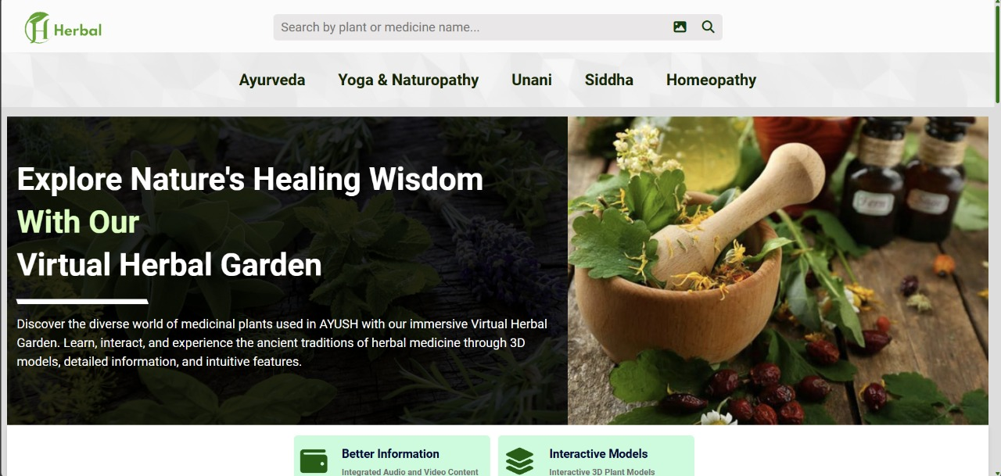
Result
.

Slide 13
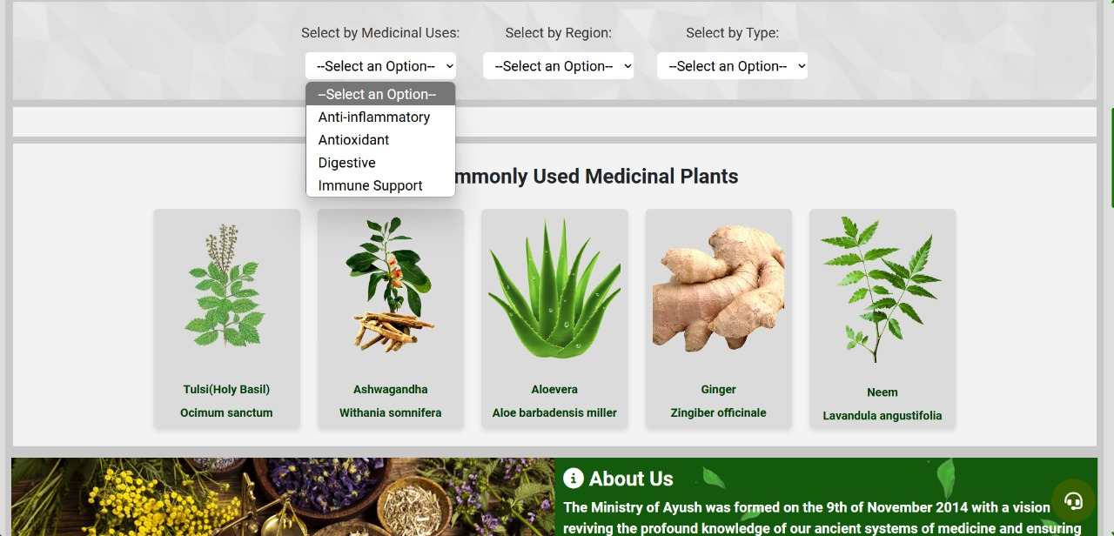
Result
.

Slide 14
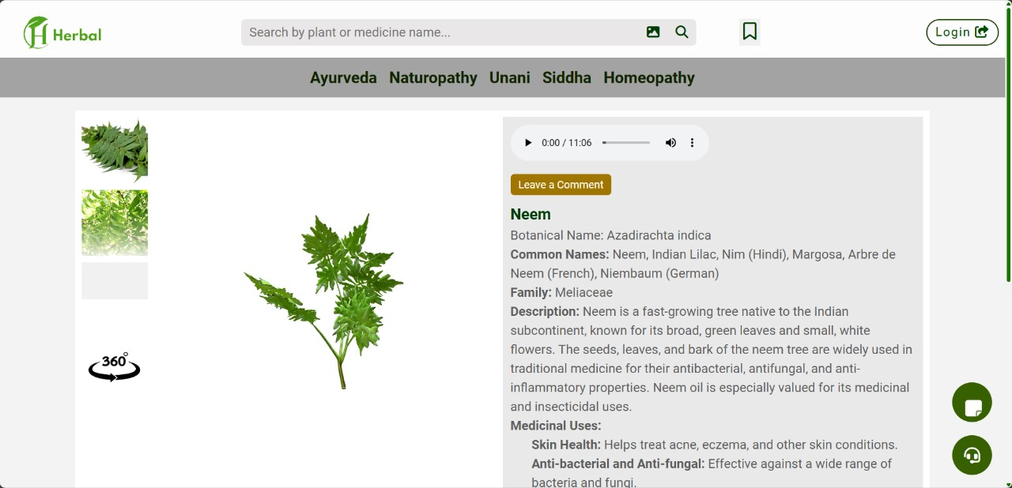
Result
.

Slide 15
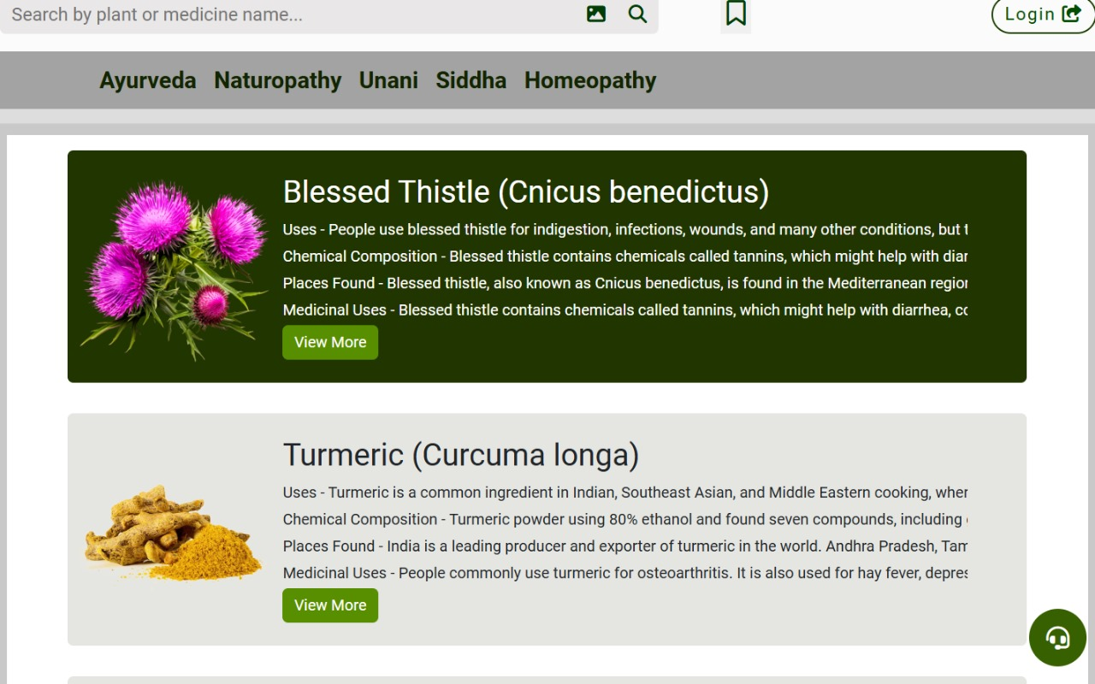
Result
.

Slide 16
Conclusion
The Virtual Herbal Garden provides a unique interactive platform to explore and learn about medicinal plants used in the AYUSH system. By integrating modern technology such as 3D modeling, intuitive search features, and extensive information on herbal practices, it bridges the gap between ancient medicinal knowledge and contemporary learning needs.

Slide 17
Thank you!

