Slide 1
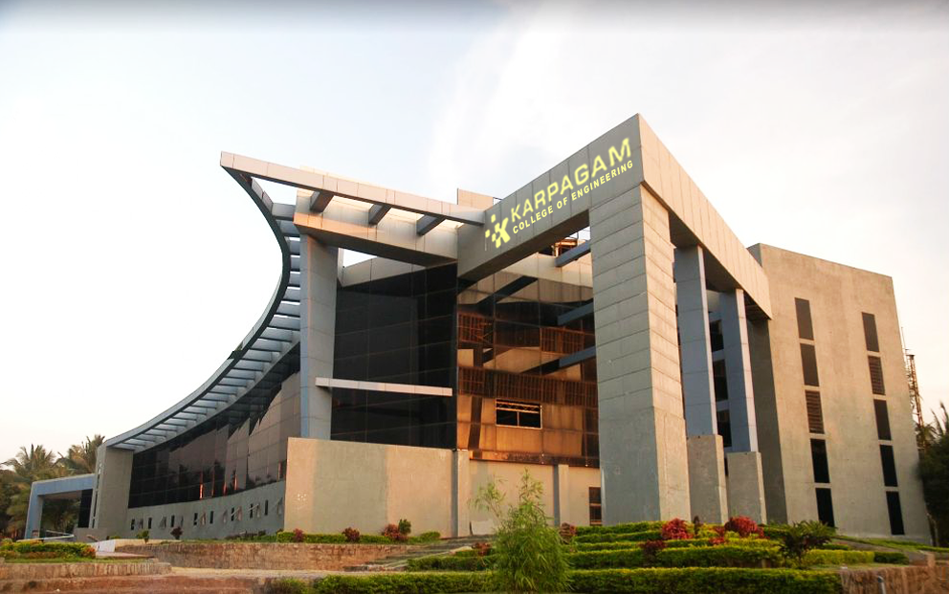

VIRTUAL HERBAL GARDEN
Name of the student:
MOHAMMED ADEL RAHMAN(717822P232)
M POOTHESH(717822P239)
K M KAVINKUMAR(717822P225)
S MUTHUKRISHNAN(717822P234)
Guide Name:
Dr. S ARUL ANTRON VIJAY
Associate Professor
Department of Computer Science and Engineering

Slide 2
Introduction
To create an interactive platform for exploring and learning about medicinal plants used in the AYUSH systems (Ayurveda, Yoga, Unani, Siddha, Homeopathy).
Plants play a central role in traditional healing systems for preventing and treating diseases.
To bridge traditional plant knowledge and modern technology, making it accessible globally.
Many medicinal plants are under threat due to over-harvesting, climate change, and lack of awareness.
A virtual 3D space where users can explore and learn about different medicinal plants.

Slide 3
Abstract
The Virtual Herbal Garden is an innovative, interactive platform designed to educate users about the medicinal plants used in traditional Indian medicine, particularly under the AYUSH (Ayurveda, Yoga & Naturopathy, Unani, Siddha, and Homeopathy) system.
This platform serves as an online resource for exploring, learning, and engaging with the rich diversity of herbs and plants with medicinal properties, promoting holistic health and wellness.
Through a user-friendly interface, the Virtual Herbal Garden offers detailed information on plant species, their medicinal uses, cultivation techniques, and health benefits.

Slide 4
Problem Statement
The knowledge and accessibility of traditional medicinal plants used in AYUSH practices are often limited due to lack of awareness, difficulty in identifying plants, and inadequate resources for learning about their applications.
Many individuals interested in natural remedies struggle to understand which plants may benefit specific health issues, how to grow them, and how to use them safely.
Additionally, the fragmented and scattered information on AYUSH medicinal plants makes it difficult for healthcare practitioners, students, and the general public to access credible, consolidated resources.

Slide 5
Objective
Educate users on the medicinal properties, historical uses, and applications of various plants within AYUSH systems.
Provide an easy-to-navigate, interactive resource that makes knowledge about traditional medicinal plants accessible to a wide audience, regardless of their location or background
Empower users to explore and incorporate herbal remedies for preventive and holistic health care based on AYUSH principles.

Slide 6
Methodology
1.Research and Content Collection
Literature Review:
Conduct a comprehensive review of AYUSH literature to identify key medicinal plants, their therapeutic benefits, and uses.
2.Development Phase
Backend Development (JavaScript):
Use JavaScript for backend development to manage the user profiles, and interactive content.
Develop APIs to serve plant information, personalized recommendations, and other interactive elements.

Slide 7
Methodology
Frontend Development (HTML, CSS):Create a user-friendly interface with HTML and CSS, ensuring visual appeal and ease of use.
Integrate interactive elements such as plant details, search functionality, and user recommendations using JavaScript for client-side interaction.
Usability Testing:Conduct usability tests with target users to ensure the platform is user-friendly, engaging, and informative.
Functional Testing:Verify the functionality of all features, including plant searches, virtual garden interactions, AR plant identification, and personalized recommendations.

Slide 8
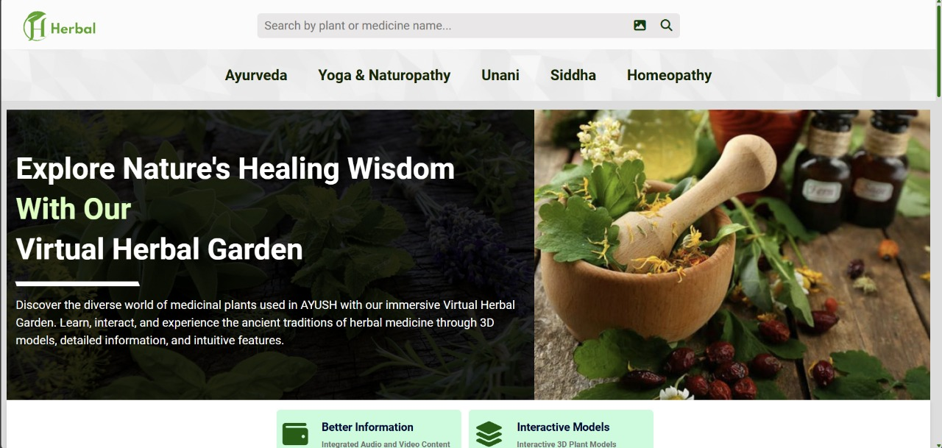
Result
.

Slide 9
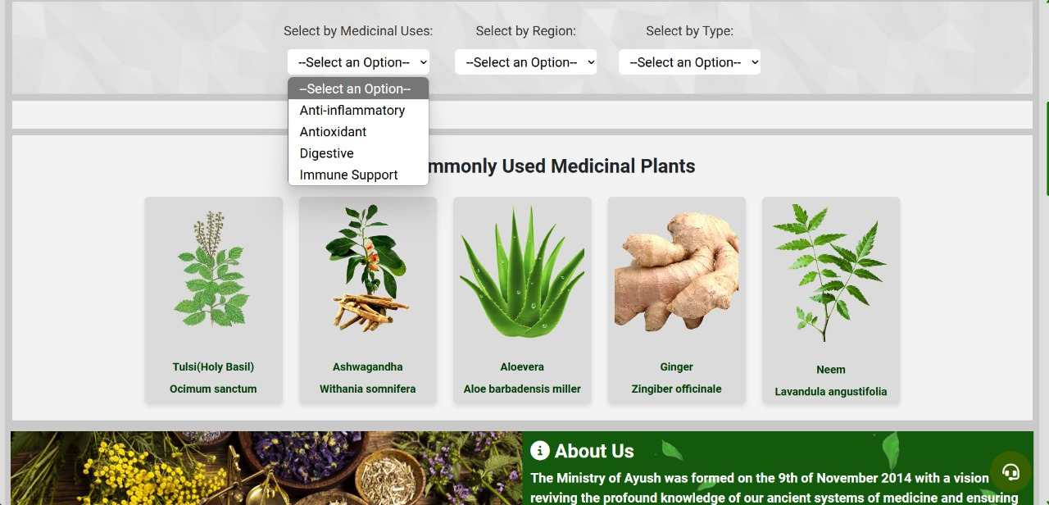
Result
.

Slide 10
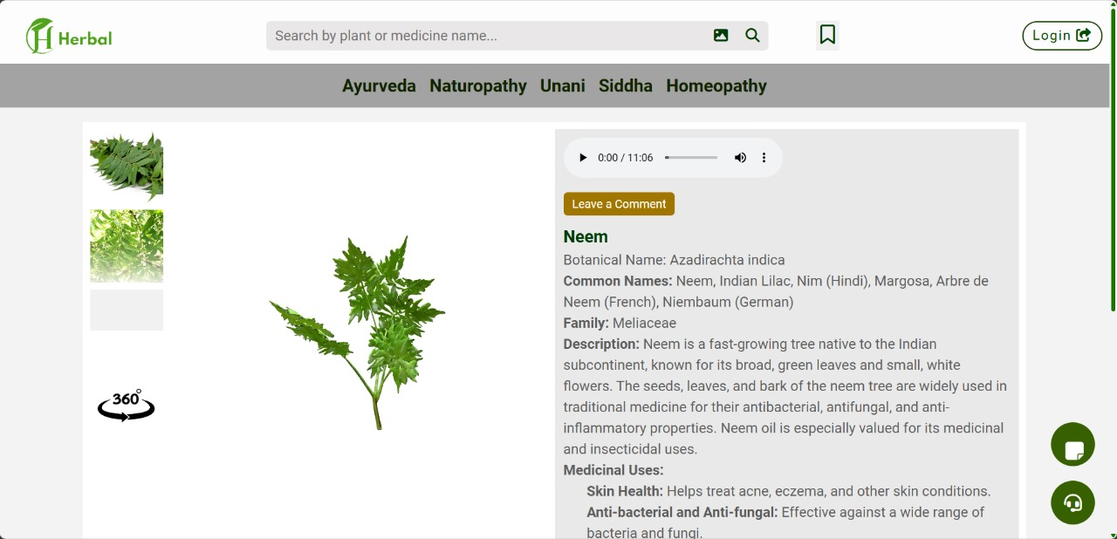
Result
.

Slide 11
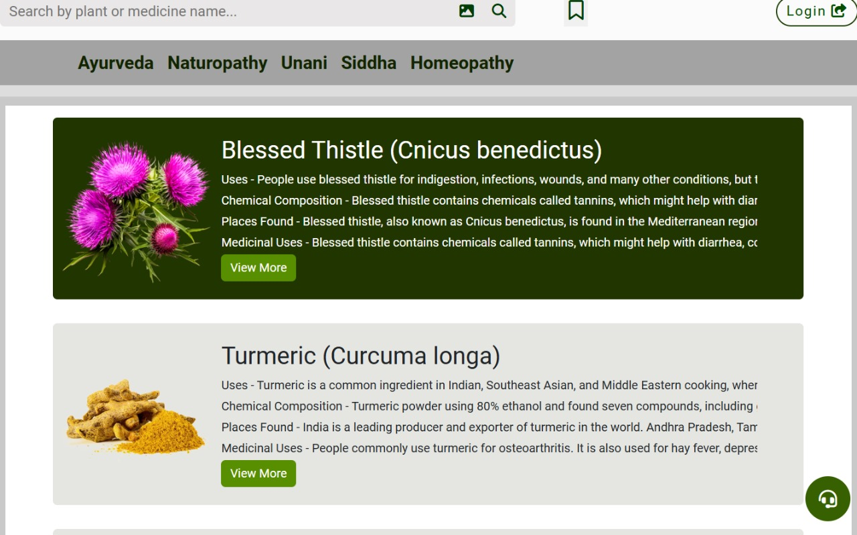
Result
.

Slide 12
Work Plan
Phase 1: Research and Content Collection (Weeks 1-2)
Phase 2: Platform Design and Planning (Weeks 3-4)
Phase 3: Development (Weeks 5-7)
Phase 4: Testing and Quality Assurance (Weeks 8-9)
Phase 5: Launch and User Education (Week 10)

Slide 13
Thank you!

