Slide 1

Data Science Project
Sanjay Varma

Slide 2
ABSTRACT
Abstract of this project is to build a machine-learning model that can predict the profit of a startup company based on its spending in various areas and the state in which it operates

Slide 3
TABLE OF CONTENTS
Introduction
Dataset
Dataset pre-processing
Model training
Evaluation
Prediction
Conclusion

Slide 4
INTRODUCTION
This model will provide valuable insights into how different factors such as R&D spending, administration spending, marketing spending, and location influence a startup's profitability. By analyzing these relationships, we aim to create a predictive tool that can assist entrepreneurs and investors in making informed decisions about new ventures

Slide 5
DATASET
This dataset contains four independent variables: R&D Spend, Administration, Marketing Spend, and State
R&D Spending: This represents the amount that startups are spending on research and development activities. It reflects the investment made in innovation and product development.
Administration Spending: This variable denotes the amount that startups allocate to administrative functions. It includes expenses related to management and organizational operations.
Marketing Spending: This attribute signifies the amount that startups are investing in marketing strategies and promotional activities.
State: This categorical variable indicates the state in which a particular startup is located. It captures the geographical aspect of the business.
Profit: This is the target variable and represents the amount of profit that a particular startup is making. It serves as the dependent variable that we aim to predict.

Slide 6

DATA-PREPROCESSING
Handling null values
1
Changing non-numeric values to numeric
2
Removing duplicates
3
Removing outliers
4
Handling collinearity
5
Data sampling
6

Slide 7
MULTICOLLINARITY
Multicollinearity occurs when two or more independent variables in a linear regression model are highly correlated with each other
This can cause problems in the estimation of the model coefficients and the interpretation of the results
Two methods
Correlation matrix
VIF

Slide 8
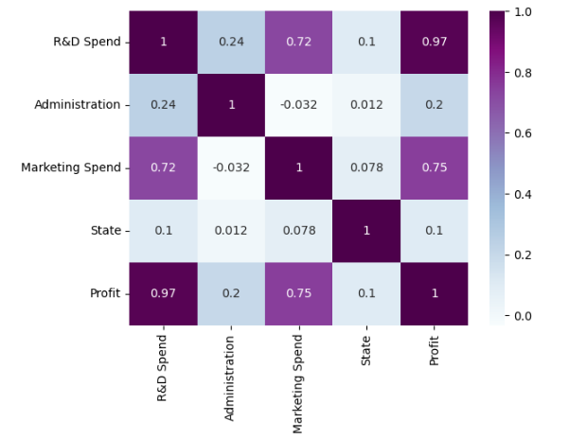
CORRELATION MATRIX

Slide 9
VIF
The VIF measures how much the variance of the estimated regression coefficient is inflated due to the presence of multicollinearity
A high VIF value indicates that the variance of the coefficient estimate is significantly larger than it would be if the predictor variable were not correlated with the other predictor variables in the model

Slide 10
MODEL TRAINING (Linear Regression)
It is a fundamental statistical method used in machine learning and data analysis to model the relationship between a dependent variable (target) and one or more independent variables (predictors)
The primary goal of linear regression is to find the best-fitting linear equation that can predict the target value based on the input features

Slide 11
EVALUATION METRICS
MSE
RMSE
MAPE
ACCURACY

Slide 12
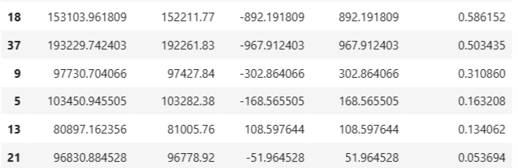

RESULT
Achieved a best accuracy using linear regression

Slide 13
CONCLUSION
The Profit Prediction for Startups project successfully demonstrates the application of linear regression to predict a startup's profitability based on key financial indicators and location.
By analyzing the relationships between R&D spending, administration spending, marketing spending, and the state of operation, we developed a robust model that provides insights into the factors influencing profitability

Slide 14
FUTURE WORK
Further enhancements to the model could include the incorporation of additional variables, such as industry type or market trends, and exploring advanced machine learning techniques to improve accuracy.
Additionally, conducting a broader analysis with larger datasets could provide deeper insights into the dynamics of startup profitability

Slide 15
THANK YOU

