Slide 1
Interview Trainer Agent
IBM HACKATHON PROJECT
Presented By:
Student name :k Sanjay Balaji
College Name & Department : Avs college of technology & CSE

Slide 2
OUTLINE
Problem Statement
Technology used
Wow factor
End users
Result
Conclusion
Git-hub Link
Future scope
IBM Certifications

Slide 3
Problem Statement
an Interview Trainer Agent, powered by RAG (Retrieval-Augmented Generation), prepares users for job interviews by generating tailored question sets and preparation strategies based on their profile name, experience level, and job role.It retrieves role-specific interview questions, industry expectations, behavioral scenarios, and HR guidelines from recruitment portals, professional networks, and company interview databases.Users can input their resume or job title, and the agent provides targeted questions, model answers, and improvement tips.It supports both technical and soft skill assessment, ensuring a comprehensive interview prep experience.This AI-driven assistant builds user confidence, sharpens responses, and increases success rates in competitive hiring environments.
Proposed Solution: AI-powered Interview Trainer Agent that uses Retrieval-Augmented Generation (RAG) and IBM Granite models on IBM Cloud Lite to deliver personalized interview preparation. By analyzing user inputs such as resume, job title, and experience, the agent retrieves relevant interview content and generates tailored technical, behavioral, and HR questions with model answers and feedback. It simulates mock interviews, evaluates responses, and provides improvement tips, helping users strengthen both technical and soft skills. This intelligent system boosts confidence and readiness, increasing success rates in competitive job interviews

Slide 4
Technology used
IBM cloud lite services
Natural Language Processing (NLP)
Retrieval Augmented Generation (RAG)
IBM Granite model

Slide 5
IBM cloud services used
IBM Cloud Watsonx AI Studio
IBM Cloud Watsonx AI runtime
IBM Cloud Agent Lab
IBM Granite foundation model
IBM Cloud Object Storage

Slide 6
Wow factors
1. Personalized, Role-Specific Preparation
The agent generates interview questions and strategies tailored to the user's resume, job title, experience level, and target company—offering a highly customized preparation experience.
2. Powered by IBM Granite and RAG Architecture
By combining Retrieval-Augmented Generation (RAG) with IBM Granite foundation models, the system provides accurate, context-aware responses based on real-world interview data.
3. AI-Simulated Mock Interviews with Real-Time Feedback
Users can engage in realistic mock interviews with AI-generated questions, receive instant evaluations, and get actionable feedback to improve their performance.
4. Company-Specific Question Retrieval
The agent accesses curated datasets to retrieve interview questions and expectations specific to companies like Amazon, Google, Infosys, and others.
5. Resume-Aware Question Generation
Using NLP techniques, the agent analyzes uploaded resumes to extract key skills and experiences, then generates targeted questions relevant to the user’s background.
6. Soft Skill and Behavioral Assessment
In addition to technical questions, the system evaluates users on communication, leadership, and behavioral alignment with common HR expectations.
7. Scalable and Lightweight IBM Cloud Deployment
Built using IBM Cloud Lite services such as Cloud Functions, Watsonx.ai, and Object Storage, the solution is scalable, cost-efficient, and serverless.
8. Secure and Privacy-Conscious Architecture
All user data, including resumes and session history, is handled securely through IBM Identity and Access Management, ensuring compliance and confidentiality.

Slide 7
End users
1. Job Seekers
Individuals actively applying for jobs who want to practice and improve their technical and behavioral interview skills.
2. College Students & Fresh Graduates
Final-year students and recent graduates preparing for campus placements, internships, or entry-level roles.
3. Working Professionals
Experienced professionals looking to switch jobs, prepare for higher-level roles, or re-enter the job market.
4. Career Coaches & Mentors
Professionals or institutions providing career guidance who can use the tool to support their clients or students with AI-driven interview preparation.
5. Training Institutes & EdTech Platforms
Organizations offering interview prep, soft skills training, or placement support that can integrate or offer the agent as a value-added service.
6. HR & Recruitment Teams
Internal hiring teams or recruiters using the platform to assess candidate readiness before final interview rounds.

Slide 8
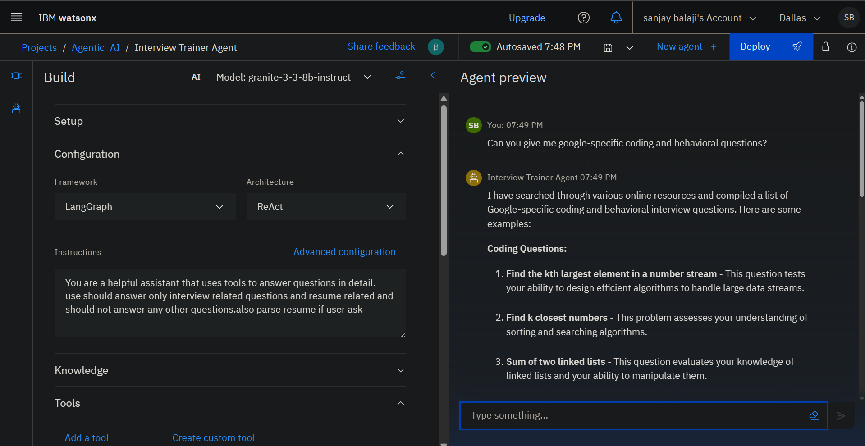
Results

Slide 9
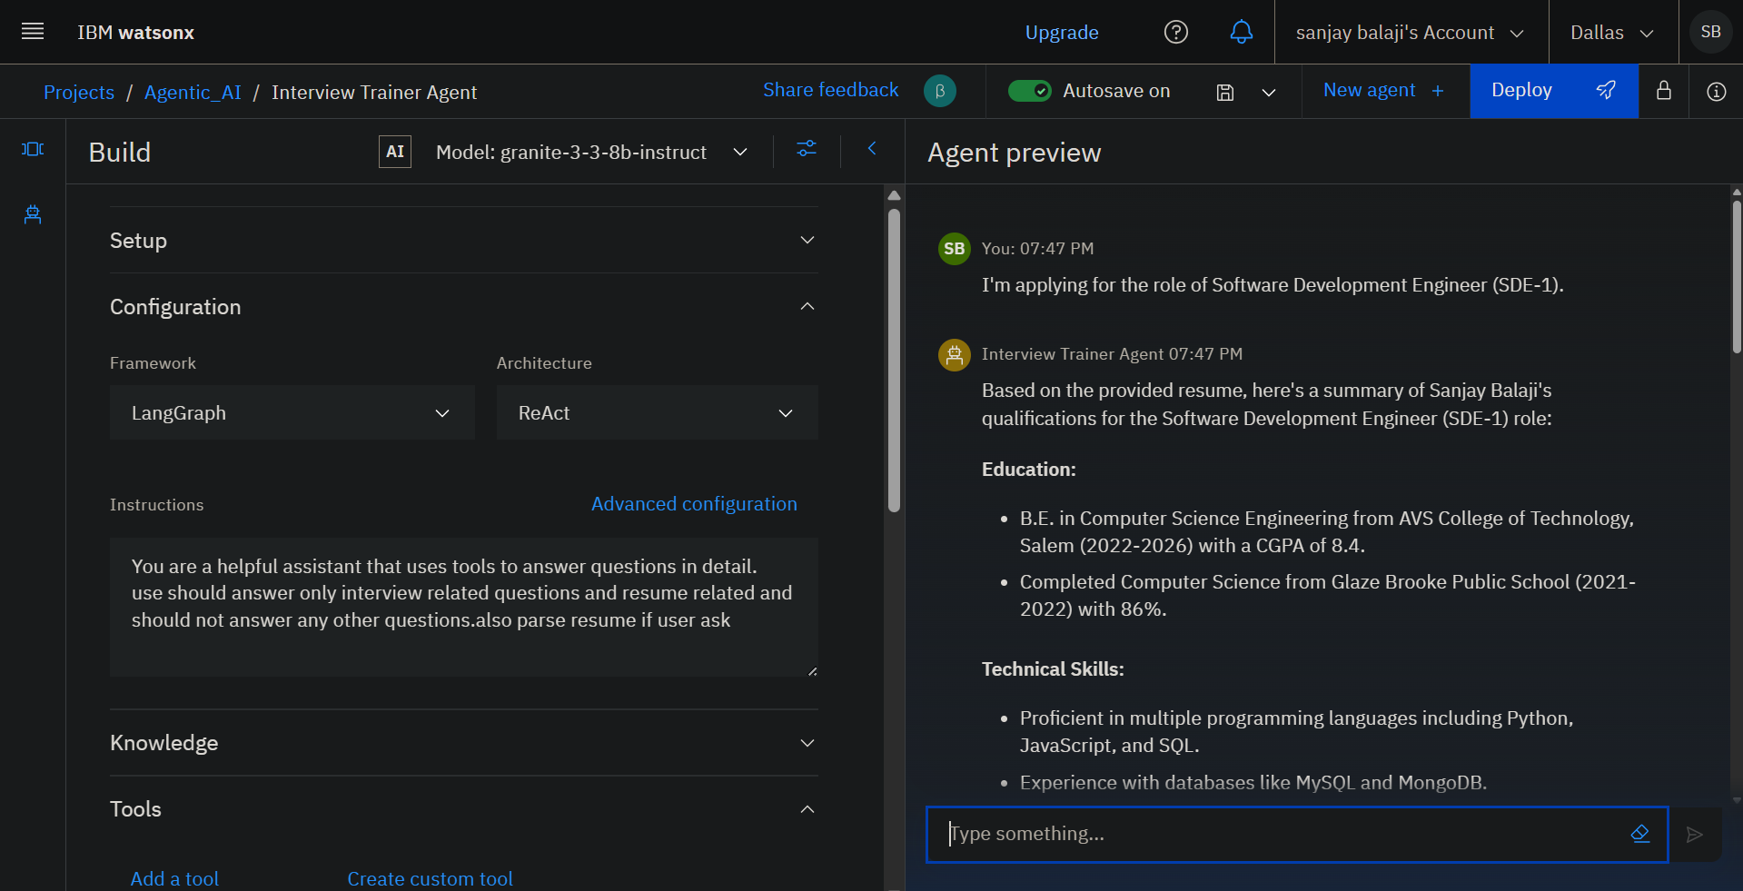
Results

Slide 10
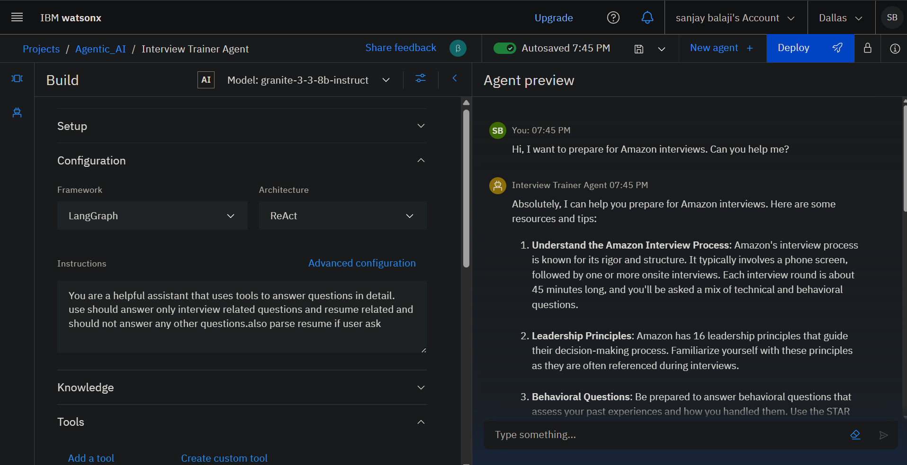
Results

Slide 11
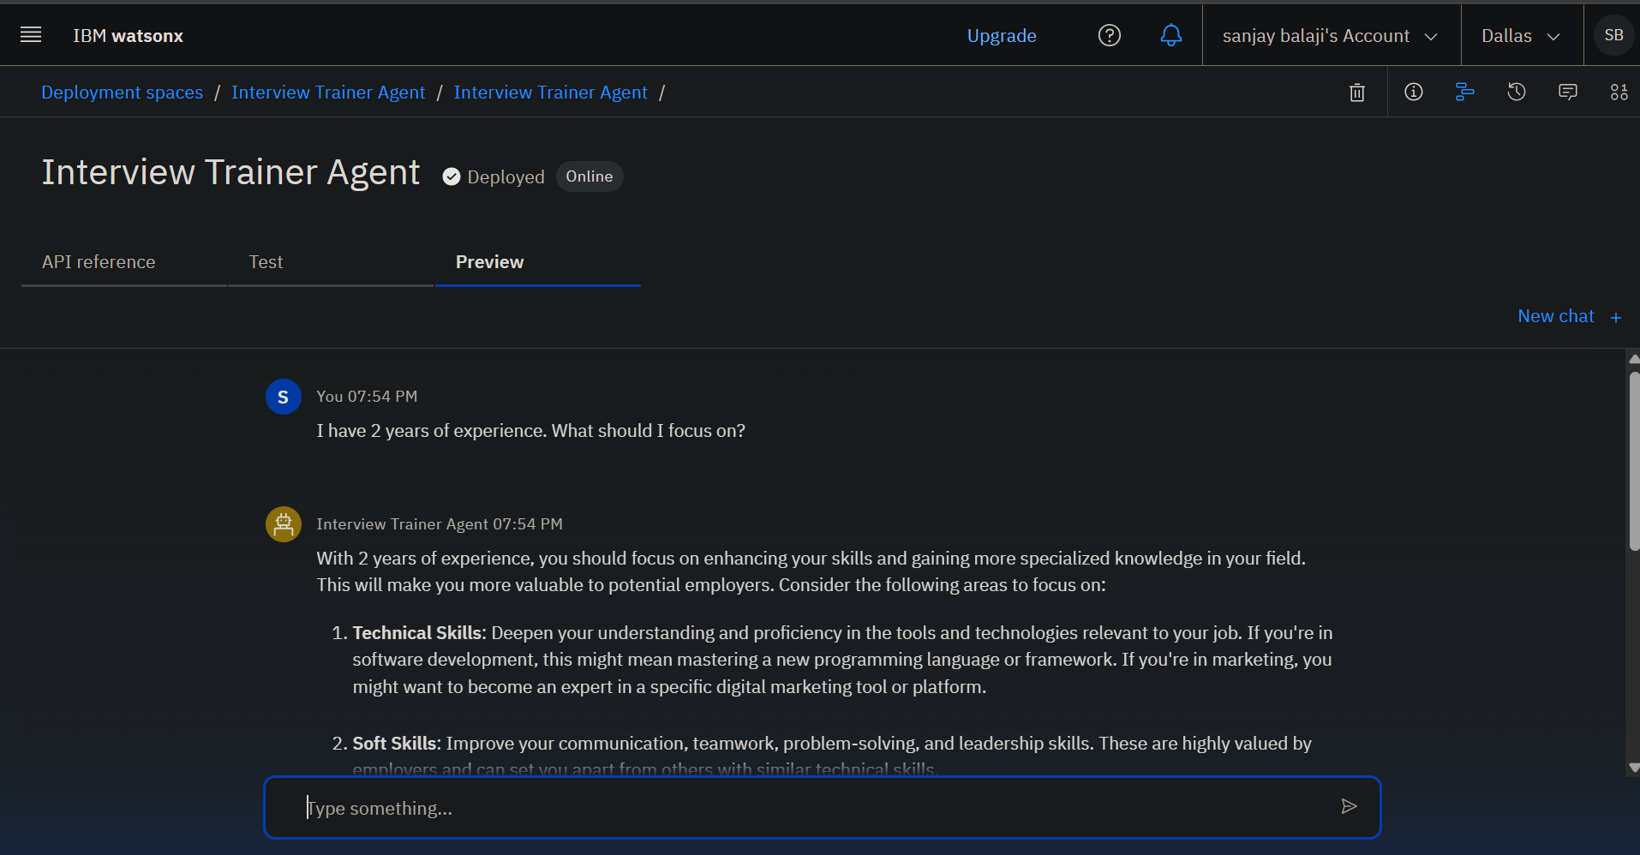
Results
Deployed AI Agent

Slide 12
Conclusion
The Interview Trainer Agent offers a smart, scalable, and personalized solution to modern interview preparation challenges. By leveraging IBM Granite models and Retrieval-Augmented Generation on IBM Cloud Lite, it delivers context-aware, company-specific practice tailored to individual user profiles. Supporting both technical and soft skill development, the agent simulates realistic interview scenarios, provides actionable feedback, and increases candidate confidence and success rates. Its flexibility makes it valuable for job seekers, students, professionals, and institutions alike—marking a significant step forward in AI-driven career readiness tools.

Slide 13
GitHub Link
https://github.com/sanjay1612004/interview_trainer_ai/

Slide 14
Future scope
Multilingual Research Support
Voice-Activated Research Assistant
Real-Time Collaboration Features
Research Gap and Novel Topic Identification
Integration with Publishing Platforms
AI-Assisted Paper Drafting

Slide 15
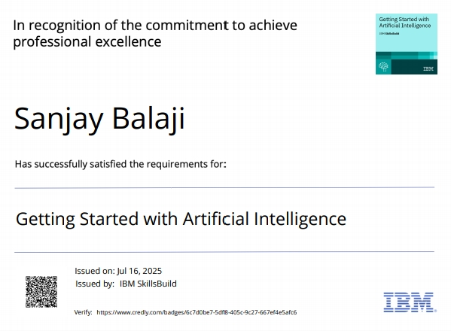
IBM Certifications

Slide 16
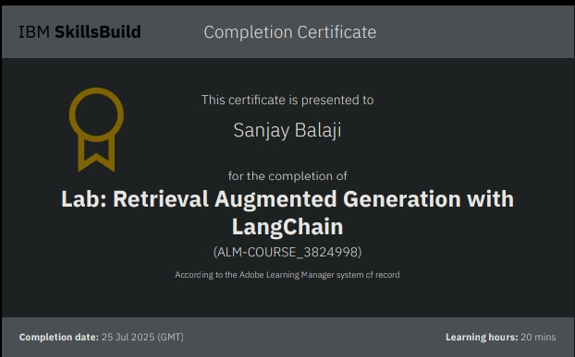

Slide 17
THANK YOU

